Slide 1
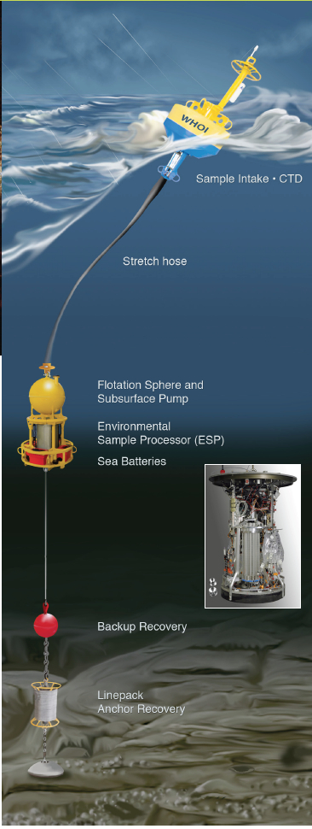
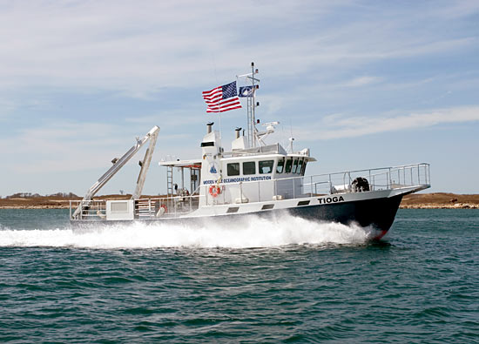
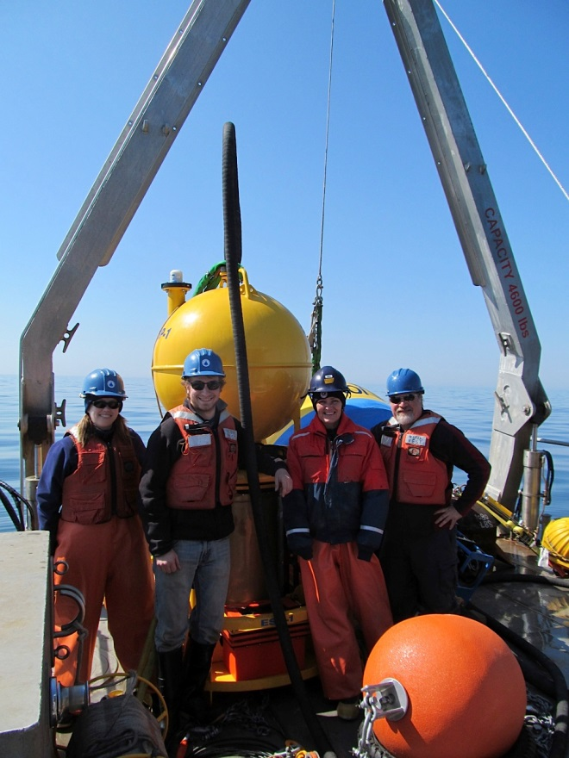
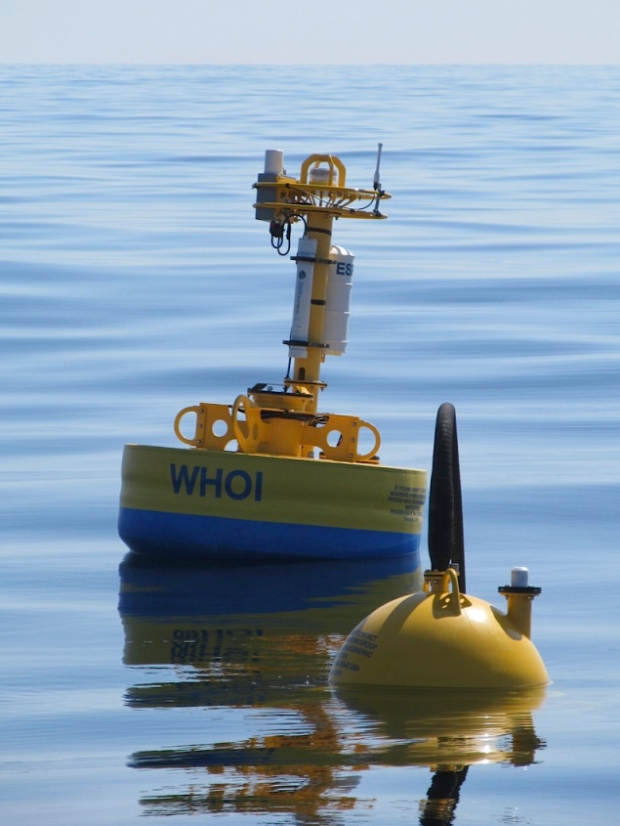
Dynamics of harmful algal blooms:
rapid response sampling of key processes
Dennis J. McGillicuddy, Jr., Project PI
Donald M. Anderson, Co-Investigator
Katherine A. Hubbard, Co-Investigator

Slide 2
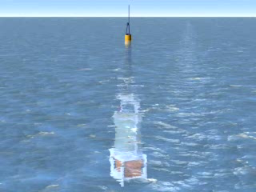
Environmental Sample Processor (C. Scholin)

Slide 3
Specific Aims
1. Monitor ESP real-time data to identify key bloom events (A. fundyense, Pseudo-nitzschia spp.)
2. Carry out rapid-response sampling of key bloom processes identified by ESP data streams
3. Conduct laboratory measurements of vital rates of toxic Pseudo-nitzschia species
4. Incorporate process understanding into models

Slide 4
Life Cycle of Alexandrium

Slide 5
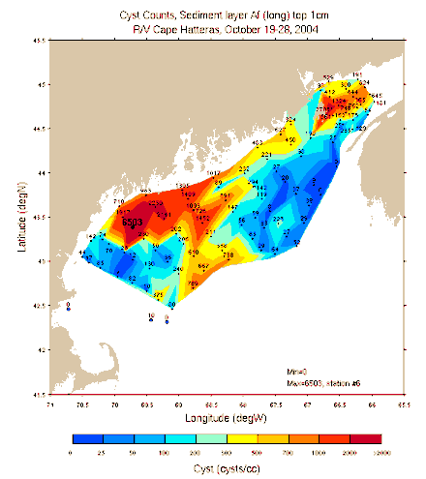
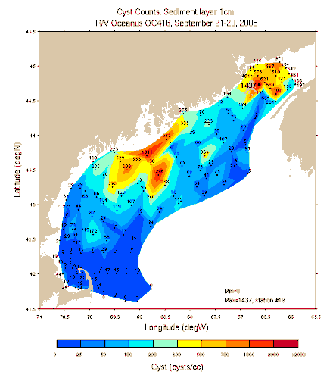
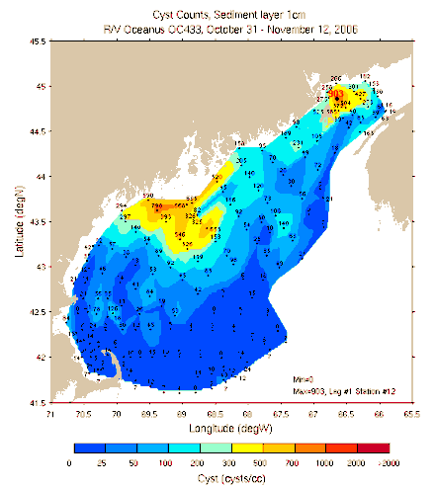
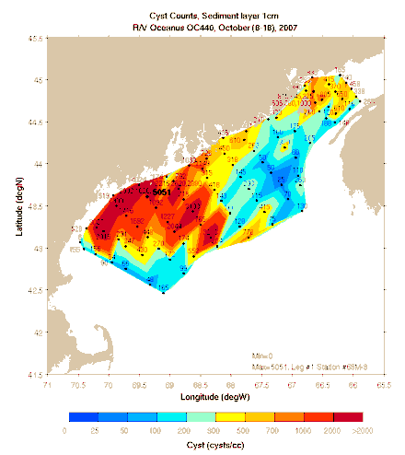
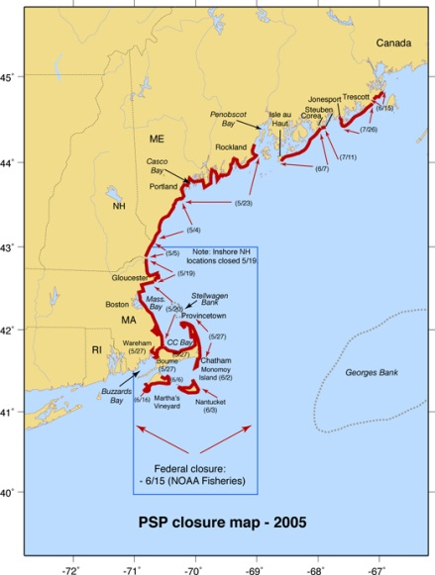
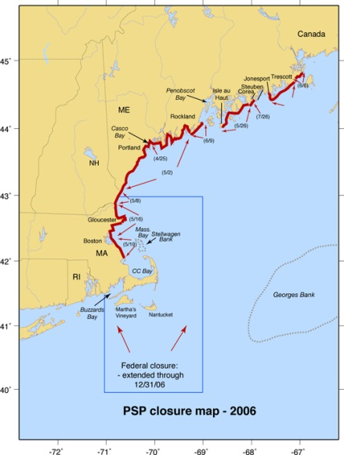
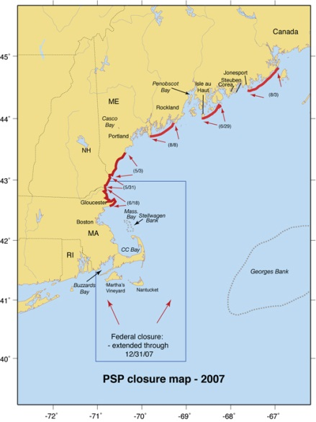
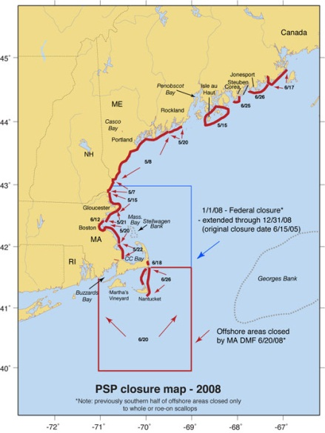
H₁: Interannual variations in bloom severity result from fluctuations in cyst abundance
Cysts
Fall 2004 Fall 2005 Fall 2006 Fall 2007
Toxicity 2005 2006 2007 2008
Spring/
Summer
Shellfish
closures

Slide 6
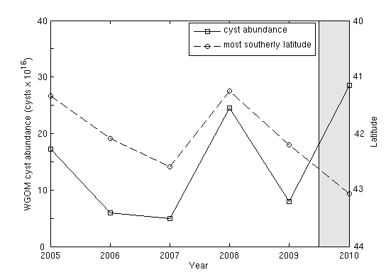
WGOM cyst abundance and toxicity
2005-2009: r=-0.93
Toxicity extent
Cysts
McGillicuddy et al. 2011 L&O

Slide 7
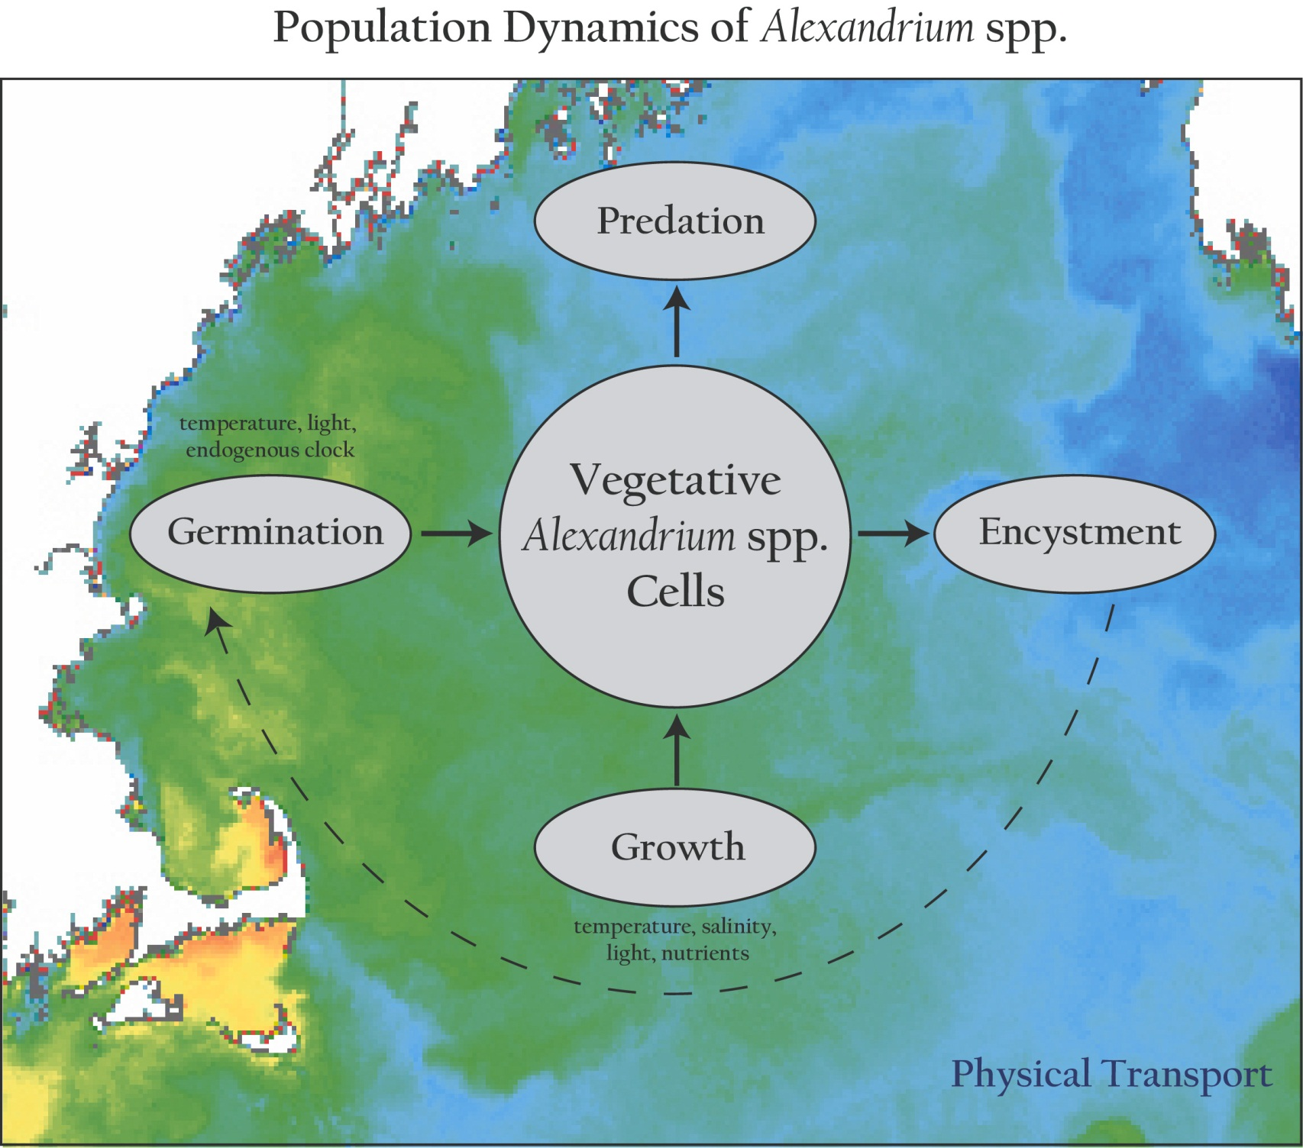
Population dynamics of Alexandrium spp.

Slide 8
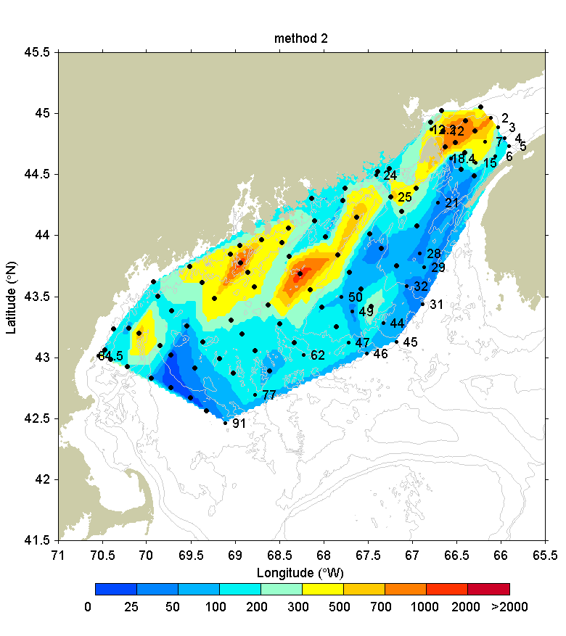
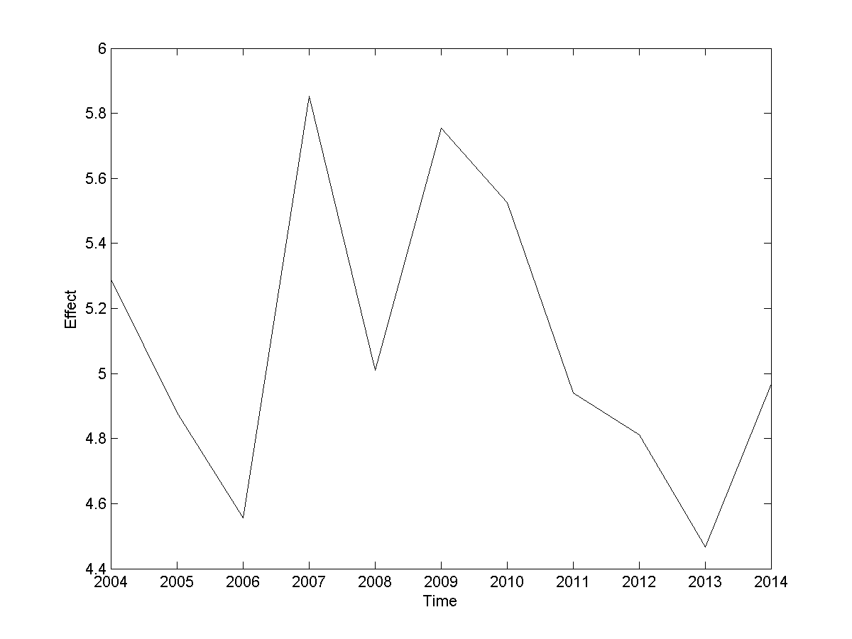
Hydrodynamics
2015 Seasonal Forecast
2004
Scenario 1
Scenario 2
Scenario 3
Scenario 4
Scenario 5
Scenario 6
Scenario 7
Scenario 8
Scenario 9
Scenario 10
Scenario 11
Benthic Cyst Abundance
2005
Fall 2014
2006
2007
2008
2009
2010
Cyst time-series
2011
2012
2013
2014
2004 2014
Notes:
8

Slide 9
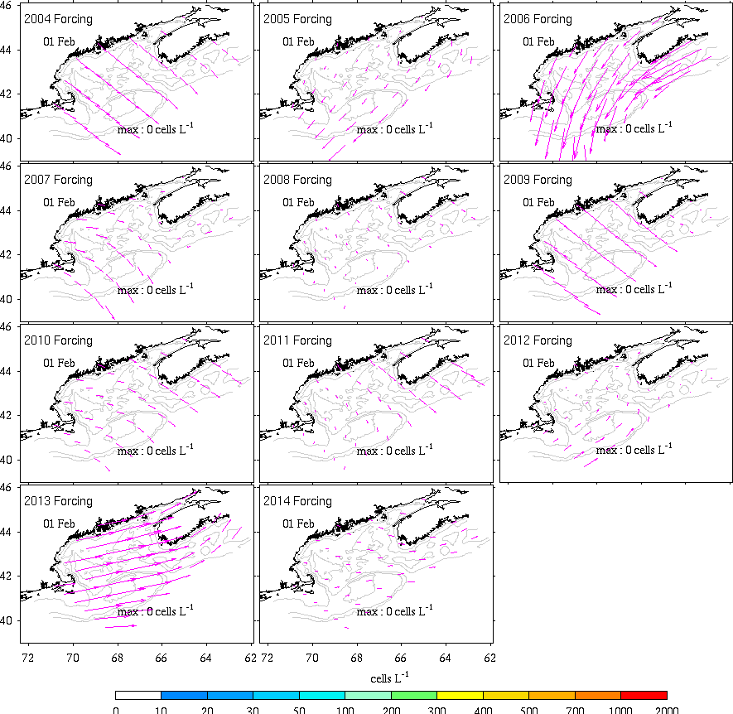
2015 Ensemble Forecast

Slide 10
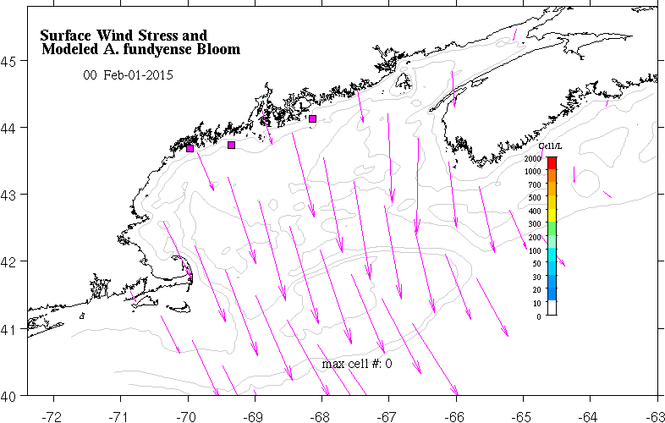
2015 Weekly nowcast/forecast
ESP
Jake
ESP
Dennis
ESP
Don

Slide 11
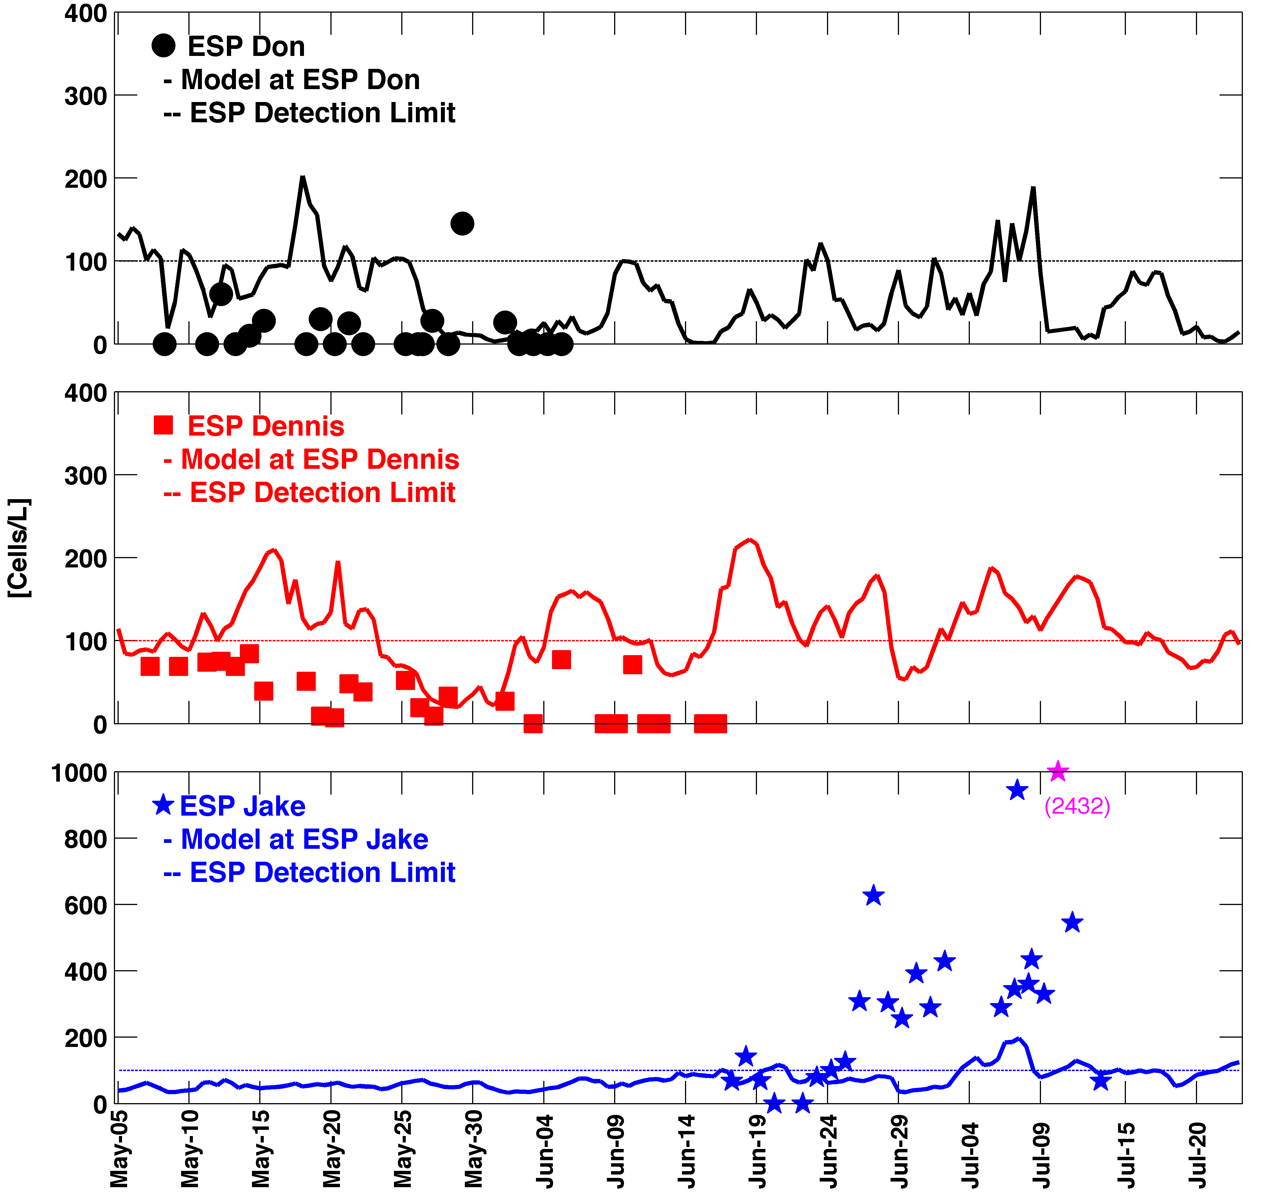
Model-data comparisons
WGOM
ESPs Don, Dennis
ESP Don
ESP quantitation threshold
Model
Model , obs near ESP threshold for quantitation
Generally below the concentrations that cause shellfish toxicity (200–1000 cells L⁻¹)
ESP Dennis
Cells L⁻¹
ESP Jake
EGOM
ESP Jake
Model did not predict bloom observed in July

Slide 12
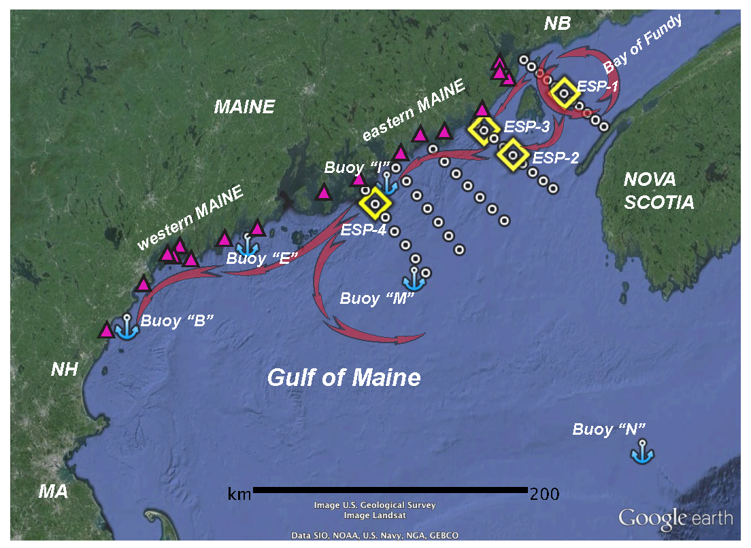
The “leaky gyre” hypothesis

Slide 13
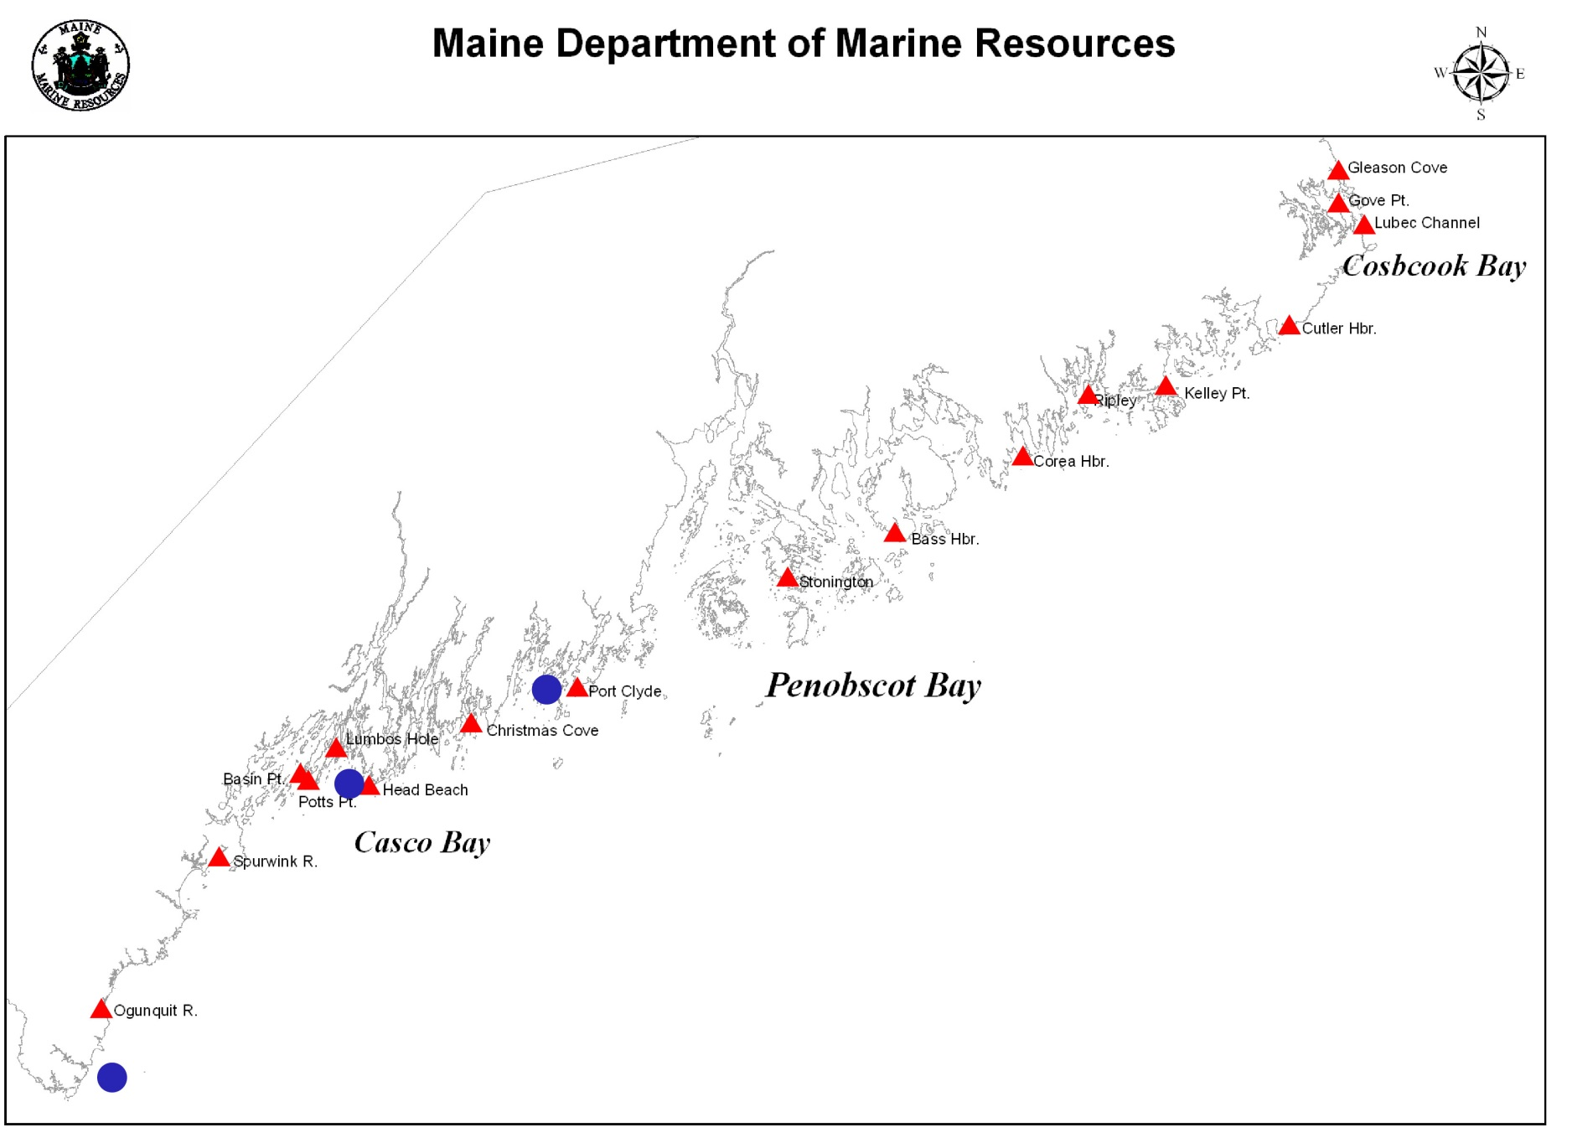
Estimating shellfish toxicity from ESP data
Toxicity submodel
[STX] at shellfish monitoring stations
[Alex] at ESP locations

Slide 14
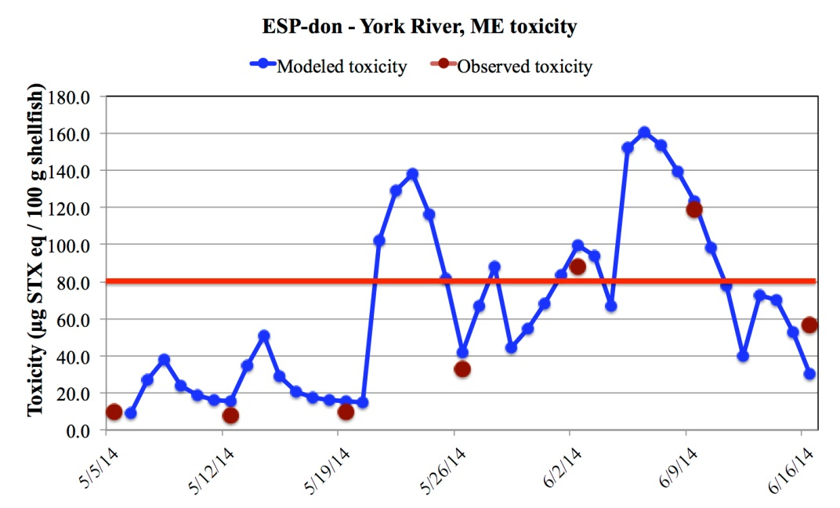
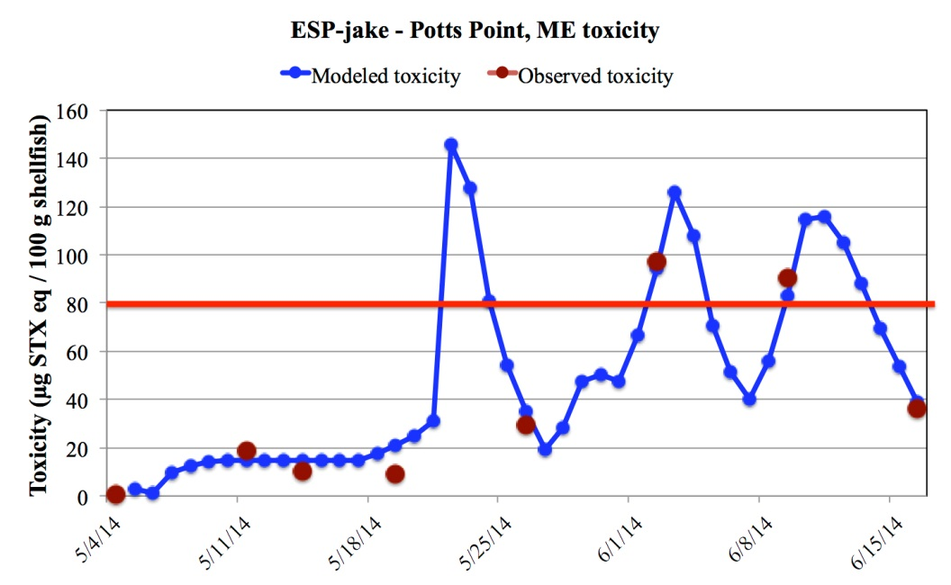
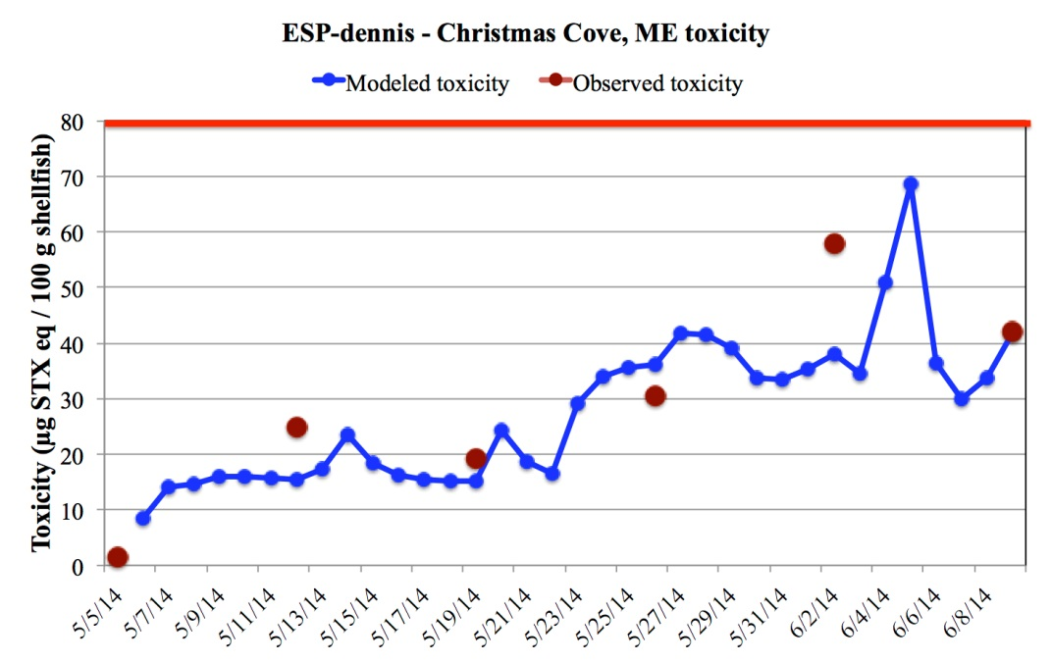
Quarantine
Quarantine
Modeled toxicity vs. measured toxicity in shellfish (Maine DMR) - 2014
Quarantine

Slide 15
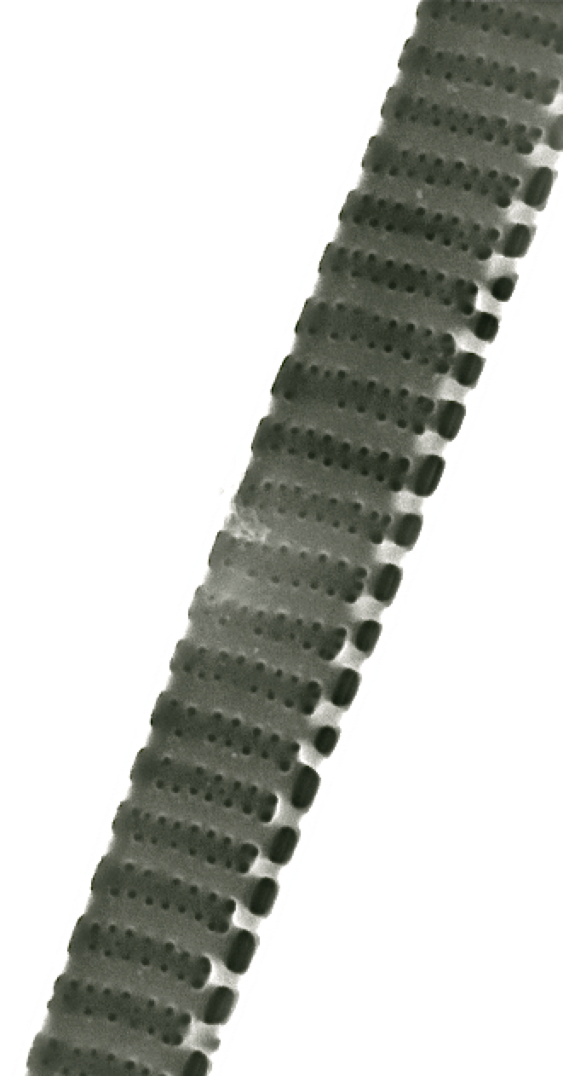
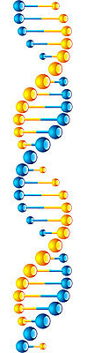
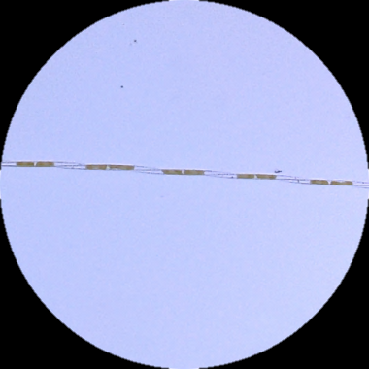
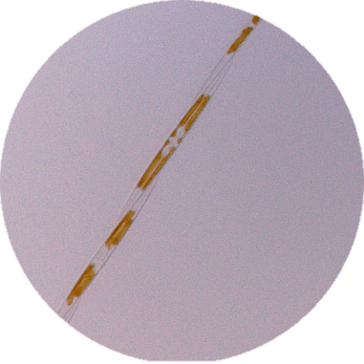
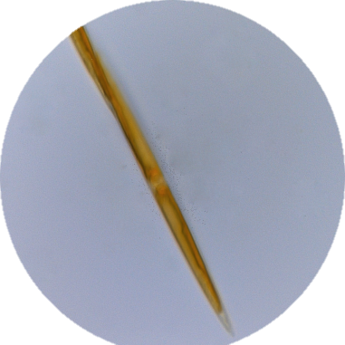
The toxigenic diatom Pseudo-nitzschia
  Distributed from the equator to the pole
  >40 described species in genus
  Some species produce neurotoxin domoic acid (DA) → Amnesic Shellfish Poisoning
  Toxic/non-toxic species can look alike
2 μm
DA production is complex
Species, strain, life cycle, nutrients, temperature, salinity, trace metals, vitamins, pH

Slide 16
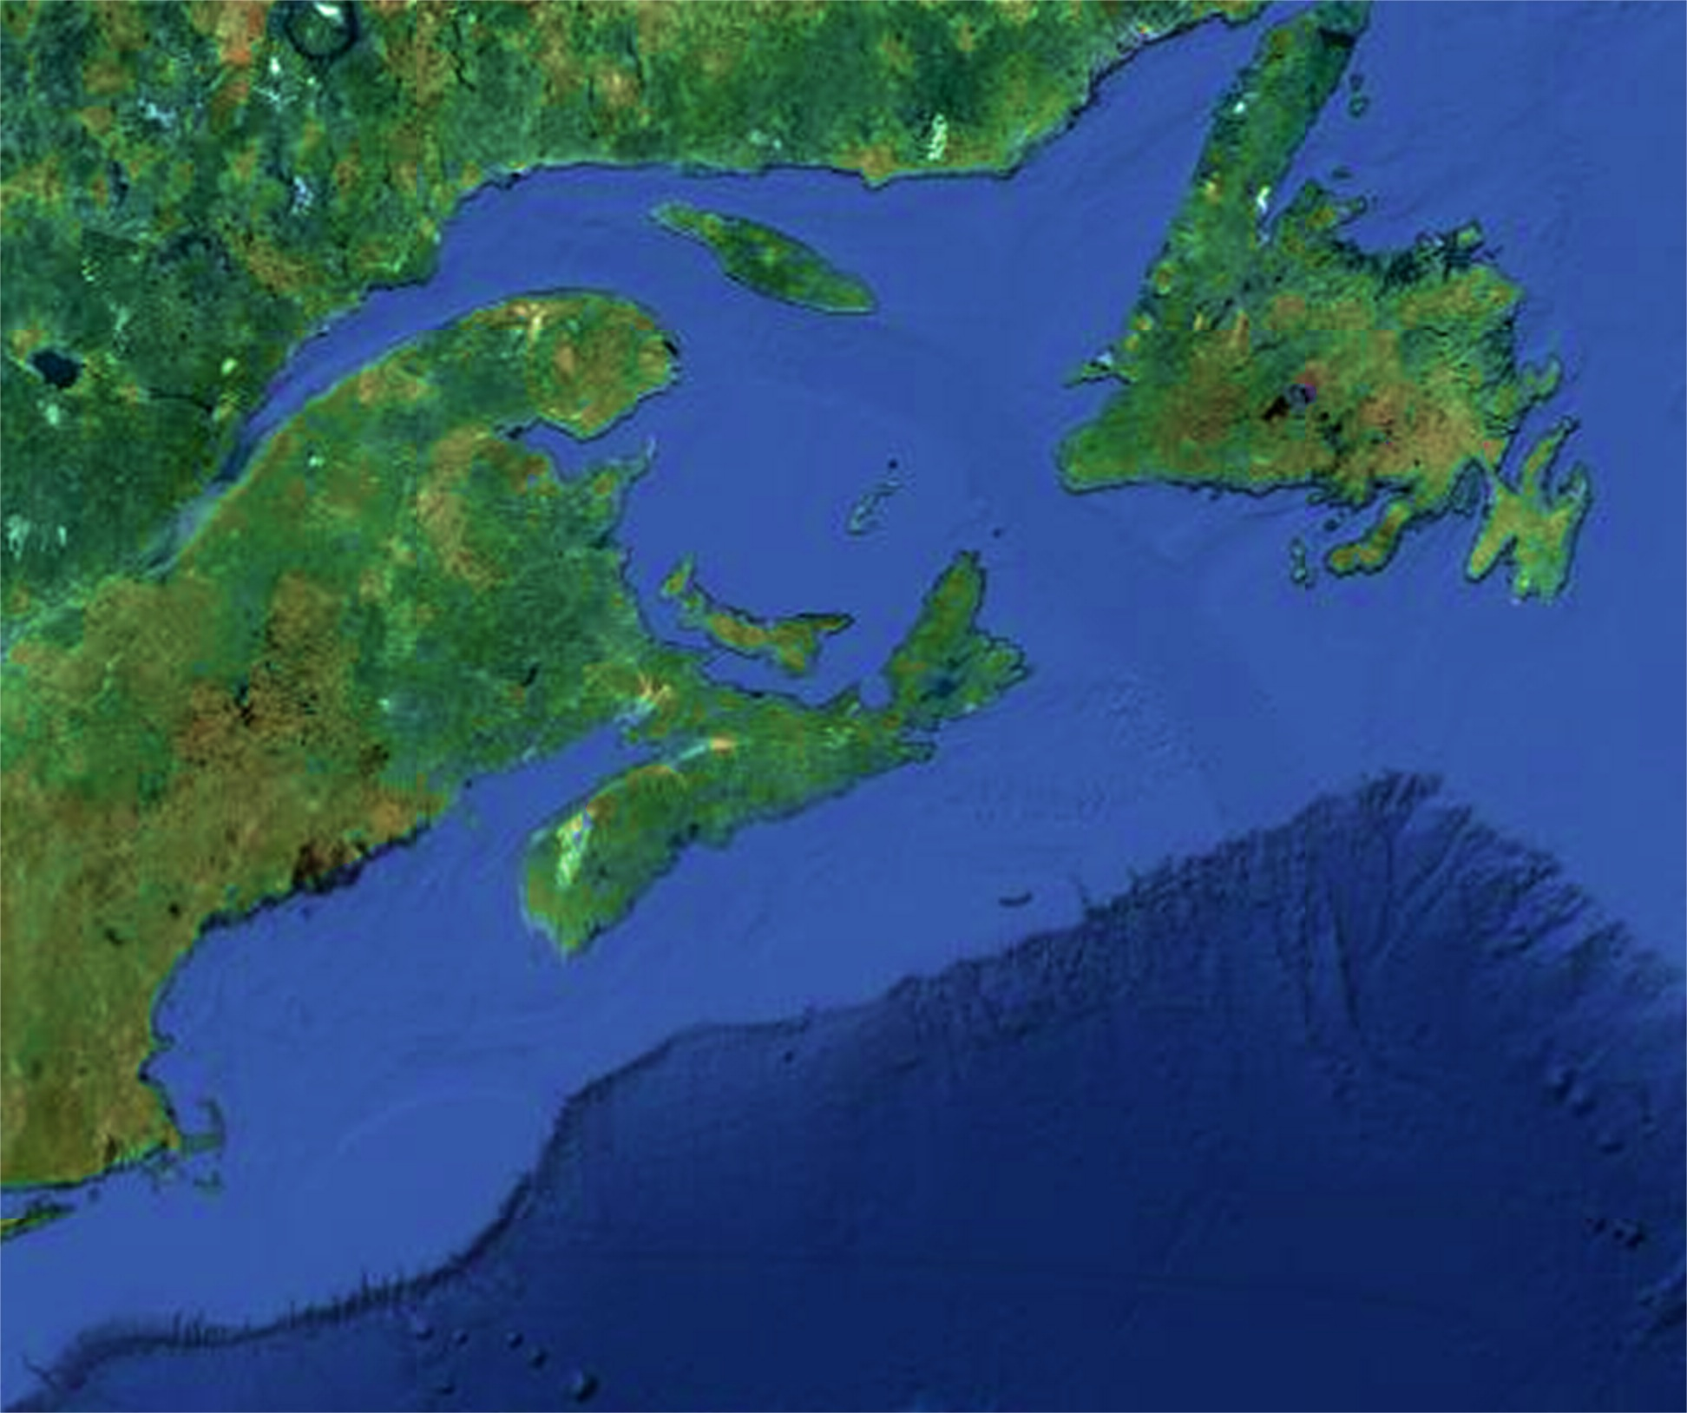
ASP Closures in Eastern Canadian provinces
87
88
89
90
91
92
93
94
95
96
97
98
99
00
01
02
03
04
05
06
07
08
09
10
11
12
13
Closures in one province
Closures in more than one province
Low levels (trace or below regulatory limit )
1991 Nantucket Shoals – Shellfish
2003 Georges Bank – Whale mortalities
2004-2006 Georges Bank – Scallops
2005-2006 Gulf of Maine – Whale feces, krill
2012-2015 Eastern Maine – Shellfish
Toxic levels
1995 Browns and Georges Banks – Scallops
Fernandes et al. 2014
Domoic Acid in the Eastern US
Quebec
Newfoundland
PEI
New Brunswick
Nova Scotia
ME
Gulf of
Maine
NH
MA

Slide 17
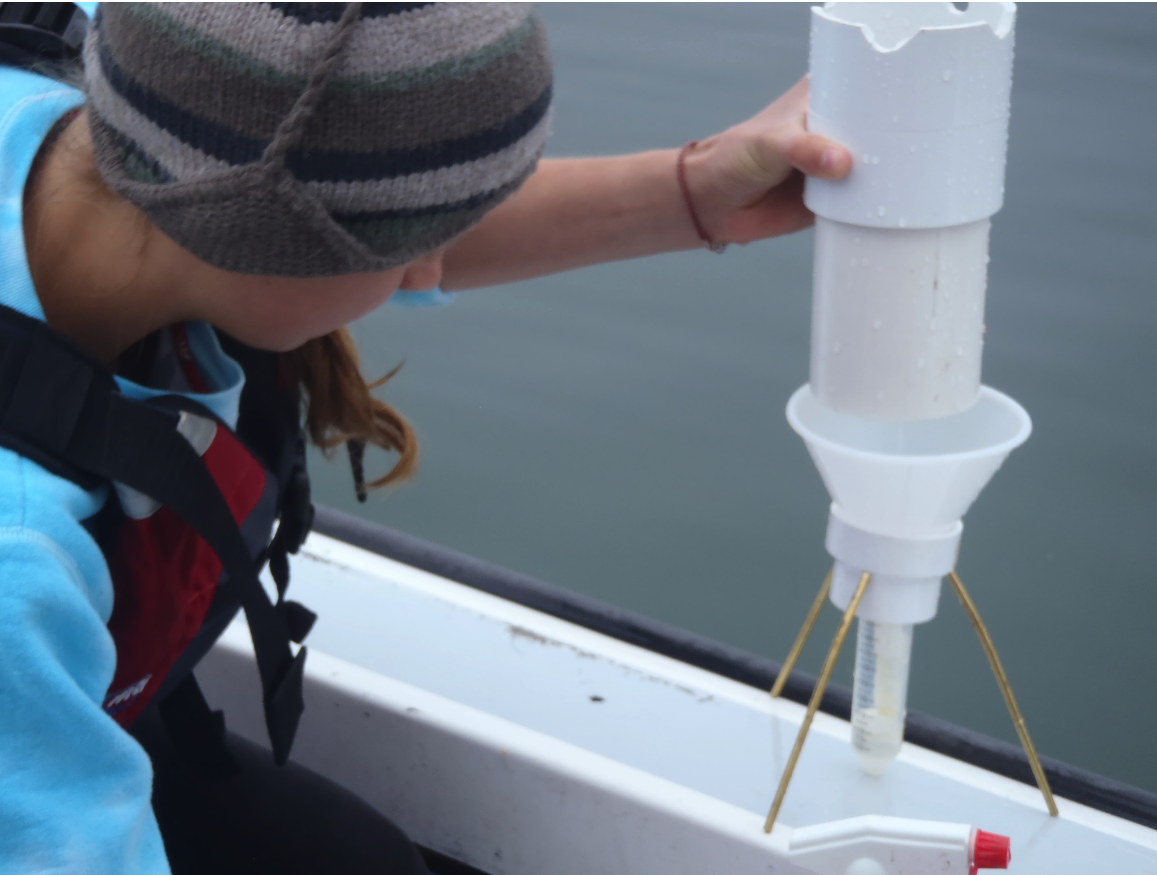
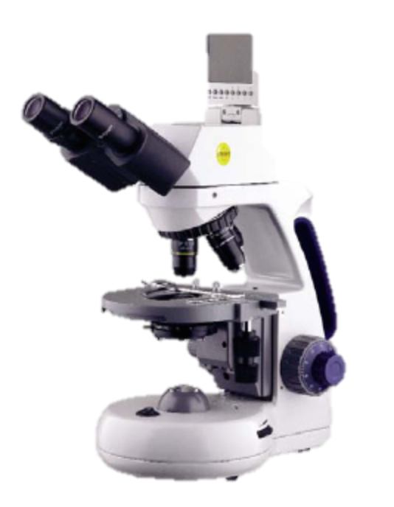
Domoic acid variability in Gulf of Maine P-n species
P. seriata
P. fraudulenta
P. pungens
P. multiseries
P. caciantha
P. heimii/P. subpacifica
P. delicatissima
P. americana
P. cuspidata
P. plurisecta
P. pseudodelicatissima
>1200 μm³
600- 1200 μm³
Not tested
200-600 μm³
Not tested
Not toxic
0-200 μm³
fg DA cell⁻¹
Lundholm et al. (2006)
Trainer et al. (2012)
Fernandes et al. (2014)

Slide 18
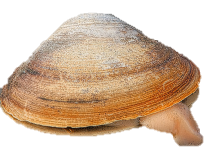
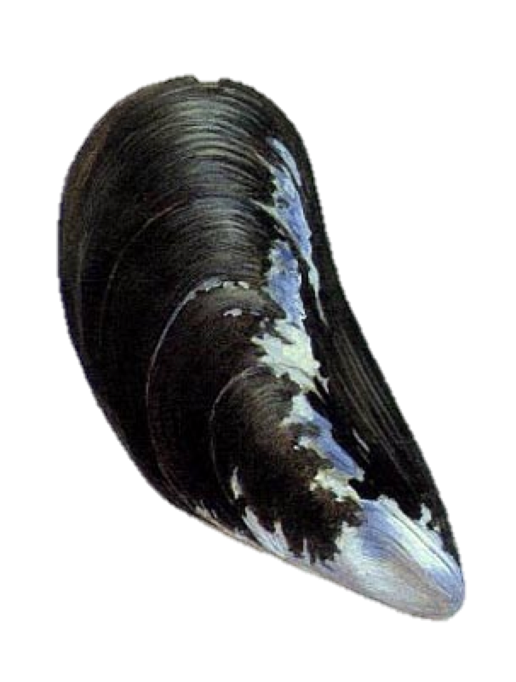
Pseudo-nitzschia spp.: Monitoring and Toxin Analyses
Phytoplankton monitoring
State regulatory shellfish testing for domoic acid
DMR Shellfish Monitoring site
OHH/DMR Pseudo-nitzschia time series sites

Slide 19
Identifying Pseudo-nitzschia bloom events in 2015: ESP
PRESENCE/ABSENCE:
Positive ESP signal
X
No ESP signal observed
“AUD1” Probe:
Pseudo-nitzschia australis
“SED-KH” Probe:
Pseudo-nitzschia seriata
“MUD2” Probe:
P. multiseries and
other P. spp.
ESP Dennis
ESP Jake

Slide 20
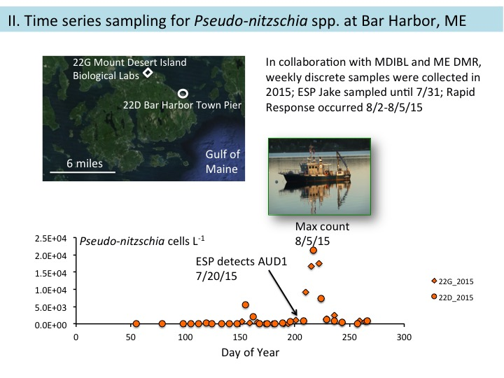
8/5/15
Max P-n. cell abundance
7/21/15
ESP detects community shift
Pseudo-nitzschia cells L⁻¹
OHH/DMR phytoplankton monitoring
2/19
4/10
5/30
7/19
9/7
10/27
Genetic screening
100
80
60
% ARISA Fluorescence
40
20
P. pungens
P. delicatissima
0
P. obtusa
P. plurisecta
More
toxic
species
7/1
7/8
P. seriata
7/15
7/22
P. cuspidata type II
7/29
8/5
8/12
8/19
8/26
9/2
9/9
ARISA: Hubbard et al. 2008; Hubbard et al. 2014

Slide 21
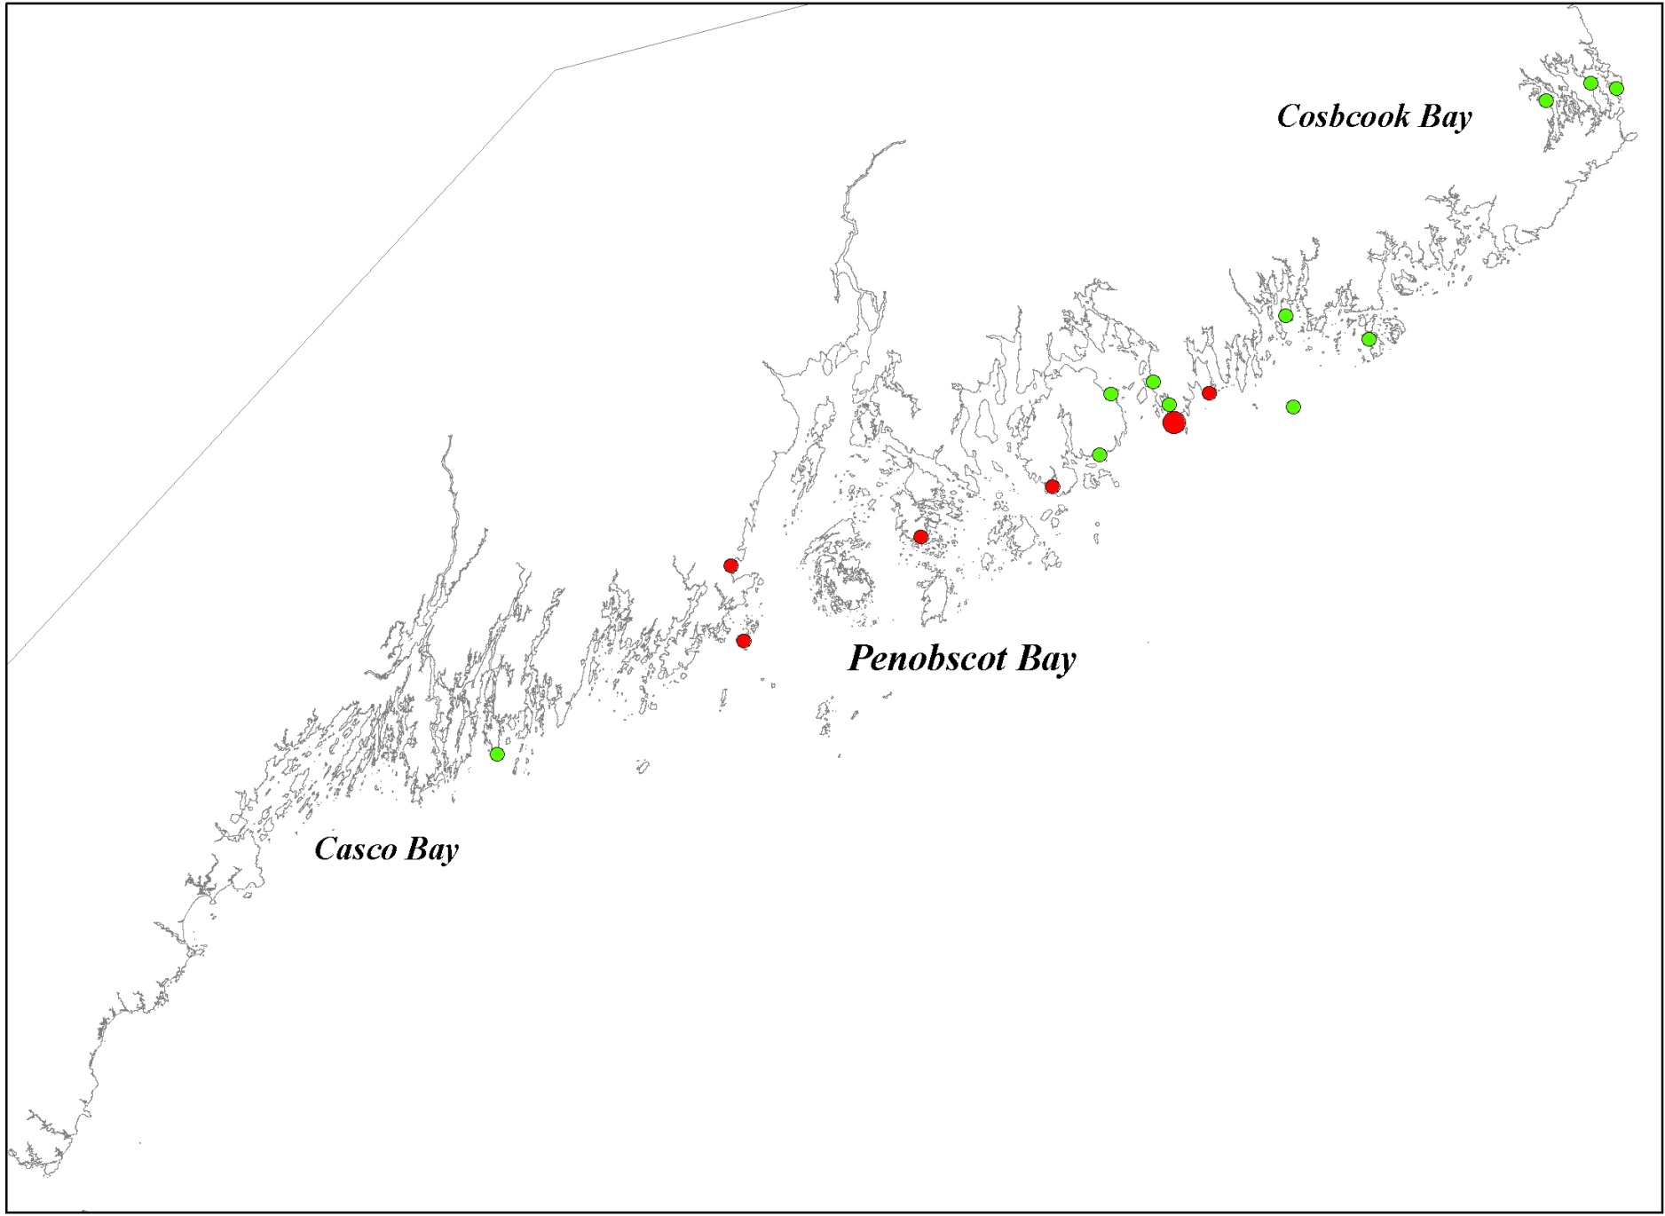
2015 Domoic Acid (DA) Shellfish Testing, ME DMR
Quarantine: 20 μg DA g⁻¹
<0.8 μg DA g⁻¹ shellfish tissue for all samples tested at site
>0.8 and <2.5 μg DA g⁻¹
>2.5 and <6.0 μg DA g⁻¹
Mytilus used for DA testing
OHH/DMR Pseudo-nitzschia time series sites
August 2-5, 2015: Rapid Reponse Cruise launched
August 10-16, 2015: DA first observed in shellfish
August 31-September 6, 2015: Max DA observed in shellfish → after P. plurisecta observed at Bar Harbor
Data provided by A. Sirois , Maine Department of Marine Resources

Slide 22
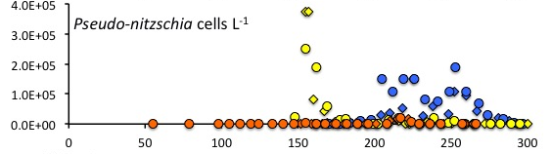
Interannual variability
Bar Harbor MDIBL
2015
2013
2014
2015
2/19
4/10
5/30
7/19
9/7
10/27
Rapid Response surveys

Slide 23
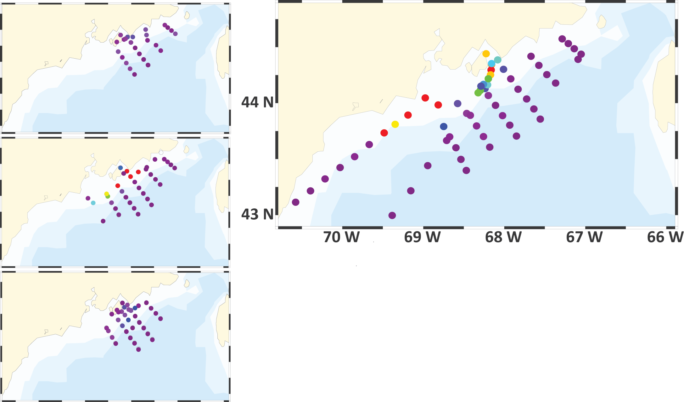
Rapid-response sampling of key bloom processes
Peak DA refers to maximum concentration of domoic acid observed in shellfish by ME DMR
2012 – after peak DA
2015 – before peak DA
2013 – during peak DA
2014 – before peak DA
Pseudo-nitzschia (cells L⁻¹)

Slide 24
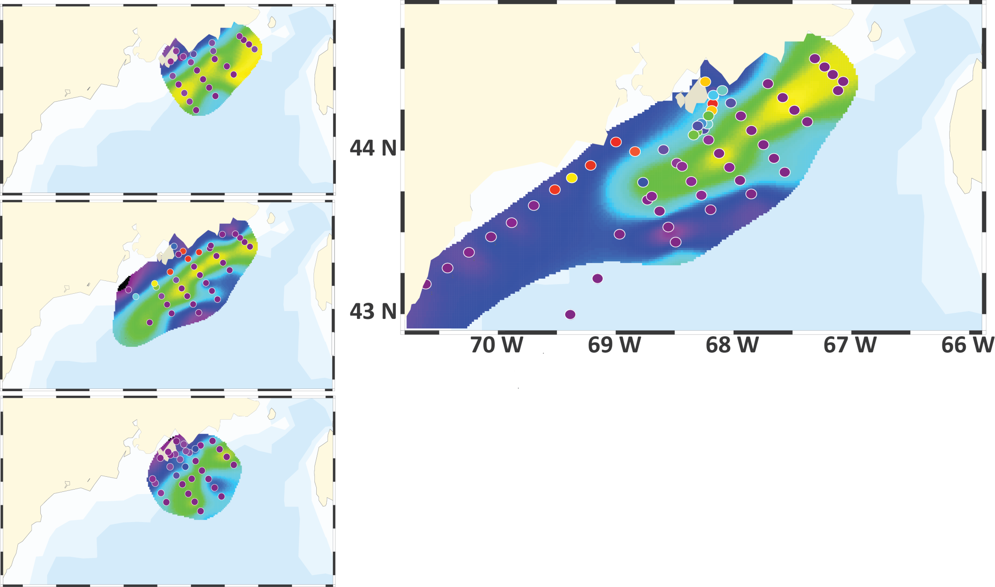
Rapid-response sampling of key bloom processes
2012 – after peak DA
2015 – before peak DA
2013 – during peak DA
2014 – before peak DA
Pseudo-nitzschia (cells L⁻¹)
Density σ_{θ} (kg m⁻³)

Slide 25
Observations of P. spp. diversity in Gulf of Maine
Pseudo-nitzschia spp.
Most toxic species
P. seriata
P. plurisecta
May
June
10 μm
July
Aug
P. pungens
P. delicatissima
Salinity
10 μm
Temperature (°C)

Slide 26
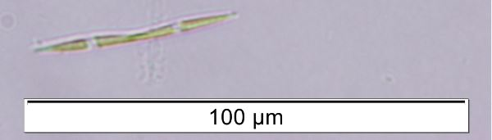
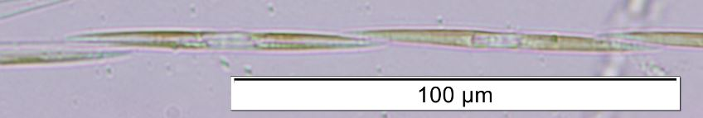
Pseudo-nitzschia growth rate experiments
Conditions mimic time of isolation (Aug 2015):
16 °C
14:10 light:dark @ 40 μE m² s⁻¹
F/2 + Si + NH₄ + Se
0.30-1.22 d⁻¹ → Published growth rates (Trainer et al. 2012; Fehling et al. 2005)
MIX
Exponential growth rate
(d⁻¹)
2 to 4 replicates
Growth rate (d⁻¹)
Strain
A B C D E F G H I J K L M N O P
Sequence ID
P. delicatissima
P. pungens
Size
30-100 μm long = “intermediate”
≤30 μm long = “small”
10 μm
10 μm

Slide 27
Field surveys inform experimental cultivation conditions
+
+
Species composition important
Correlation w/ P-n. abundance
Correlation w/ DA conc.
-
-
Modified from Lelong et al. 2013

Slide 28
Summary and next steps
Pseudo-nitzschia
Integrated approach: ESPs, ME DMR phytoplankton and toxin monitoring, rapid response cruises, advanced genomic methods
Characterizing seasonal to interannual variability at local to regional scales
Toxic Pseudo-nitzschia species coincide with low levels of DA in shellfish
Two taxa in culture, more on the way
Alexandrium fundyense
ESP data streams essential for evaluating forecasts
Used ESP data directly for toxicity predictions
Weak blooms of the last few years have not been amenable to rapid-response sampling of bloom termination
Future ESP deployments to focus on the “leaky gyre” hypothesis controlling interannual variability in eastern GOM toxicity
2 posters – Hubbard et al.

Slide 29










Slide 30
Weekly monitoring, June-October 2013
Correlation between cell abundance and pDA (Spearman’s R = 0.788, p<0.01)
Highest pDA ~ highest abundance of P. plurisecta
Coexistence of toxic species
Particulate DA ng L⁻¹
Pseudo-nitzschia spp.
P. seriata
P. plurisecta
P. pungens
P. americana/P. heimii
P. delicatissima
P. cuspidata
Fragment 223
P. fraudulenta
Pseudo-nitzschia cells L⁻¹

