Slide 1
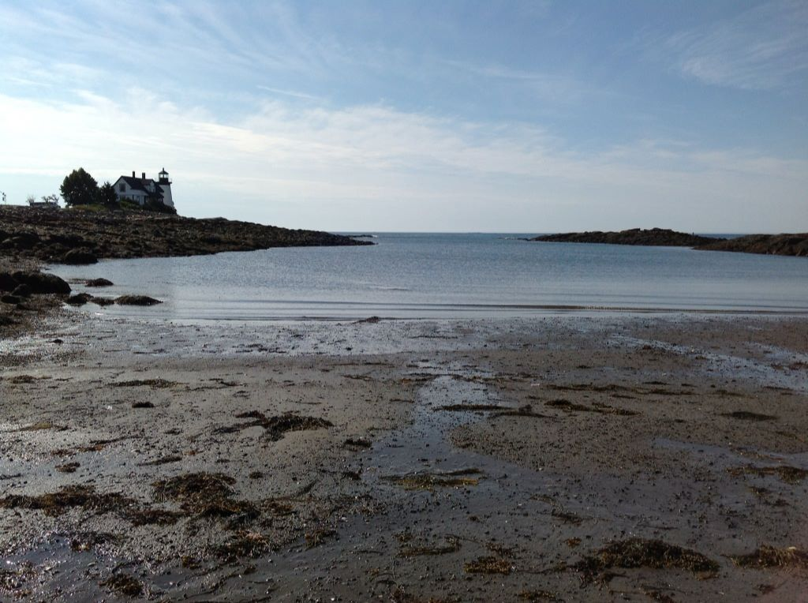
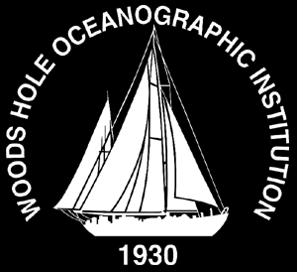






SPATIAL AND TEMPORAL VARIABILITY OF TOXIC PSEUDO-NITZSCHIA SPP. IN THE GULF OF MAINE DURING SUMMER 2012
Katherine A. Hubbard, Alison Sirois, Jane Disney, Leanne Flewelling, Sheila O’Dea, Steve Morton, Alison Robertson, Harold A. Flores Quintana, Maura A. Thomas, David W. Townsend, Judith L. Kleindinst, Dennis J. McGillicuddy, Donald M. Anderson

Slide 2
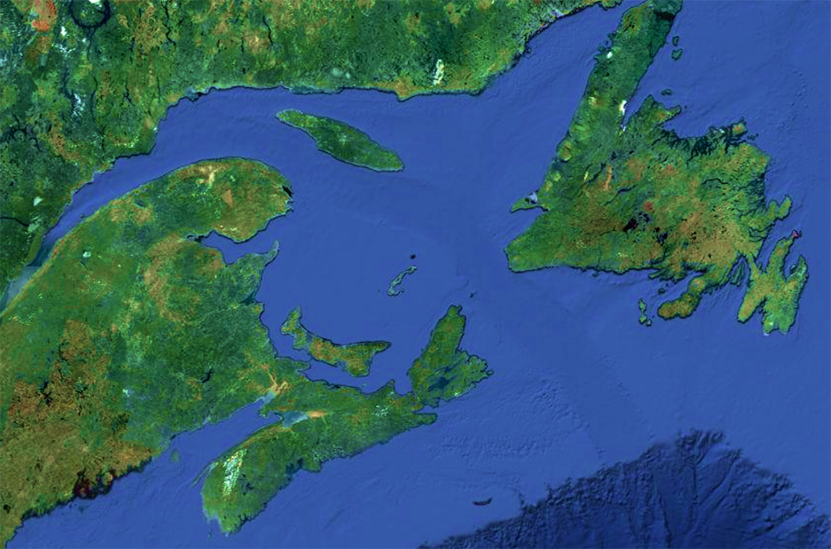
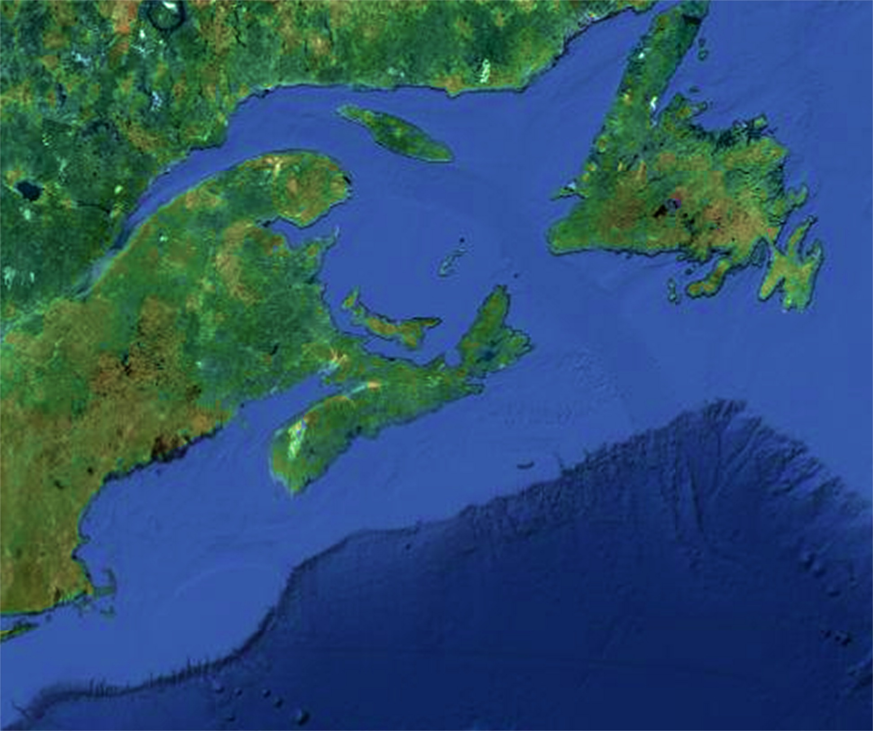
DA and Pseudo-nitzschia spp. in eastern North America since 1987
Closures in eastern Canadian provinces
87
88
89
90
91
92
93
94
95
96
97
98
99
00
01
02
03
04
05
06
07
08
09
10
11
12
13
Closures in one province
Closures in more than one province
Quebec
Newfoundland
Prince Edward Island
New Brunswick
Nova Scotia
Fernandes et al. 2013 DSR II
Notes:
Most blooms in mid to late summer due to P. multiseries, except for BOF- P. pseudodelicatissima/ P. calliantha, one notable bloom in 2002 occurred during spring;

Slide 3
DA and Pseudo-nitzschia spp. in eastern North America since 1987
Closures in eastern Canadian provinces
87
88
89
90
91
92
93
94
95
96
97
98
99
00
01
02
03
04
05
06
07
08
09
10
11
12
13
Closures in one province
Closures in more than one province
Pseudo-nitzschia spp.
Three involved in toxic events:
P. multiseries
P. pseudodelicatissima
P. seriata
Quebec
Newfoundland
Prince Edward Island
New Brunswick
Nova Scotia
Fernandes et al. 2013 DSR II
Notes:
Most blooms in mid to late summer due to P. multiseries, except for BOF- P. pseudodelicatissima/ P. calliantha, one notable bloom in 2002 occurred during spring;

Slide 4
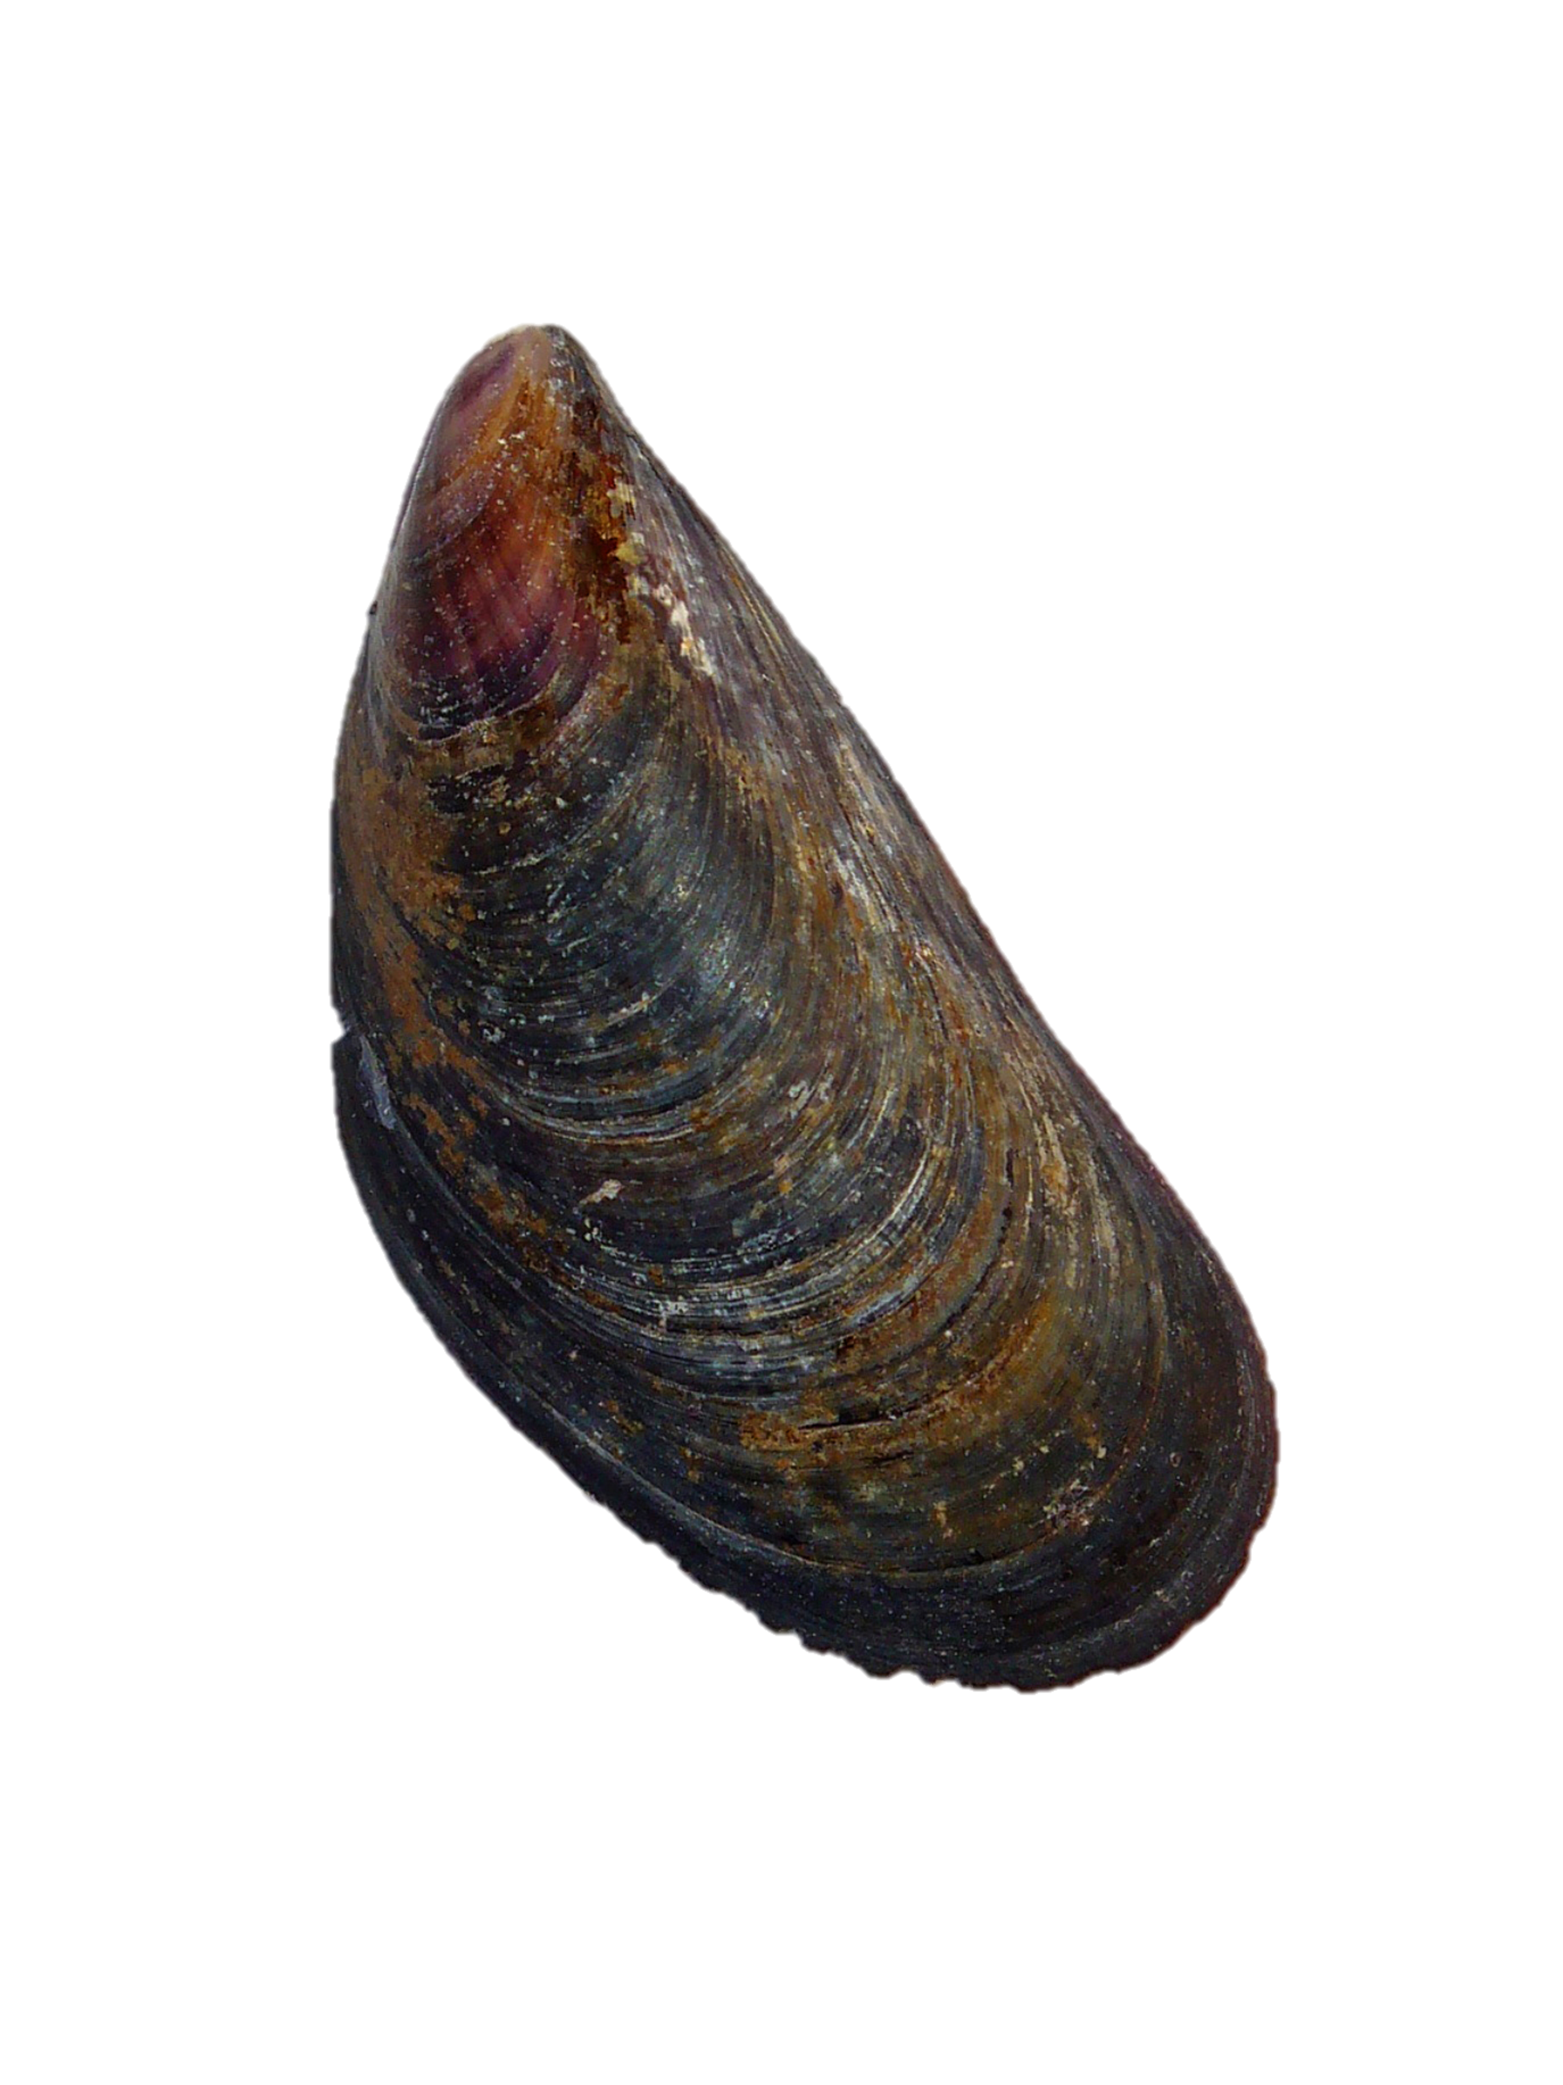
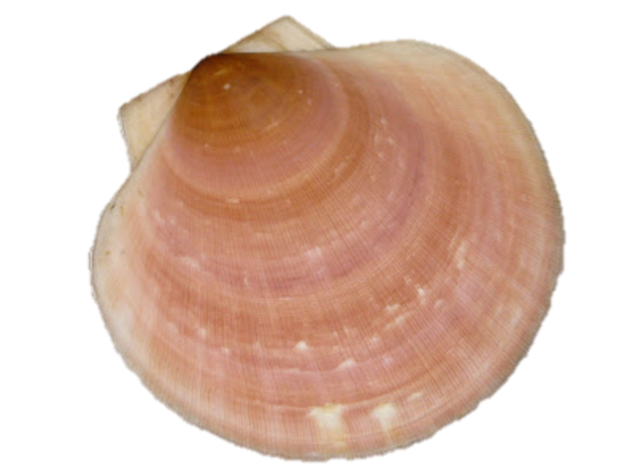
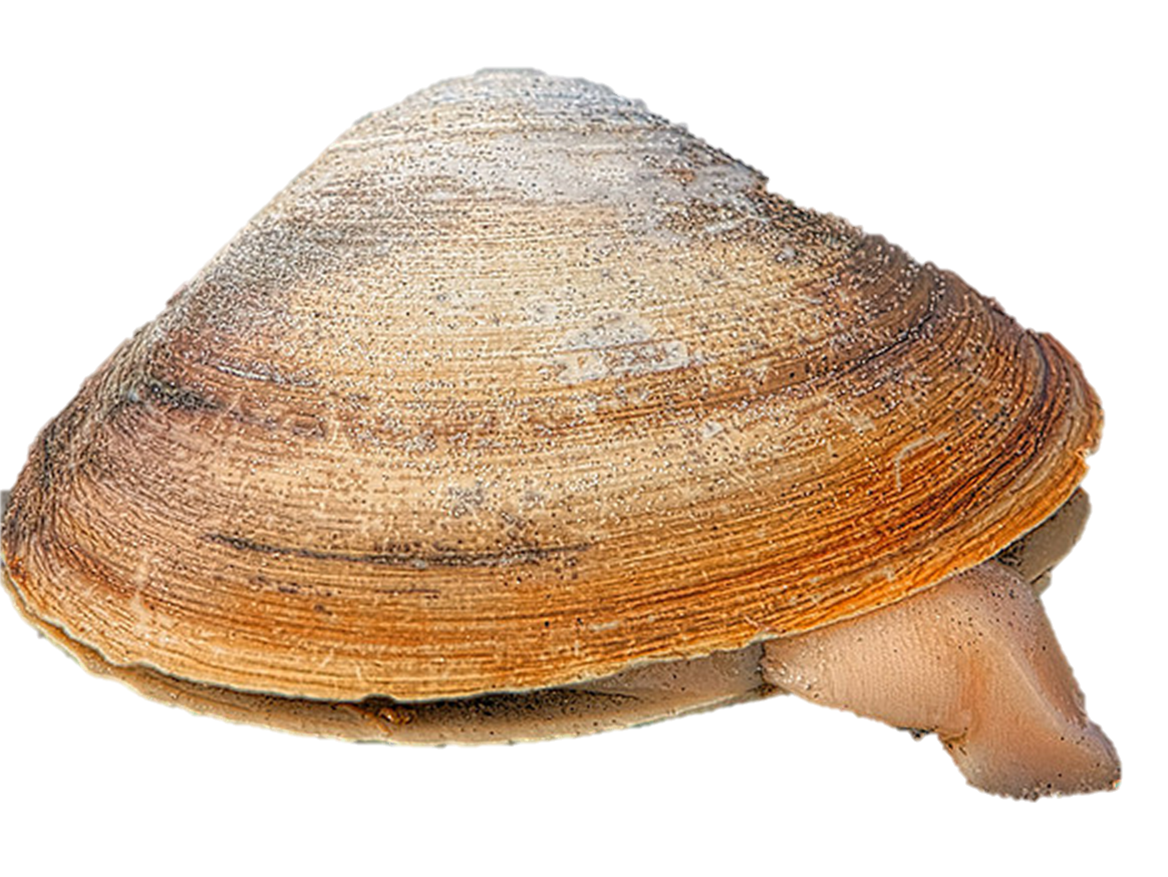
DA and Pseudo-nitzschia spp. in eastern North America since 1987
Closures in eastern Canadian provinces
87
88
89
90
91
92
93
94
95
96
97
98
99
00
01
02
03
04
05
06
07
08
09
10
11
12
13
Closures in one province
Closures in more than one province
Pseudo-nitzschia spp.
Three involved in toxic events
Quebec
Domoic acid in shellfish
≈
Newfoundland
<
Prince Edward Island
New Brunswick
Nova Scotia
Fernandes et al. 2013 DSR II
Notes:
Most blooms in mid to late summer due to P. multiseries, except for BOF- P. pseudodelicatissima/ P. calliantha, one notable bloom in 2002 occurred during spring;

Slide 5
DA and Pseudo-nitzschia spp. in eastern North America since 1987
Closures in eastern Canadian provinces
87
88
89
90
91
92
93
94
95
96
97
98
99
00
01
02
03
04
05
06
07
08
09
10
11
12
13
Closures in one province
Closures in more than one province
Pseudo-nitzschia spp.
Three involved in toxic events
Domoic acid in shellfish
≈
<
GOM??
Fernandes et al. 2013 DSR II
Notes:
Most blooms in mid to late summer due to P. multiseries, except for BOF- P. pseudodelicatissima/ P. calliantha, one notable bloom in 2002 occurred during spring;

Slide 6
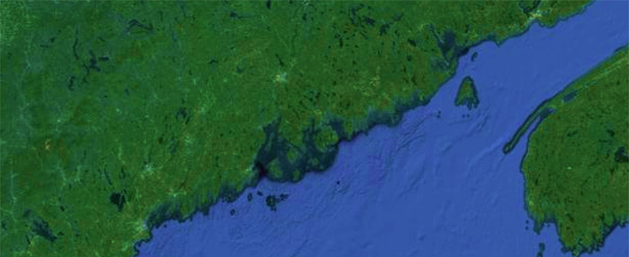
July 2012: First provisional shellfish closure for DA by Maine DMR
>5000 Pseudo-nitzschia cells per liter
+ pDA Jellet ASP test
- pDA Jellet ASP test
1000-5000 Pseudo-nitzschia cells per liter
<1000Pseudo-nitzschia cells per liter
July
NB
MAINE
Bay of Fundy
Schoodic Peninsula
Mount Desert Island
Penobscot Bay
Casco Bay
WGOM
EGOM
Phytoplankton data, ME DMR
Notes:
Purple is below 1000
Orange is 1000-5000
ADD LABELS
Explain methods
Wonder if might be able to google earth it…

Slide 7
July 2012: First precautionary shellfish closure for DA by Maine DMR
>5000 Pseudo-nitzschia cells per liter
+ pDA Jellet ASP test
- pDA Jellet ASP test
1000-5000 Pseudo-nitzschia cells per liter
<1000Pseudo-nitzschia cells per liter
Shellfish, seawater samples collected
July 30 and July 31 in response to + Jellet
(FDA regulatory limit 20 ppm)
July
NB
MAINE
Bay of Fundy
Schoodic Peninsula
Mount Desert Island
Penobscot Bay
C
W
Casco Bay
WGOM
EGOM
Phytoplankton data, ME DMR
 | Wonsqueak | Corea
Mytilus edulis | 5.77 ppm | 1.28 ppm
Mya arenaria | 5.68 ppm | 3.16 ppm
P-n. abundance (cells L⁻¹) | 3.5 x 10⁵ | 1.2 x 10⁶
pDA (ng L⁻¹) | 234 | 846
cellular pDA (pg cell⁻¹) | 0.77 | 0.70
Notes:
Purple is below 1000
Orange is 1000-5000
ADD LABELS
Explain methods
Wonder if might be able to google earth it…

Slide 8
Pseudo-nitzschia spp.
Fourteen species described:
P. americana, P. calliantha, P. cuspidata, P. delicatissima, P. fraudulenta, P. hasleana, P. heimii, P. multiseries, P. pseudodelicatissima, P. pungens, P. seriata, P. subpacifica, P. turgidula, and P. sp. GOM

Slide 9
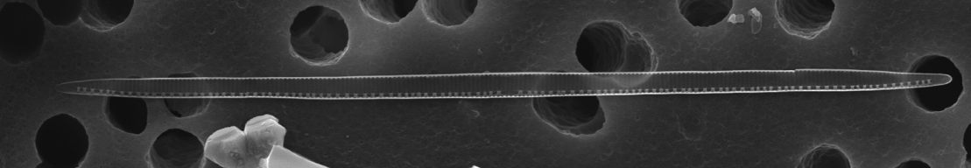
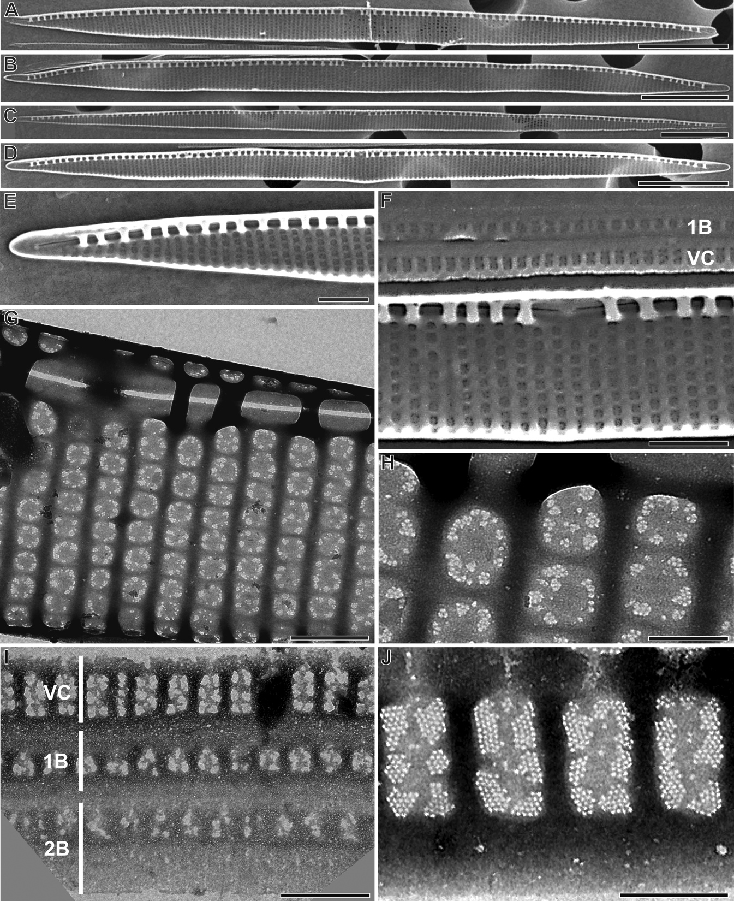
Pseudo-nitzschia spp.
Fourteen species described:
P. americana, P. calliantha, P. cuspidata, P. delicatissima, P. fraudulenta, P. hasleana, P. heimii, P. multiseries, P. pseudodelicatissima, P. pungens, P. seriata, P. subpacifica, P. turgidula, and P. sp. GOM
P. sp. GOM
P. pseudodelicatissima complex
10 μm
33-54 μm long
1.5-2.1 μm wide
(in culture)
DA per cell in culture:
<0.38 pg cell⁻¹
DA per cell in field July 31
0.70-0.77 pg cell⁻¹

Slide 10
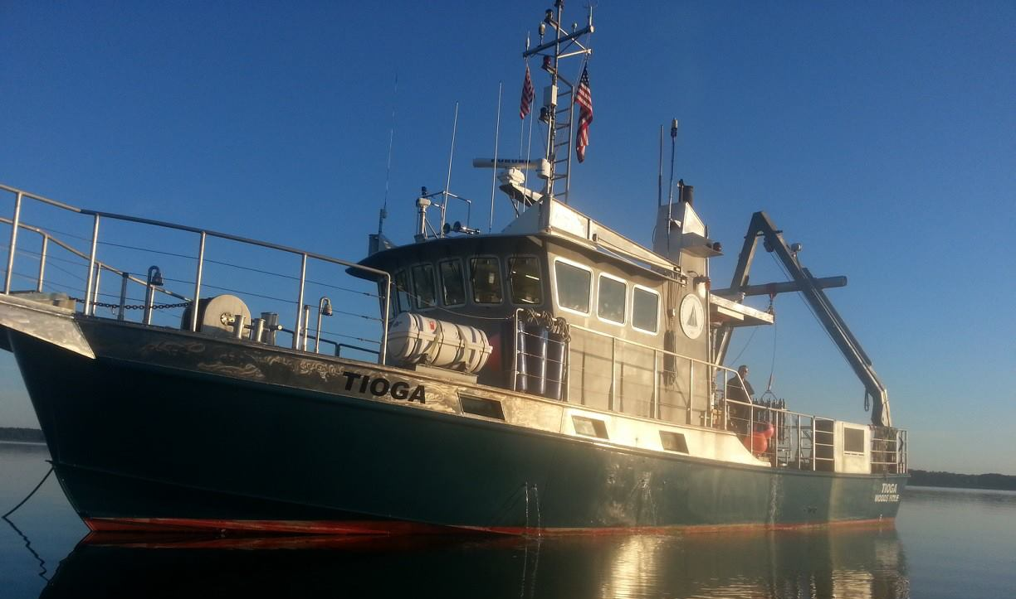
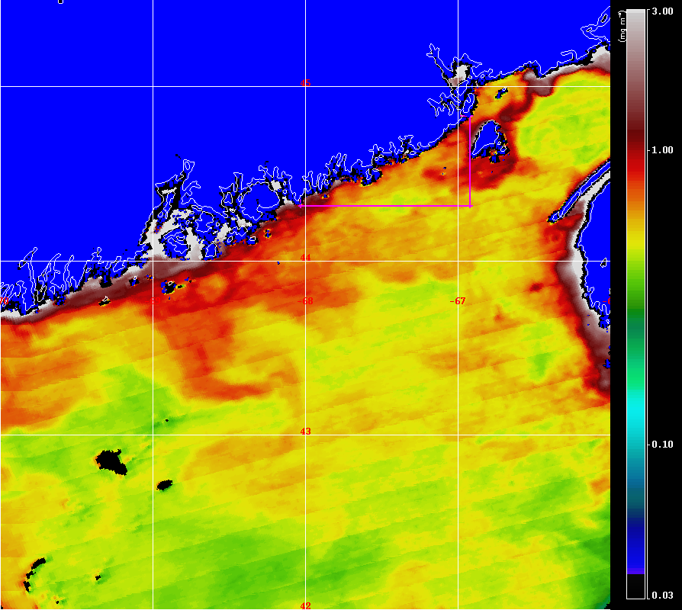
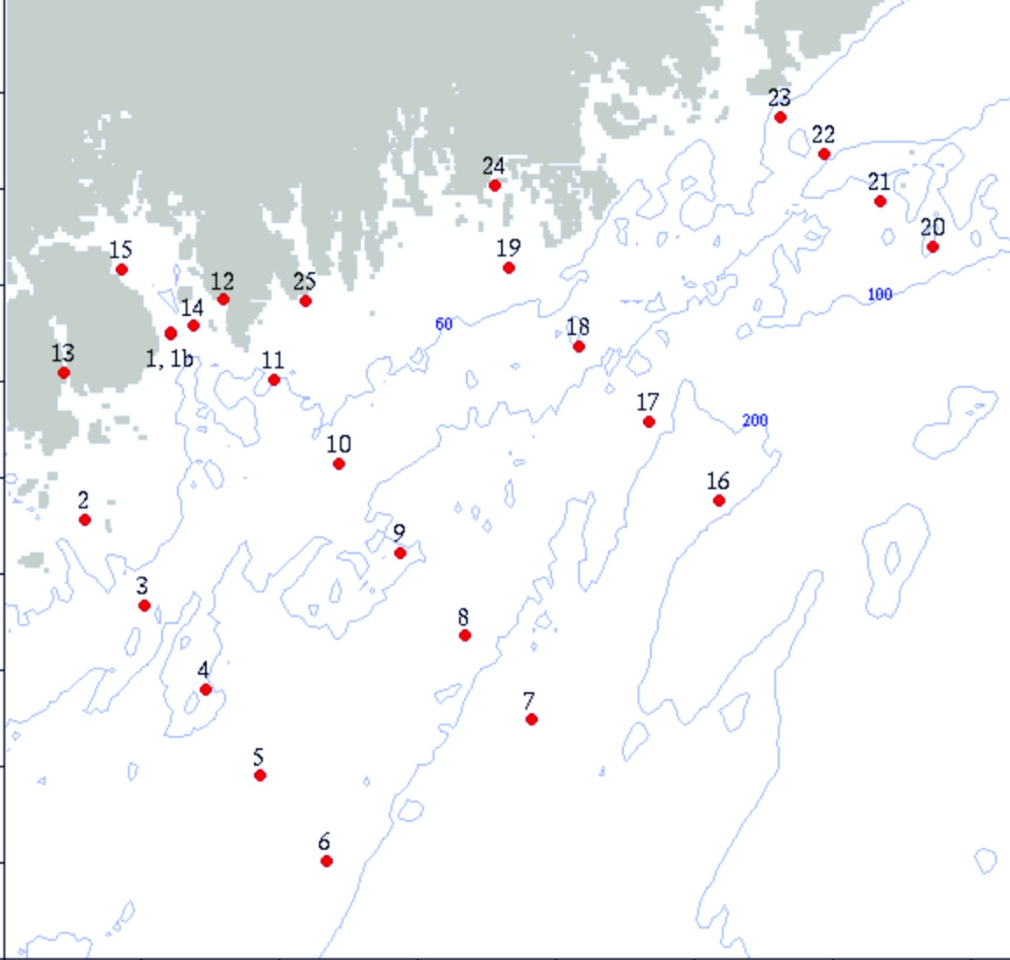
What is the spatial extent of the bloom and is it intensifying?
Rapid response effort aboard R. V. Tioga
August 4-5, 2013
Sea surface chlorophyll July 30, 2012
Latitude (°N)
44.6
44.4
44.2
44.0
43.8
68.4
68.0
67.6
67.2
Longitude (°W)
Notes:
Pic of tioga

Slide 11
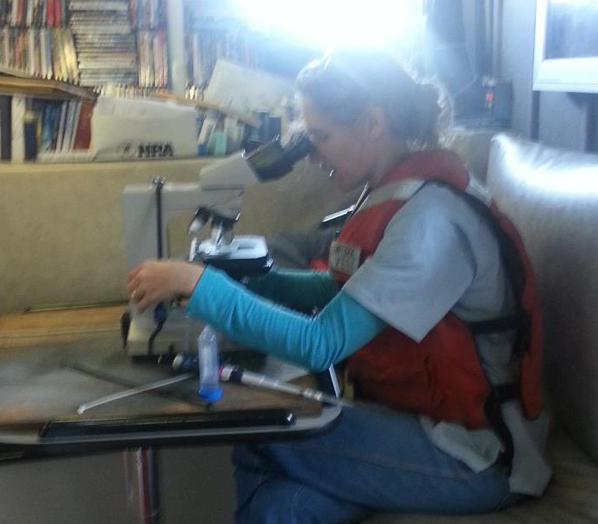
What is the spatial extent of the bloom and is it intensifying?
Where (and why) are Pseudo-nitzschia cells producing domoic acid?
Which species are associated with DA during 2012?
  How do cell abundance, DA/cell, and species composition vary across spatial gradients?
Underway sampling and satellite analysis
Discrete sampling:
Dissolved nutrients (Nitrate + Nitrite, Silicate, Phosphate, Ammonium)
CTD profiling
Lugol’s preserved seawater for cell counts
Filtered seawater for DNA and particulate DA
pDA analyzed by LC/MS/MS, verified by ELISA
Notes:
Pic of tioga

Slide 12
Surface variability in domoic acid and Pseudo-nitzschia cell abundance
Temperature (°C)
Pseudo-nitzschia spp. abundance (cells L⁻¹)
Salinity (°C)
Domoic acid (ng L⁻¹)
LC/MS/MS LOD 12 ng L⁻¹
Notes:
Pic of tioga
p. Seriata at depth as well…

Slide 13
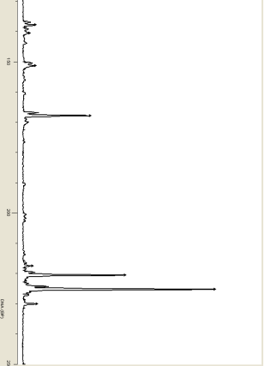
Automated Ribosomal Intergenic Spacer Analysis (ARISA) was used to identify species based on the ITS1 fragment length and relative contribution to community fluorescence
Relative fluorescence units
138 bp
142 bp
150
151 bp
168 bp
Extract DNA
PCR
purification
200
218 bp
Small P-n. cells have less DNA and less ITS1 copies than large P-n. cells.
220 bp
226 bp
228 bp
Hubbard et al. 2008
ARISA profile from GOM
250

Slide 14
Patchy, diverse Pseudo-nitzschia spp. in surface communities
Salinity
Latitude [°N]
P. sp. GOM
P. pungens
P. seriata
Fragment 157
P. cuspidata
P. delicatissima
P. pseudodelicatissima
Longitude [°W]

Slide 15
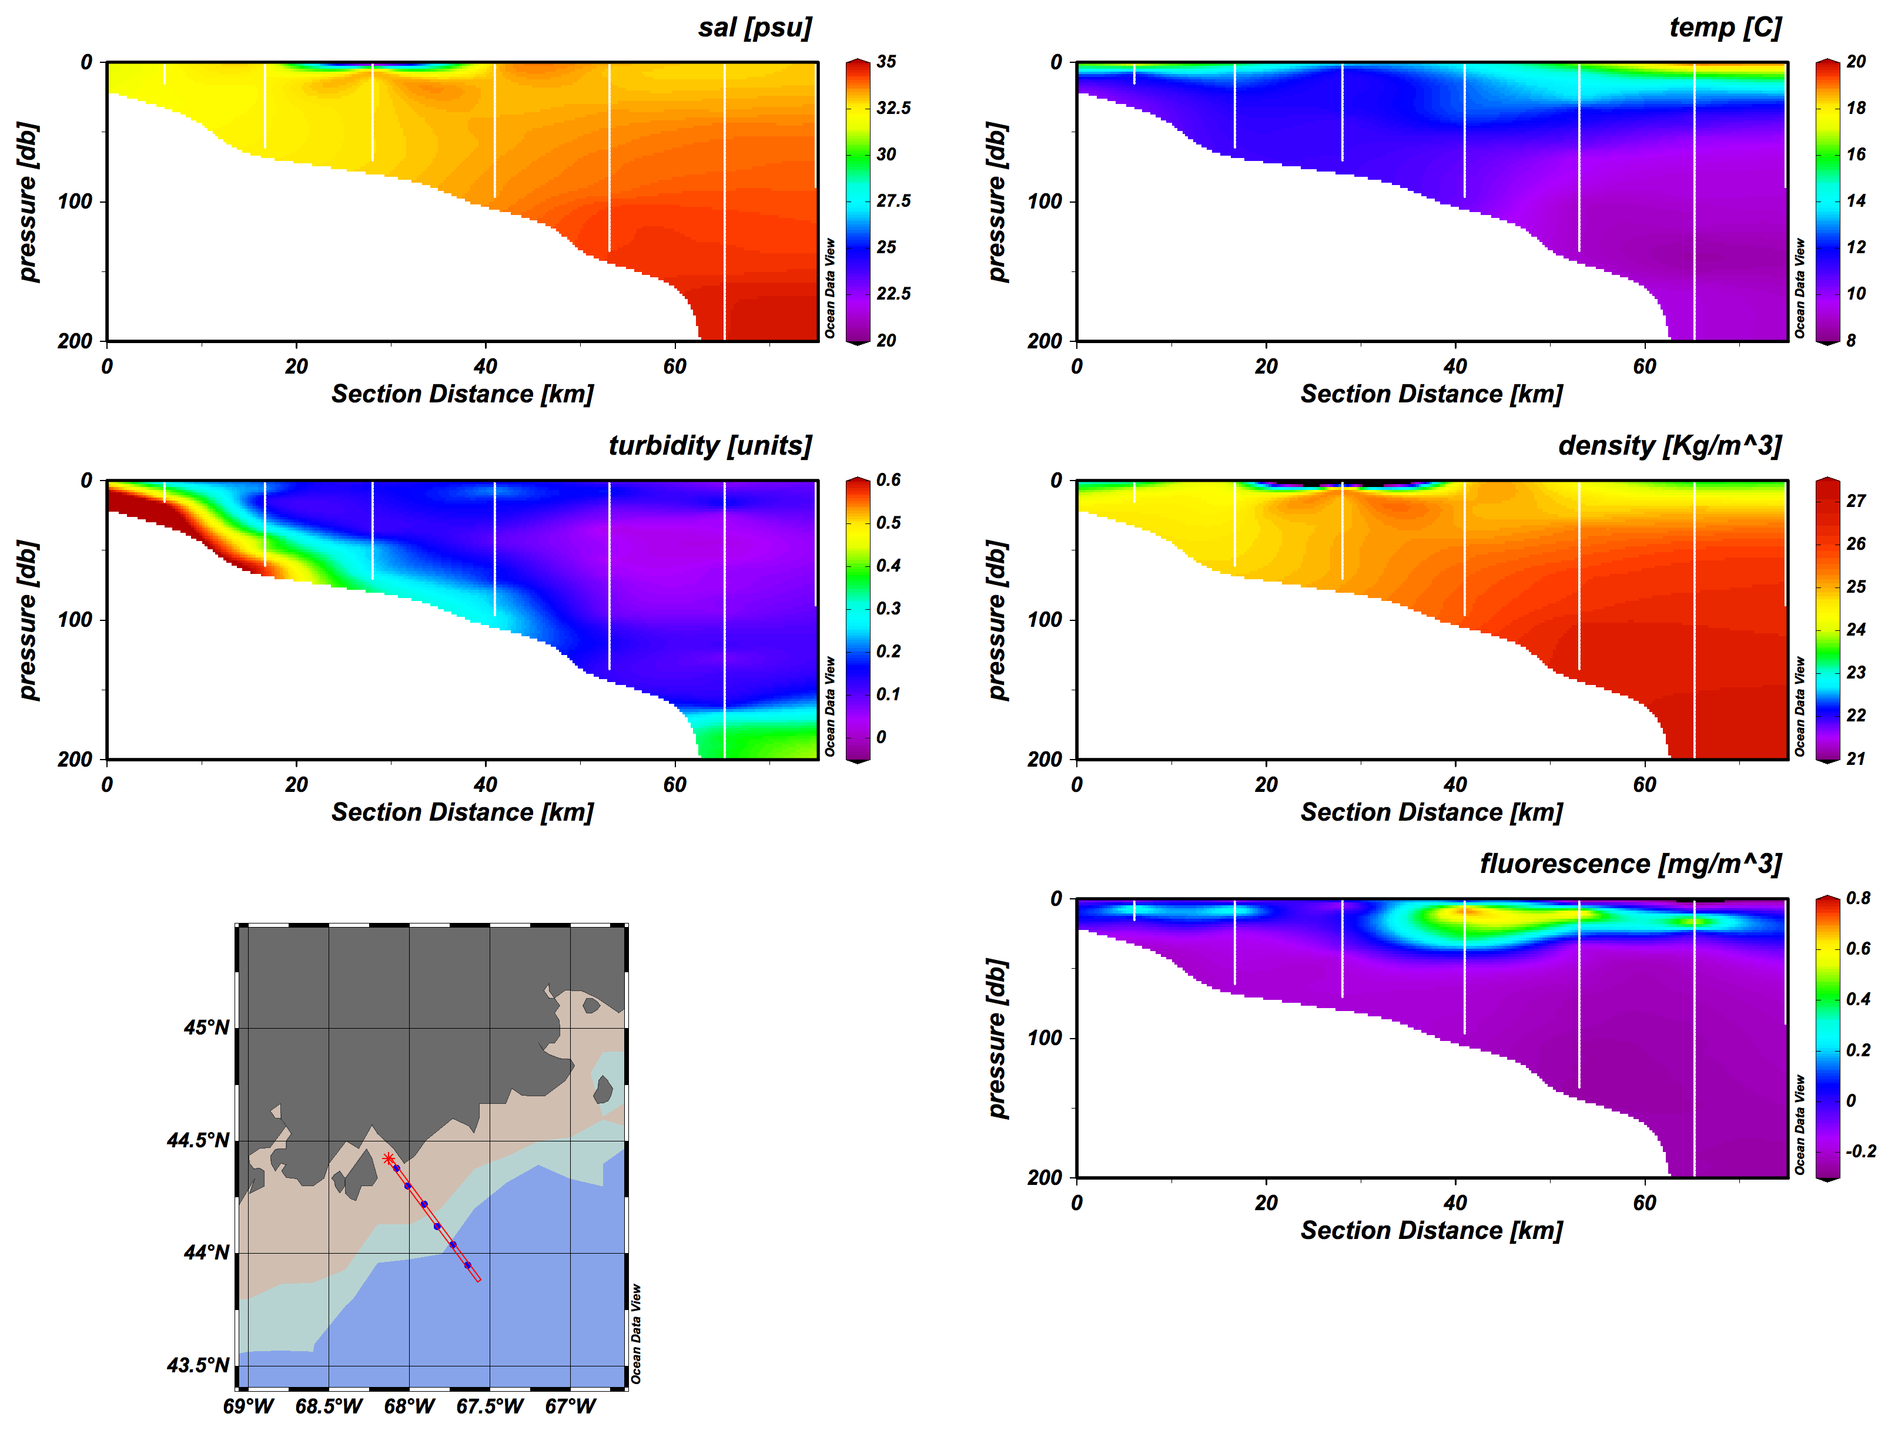
Vertical and horizontal structure observed along cross-shelf transect
Latitude (°N)
44.6
44.4
44.2
44.0
43.8
68.4
68.0
67.6
67.2
Longitude (°W)

Slide 16
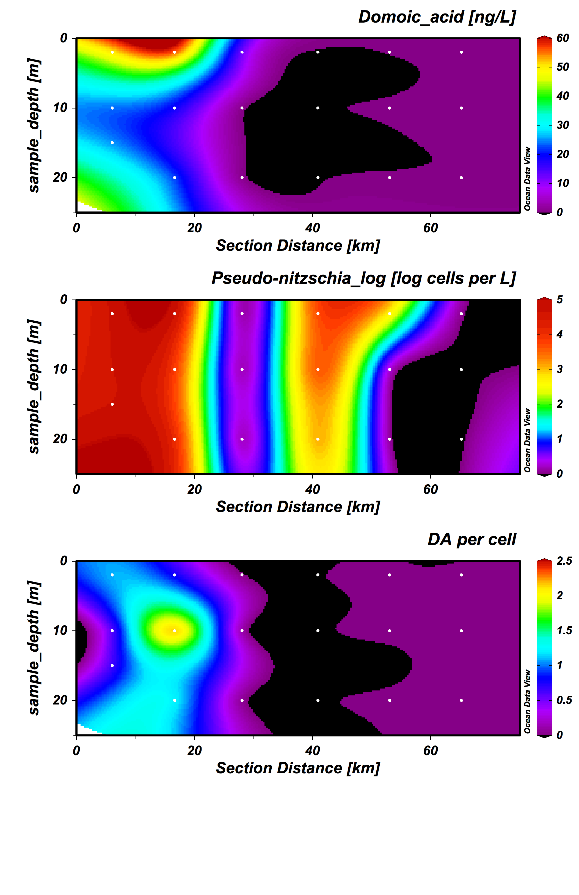
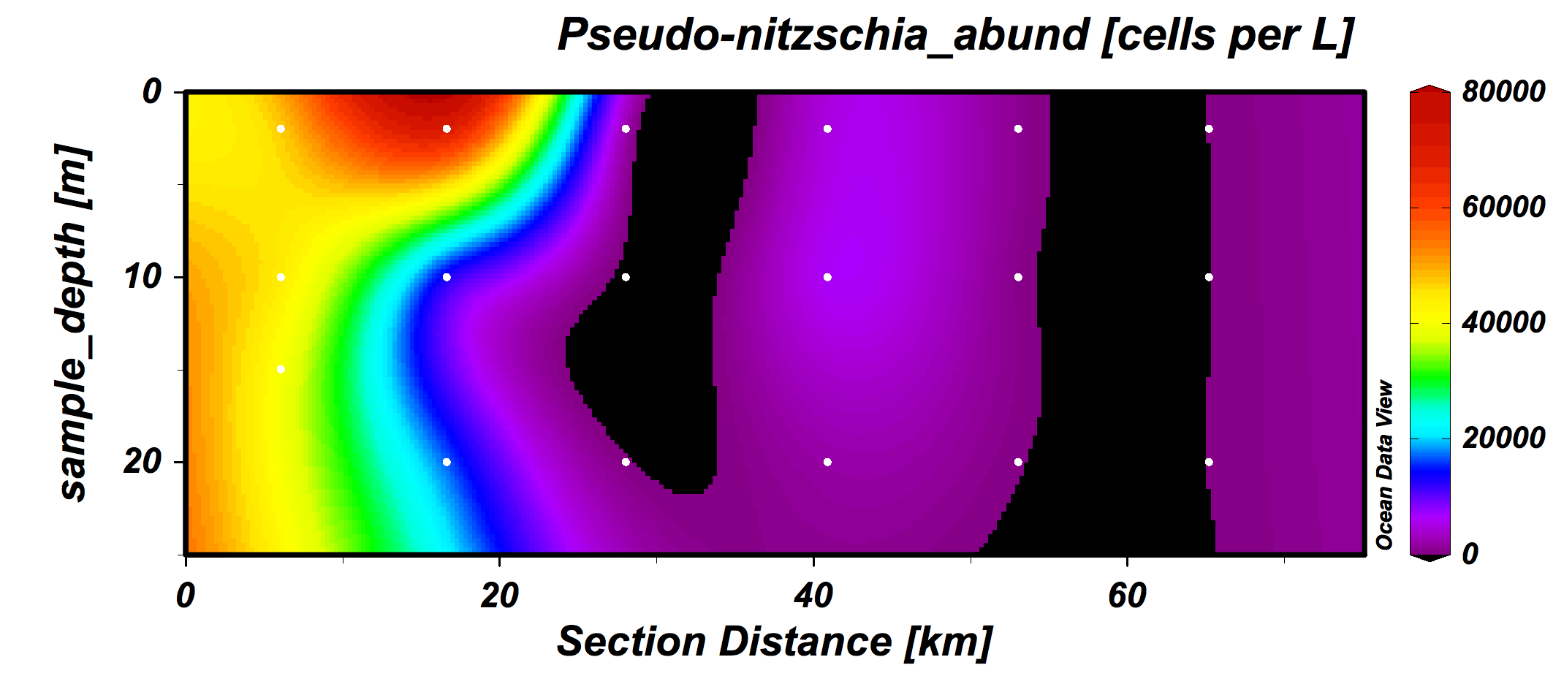
Variability in DA and Pseudo-nitzschia spp. abundance and diversity

Slide 17
Variability in DA and Pseudo-nitzschia spp. abundance and diversity
8 x 10⁴
6 x 10⁴
4 x 10⁴
2 x 10⁴
≤583
P. sp. GOM
P. pungens
Spearman’s R (p<0.05) N=25 | Pseudo-nitzschia cells L⁻¹ | ng pDA L⁻¹
ng pDA L⁻¹ | 0.716
NH₄ (μm) | 0.504 | 0.394
N:NH₄ | -0.350 | -0.327
N:P | -0.287 | -0.346
P. seriata
Fragment 157
P. cuspidata
P. delicatissima
P. pseudodelicatissima

Slide 18
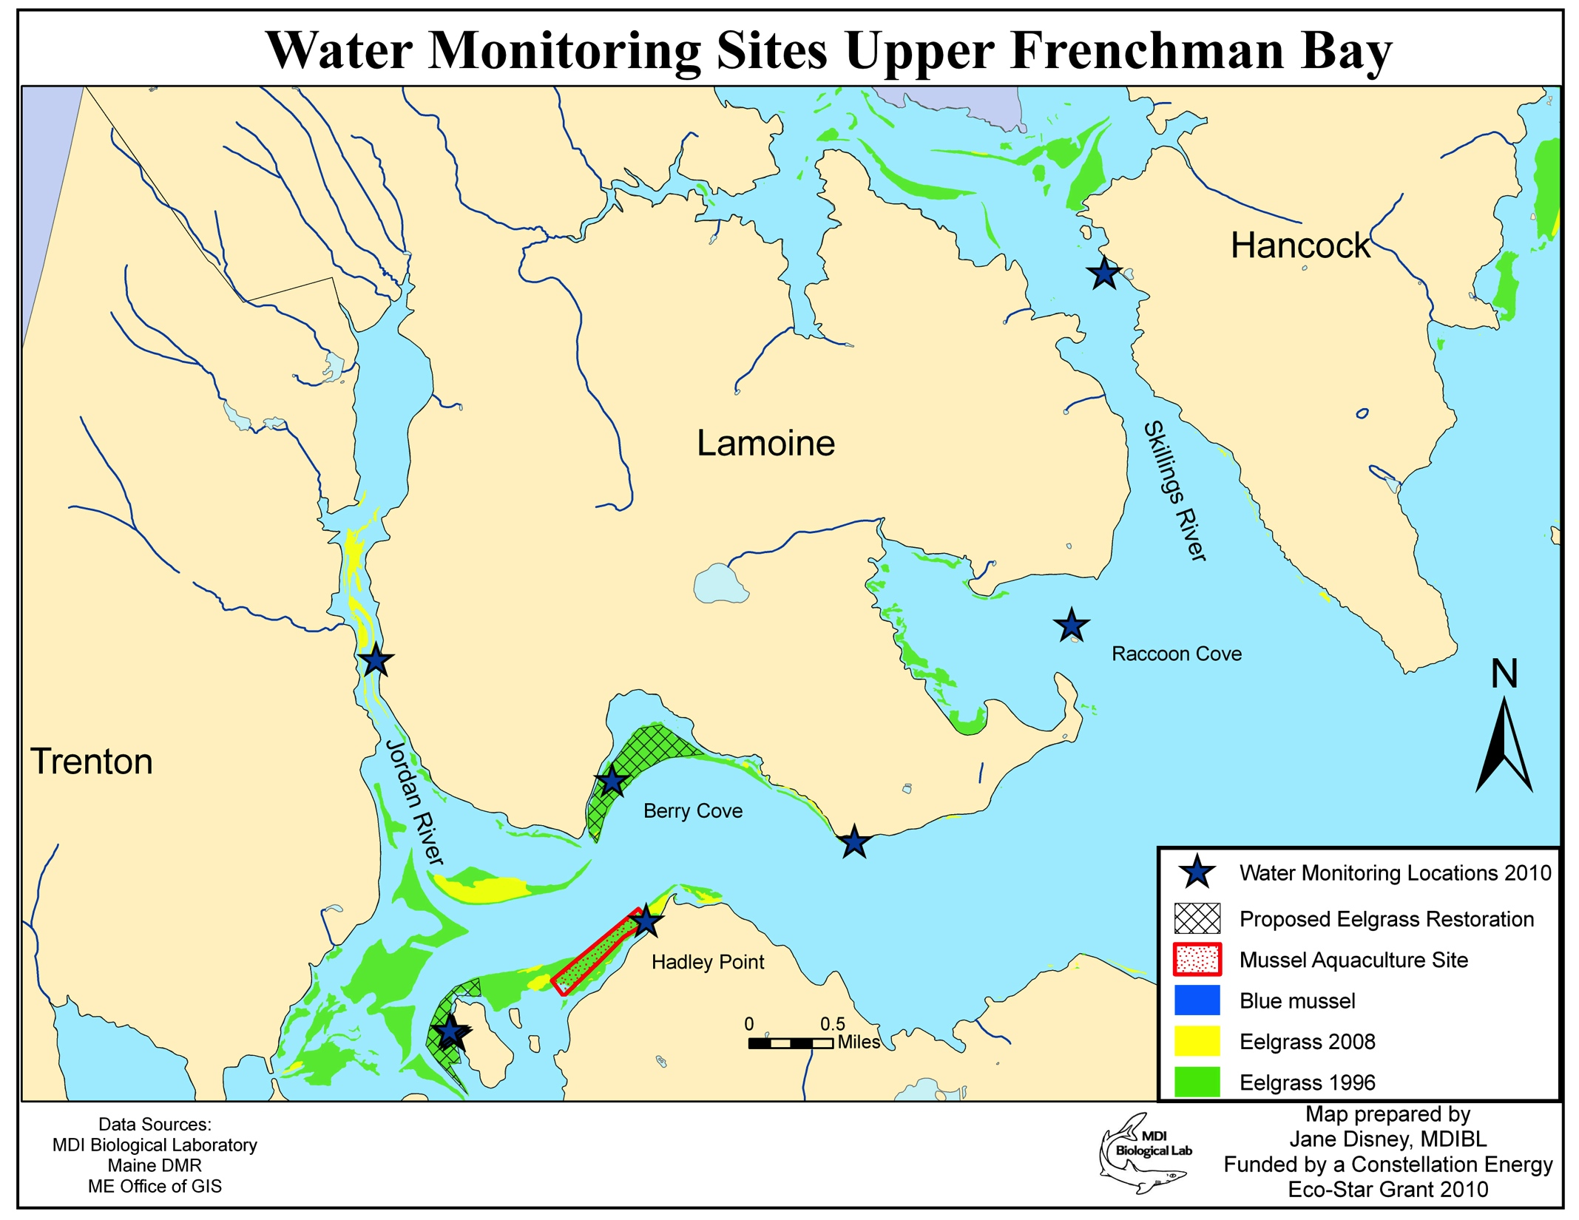
Inshore increase in ammonium (μM) between mid-July and mid-August
Ammonium (μM)

Slide 19
Prior observations of P. spp. diversity in Gulf of Maine
Pseudo-nitzschia species/ ARISA fragments
P. sp. GOM
May
June
10 μm
July
Aug
P. pungens
P. seriata
10 μm

Slide 20
Prior and current observations of P. spp. diversity in Gulf of Maine
Pseudo-nitzschia species/ ARISA fragments
P. sp. GOM
May
June
10 μm
July
Aug
P. pungens
P. seriata
10 μm

Slide 21
Temporal variability in domoic acid and Pseudo-nitzschia spp.
7/30-7/31
8/5/2012
P. sp. GOM
P. sp. GOM
and
P. pungens
P. sp. GOM,
P. pungens, P. cuspidata, Frag. 157
P. sp. GOM, P. pungens, P. cuspidata, P. seriata, P. pseudodelicatissima, P. americana
 | Won-squeak | Corea | Won-squeak | Corea
DA in Mytilus edulis | 5.77 ppm | 1.28 ppm | 0.22 ppm | 0.06 ppm
DA in Mya arenaria | 5.68 ppm | 3.16 ppm | 0.31 ppm | 0.05 ppm
P-n. abundance (cells L⁻¹) | 3.5 x 10⁵ | 1.2 x 10⁶ | 4.5 x 10⁴ | 4.0 x 10⁴
pDA (ng L⁻¹) | 234 | 846 | 49.6 | 15.2
cellular pDA (pg cell⁻¹) | 0.77 | 0.70 | 1.10 | 0.4
Notes:
Pic of tioga
p. Seriata at depth as well…

Slide 22
Temporal variability in domoic acid and Pseudo-nitzschia spp.
7/30-7/31
8/5/2012
P. sp. GOM
P. sp. GOM
and
P. pungens
P. sp. GOM,
P. pungens, P. cuspidata, Frag. 157
P. sp. GOM, P. pungens, P. cuspidata, P. seriata, P. pseudodelicatissima, P. americana
 | Won-squeak | Corea | Won-squeak | Corea
DA in Mytilus edulis | 5.77 ppm | 1.28 ppm | 0.22 ppm | 0.06 ppm
DA in Mya arenaria | 5.68 ppm | 3.16 ppm | 0.31 ppm | 0.05 ppm
P-n. abundance (cells L⁻¹) | 3.5 x 10⁵ | 1.2 x 10⁶ | 4.5 x 10⁴ | 4.0 x 10⁴
pDA (ng L⁻¹) | 234 | 846 | 49.6 | 15.2
cellular pDA (pg cell⁻¹) | 0.77 | 0.70 | 1.10 | 0.4
Notes:
Pic of tioga
p. Seriata at depth as well…

Slide 23
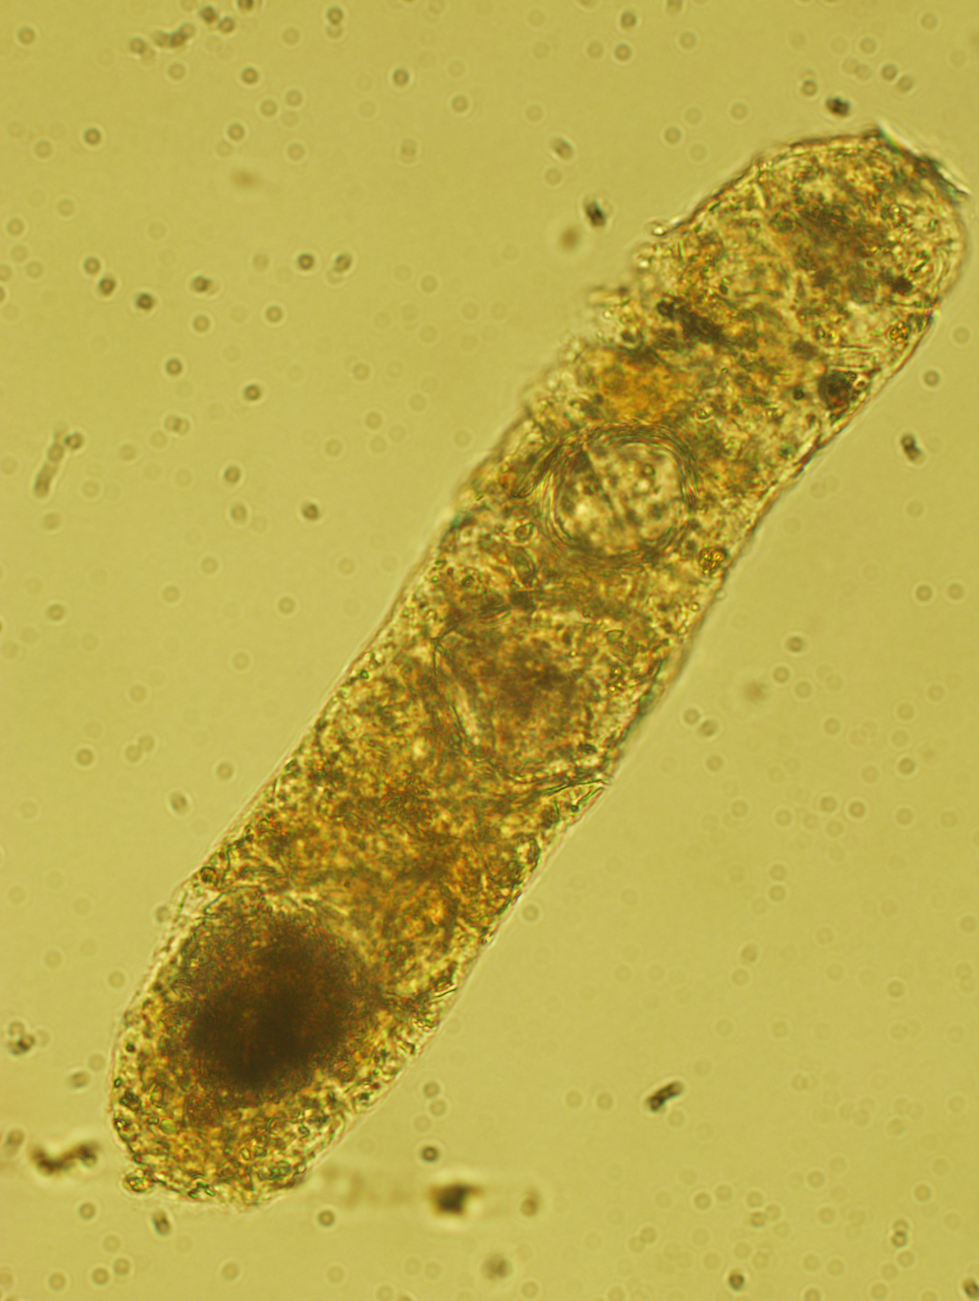
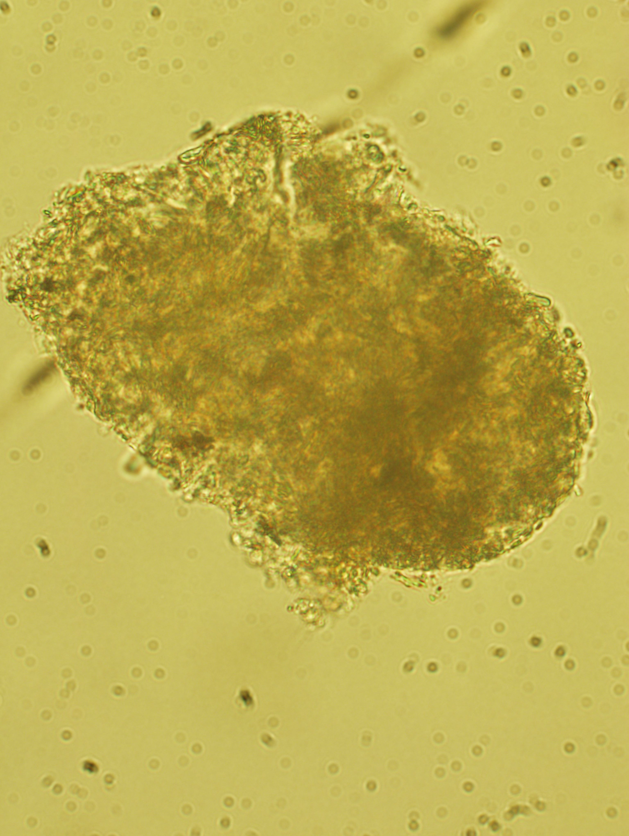
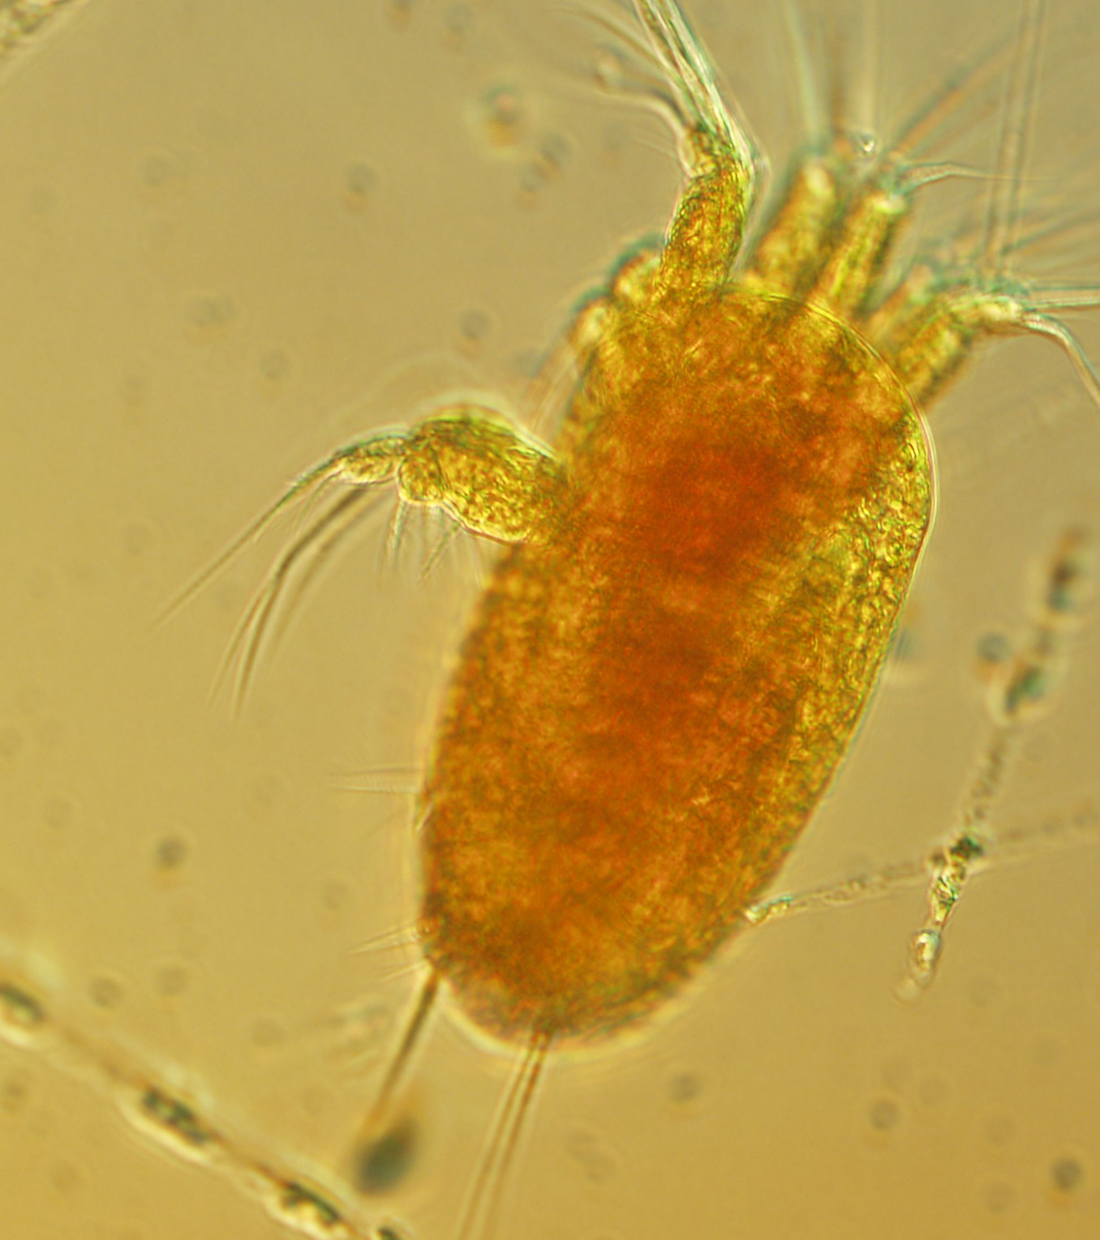
Temporal variability in domoic acid and Pseudo-nitzschia spp.
7/30-7/31
8/5/2012
P. sp. GOM
P. sp. GOM
and
P. pungens
P. sp. GOM,
P. pungens, P. cuspidata, Frag. 157
P. sp. GOM, P. pungens, P. cuspidata, P. seriata, P. pseudodelicatissima, P. americana
 | Won-squeak | Corea | Won-squeak | Corea
DA in Mytilus edulis | 5.77 ppm | 1.28 ppm | 0.22 ppm | 0.06 ppm
DA in Mya arenaria | 5.68 ppm | 3.16 ppm | 0.31 ppm | 0.05 ppm
P-n. abundance (cells L⁻¹) | 3.5 x 10⁵ | 1.2 x 10⁶ | 4.5 x 10⁴ | 4.0 x 10⁴
pDA (ng L⁻¹) | 234 | 846 | 49.6 | 15.2
cellular pDA (pg cell⁻¹) | 0.77 | 0.70 | 1.10 | 0.4
Wonsqueak H.
Lugol’s preserved material
Notes:
Pic of tioga
p. Seriata at depth as well…

Slide 24
Data provided by ME DMR
>5000 Pseudo-nitzschia cells per liter
+ Jellet ASP test
- Jellet ASP test
1000-5000 Pseudo-nitzschia cells per liter
<1000Pseudo-nitzschia cells per liter
April/May
August
WGOM
EGOM
WGOM
EGOM
June
September
July
October
1.2 million cells L⁻¹
350,000 cells L⁻¹
Notes:
Purple is below 1000
Orange is 1000-5000

Slide 25
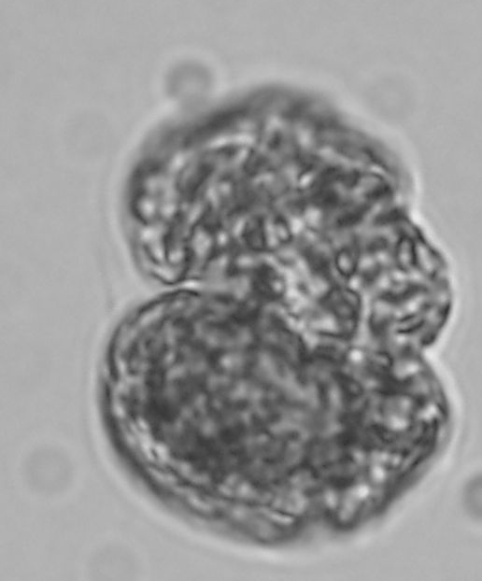
Cell abundance, DA, and species composition are clearly variable across space and time…
Best predictors of DA, toxic blooms, and toxic Pseudo-nitzschia species?
At present, there are more than 40 Pseudo-nitzschia species
  Region-specific challenges for monitoring Pseudo-nitzschia species, especially as ID tools may need to be reevaluated
Best management and monitoring strategies, given different bloom scenarios:
  frequent occurrence of Pn. and low DA
  sporadic events with high DA (GOM?)
  Long bloom season of Pseudo-nitzschia (April-November)
  Coexistence of Pseudo-nitzschia and other HABs
Enhanced education and awareness is key!
    Pseudo-nitzschia identification training sessions for ME phytoplankton volunteer monitoring program (Spring 2013)
    Pilot time series study during 2013 bloom season
      Archived DNA and DA samples archived by phytoplankton monitors
      Comparison of different enumeration strategies
“KLP”

Slide 26
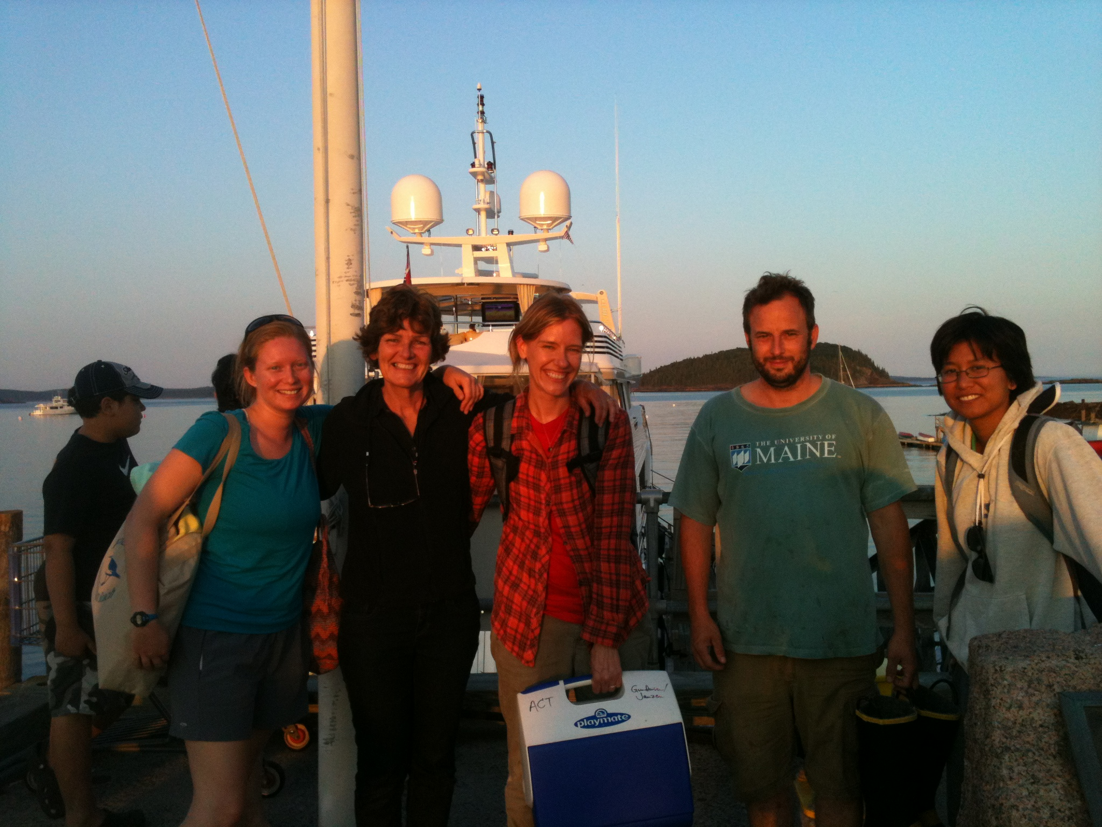





NOAA CSCOR Event Response Funding

