Slide 1
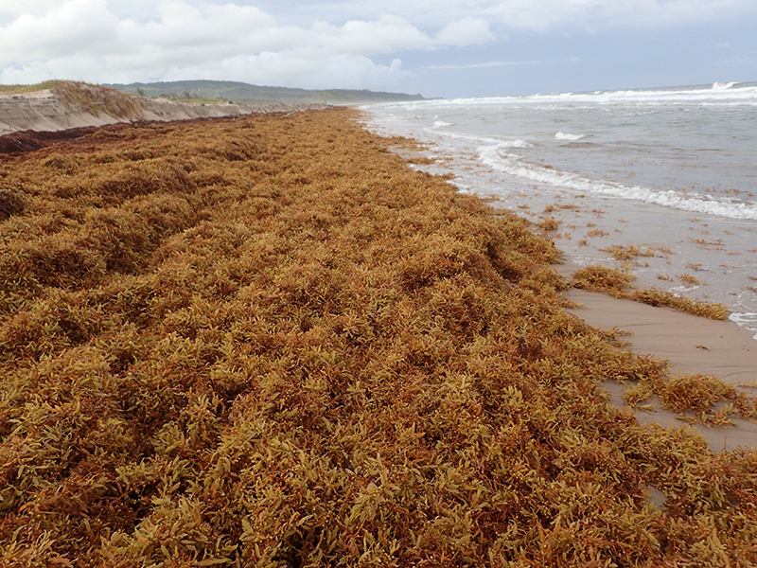
Accumulations of Sargassum in the Caribbean and West Africa since 2011 - An introduction
Peter Kershaw
Independent marine scientist
Member of GESAMP*
peter@pjkershaw.com
www.gesamp.org
© Hazel Oxenford
*GESAMP – Joint Group of Experts on Scientific Aspects of Marine Environmental Protection
- an inter-agency body of the UN, established in 1969
East coast Barbados, September 2014

Slide 2
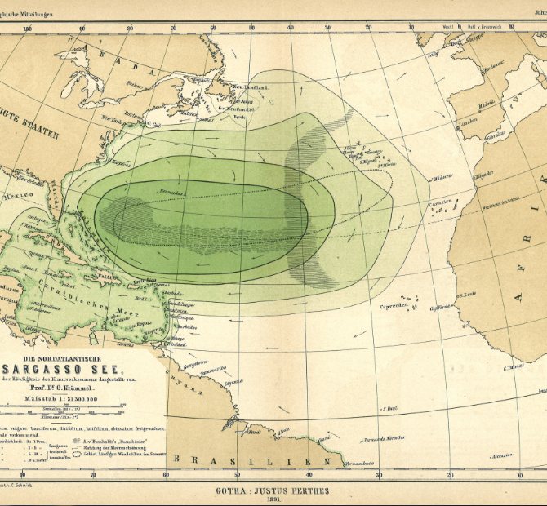
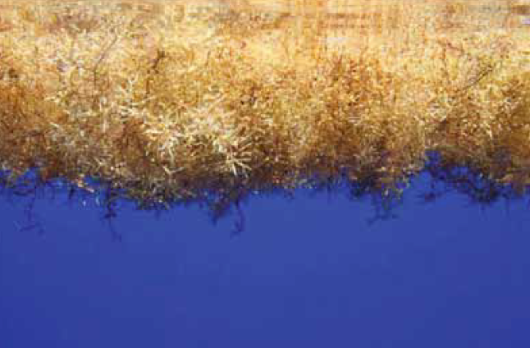
The Sargasso Sea:
‘the golden floating rainforest of the Atlantic Ocean’
Internationally-recognised importance
Essential habitat
Biodiversity ‘hotspot’
Sargasso Sea Commission
www.sargassoseacommission.org
Taken from: The Protection and Management of the Sargasso Sea, Laffoley et al. 2011
© P. Rouja

Slide 3
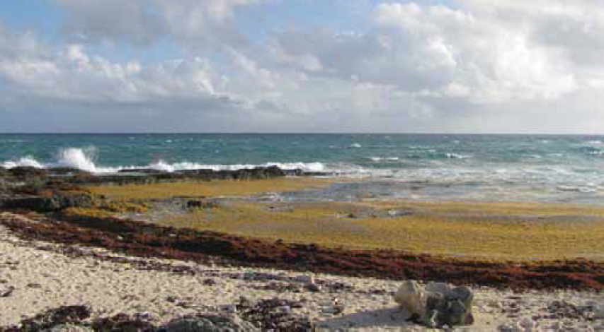
Perceived benefits of Sargassum accumulation
Coastal waters and on shorelines in Bermuda – pre-2011
Food source for fish e.g. sunken Sargassum important food for Bream
Food source for intertidal invertebrates and shorebirds
Source of nutrients to coastal soils
Stabilisation of shoreline by cementing sand grains – dune formation
Source of fertiliser for local farmers
Perceived problems:
‘Decomposing Sargassum on the
beach smells and in some people’s view creates a nuisance …’
Taken from: The Protection and Management of the Sargasso Sea, Laffoley et al. 2011
© S.R.Smith

Slide 4
Impacts of widespread, excessive accumulations of Sargassum from 2011 onwards
Socio-economic impacts:
Fisheries - shoreline & nearshore - limit access to fishery, navigation hazard, kills/limits target species
Tourism
Human health – e.g. respiratory illness due to decomposition and release of ammonia and hydrogen sulphide
Environmental impacts:
Oxygen depletion & eutrophication
Biodiversity loss, including vulnerable species, e.g. nesting turtles (smothering sites, barrier to hatchlings)
Habitat damage during clearing operations – loss of sand leading to beach instability

Slide 5
Accumulations of Sargassum– a basin-wide phenomenon
Images from presentation by Hazel Oxenford & James Franks – CC4FISH Project

Slide 6
Potential benefits of Sargassum accumulations
Utilisation:
Soil conditioner/fertiliser*
Animal feed
Energy extraction
To optimises use/mitigate impacts:
Predictable timing, location and quantity
Reliable supply
Non-damaging and cost-effective interception & harvesting mechanisms
* May have limited use due to relatively high levels of arsenic – further research needed

Slide 7
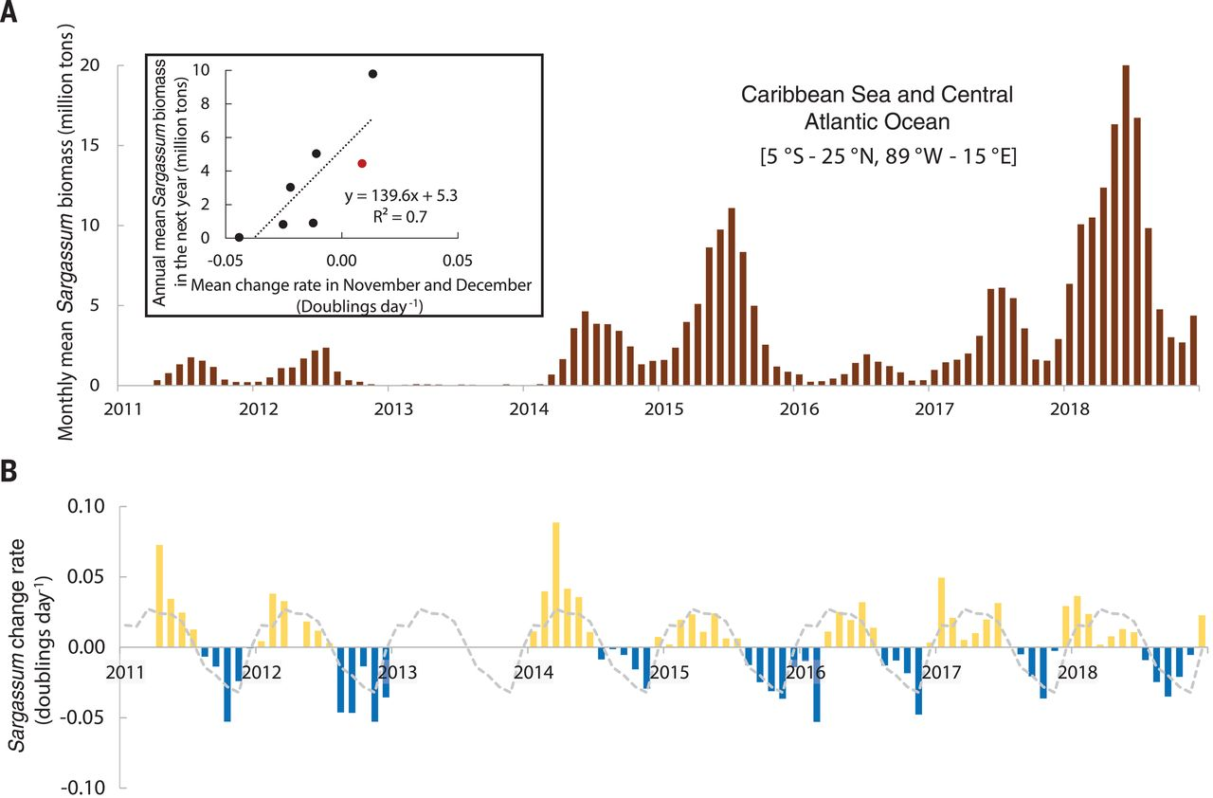
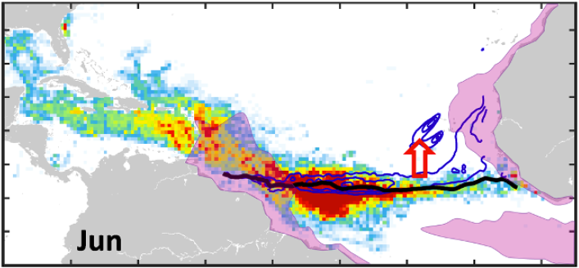
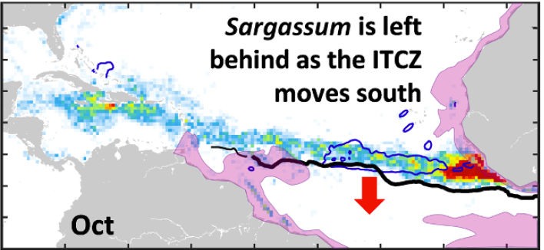
Variability in monthly Sargassum biomass
Seasonal & inter-annual
Extracted from: Wang et al. 2019, Science 236:83-87*
Geographical
Average Sargassum density (2010 – 2018) – taken from Johns et al. 2020 (Creative Commons)
* Copyright © 2019 The Authors, some rights reserved; exclusive licensee American Association for the Advancement of Science. No claim to original U.S. Government Works
ITCZ – Inter-Tropical Convergence Zone

Slide 8
Potential contributory factors to Sargassum inundations
Variability in ocean circulation and ocean climate:
Upwelling off West Africa and eastern boundary currents
Position & intensity of currents in western central Atlantic
Outflow of the Amazon and extent of the Amazon plume
Potential trigger for 2011 event – transport of Sargassum to Eastern Atlantic due to extreme negative North Atlantic Oscillation (NAO) in 2009-2010 (Johns et al. 2020, Prog. Oceanog. 182 102269)
Variability in external nutrient inputs:
Riverine nutrient inputs, especially Amazon and Congo, linked to land-use changes (deforestation & agriculture) (Wang et al. 2019, Science 365, 83-87)
Local inputs from wastewater and fertiliser use
Atmospheric inputs – e.g. Saharan dust?

Slide 9
GESAMP
The Joint Group of Experts on the Scientific Aspects of Marine Environmental Protection
Purpose: ‘to provide authoritative, independent, interdisciplinary scientific advice to organizations and governments to support the protection and sustainable use of the marine environment.’
Scoping paper, April 2017:
‘Causes and impacts of massive accumulations of the brown macro-algae Sargassum in the nearshore environment of the Caribbean and West Africa’
Limited review of knowledge
Identified relevant research groups, organisations & initiatives
New GESAMP Task Team created September 2019

Slide 10
GESAMP Task Team on Sargassum
Purpose:
Jointly organise an Open Science Meeting (OSM) on Sargassum with SCOR-IOC GlobalHAB – timing and mechanisms to be confirmed
Provide an update of the situation – underlying science
Bring together the interests of all relevant GESAMP sponsoring agencies:
UN Environment – GPA land-based sources of nutrients, Regional Seas
IOC - UNESCO – oceanography, harmful algal blooms
FAO - fisheries
UNDP – Amazon Basin – nutrient management; WMO – atmospheric inputs; and IAEA – use of tracers
Outputs of OSM:
Discussion ‘White’ paper, peer-reviewed publications, meeting report
Recommendations to GESAMP on options for coordination & assessment
Membership:
Discipline/expertise, geography & gender – expressions of interest?

Slide 11
Thank you!
Peter Kershaw
peter@pjkershaw.com
www.gesamp.org
© Hazel Oxenford

