Slide 1
The Cartagena Convention
Wider Caribbean Regional Reflections
SPAW Protocol and Sargassum
Ileana C Lopez
UNEP SPAW PO
Sandrine Pivard
SPAW RAC Director
26 May 2020

Slide 2
Summary
Caribbean
Caribbean Environment Programme Actions
Cascade of events
Cartagena and Abidjan Conventions
Current Situation and
Potential causes of the outbreak
International Framework
Urgent call for Coordination
Facts & numbers
Recommendations

Slide 3
Cartagena Convention
1974
1983
1990
Specially Protected Areas and Wildlife Protocol adopted
UNEP launched the Regional Seas Programmes, one of its most significant achievements in the past four decades
Countries of the Region adopted the Cartagena Convention on 24 March
2000
Entered into force
1981
1986
UNEP established the Caribbean Environment Programme (CEP) as one of its Regional Seas Programmes
The Caribbean Regional Co-ordinating Unit (CAR/RCU) was established in Kingston, Jamaica. It is the Secretariat for the Cartagena Convention and the CEP
Notes:
The Convention for the Protection and Development of the Marine Environment in the Wider Caribbean Region (WCR) or Cartagena Convention is a regional legal agreement for the protection of the Caribbean Sea.
The Convention was adopted in Cartagena, Colombia on 24 March 1983 and entered into force on 11 October 1986.
The Convention is supported by three technical agreements or Protocols on Oil Spills, Specially Protected Areas and Wildlife (SPAW) and Land Based Sources of Marine Pollution (LBS).
The Protocol Concerning Co-operation in Combating Oil Spills in the Wider Caribbean Region was adopted in 1983 and entered into force on 11 October 1986.
The Protocol Concerning Specially Protected Areas and Wildlife (SPAW) in the Wider Caribbean Region was adopted on 18 January 1990 and entered into force on 18 June 2000.
The Protocol Concerning Pollution from Land-Based Sources and Activities was adopted on 6 October 1999 and entered into force on 13 August 2010.
The Regional Coordinating Unit (UNEP-CAR/RCU) was established in 1986 in Kingston, Jamaica and is the Secretariat to the Cartagena Convention and its Protocols.

Slide 4
Facts & numbers
2018
$ 120 Million
The estimated US dollar clean-up cost for Sargassum across the Caribbean:
MEXICO
Many other areas of the Caribbean have witnessed similar declines
During the first semester
has witnessed a large decline in tourism
with a
35% DROP
.
Notes:
Source: Arellano, S. Sargazo provoca baja de 35% de turismo: alcaldesa electa en QRoo. Milenio, August 3rd 2018.
Accessed September 20th, 2018. Available at: http://www.milenio.com/estados/sargazo-provoca-baja-35-turismo-alcaldesa-electa-qroo

Slide 5
Facts & numbers
2018
It was another record-breaking year: the total amount of seaweed reached approximately
6000 km²
and a weight of
20 million tons
in the month of June.
Which would make necessary 30,000 of the world’s biggest trucks to completely remove it
As large as 4 times the island of GUADELOUPE
Notes:
2018 was another record-breaking year when the total amount of seaweed reached approximately 6000 km2 (Source: Pfaff, M. (2015) Key scientific questions addressing environmental drivers and effects of periodic mass deposits of a brown seaweed (golden tides) along the Sierra Leone coast. Draft report for Oceans and Coastal Research, Directorate: Biodiversity and Coastal Research) with a weight of approximately 20 million tons in the month of June (Source: Wang, M., Hu, C., Barnes, B. B., Mitchum, G., Lapointe, B., & Montoya, J. P. (2019). The great Atlantic Sargassum belt. Science, 365(6448), 83-87.). The mass landings – in mounds up to two meters thick in some places – caused dreadful beaching events throughout the Wider Caribbean Region (WCR).

Slide 6
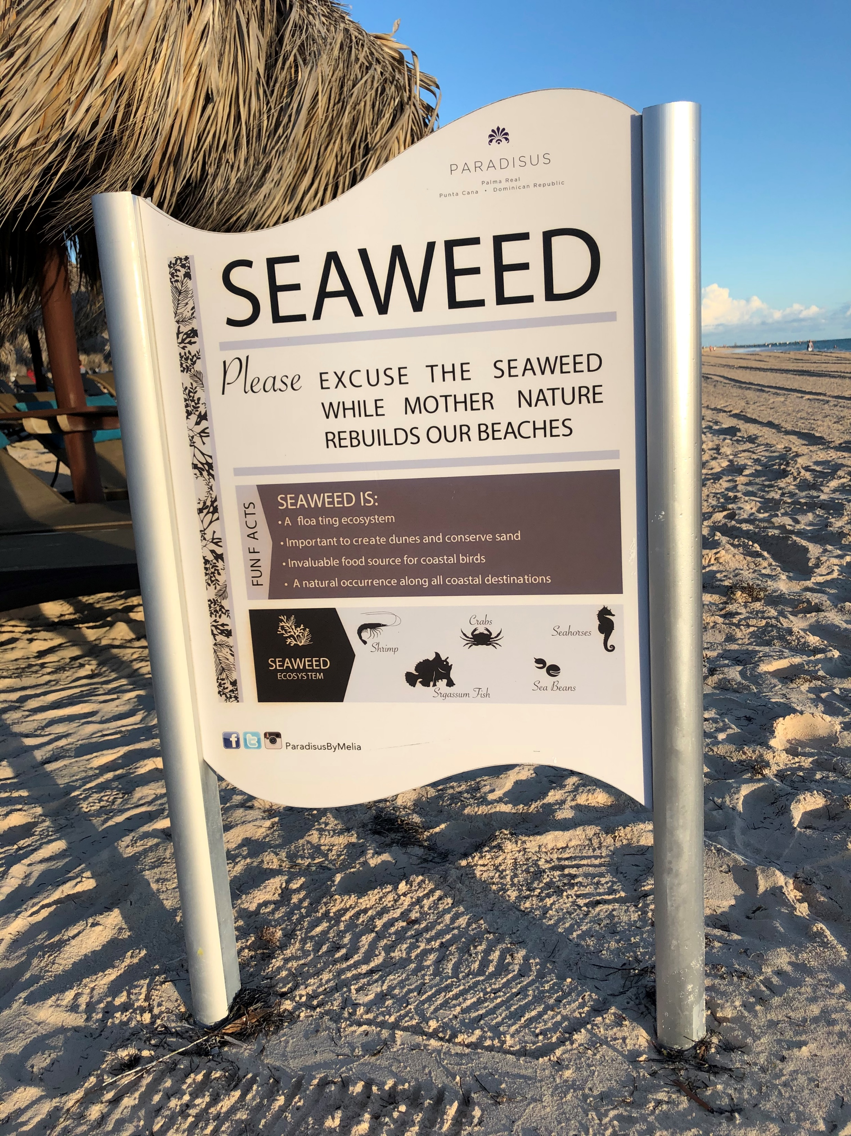
Facts & numbers
2018
$150,000
2019
The cost of keeping one beach resort clean in Grand Cayman:
Mexico has spent
$ 17 million
to remove Sargassum from over 1,000 km (621 miles) of Mexican beaches through 2019
From May to August 2019,
69,606 tonnes of Sargassum
were collected and 13,527 people were employed to clean up beaches.

Slide 7
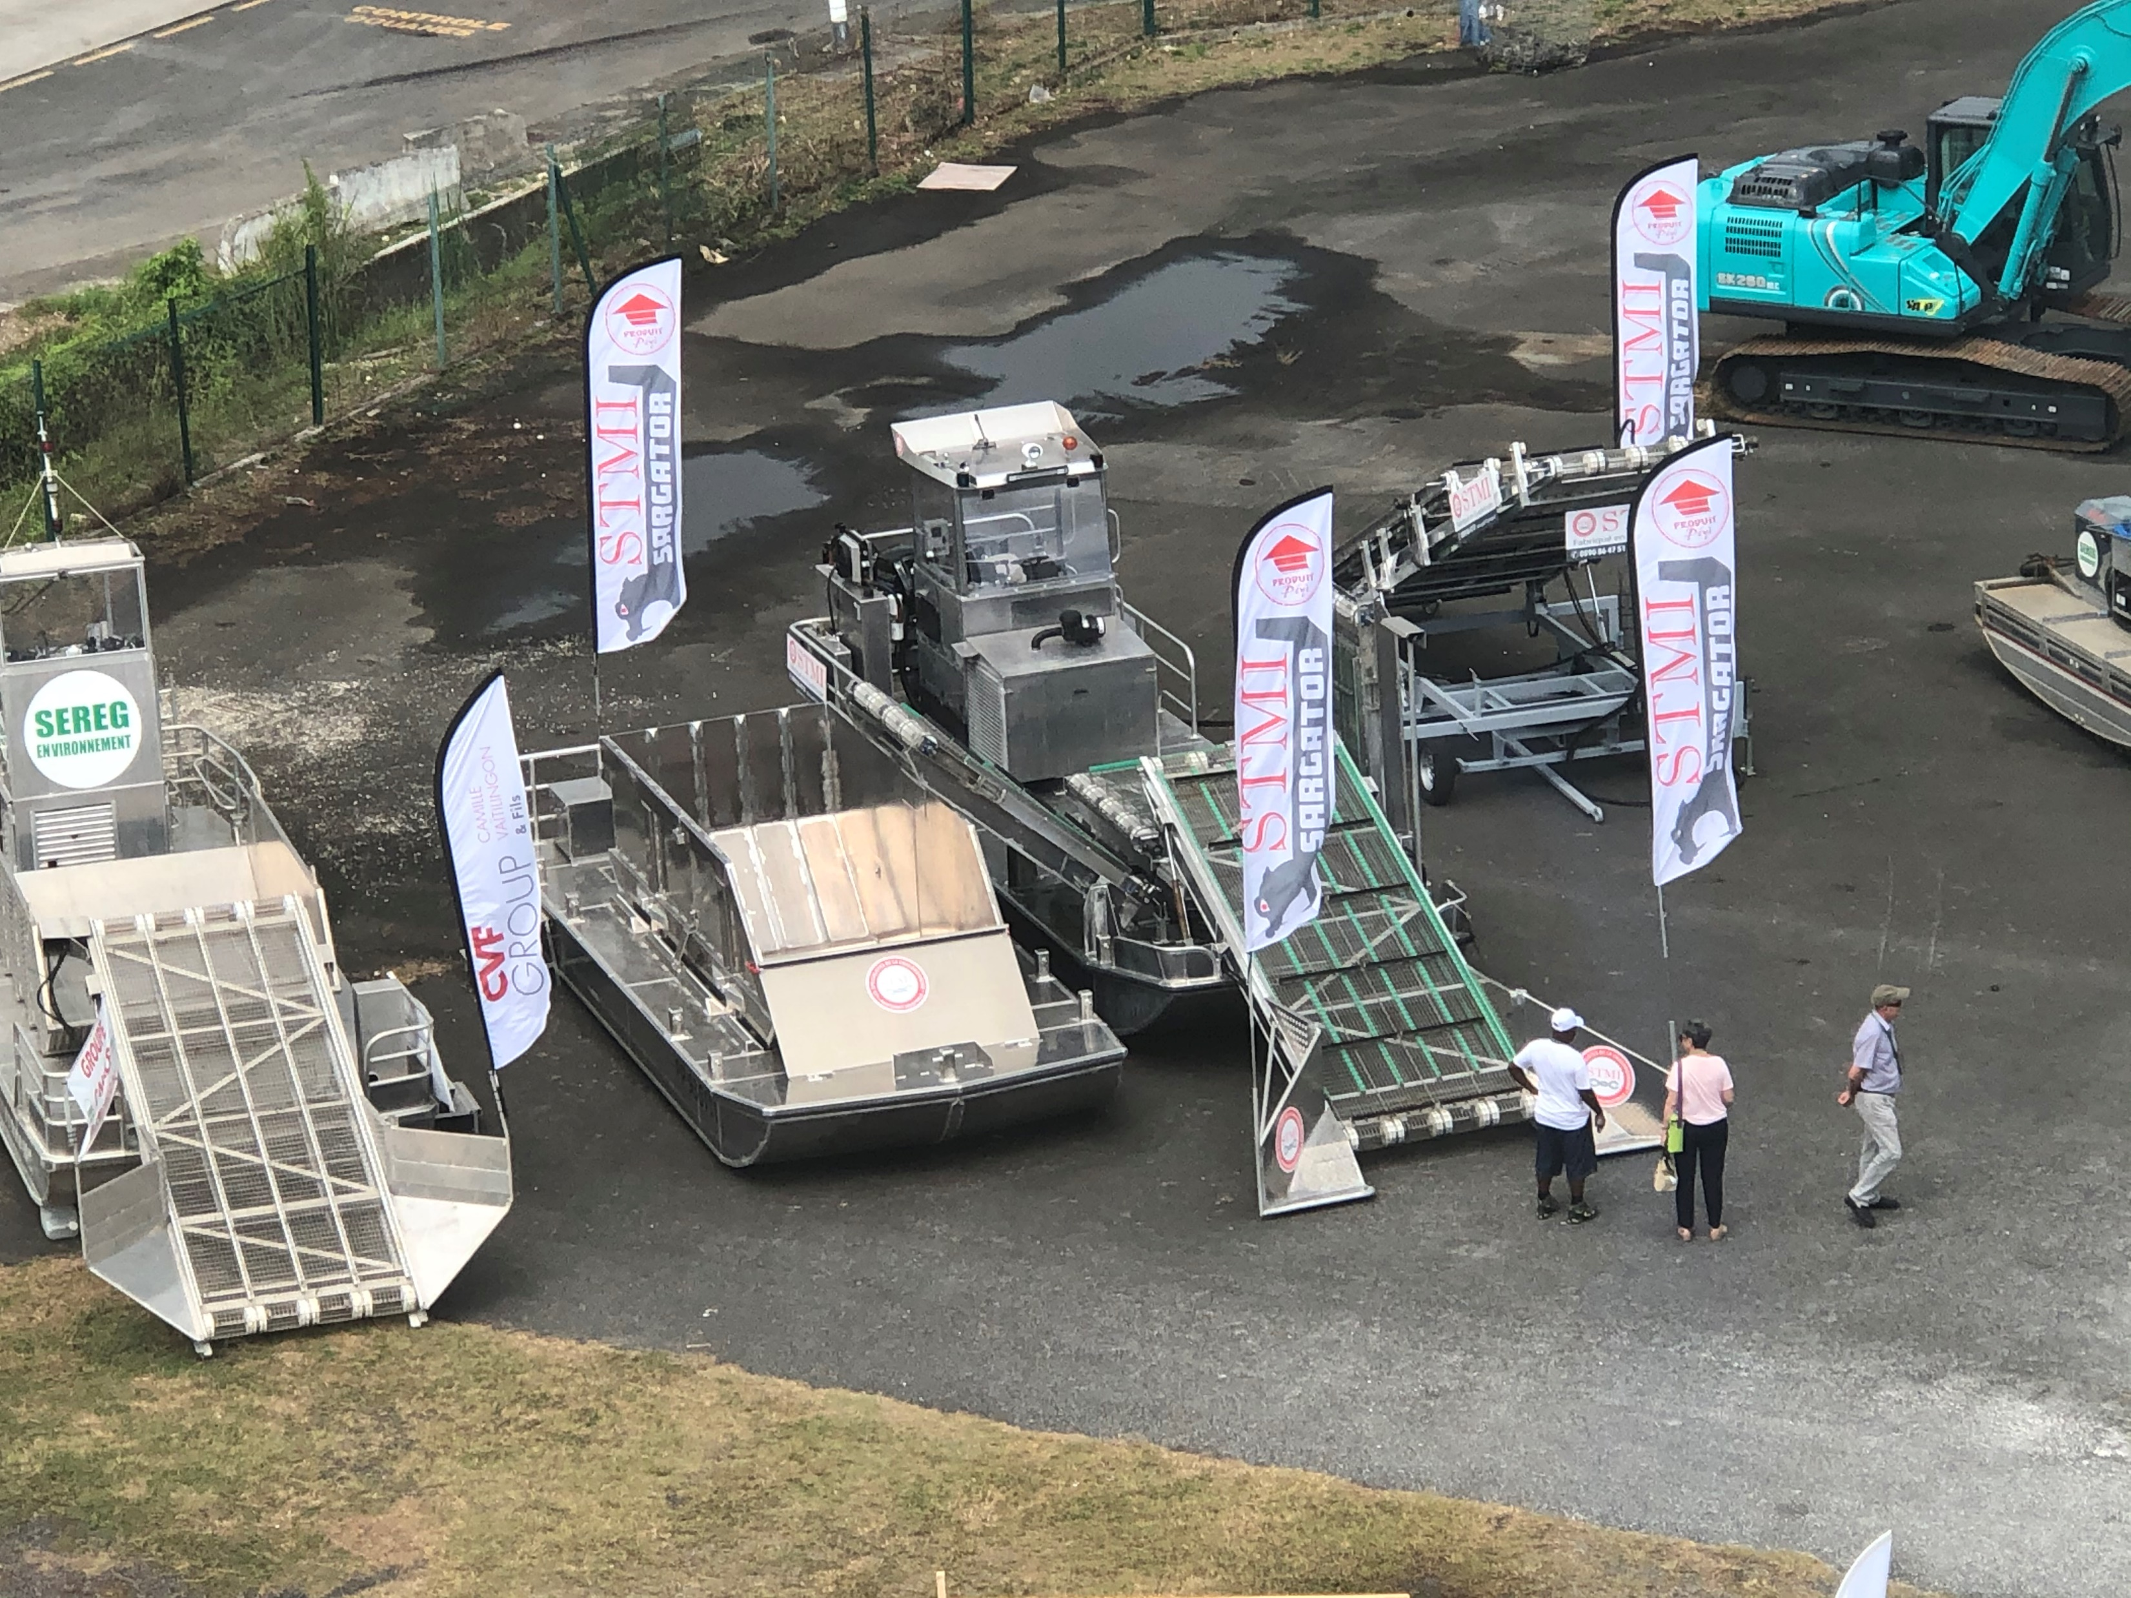
Facts: Clean up Beaches Methodologies
Different methodologies and equipment to remove sargassum in the region:
2019

Slide 8
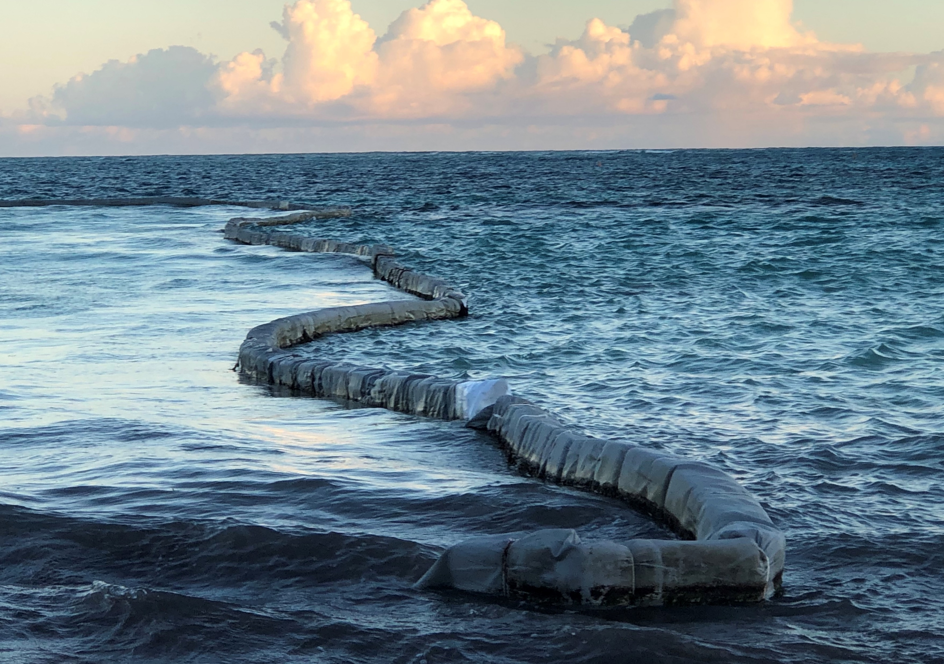
Barrier to stop sargassum
Some Uses
Different types of :
2019

Slide 10
Cascade of events
2-4 May 2018
Workshop: Sargassum and oil spills monitoring pilot project for the Caribbean and adjacent regions
Montserrat, 10-11 July 2018
The 5th Meeting of the Organization of Eastern Caribbean States (OECS) Council of Ministers: Environmental Sustainability (COMES-5). The theme: “Building Resilience on the Frontline of Climate Change”.
Mexico, June 2019
High-level International Meeting on Sargassum in the Wider Caribbean held in Quintana Roo
Guadeloupe, 23-26 Oct 2019
Sargassum
Conference and Expo focusing on Sargassum management solutions and technologies
Jamaica, NOV 2019
The International Atomic Energy Agency (IAEA) Technical Meeting on Sargassum

Slide 11
Recommendations
Consideration/recommendation for Member States and partners to present a
draft Resolution on Sargassum Challenges and Opportunities
at the 5th Session of the UN Environment Assembly (UNEA-5) scheduled to take place during the last week of February 2021, in Nairobi, Kenya for deliberation.
This Decade will provide a common framework to ensure that ocean science can fully support countries’ actions to sustainably manage the Oceans and more particularly to achieve the 2030 Agenda for Sustainable Development.
Urgent call for Interregional Collaboration & Coordination

Slide 12
SPAW RAC and
Caribbean Environment Programme Actions
A priority in the work of the Specially Protected Areas and Wildlife (SPAW) Protocol:
MoUs
Sargasso Sea Commission (2017) CRFM (2018)
SPAW-RAC interactive platform of exchanges
Partnerships with University of South Florida and Texas A&M
Disseminate information
Factsheets
Posters
Greater collaboration with LBS Protocol
Representation Global/Regional Meetings
Workshops

Slide 13
SPAW RAC AND CEP
A priority in the work of the Specially Protected Areas and Wildlife (SPAW) Protocol:
Sargassum
Ad-Hoc
Working
Group
SPAW RAC
International
Sargassum
Network
(Florida International University)
CEP – RAC Sargassum
White
Paper
Regional Intergovernmental resolutions endorsed by countries
Resource mobilization
New Funding/Projects

Slide 14
Urgent call for Coordination
Strengthen
and
at global and regional levels
amongst
is essential to optimize resources
and avoid duplicity of efforts.
COLLABORATION
COORDINATION
ALL RELEVANT
STAKEHOLDERS

Slide 15
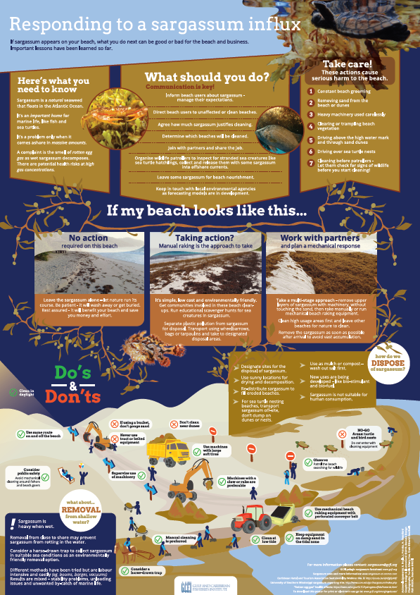
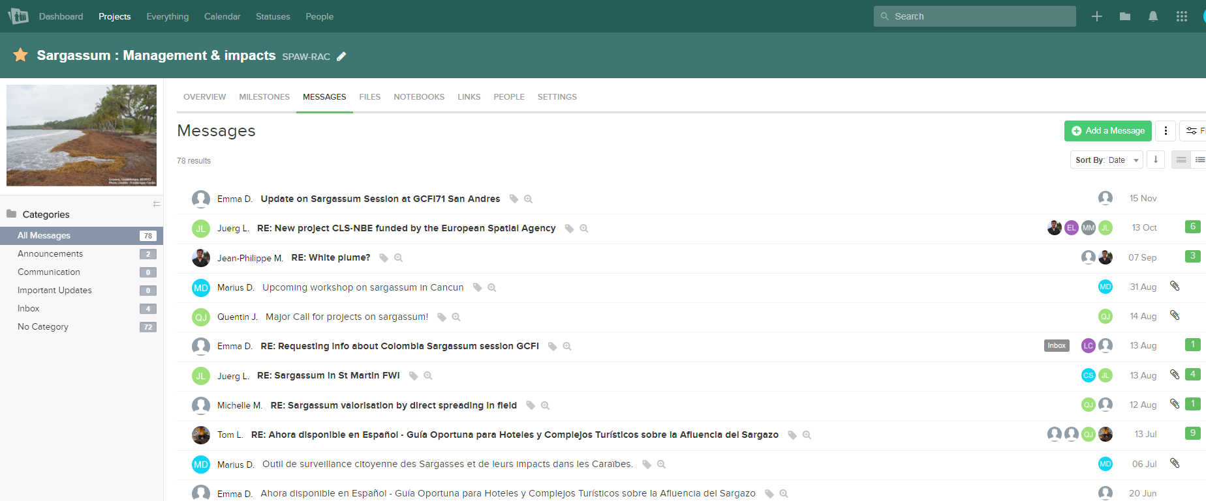
A few actions from SPAW
- Networking of stakeholders involved in communication/awareness, research and management of the influx
- Funding and broadcasting communication tools
- Fund raising (project proposal drafted upon request by the Irish Government)
a dedicated teamwork platform
• Sargassum influx, Sargassum detection and prediction, management technics, best practices, impacts on biodiversity…
• Shared files: posters, reports, white paper…
• about 300 participants from nearly 200 different organizations
Forum address: https://spawrac.teamwork.com
- Subscribe at: sargassum.forum@gmail.com

Slide 16
A dedicated Sargassum Working Group
Creation of an Ad Hoc Working Group on Sargassum to establish coordination and collaboration with relevant regional and global initiatives
SPAW Workplan: “Support protected areas and species management, also considering the context of the Sargassum influx as appropriate” “Sharing general data across the region and research on Sargassum”
STAC8 : “cooperate with relevant partners to assess and merge information and best practices on managing the Sargassum influx impacting Caribbean countries” (i.e. MoC concluded with the SSC)
COP10 : “coordinate with LBS, liaise with the Atomic Energy Commission and CARICOM building synergies with other national and regional groups or initiatives working on this issue that working in this area.”
-> Developing clear objectives and responsibilities
-> Coordinating and collaborating with relevant regional and global initiatives in order to promote maximum impact of synergies and solutions to the Sargassum influxes
-> Currently 12 members, a few more expected

Slide 17
Sargassum Ad hoc Working Group
Next steps :
→ Review the various UNEP CEP/ RAC productions (White Paper on Sargassum, concept note …)
→ Review external reports (eg from the International Atomic Energy Agency workshop with Caribbean SIDS) to find linkages for further collaboration
→ Find synergies with the Caribbean Sargassum Programme (SARG'COOP Interreg Project) to implement actions and make recommendations to contracting parties
→ Sub-regional assessments and recommendations since the impacts are very different in term of frequency and intensity from a territory to another (Lesser Antilles, Greater Antilles, Mesoamerican Region, Guiana Shield)?
→ Explore funding opportunities for Contracting Parties (Ex: Ireland’s new SIDS Partnership strategy) to improve research and responses on the ground.
→ Contact people and organizations to collect further documents and add more experts to the group (See list of contacts and initiatives to reach out to)
-> Any suggestions?

Slide 18
Cartagena Convention Secretariat
Thank you
Merci Beaucoup
Gracias
Ileana Catalina Lopez
UNEP
SPAW Programme Officer
Sandrine Pivard
SPAW RAC
Director

