Slide 1
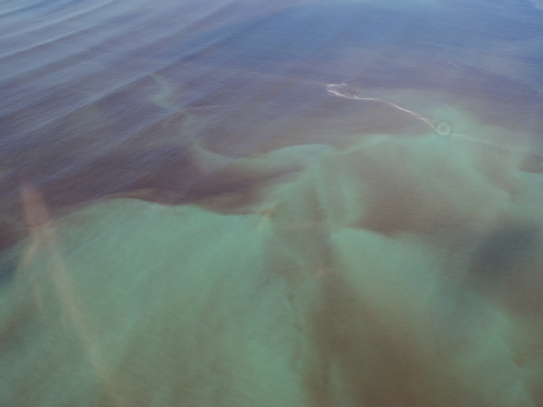
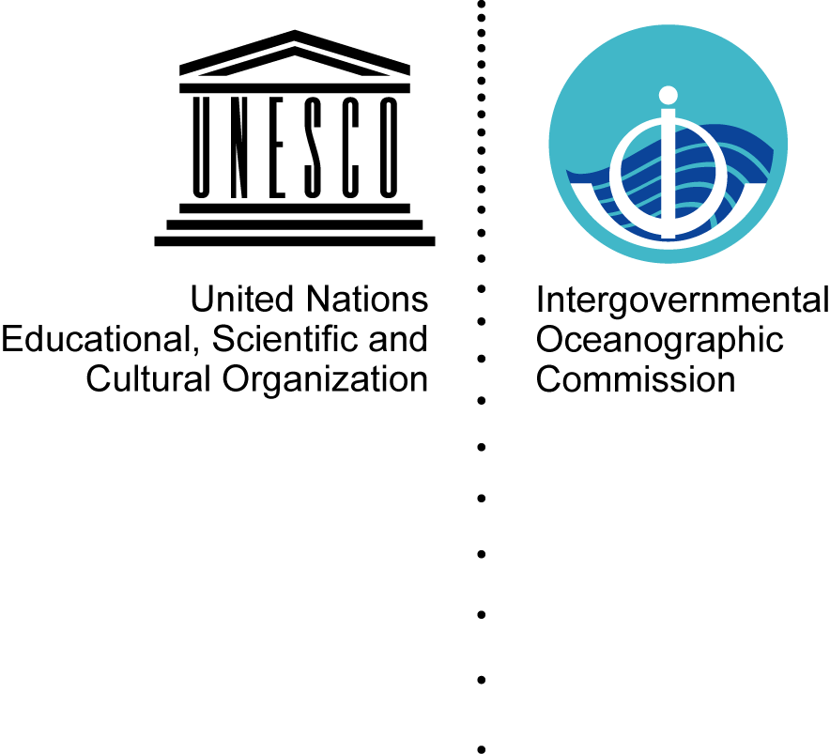


Research Update on Harmful Algal Blooms
Elisa Berdalet, GlobalHAB SSC Chair
and the GlobalHAB subcommittee on Sargassum
Sargassum in the Caribbean and West Africa:
Key Challenges, Responses and Collaboration
UNEP GPNM GESAMP – Webinar - 26 May 2020
Notes:
Thanks to SCOR and IOC for support

Slide 2
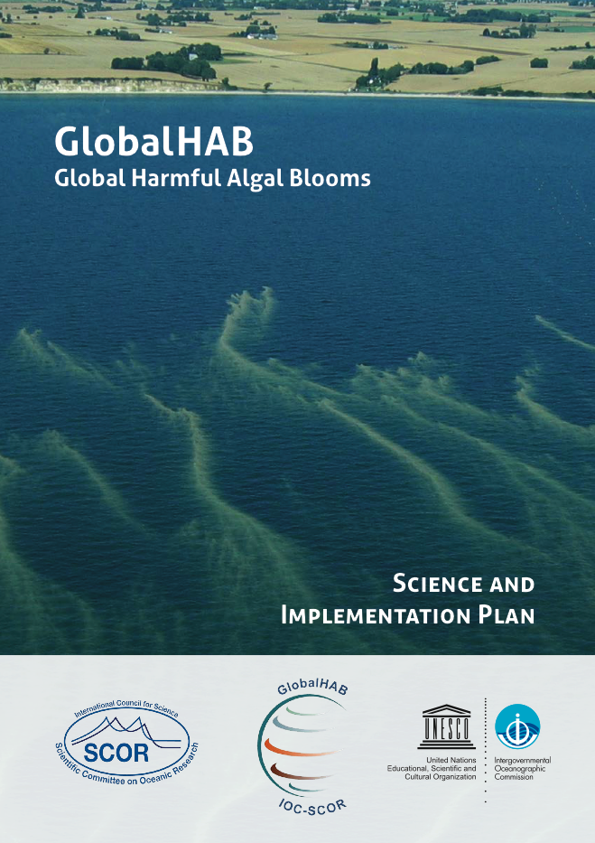
GlobalHAB: 2016-2025 program
The overall Goal of GlobalHAB is to improve:
understanding and prediction of HABs in aquatic ecosystems, and
management and mitigation of their impacts.
The Mission of GlobalHAB includes:
• Foster international coordination and co-operative research to address the scientific and societal challenges of HABs, including the environmental, human health and economic impacts, in a rapidly changing world.
• Serve as a liaison between the scientific community, stakeholders and policy makers, informing science-based decision-making.
http://www.globalhab.info
Notes:
A brief reminder of GlobalHAB overarching Goal and Mission.
The revised Science and Implementation Plan was finalized in November 2017, printed in December 2017.

Slide 3
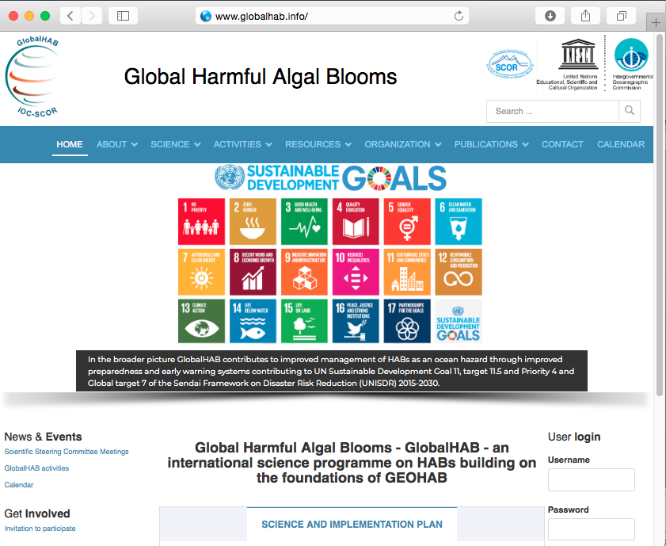
Notes:
Important to note the aim of GlobalHAB to contribute to the UN SDGs, not only to some of them.
Home page of the GlobalHAB website. This image illustrates in particular that, in the broader picture, GlobalHAB contributes to improved management of HABs as an ocean hazard through improved preparedness and early warning systems thus contributing to UN Sustainable Development Goal 11, target 11.5 and Priority 4 and to Global target 7 of the Sendai Framework on Disaster Risk Reduction (UNISDR) 2015-2020.

Slide 4
The GlobalHAB Science Plan:
- initially structured on 12 Themes
- multidisciplinary, from small scale to planetary scale
- including ecology and society
"Sargassum blooms": a new topic integrating the overall GlobalHAB perspective
Sargassum
Notes:
The Themes integrated in GlobalHAB range from small-scale (e.g., cellular) subjects (e.g., biodiversity, adaptive strategies) to studies at ecosystem scale and climate change-related processes. GlobalHAB’s perspective is multidisciplinary, integrating physics, chemistry and biology, and addressing the impacts of HABs on the environment and human societies (including Health, Economy and Socio-cultural aspects). Improved observation within and across the different themes should result in better predictions of HAB events and contribute to the management of their impacts. Terms shown in italics (i.e., Planktonic, Ecology, Socio-culture) are not established as individual GlobalHAB themes, but are intrinsically integrated in HAB research.

Slide 5
Open Science Meeting on Sargassum
Overall objective: To identify research priorities to understand Sargassum growth dynamics and to develop adequate forecasting and warning systems to allow long term preventive measures for Sargassum beaching
GlobalHAB organization subcommittee:
* Brigitta van Tussenbroek, UNAM, Mexico, vantuss@cmarl.unam.mx
* Brian Lapointe, Harbor Branch Oceanographic Institute, Fl, US, blapoin1@fau.edu
* Ester Serro, University of Algarve, Portugal, eserrao@ualg.pt
* José E. Martinelli Filho, Federal University of Parà, Brazil, martinelli@ufpa.br
* Hoang C. Tin, University of Sciences, Hue City, Vietnam, hoangcongtin@gmail.com
* Elisa Berdalet, GlobalHAB SSC Chair, ICM-CSIC, Spain, berdalet@icm.csic.es
* Henrik Enevoldsen, IOC representative, h.enevoldsen@bio.ku.dk
Jointly with GESAMP (Peter Kershaw, peter@pjkershaw.com)
and EuroSea (Caroline Cusack, Caroline.Cusack@Marine.ie)

Slide 6
Open Science Meeting on Sargassum - Content
A) State-of-the-art of the Sargassum beaching in NW Africa,
the Caribbean Sea and Asia, dynamics, trends, forcings, ...
B) Assess IMPACTS:
- in ecology: floating biodiversity islands supporting oceanic food webs, identify unbalances
- in economy: fisheries, tourism, local populations
C) Identify SOLUTIONS:
Biomass use, fertilizer? Prevent beachings and impacts?
D) Design MONITORING strategies:
Identify protocols and integrate data for Africa, the Caribbean Sea and Asia

Slide 7
Open Science Meeting on Sargassum
Structure:
A) Presentations
B) Discussion groups
Outcomes:
- Report, white paper
- Establishment of a GlobalHAB Subcommittee to define the Sargassum Science and Implementation Plan (as in www.globalhab.info)
- Identify international research coordination on Sargassum

Slide 8
Open Science Meeting on Sargassum - Logistics
Local host: UNAM, Universidad Autónoma Nacional de México
Local organizer: Dr. Brigitta van Tussenbroek (UNAM, vantuss@cmarl.unam.mx)
Locality: Cancún, Mexico
Hotel: Moon Palace (www.moonpalace.com)
Dates: To be decided (originally 16-18 November 2020)
GlobalHAB Contact: Elisa Berdalet (berdalet@icm.csic.es), Henrik Enevoldsen (h.enevoldsen@bio.ku.dk)

