Slide 1

Sargassum in West Africa
Key Challenges, Responses and Collaborations
by
Jacques ABE
jacques.abe@un.org

Slide 2
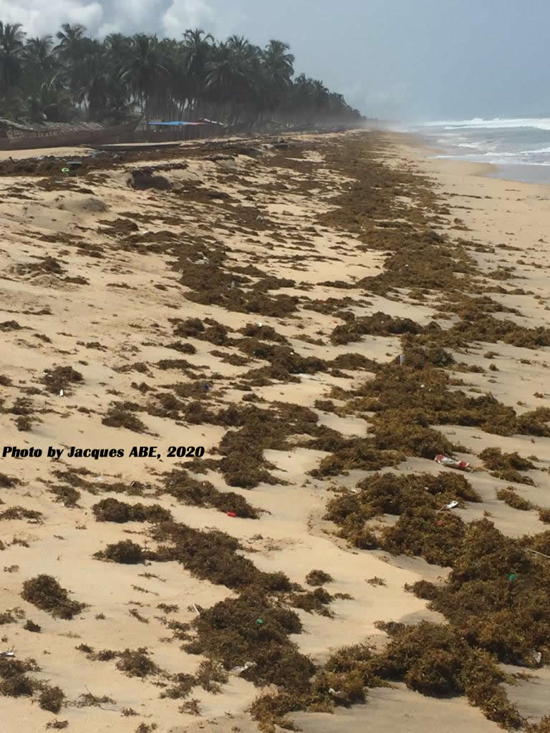
Sargassum in West Africa
Key Challenges, Responses and Collaborations
by
Jacques ABE
jacques.abe@un.org

Slide 3

What is Sargassum ?
Sargassum is free-floating brown seaweed that naturally blooms in the Sargasso Sea of the Northern Atlantic Ocean. Since 2011 there has been an unprecedented and quite steady influx of Sargassum landing on the shores of West Africa States,
This recurring phenomenon has drawn increasing interest from national and regional entities seeking an effective mechanism to manage this new regional environmental challenge.
Key Challenges

Slide 4
Where are they from ?
This is being attributed to factors including warming of the ocean due to global climate change, discharge of nutrients (nitrogen and phosphorus) from agricultural runoff and untreated wastewaters from major rivers (River Congo, and the Amazon River), and the deposition of iron and nutrient-rich dust from the Sahara into the ocean.
Key Challenges

Slide 5
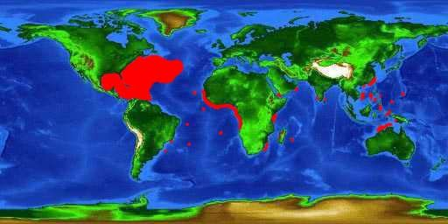
Sargassum distribution in the world
Key Challenges

Slide 6
Sargassum in West Africa
The two Sargassum species (Sargassum natans, Sargassum fluitans) had been identified in the west african coastal environment yearly between April and July during the wet season. They are alien to west africa ecology and have invasive tendencies.
Key Challenges
source: AlgaeBase

Slide 7
Invasive Sargassum Species Occurrence In West Africa
Countries | 2011 | 2012 | 2013 | 2014 | 2015 | 2016 | 2017 | 2018 | 2019 | 2020
Senegal
Sierra Leone
Guinea |  | March
Côte d’Ivoire |  | April -May | April -May | April -May | April -May | April -May | April -May | April -May | April -May | April -May
Ghana
Togo
Benin | May Pirata FR 21 | May Pirata FR 22 | May | May | May | May | May | May | May | May
Nigeria
Key Challenges

Slide 8
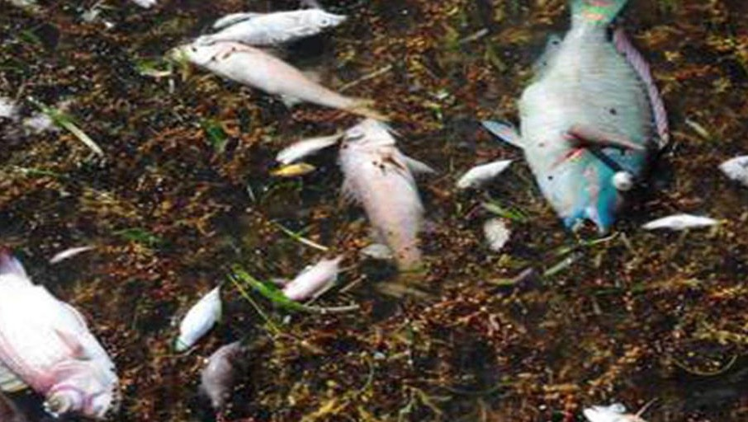
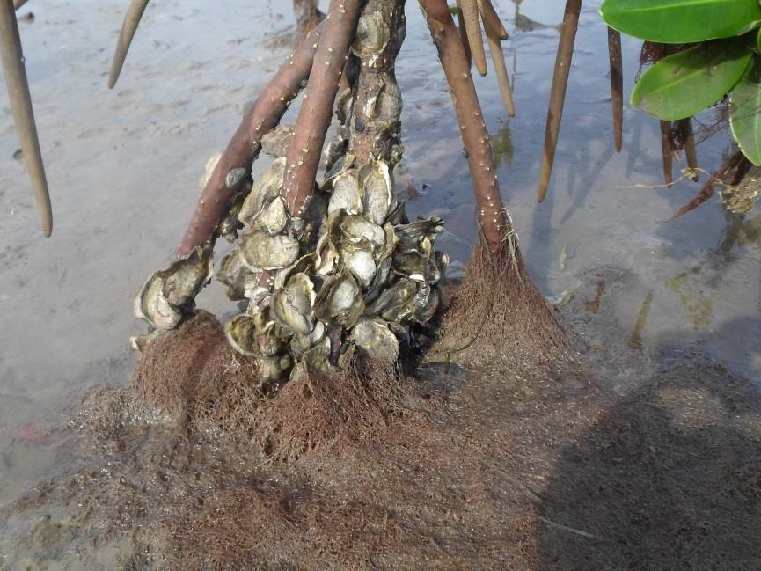
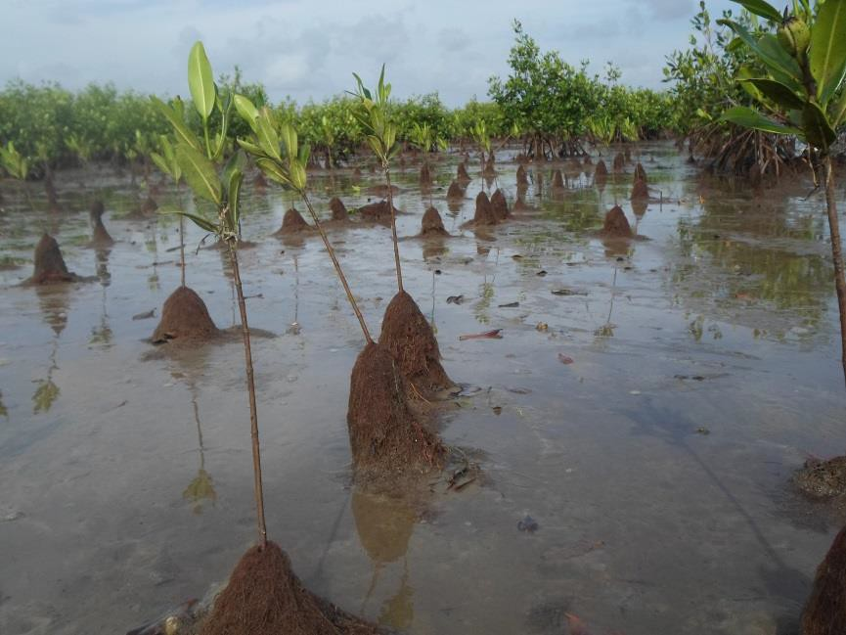
Ecological Impact
Large deposits can make it difficult for tiny sea turtle hatchlings to find their way to the ocean.
Key Challenges
Fish kills in areas where the decomposition process has depleted the oxygen supply causing fish to suffocate;
Significant quantities of dead oysters asphyxiated by the marine algas. Hectares of young mangrove seedlings (Rhizophora racemosa) invaded by Sargassums in Senegal

Slide 9
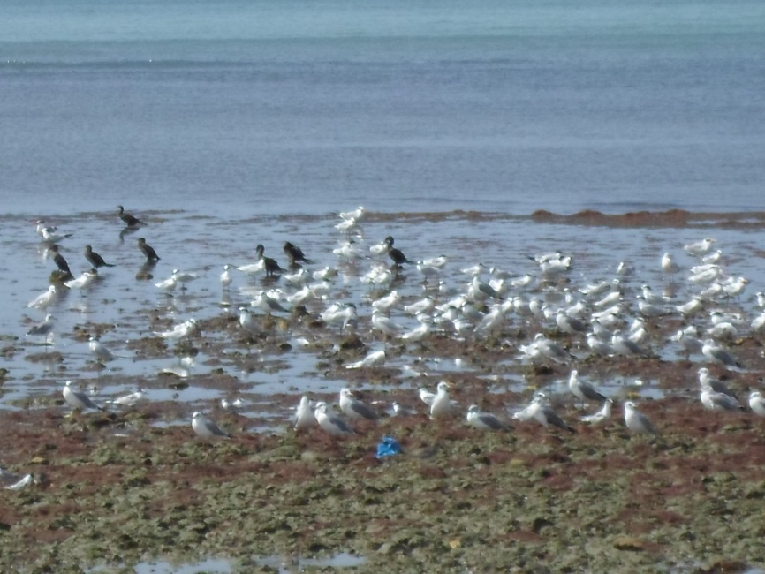
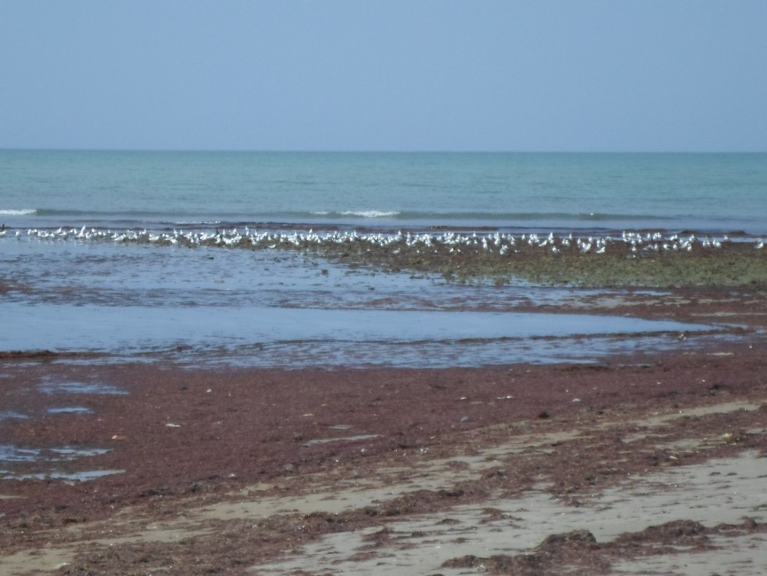
Ecological Impact
Key Challenges
Dead birds found sometimes in the invaded zones

Slide 10
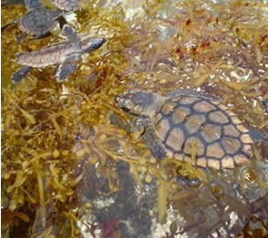
Ecological Impact
The seaweed has important beach building function by helping to secure sand in place, contributing to the structure and stability of sand dunes
Sargassum rafts are classified as “essential fish habitat” providing a home and food source for many fish and invertebrates species. Sargassum supports critical species such as sea turtles
Key Challenges

Slide 11
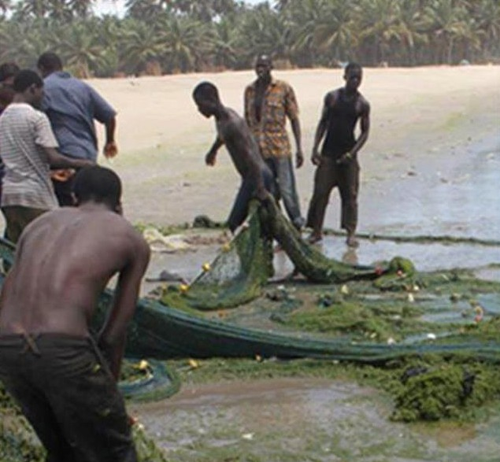
Socieconomic Impacts
Reduced fish catch and income because weeds are caught in the nets rather than fish
Entangled nets and propellers
Impeded movements of canoes resulting in longer travel time.
Longer nets mending time.
Longer time spent to sort fish catch from the weeds.
Reduced revenue along the value chain
Key Challenges

Slide 12
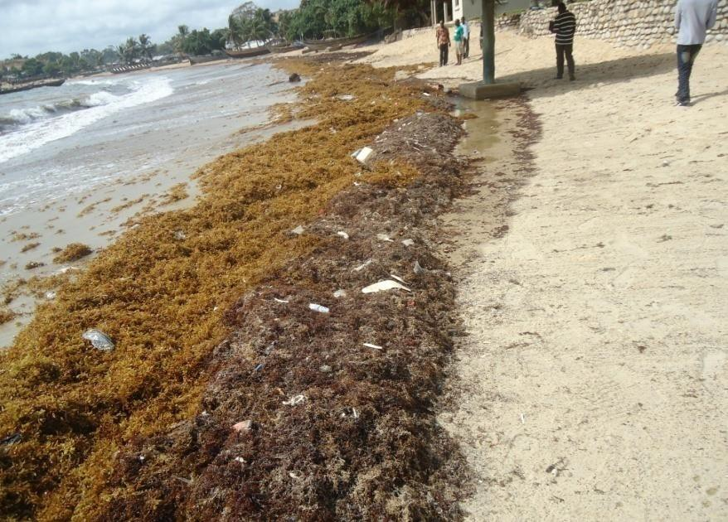
Impact on Tourism and Leisure
Reduced beaches’ aesthetics
Undesirable/unpleasant odour and heat emanating from the decaying weeds
Itching skin after swimming in infested water
Reduced number of tourists or travelers patronizing facilities
Key Challenges

Slide 13

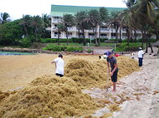
Local Management Actions
Several countries in West Africa have adopted seaweed cleanup policies to periodically remove invasive seaweeds from the beach, but funding remains a challenge
Institutional framework - District Assemblies, Municipalities or caretaking/environmental agencies are responsible for managing and protecting local environment in the region
These bodies Mobilize front line communities to clean up the beaches.
Responses &
Collaborations
Roland O. Ofori*, Mark D. Rouleau

Slide 14
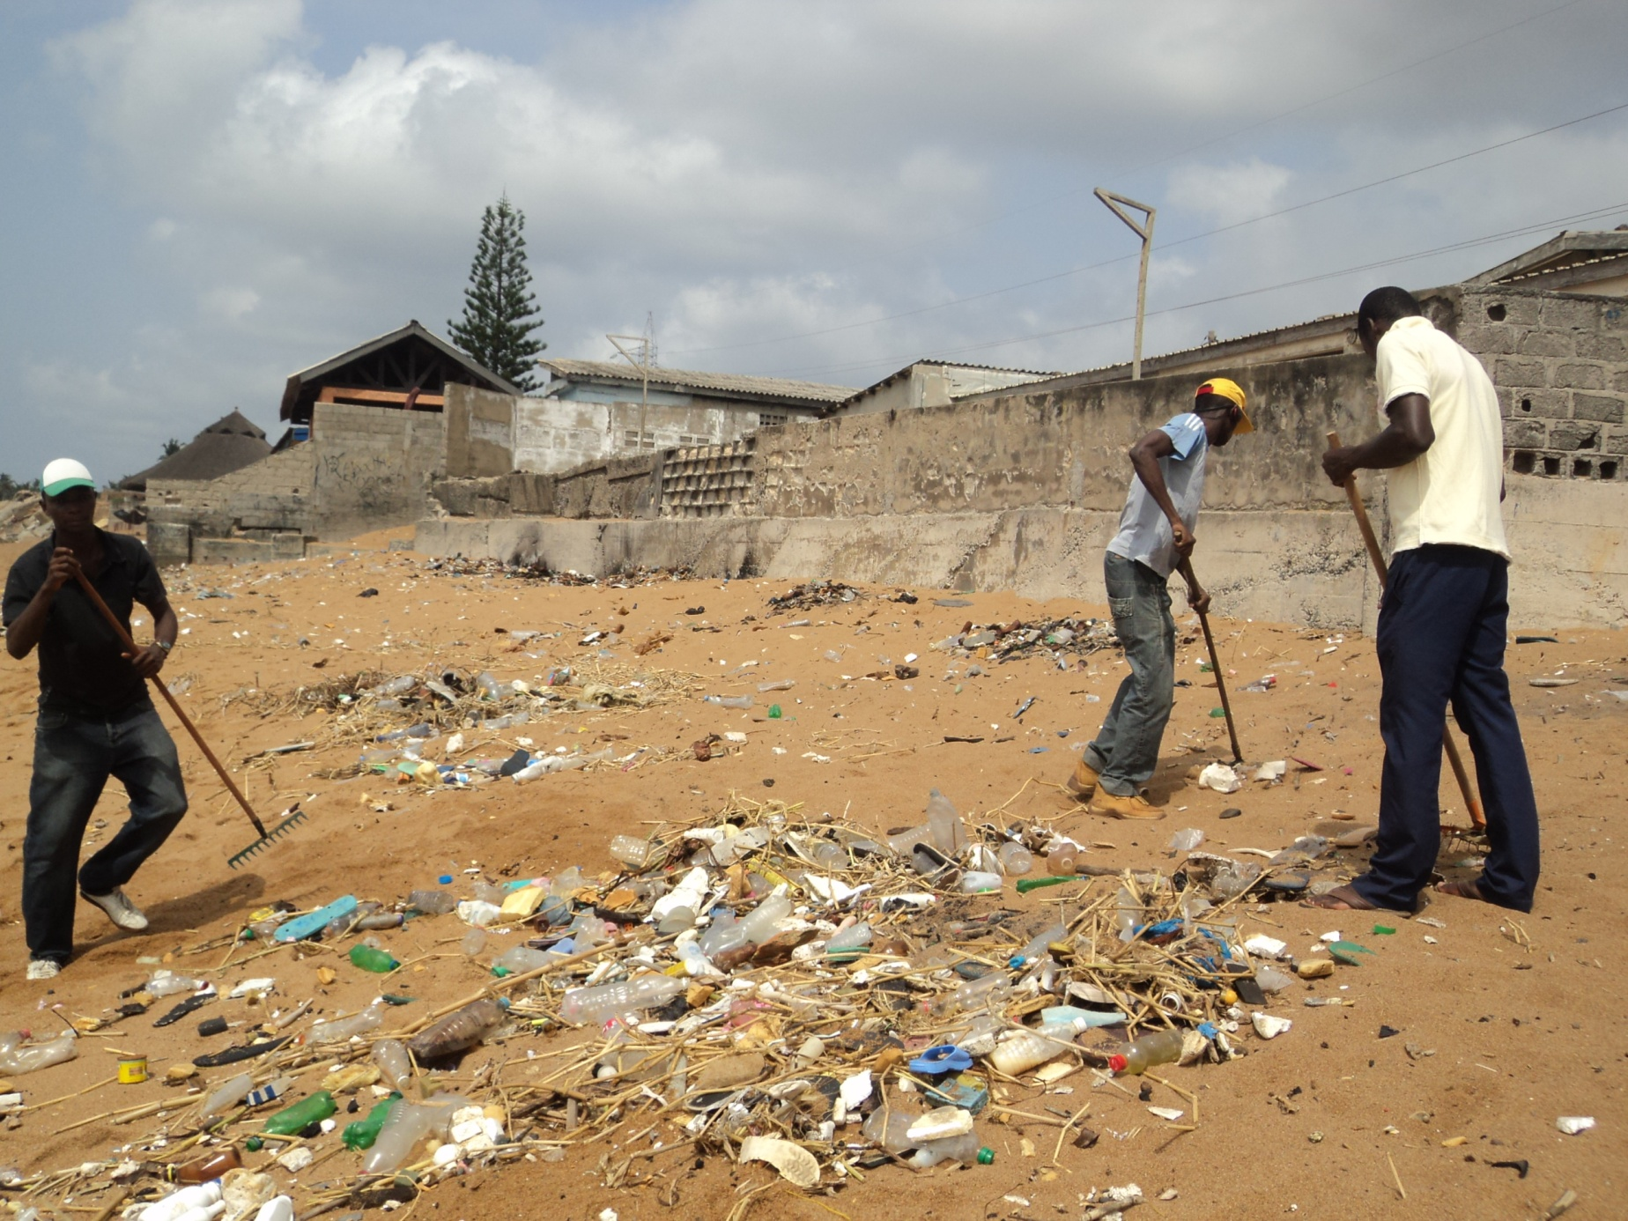
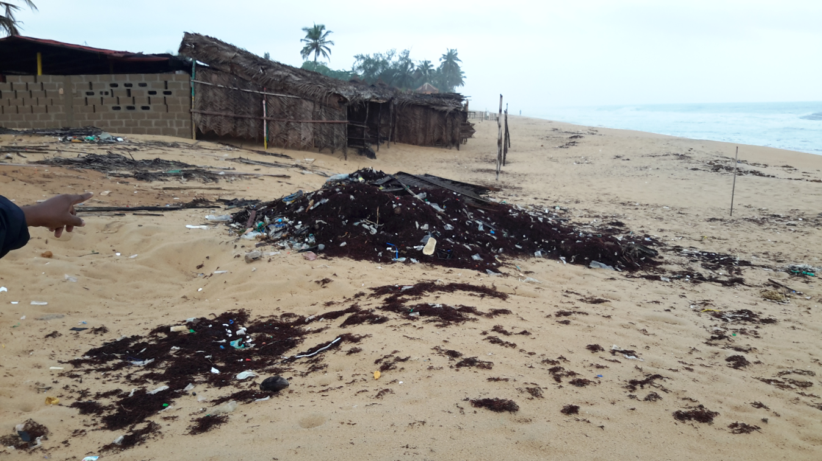
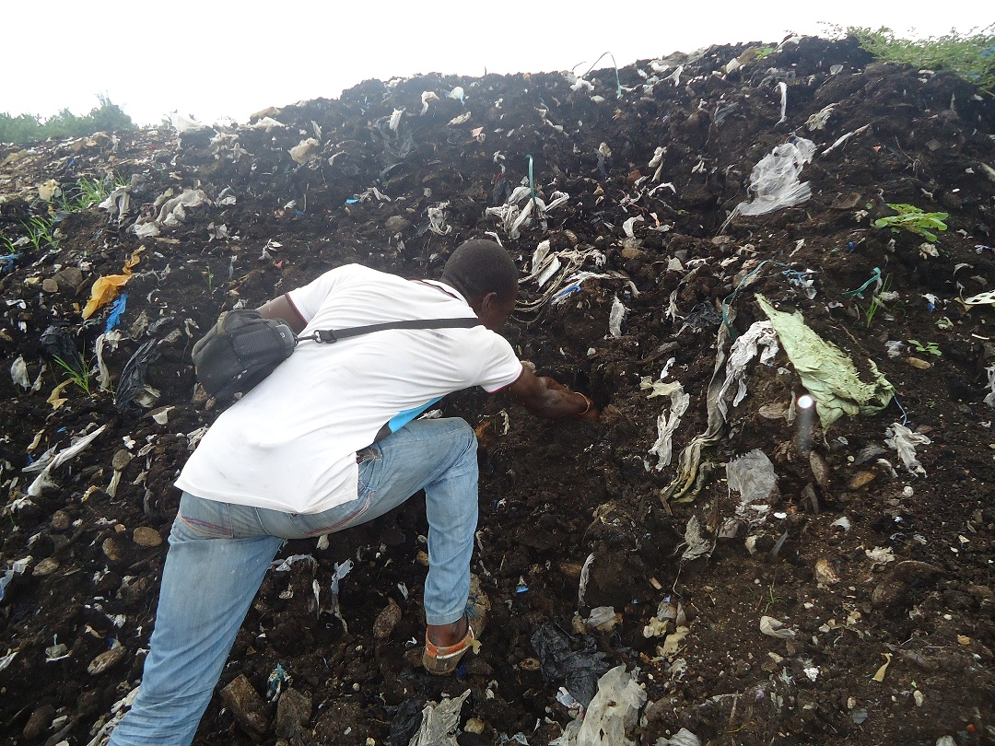
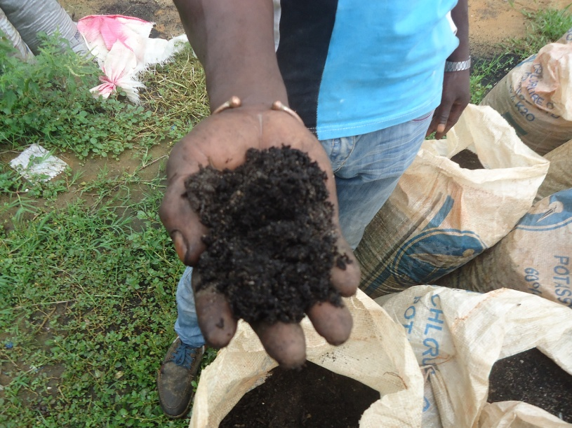
Local Management Actions
Emerging studies point that seaweed can also be used as
bio-fuel,
fertilizer,
livestock feed,
pharmacy
Responses &
Collaborations

Slide 15
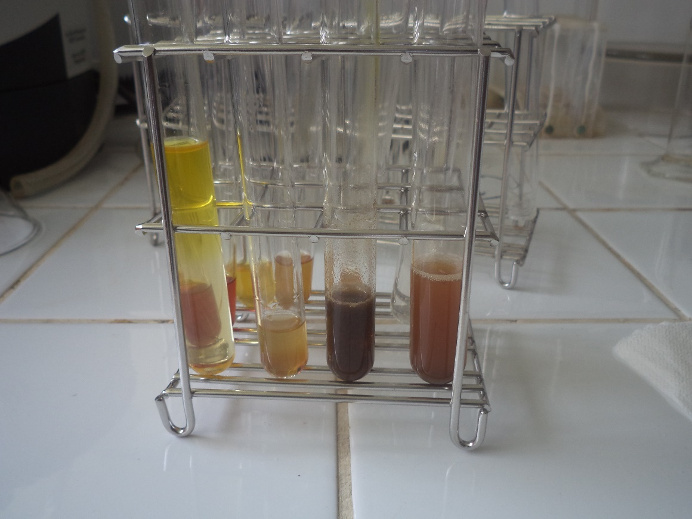
Chemical analysis
Elements | Concentration (dry maters)
Calcium | 30,28 %
Magnésium | 8,99 %
Potassium | 3,41 %
Fer | 0,97 %
Manganèse | 0,02 %
Iode | 73,2 ppm
Zinc | 88,4 ppm
Césium | 22,1 ppm
Protéines | 13,24 %
Azote | 2,12 %
Phosphore | 55,76 %
Responses &
Collaborations

Slide 16
West Africa Regional Actions
Local action alone may not address the problem
We have to seek regional collaboration to address the sargassum invasion
Responses &
Collaborations

Slide 17
West Africa Regional Actions
In response to this new transatlantic marine environmental challenge, UN Environment /Abidjan Convention Secretariat in partnership with USAID through the West Africa Biodiversity and Climate Change (WA BiCC) Program, and UNEP Global Program of Action for the Protection of the Marine Environment from Land-based Activities (GPA), have taken several actions since November 2015 in order to define a Regional Strategy and Action Plan on the management of Sargassum seaweed and Marine/Coastal Invasive Species
Responses &
Collaborations

Slide 18
West Africa Regional Actions
In Sept 2015, Marine Biologists & Oceanographers were identified in the region
In November 2015, First Regional Expert Group Meeting in Freetown - Sierra Leone, in November 2015 on Sargassum infestation in West Africa marine-biologists, oceanographers, environmentalists, and policy experts from affected countries within the region working on marine and coastal biodiversity management
Responses &
Collaborations

Slide 19
West Africa Regional Actions
In March 2016, Sargassum Regional Conference, British Virgin Islands
In May 2016, UNEA / SDGs the issue of sargassum in Caribbean and West Africa, was discussed in a side event to mobilize required resources for a regional program
Responses &
Collaborations
In August 2016, Second Regional Expert Group Meeting on Sargassum infestation in West Africa, Monrovia, Liberia

Slide 20
West Africa Regional Strategy
Early detection and rapid response
Control of IAS populations using regionally coordinated, effective methods
Research, monitoring and capacity building
Legislation, control and management
Collaboration
Education and awareness
Funding arrangement
Value-Addition/Alternative Use
Prevention
Pollution control
Responses &
Collaborations

Slide 21

THE WAY FORWARD
The campaign to dispel any notion of the Sargassum influx being nothing but a great plague should continue, because even if it is causing some important but temporary impacts and inconveniences that can be addressed and managed, the Sargassum also brings with it a number of important benefits that must be fully appreciated and accounted for in our response.
Investments in clean-up technologies and management systems
Investment in new business opportunities
A regional adaptive strategy would require greater understanding of the seasonal landing of seaweeds, including their growth dynamics, and their economic potential use.
This issue will be discussed at the COP13 of the Abidjan Convention to be held in March 2021 in Pointe noire, Republic of Congo.
Conclusion

Slide 22
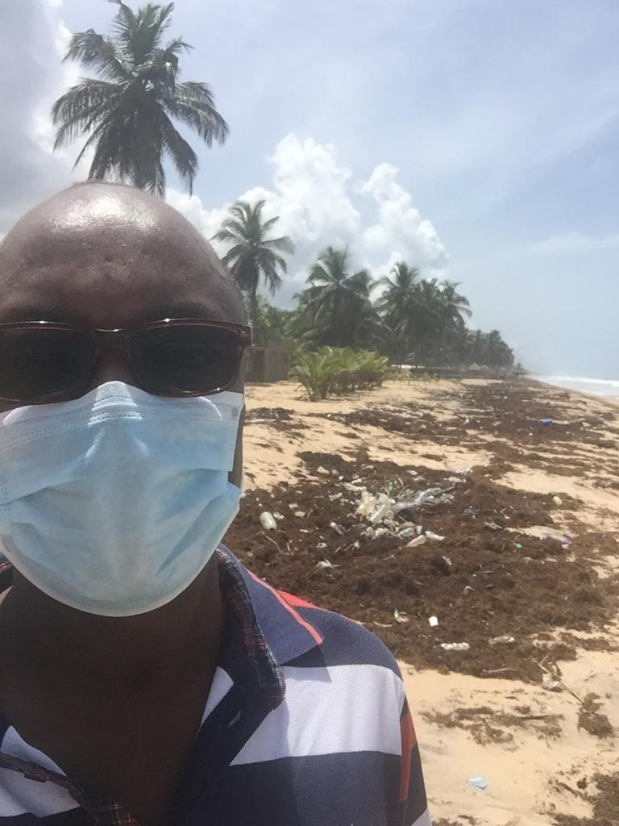
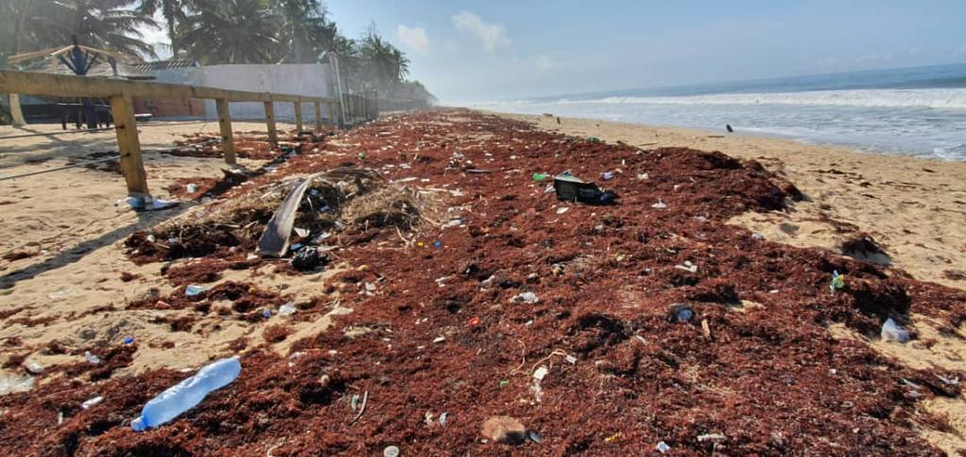
Thank you

