Slide 1
Recap and next steps
Suzi Clark’s thesis defense – any questions?
2. GRF Stability Lecture – any questions?
3. Today:
NPZ models, part 3 (DJM)
Advection diffusion reaction models

Slide 2
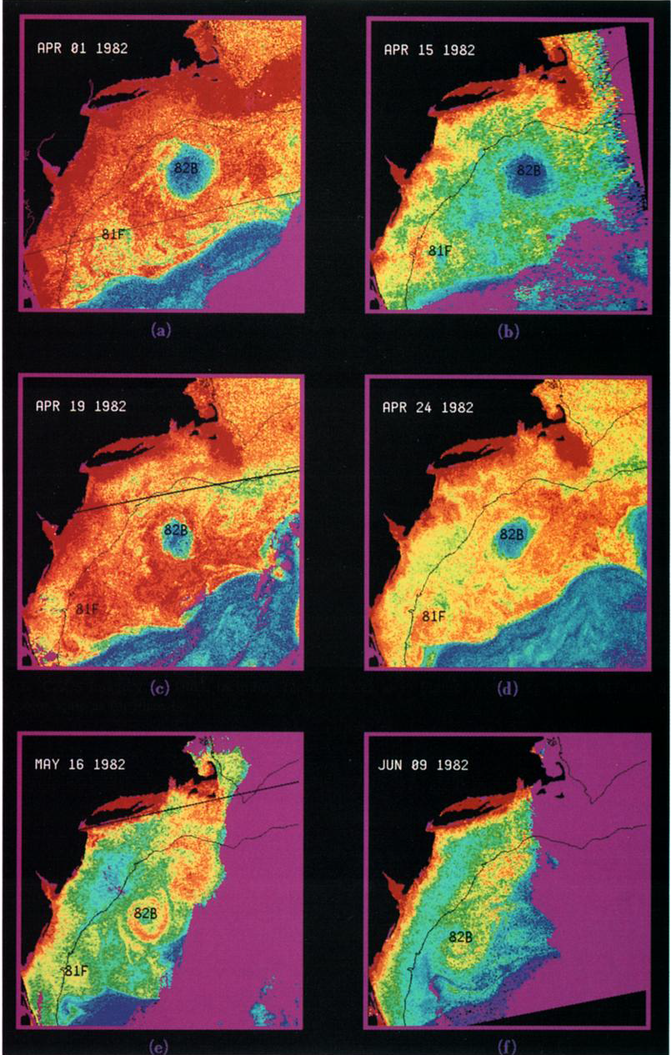
Chlorophyll time-series of WCR82B
April 1
April 15
April 19
April 24
May 16
June 9
Garcia-Moliner and Yoder, 1994
Notes:
Low biomass in otherwise high-chl water in the slope region
Evolution: spring bloom
mid-may transition: Chl increasing
Big surprise: why would relative low in chl biomass transition into relative high?

Slide 3
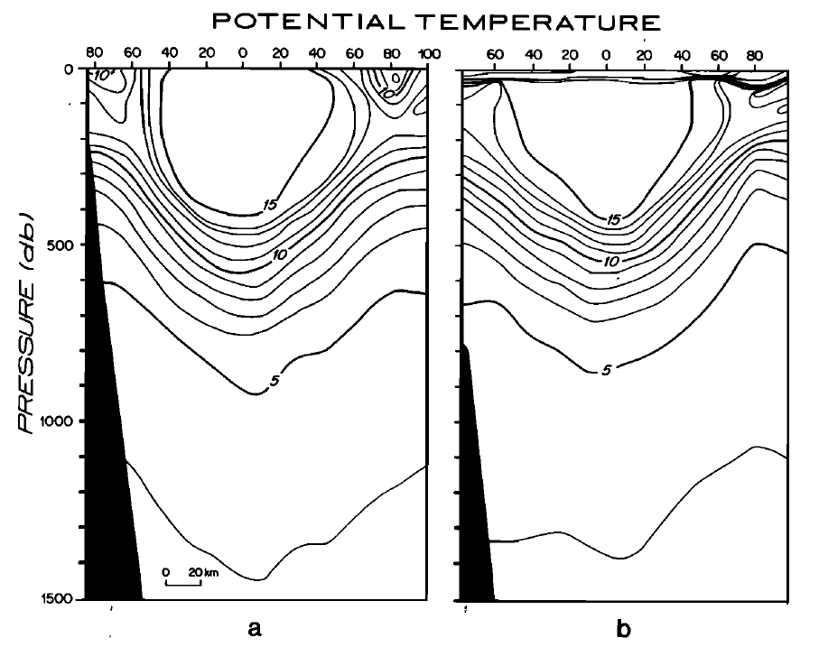
WCR82 Cross Sections
50 m upward displacement of 10°C isotherm in 60 days
April June
Joyce and Kennelly (1985)
Notes:
WCR 82B April and June; Joyce and Kennelly (1985)
Clue is here
Red line: bottom of 10 degree isotherm
Dashed line: 60 days later
1 m / day upwelling
Doesn’t sound like much
Other aspects: stratified surface ocean; deep ML in spring

Slide 4
Frictional decay of a Warm Core Ring
ρ₀
1% I₀
Upwelling
z
Franks et al. (1986)
x
Notes:
Geostrophic balance
What does it do? [steady balance]
Friction, ageostrophic circulation
Nutrient flux
Franks 2D radial model

Slide 5
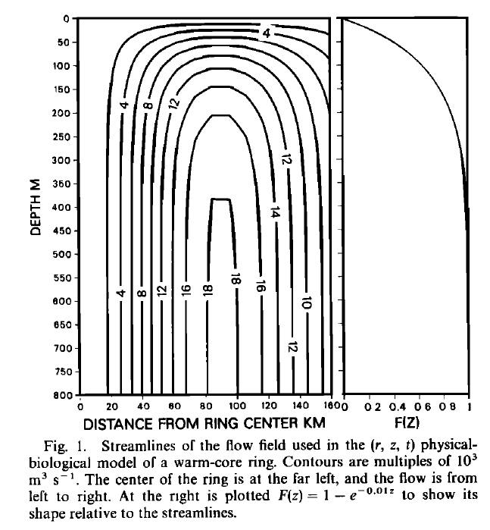
Simulating WCR frictional spindown: ageostrophic secondary circulation
Radial Streamfunction ψ F(z)
Franks et al.(1986)
Notes:
Ageostrophic secondary circulation
1 m/day up in the middle
down at the periphery
Geostrophic swirl velocity – 1 m/s [not depicted here]
Vertical structure function
zero at the surface [rigid lid approximation]
increases with depth into the main thermocline
Simplified schematic does not include downwelling at the edge– all the flow was assumed to leave out the sides above rho0

Slide 6
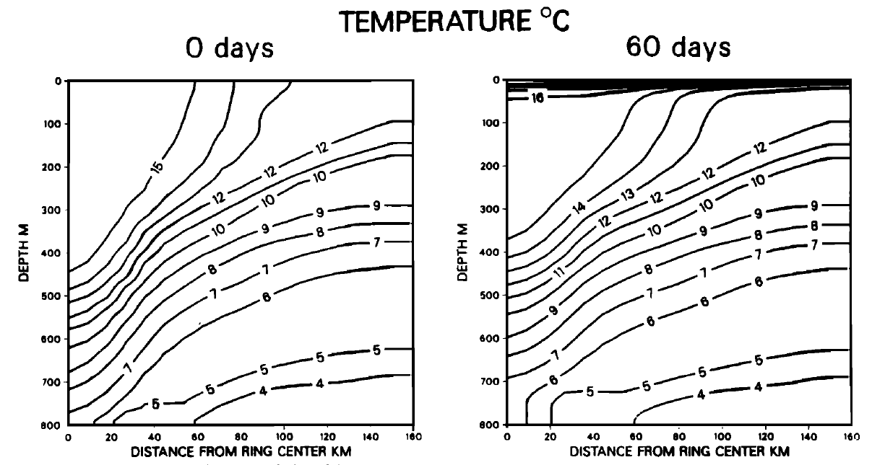
Results of the physical simulation
Notes:
Ics: fit to obs, deeper MLD inside than outside
Heating near surface, upwelling at depth
7 degree isotherm rises from 780 to 700
15 rises from 440 to 370

Slide 7
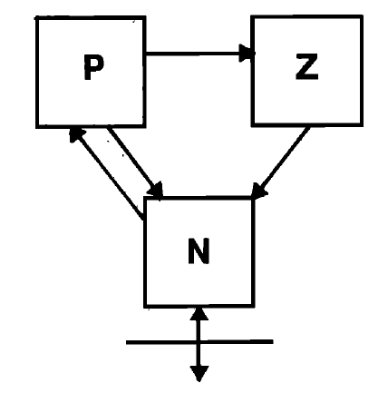
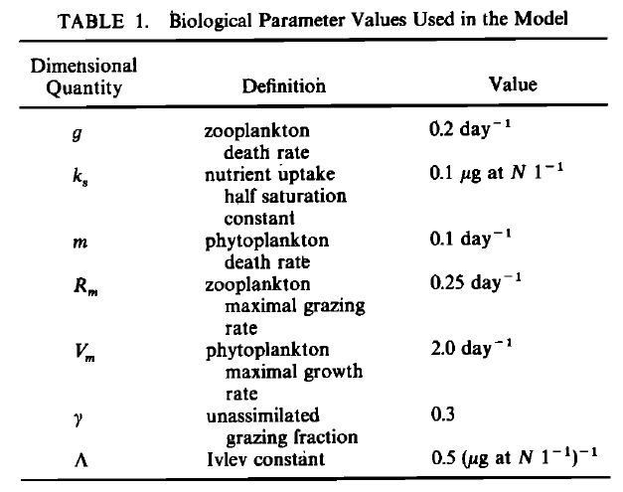
Notes:
Term-by-term analysis; closed system, +/- terms, relate to arrows
Michaelis-Menten nutrient uptake
Phytoplankton mortality
Ivlev grazing formulation; no limitation on total grazing
lambda – Ivlev constant
acclimation to food concentrations
Gamma – slopping feeding
g – zooplankton mortality
Upwelling, nutrient supply; Note Ks

Slide 8
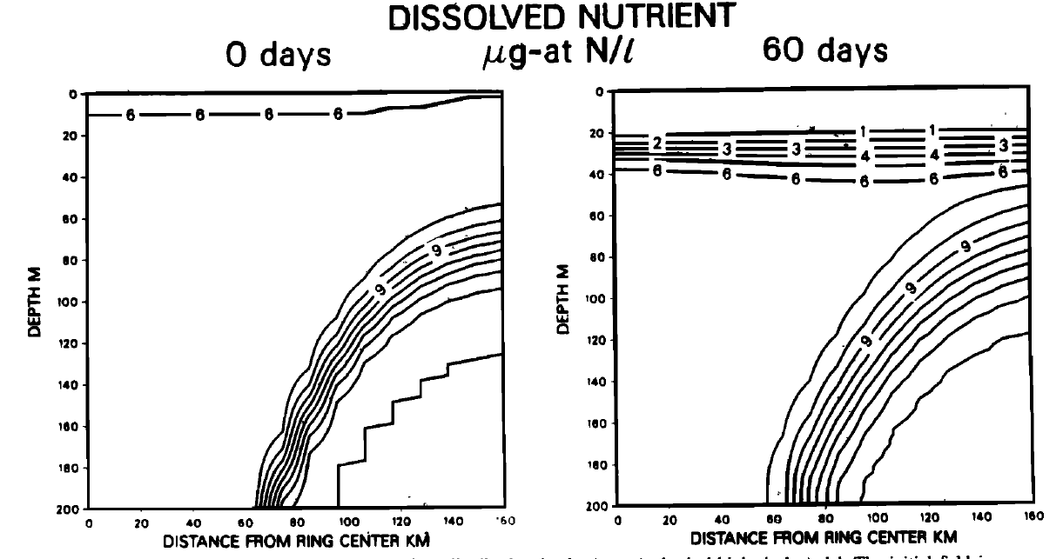
Simulated nutrient concentration
Notes:
Initial condition based on obs: lower inside than out near surface
Cf. Ks value
nutrient replete, i.e. light limited
Formation of the nutricline; nutrient limited above
Evidence of upwelling at eddy center
gradient tighter in the core of the eddy
broader at the periphery

Slide 9
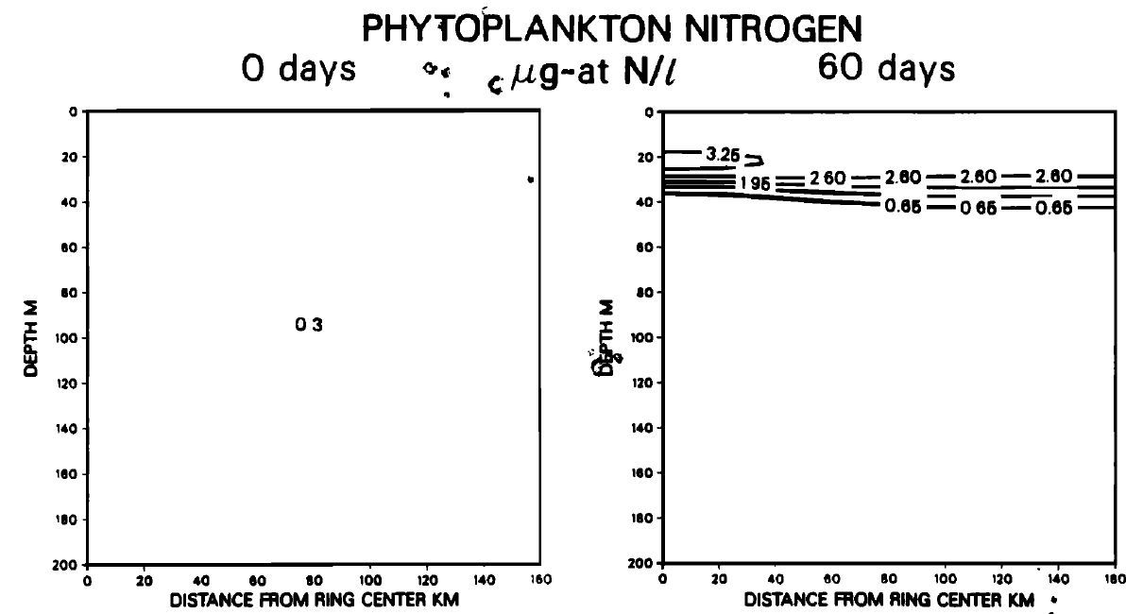
Simulated phytoplankton concentration
Notes:
Uniform IC
Turnover time is fast, ICs are quickly forgotten.
Phytoplankton bloomed everywhere; eddy center higher 3.25 vs. 2.6 (25% increase)

Slide 10
Why is the eddy-induced upwelling almost invisible in the nutrient field?
Radial Streamfunction Nutrients Phytoplankton
Notes:
P accumulation confined to area of maximum upwelling within 30km of eddy center
Difference in the nutrient field barely detectable
Capacity for uptake by phytoplankton far surpasses the rate of physical supply
Good thing ocean color sensors see 1-2 optical depths, otherwise this would not be visible from space. Cf SST sensors.

Slide 11
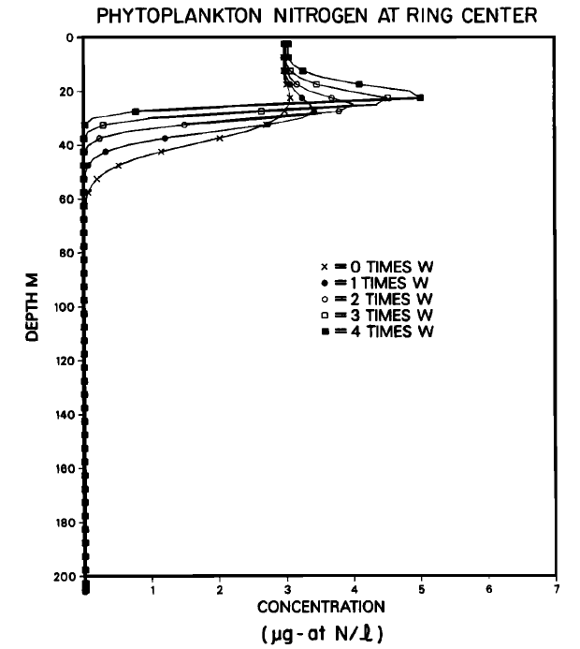
Sensitivity to the prescribed upwelling velocity
Notes:
No upwelling – no enhancement
Higher the upwelling, bigger the peak in P.
Augmented upwelling sharpens the phytocline [and nutricline] but enhancement never makes it all the way to the surface.
As soon as the nutrients hit the light, phytoplankton will bloom and fully utilize all of the upwelled nutrient.
Satellite detection – 1-2 optical depths, can’t see the DCM if it is too deep.

Slide 12
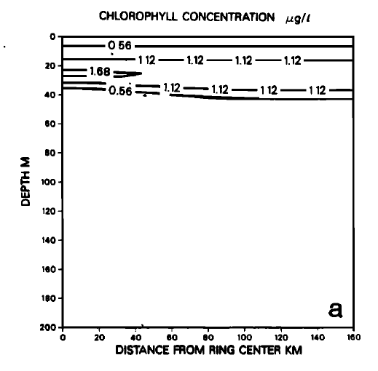
Comparing with observations: simulated chlorophyll concentration
Phytoplankton nitrogen
Notes:
Conversion to chlorophyll necessary for comparison with observations. Simple bio-optical model of Falkowski and Wirick (1981).
Outside the ring: uniform phytoplankton biomass in the upper 30m, yet chl increases: photoadaptation.
Inside the ring: augmentation of the DCM to about 1.7 ug l/ l (50 % increase)
Notice no surface enhancement– if ocean color satellites were like AVHRR and only saw the surface, the eddy-induced bloom would not be visible. However, it sees the 1st optical depth which is a few tens of meters in the open ocean.

Slide 13
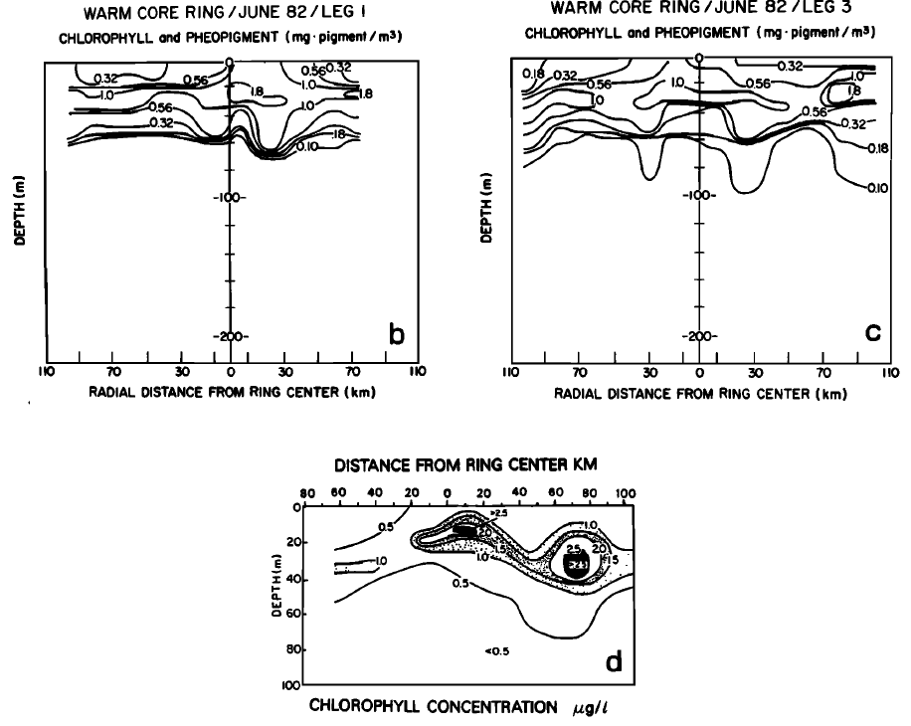
Chlorophyll observations from WCR82B
Smith and Baker (1985)
Yentsch and Phinney (1985)
Notes:
Enhanced DCM present at eddy center, but lots of other structure at the periphery.
Stommel – “our models have a dream-like quality”
1.8 ug Chl per liter contour
1.0
2.5
Periphery in section 3 – over 3

Slide 14
Chlorophyll time-series of WCR82B
April 1
April 15
April 19
April 24
May 16
June 9
Garcia-Moliner and Yoder, 1994
Notes:
Biomass min to max
Far from uniform
Streamer along the periphery, appears to be entrained

Slide 15
Another example application of NPZ models: Coastal upwelling
Notes:
San Francisco Bay
Columbia River
N winds, offshore Ekman transport, upwelling of cold nutrient rich water, plankton bloom.
Rich mesoscale variability, squirts, jets, etc.

Slide 16
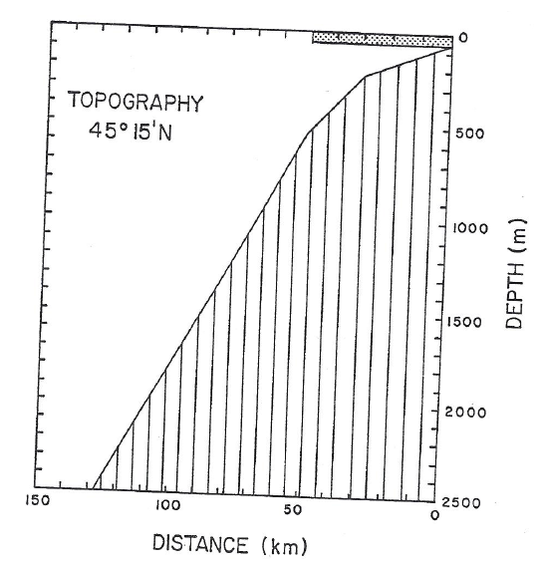
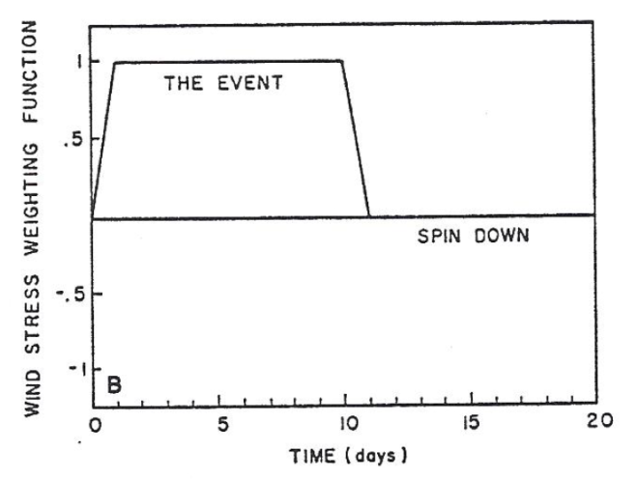
Wroblewski (1977)
$$Z$$
$${NH}_{4}$$
$$D$$
$$P$$
Export
$${NO}_{3}$$
Upwelling
Notes:
2D cross-shore transect, idealized bathymetry
physical model runs throughout
ecosystem model runs in the top layer nearshore.
More sophisticated biological model; distinguishes two forms of nutrient allowing for explicit distinction between new and regenerated production.
Nitrification from NH4 to NO3 (bacterially mediated; not explicitly simulated)
Detritus produced by phytoplankton mortality and zooplankton
Export of detritus balances nutrient input.

Slide 17
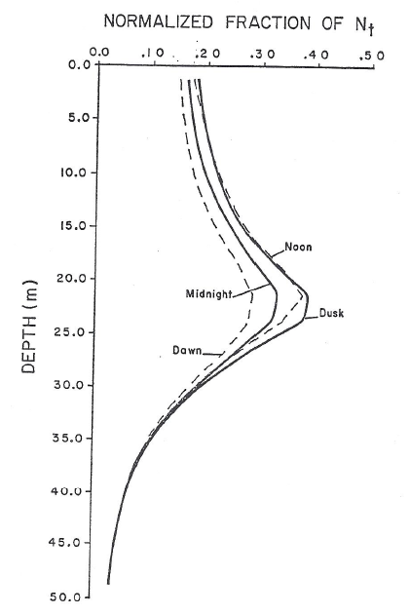
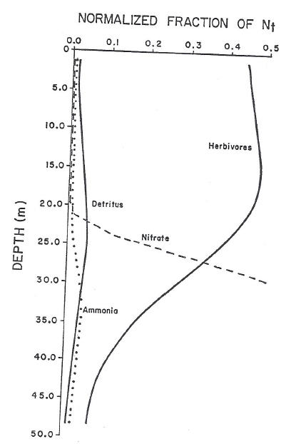
Quasi-steady state profiles
Phytoplankton
Notes:
Quasi-steady state under diurnal forcing
Highest P at dusk, net mortality at night, minimum at dawn, net growth during the day
Subsurface maximum located at the base of the nitracline
Diurnal variations in the nitrate profile and all other variables, not shown here.
Ammonium highest below the nitracline; preferential uptake by phytoplankton

Slide 18
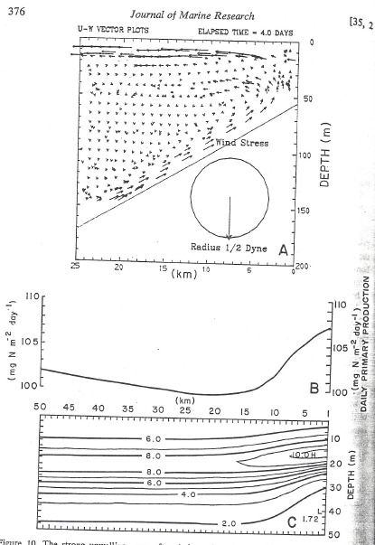
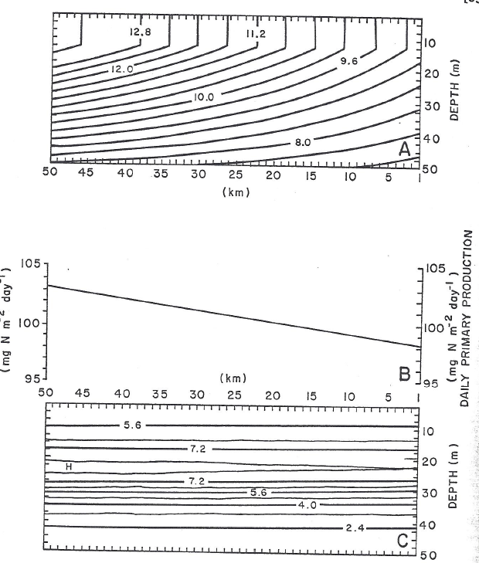
Initial conditions T = 4 days
Temperature
Wind
Primary production
Phytoplankton
Primary production
Phytoplankton
Notes:
ICs: temperature fit to observations; phytoplankton and other variables from steady state solution. Primary production increases offshore due to temperature dependence.
Experiment: force with a pulse of northerly wind for 10 days, then turn the wind off.
T=4: upwelling cell, bring up nutrients, stimulating productivity, and raising the DCM. Now the peak in integrated production is nearshore; note offshore trend has remained the same (changing vertical scale), although there is evidence of seaward advection of the gradient.

Slide 19
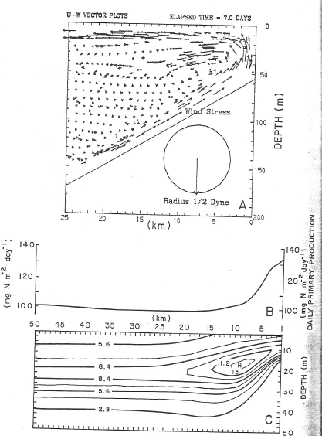
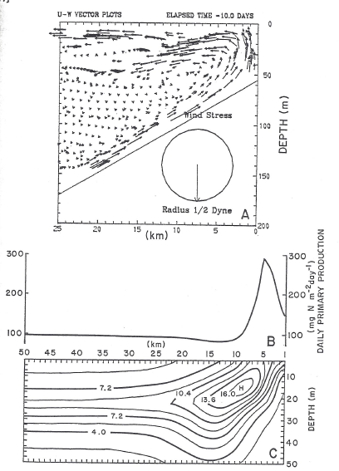
T = 7 days T = 10 days
Wind
Wind
Primary production
Phytoplankton
Primary production
Phytoplankton
Notes:
Day 7: continued adjustment, evolution of a downwelling cell just offshore, for which there is some support in observations.
Day 10: Offshore displacement of the peak production; dilution of P from upwelling, subsurface offshore peak and offshore extension in downwelling cell

Slide 20
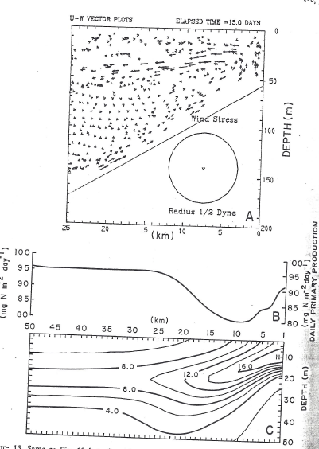
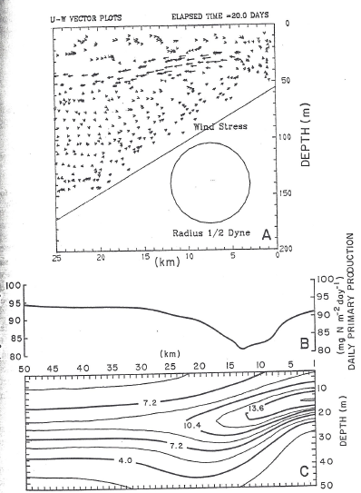
T = 15 days T = 20 days
Wind
Wind
Primary production
Phytoplankton
Primary production
Phytoplankton
Notes:
Wind relaxation: immediate decrease in productivity; velocity has a remnant of the upwelling cell but velocity field confused

Slide 21
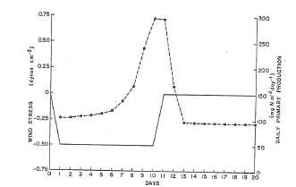
Wind stress and vertically integrated primary production
Primary production
Wind Stress

Slide 22
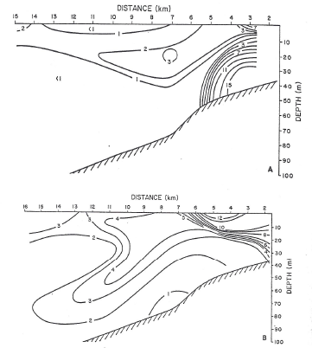
Chlorophyll Observations
Notes:
Convert P to Chl via linear relation
High Chl near the coast, low offshore
Top: highest chl near bottom
Bottom: highest chl near surface
DCM gets deeper offshore; consistent with predicted downwelling
Mesoscale variability in the observations

Slide 23
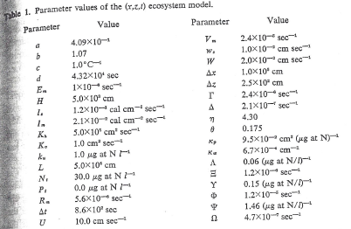
Model Parameters (34)
Notes:
What is the sensitivity of the results to the chosen parameters?

Slide 24
Prospectus thus far
Biology
Complex
ADR Theory
Dugdale and Wilkerson 1998
NPZ
theory
Huisman et al. 2006
Physics
Qualitative
Simple
Franks et al. 1986
Wroblewski 1977
Complex
Quantitative
Connection to observations
Notes:
Physical models – from geostrophic balance to the 3-D primitive equations
Biological models – from simple to more complex NPZ, including stability analysis
Huisman et al. brought us into direct comparison with observations at HOT, hypothesizing that interannual variations in the DCM result from advective-diffusive instability in an N-P model.
Dugdale and Wilkerson used a more complex NPZ model with two size classes of phytoplankton to explain the HNLC condition of the equatorial Pacific as simultaneous top-down control of picoplankton by microzooplankton and bottom up control of diatoms through the upwelled silica flux.
We saw how relatively simple NPZ models can allow us to examine the dynamical effects of upwelling
Franks et al. 86 WCR decay turning a local minimum into a local maximum of phytoplankton biomass
Wroblewski 77 coastal upwelling: forced response then biological overshoot that decreases productivity

