Slide 1
Announcements
Problem set 1 posted, due March 15
2. Readings posted as an “assignment”
3. Alternate site:
http://science.whoi.edu/users/mcgillic/12_823/
4. Monday’s class on Tues; Clark defense 1-2pm, followed by GRF lecture on stability of NPZ systems

Slide 2
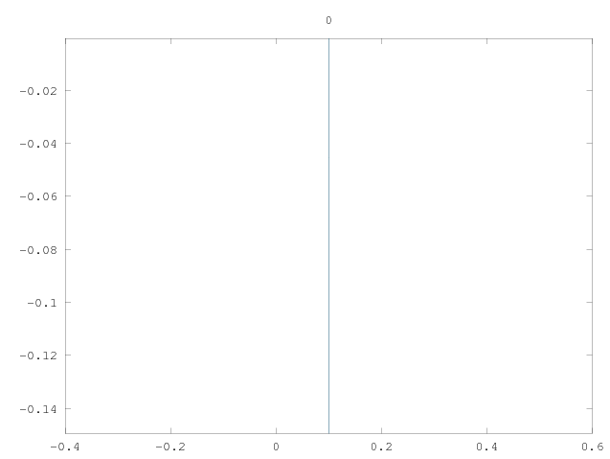

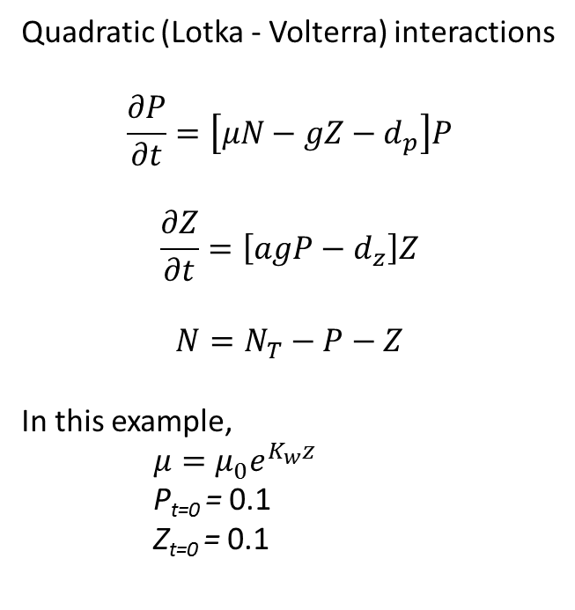
Quadratic NPZ model integration
Quadratic (Lotka - Volterra) interactions
$$\frac{∂P}{∂t}=\left[μN−gZ−d_{p}\right]P$$
$$\frac{∂Z}{∂t}=\left[agP−d_{z}\right]Z$$
$$N=N_{T}−P−Z$$
In this example,
$μ={μ_{0}^{}e}^{K_{w}z}$
P_{t=0} = 0.1
Z_{t=0} = 0.1
Depth (km)
Phytoplankton
Zooplankton
Notes:
Total amount of nutrient is fixed
Reduces to an N-P system
Nutrient uptake is light limited
Fluctuations not numerical instability – they are L-V cycles that eventually settle down and yield a steady state solution
P(z) looks like a mixed layer but there is no mixing in this problem.
PP(z) is exponential, but Z biomass adjusts so that grazing balances production.

Slide 3
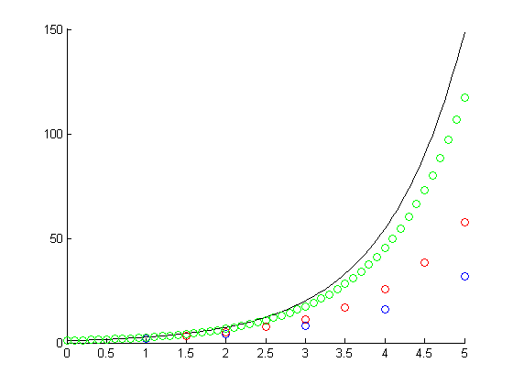
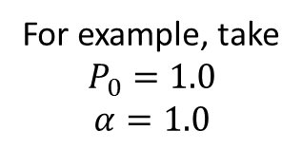
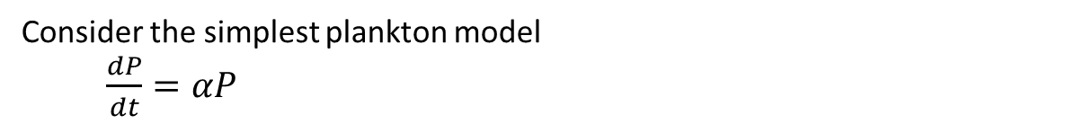
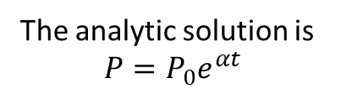
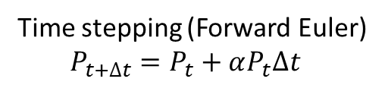
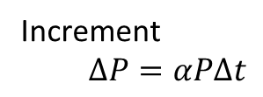
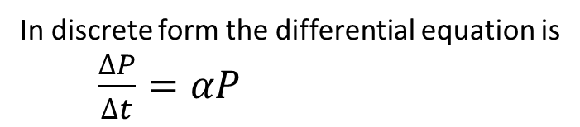
Numerical integration
Consider the simplest plankton model
$\frac{dP}{dt}=αP$
The analytic solution is
$$P=P_{0}e^{αt}$$
Undershoot: Forward Euler time stepping systematically underestimates dP/dt, which increases with time.
In discrete form the differential equation is
$\frac{∆P}{∆t}=αP$
Analytic solution
Increment
$∆P=αP∆t$
Δt=0.1
Time stepping (Forward Euler)
$P_{t+∆t}=P_{t}+αP_{t}∆t$
P
Δt=0.5
For example, take
$$P_{0}=1.0$$
$$α=1.0$$
Δt=1.0
Time
Notes:
Numerical solutions are approximate
Accuracy can be checked for special cases in which an analytic solution exists
In this case, forward euler does not take into account that dP/dt varies in time, resulting in undershoot.
Accuracy can easily be improved by decreasing the time step.
Finer resolution not always the most efficient solution; higher order numerics can help.

Slide 4
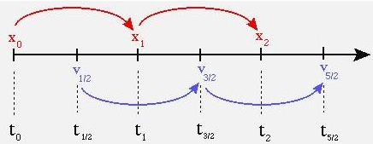
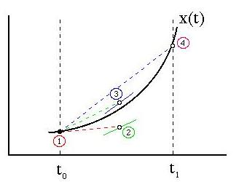
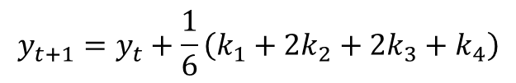
Higher order time-stepping
Leap-frogging
Runge-Kutta
$$y_{t+1}=y_{t}+\frac{1}{6}\left(k_{1}+2k_{2}+2k_{3}+k_{4}\right)$$
http://rainman.astro.illinois.edu
Notes:
Leap frogging: 2 solutions, x and v
Derivative information used at intermediate time step
Computations centered in time as compared with forward euler
How to start: a single forward euler time step
Avoid divergence of the two solutions: a single backward euler time step every so often
Runge Kutta:
multiple evaluations of derivative information to determine increments k
1 – 2
1 – 3 using 2
1 - 4 using 3
solution: weighted average of 1-4, where 2 and 3 have twice the weight of 1 and 4
Matlab toolboxes have variants of all these

Slide 5
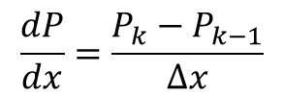
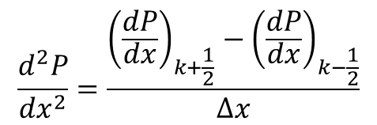
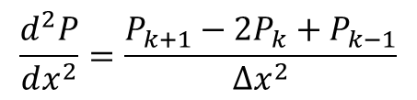
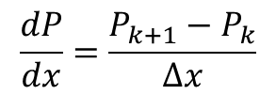
Spatial derivatives
Centered difference
P_{k-1}
P_{k}
P_{k+1}
$$\frac{dP}{dx}=\frac{P_{k}−P_{k−1}}{∆x}$$
$$\frac{dP}{dx}=\frac{P_{k+1}−P_{k}}{∆x}$$
$$\frac{d^{2}P}{dx^{2}}=\frac{{\left(\frac{dP}{dx}\right)}_{k+\frac{1}{2}}−{\left(\frac{dP}{dx}\right)}_{k−\frac{1}{2}}}{∆x}$$
$$\frac{d^{2}P}{dx^{2}}=\frac{P_{k+1}−{2P_{k}+P}_{k−1}}{∆x^{2}}$$
Notes:
First derivative information on a grid that is staggered from that of the state variable.
Second derivative information back on original grid.

Slide 6
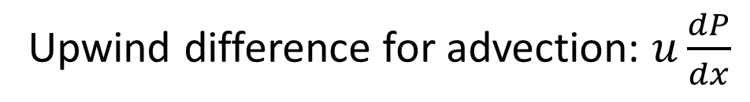
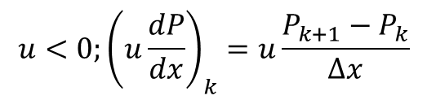
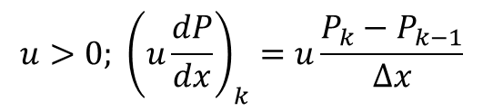
Spatial derivatives
Upwind difference for advection: $u\frac{dP}{dx}$
P_{k-1}
P_{k}
P_{k+1}
$$u>0; {\left(u\frac{dP}{dx}\right)}_{k}=u\frac{P_{k}−P_{k−1}}{∆x}$$
$$u<0;{\left(u\frac{dP}{dx}\right)}_{k}=u\frac{P_{k+1}−P_{k}}{∆x}$$
Courant-Friedrichs-Lewy (CFL) condition: $u∆t<∆x$

Slide 7
Issues
Accuracy
Stability
Efficiency
Notes:
Accuracy
simple checks
analytic solution
½ time step
½ spatial resolution
Stability
CFL
Positive definiteness
overshoot/undershoot – flux corrector methods
Efficiency

Slide 8


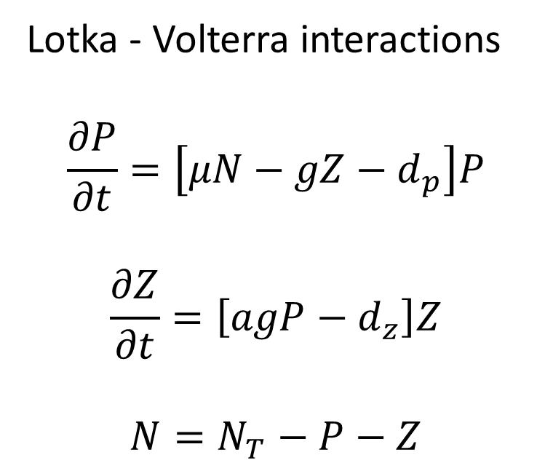






Quadratic NPZ model
Lotka - Volterra interactions
$$\frac{∂P}{∂t}=\left[μN−gZ−d_{p}\right]P$$
$$\frac{∂Z}{∂t}=\left[agP−d_{z}\right]Z$$
$$N=N_{T}−P−Z$$
$$P$$
$$agZP$$
$$Z$$
$$d_{p}P$$
$$\left(1−a\right)gZP$$
$$μNP$$
$$d_{z}Z$$
$$N$$
Notes:
Quadratic in the sense that key processes (nutrient uptake, grazing) are formulated as a product of two state variables.
Nutrient uptake
Phytoplankton mortality
Grazing – assimilated portion
Grazing – non-assimilated portion – “sloppy feeding”
Zooplankton mortality
Closed system – don’t need a separate equation for nutrients

Slide 9


Quadratic
Lotka-Volterra
Monod uptake and grazing
Notes:
Oscillatory decay; prior solution
II. Oscillations do not decay; independent limit cycles
changing the functional form of 2 of the terms totally changes the character of the solution
These examples illustrate high sensitivity to uptake and grazing formulations

Slide 10
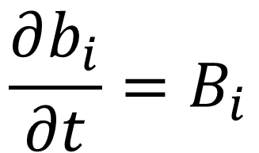
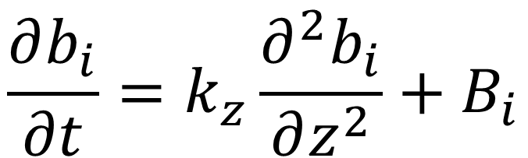
What about mixing?
Thus far these models have been implemented as stacked “zero-dimensional” box models
reduces to
$$\frac{∂b_{i}}{∂t}=B_{i}$$
$$\frac{∂b_{i}}{∂t}=k_{z}\frac{∂^{2}b_{i}}{∂z^{2}}+B_{i}$$
Notes:
Remember the 3-D ADR
In this case, 1D DR

Slide 11
Quadratic
Lotka-Volterra
Monod uptake and grazing
Monod uptake and grazing
K_{z}=1.2· 10⁻⁷ m² s⁻¹
Monod uptake and grazing
K_{z}=1.5· 10⁻⁹ m² s⁻¹
Notes:
Oscillatory decay; prior solution
II. Oscillations do not decay; independent limit cycles
changing the functional form of 2 of the terms totally changes the character of the solution
III. Mixing sufficient to damp oscillations [molecular mixing of heat; 2 orders of magnitude less than oceanic value]
structure more similar to quadratic model
IV. Even lower mixing damps oscillations, but allows coupled limit cycle [molecular mixing of salt; 3 orders of magnitude less than oceanic value]
These examples illustrate high sensitivity to
uptake and grazing formulations
vertical mixing

Slide 12
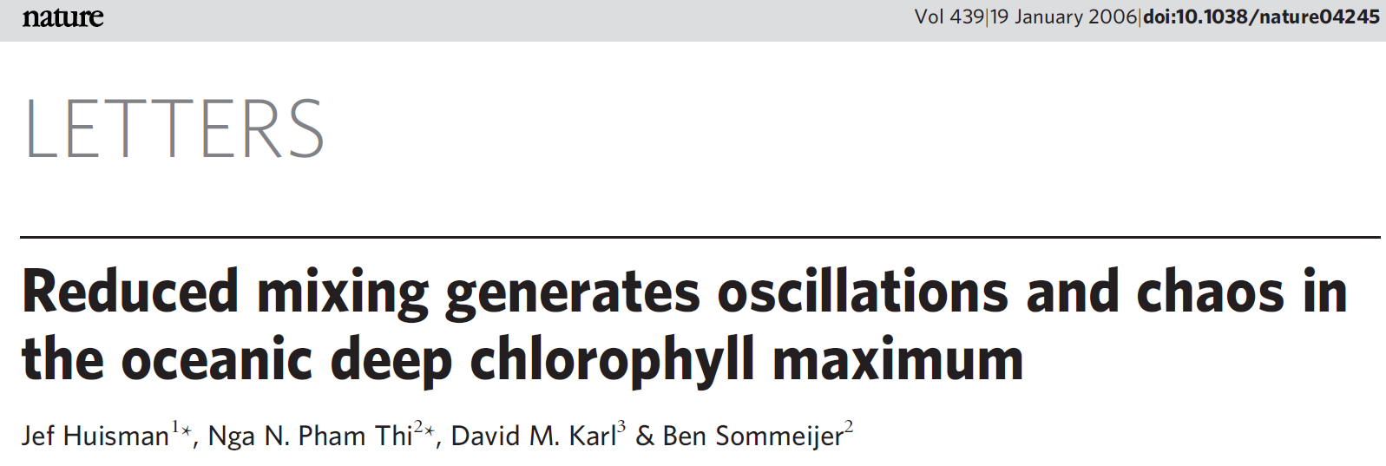
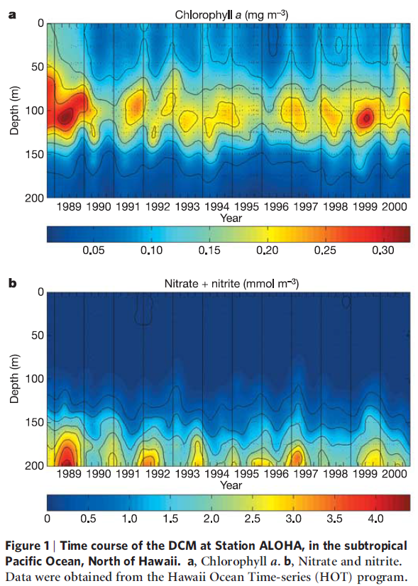

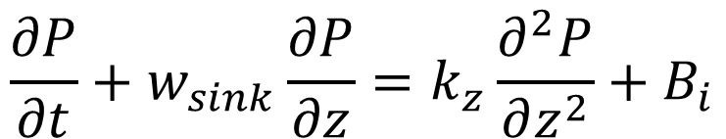
Chlorophyll a (mg m⁻³)
$$P$$
Sinking
N
Nitrate + Nitrite (mmol m⁻³)
Mixing
$$\frac{∂P}{∂t}+w_{sink}\frac{∂P}{∂z}=k_{z}\frac{∂^{2}P}{∂z^{2}}+B_{i}$$
Notes:
HOT: annual cycle of nitrate and chl, but lots of variability on higher frequency time scales.
Huisman et al. investigate whether or not these higher frequency variations in the DCM might be explained by chaotic biological dynamics.
N-P model similar in formulation to L-V models, but nitrate supplied by vertical mixing and P are removed by sinking.

Slide 13
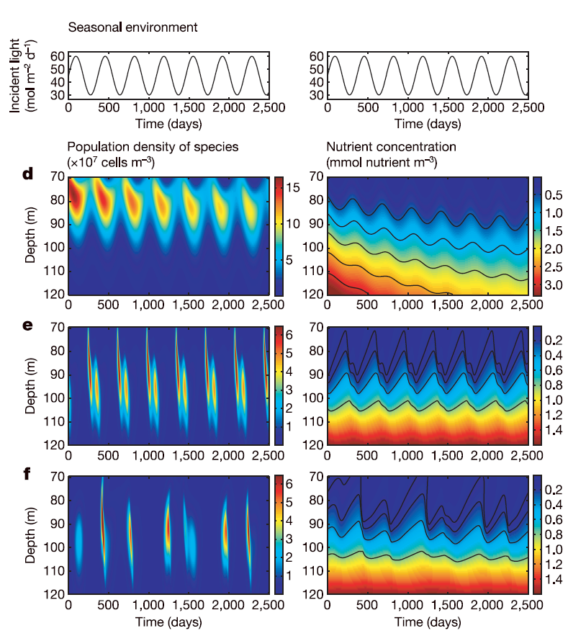
Huisman et al. model results
K_{z}=5.0·10⁻⁵ m² s⁻¹
K_{z}=1.4·10⁻⁵ m² s⁻¹
Observed
Chlorophyll a (mg m⁻³)
K_{z}=0.8·10⁻⁵ m² s⁻¹
Notes:
NP model forced with repeating annual cycle in light; 7-yr simulation
High, med, low mixing cases
High mixing: nutrients decreasing, quasi-steady annual cycle
Intermediate mixing: nutrient field quasi-steady, no drift; chl lower (note change in color bar), deeper in the water column, more vertical structure
Low mixing: chl no longer maps directly onto the forcing; chaos emerges in the solution.
not inconsistent with time-series observations
Hypothesis: stochastic variations under biological control.

Slide 14
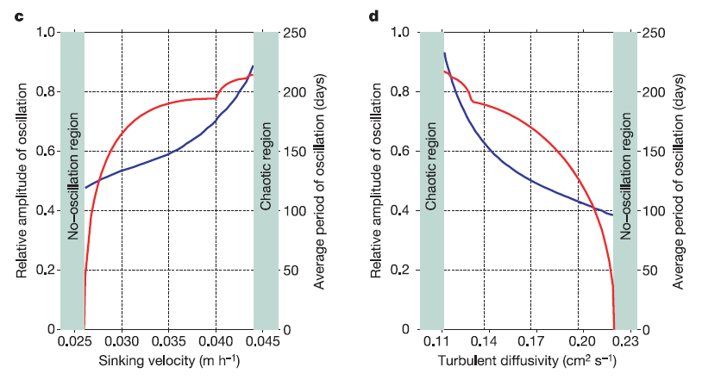
$$P$$
Amplitude
Amplitude
Sinking
Period
Period
N
Mixing
0.6 m d⁻¹ 1.0 m d⁻¹
Notes:
Just like we saw in the Lotka-Volterra models, there are three regimes: non-oscillatory, chaotic, and a transition region of periodic oscillations.
These depend both on the mixing rates and sinking velocity of the phytoplankton.
Higher mixing damps out oscillations, and lower mixing allows for chaotic behavior. There is a transition region in which the amplitude and period of regular oscillations is shown by the red and blue lines.
Similarly, slower sinking (0.6 m/d) damps out oscillations, and faster sinking (1 m/d) allows for chaotic behavior. There is a transition region in which the amplitude and period of regular oscillations is shown by the red and blue lines.
Current debate about the nature of high-frequency variability in the time-series
Will get back to this when we discuss mesoscale and submesoscale variability
Hypothesis of biological control in low-mixing environment; resonates with the intuition we got from simple NPZ models.
“advective-diffusive instability” – low mixing / faster sinking decouples nutrient supply and phytoplankton production
Sensitivity to input parameters – range of sinking rates of phytoplankton
At low diffusivity, the phytoplankton sink fast compared to the slow upward flux of nutrients. Thereby, the light conditions of the sinking phytoplankton deteriorate and the phytoplankton population declines. The declining phytoplankton population loses control over the upward nutrient flux, allowing new nutrients to diffuse further upwards. The upward flux of nutrients reaches a depth at which light conditions are suitable for growth. This fuels the next peak in the DCM.

Slide 15
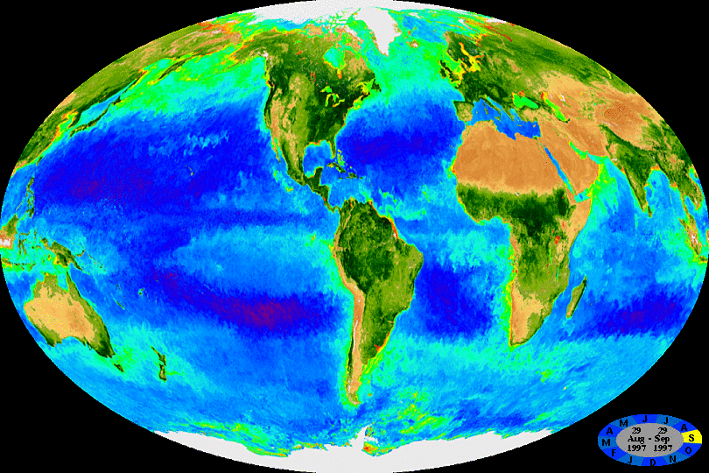

SeaWiFS 1997-2005: 32-day composites
Notes:
The animated GIF below is composed of 362 32-day SeaWiFS composites. Each 32-day composite in the sequence has a starting (and ending) date that is eight days later than the previous frame. The time period covered is from the beginning of the SeaWiFS mission through July 2005.
http://oceancolor.gsfc.nasa.gov/SeaWiFS/HTML/SeaWiFS.BiosphereAnimation.70W.html
Chl as a proxy for phytoplankton biomass
Seasonal cycles
Eddies
Amazon/Orinoco
Upwelling
W Africa
Equatorial Pacific
West coast US, South America

Slide 16
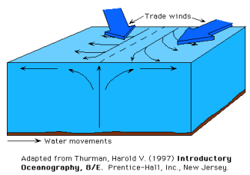
Equatorial Upwelling
Notes:
NE and SE trade winds meet at the intertropical convergence zone
Ekman divergence, upwelling

Slide 17
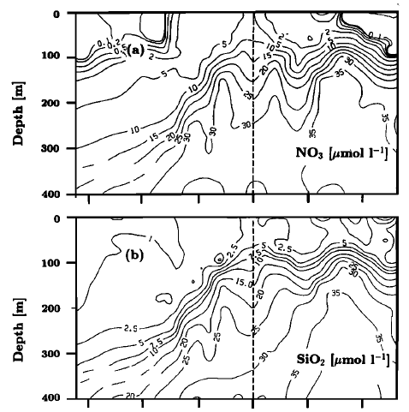
Nutrients at 150W
Nitrate
Silicate
-15 -10 -5 0 5 10
Latitude
Notes:
>5 uM nitrate in surface waters
Cf. half saturation for nitrate uptake
Nutrient depletion ca. 8 degrees off the equator
Silicate also upwelled
Why are P not using all the nitrate?

Slide 18

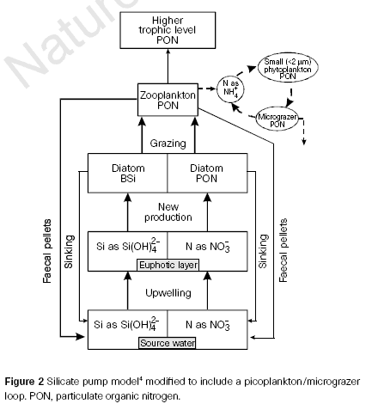
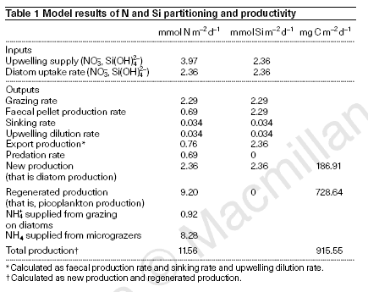
A model of the HNLC condition
Simultaneous
top down and bottom-up
controls
Notes:
Diatoms take up all the upwelled silicate
N:Si uptake ratio = 1 , so there is residual nitrate
Not used by small phytoplankton because of top-down control

Slide 19






$$P_{pico}$$
$$Z_{µ}$$
$$Z$$
$${NH}_{4}$$
Export
Export
$$P_{diat}$$
Export
$${NO}_{3}$$
$$Si$$
Upwelling 1 m d⁻¹
Notes:
NPZ model redrawn in more familiar format
2 species of phytoplankton
Diatoms need silicic acid
Picoplankton don’t

Slide 20
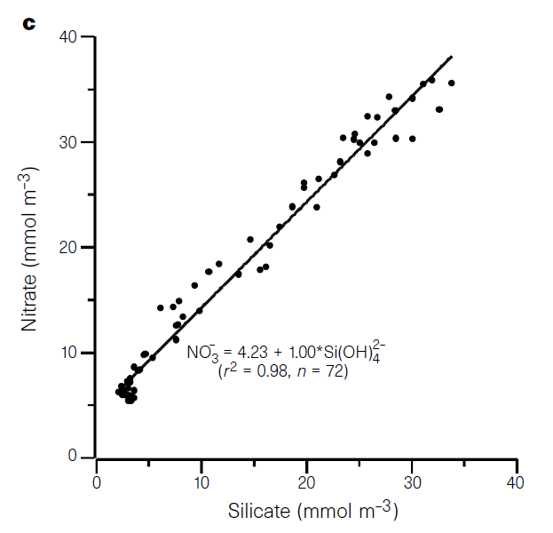
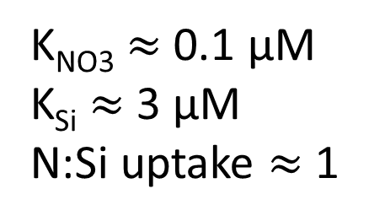
Nitrate vs. silicate, upper 200m
K_{NO3} $≈$ 0.1 μM
K_{Si} $≈$ 3 μM
N:Si uptake $≈$ 1
Dugdale and Wilkerson, 1998
Notes:
Ks for silicate is ~3 micromolar
When silicate runs out, there is still 5 micromolar nitrate unused.
Why is the nitrate not used by other species of phytoplankton? Top-down control and the microbial loop.
Nitrate and silicate used in 1:1 molar ratio

Slide 21
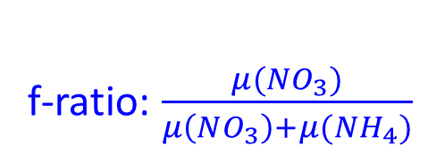
Total primary production: ¹⁴C
Total Chl + HPLC
f-ratio: $\frac{μ(NO_{3})}{μ\left(NO_{3}\right)+μ(NH_{4})}$
$$P_{pico}$$
Infer from ¹⁴C
and δ ¹⁵NO₃ uptake
$$Z_{µ}$$
$$Z$$
$${NH}_{4}$$
Export
Sediment trap
$$P_{diat}$$
Total Chl + HPLC
Export
Sediment trap
δ ¹⁵NO₃ uptake
Nutrient
concentrations
$${NO}_{3}$$
$$Si$$
Ekman theory
+
observed nutrient gradients
Upwelling 1 m d⁻¹
Notes:
HPLC – diatoms fucoxanthin; partition total Chl accordingly; CHEMTAX
Drifting sediment traps; catch sinking diatoms and Z fecal pellets
14C – total productivity: Pdiat + Ppico
Get NH4 uptake by difference assuming Redfield proportions

Slide 22
A model of the HNLC condition
Simultaneous
top down and bottom-up
controls
Notes:
Diatoms take up all the upwelled silicate
N:Si uptake ratio = 1 , so there is residual nitrate
Not used by small phytoplankton because of top-down control
Stoichiometry of upwelled waters: excess N relative to Si

Slide 23
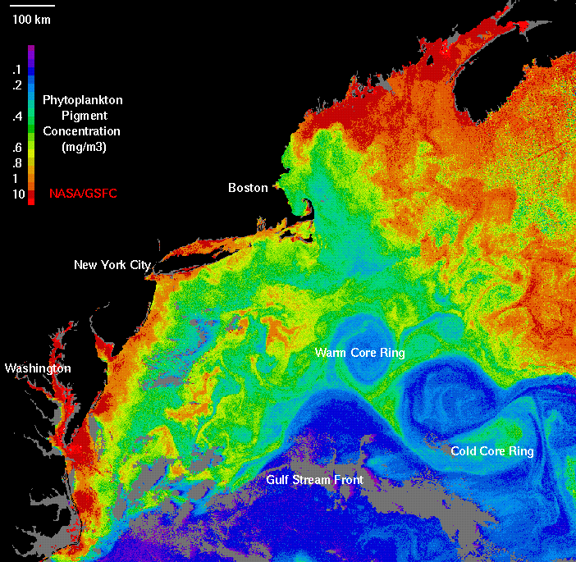
Example application of NPZ models:
Warm Core Rings of the Gulf Stream
Notes:
WCR Program (1982-1983) questions:
1. What is the physical structure and motion?
How are physical processes affected by
interactions with surroundings? How does a
ring change as it ages?
2. What effect do they have on large-scale
chemical transport in the region? Do they enhance
vertical fluxes and accelerate biological
and chemical interactions?
3. What are the population distributions? How do they
relate to environmental factors in the ring, particularly as
it matures? What controls primary production and activity at
higher trophic levels within the ring?

Slide 24
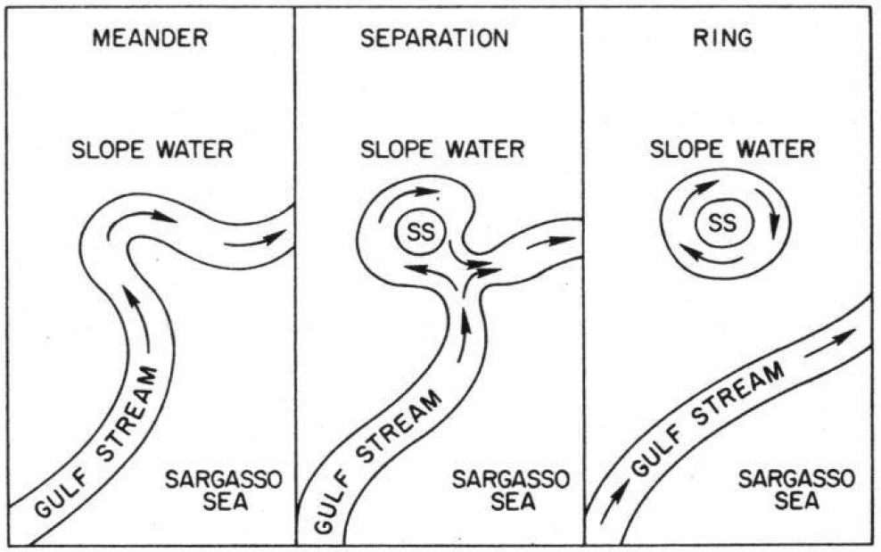
Warm Core Ring Formation
Warm Core Ring Executive Committee, 1982
Notes:
Describe formation process
Back to satellite image
slope water environment bounded by GS to the S and 100m isobath
WCRs occupy a significant fraction of the area in that biome

Slide 25
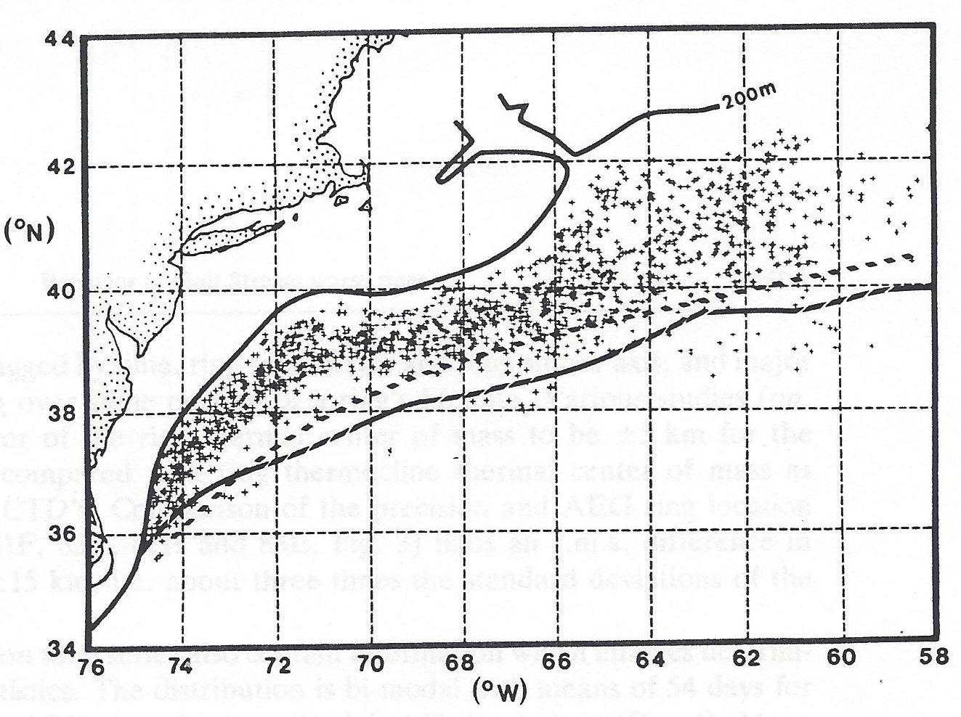
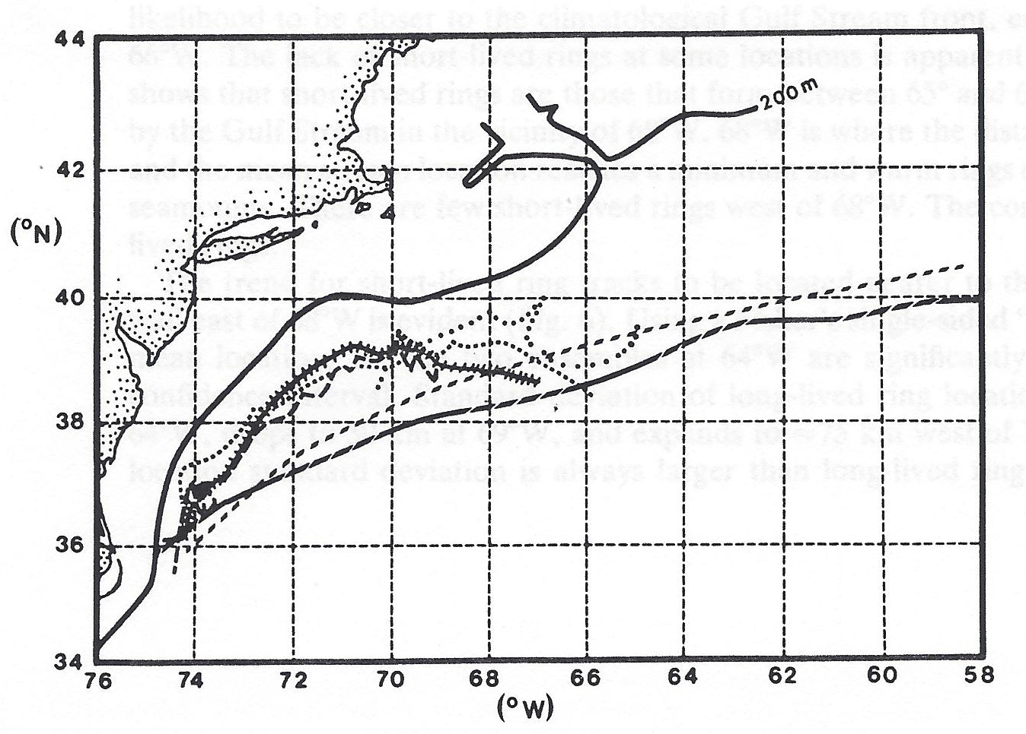
Satellite-based climatology of
Warm Core Rings 1974-1983
Brown et al. (1986)
Estimates of the mean north wall of the Gulf Stream
Observed locations Example trajectories
Notes:
Solid line: 200m isobath
Dashed lines: 2 different estimates of mean north wall position of GS
WCR locations span the biome
Trajectories: propagate west – southwest
[Rossby wave]
Fate:
interaction with the shelf
reabsorbed into the GS

Slide 26
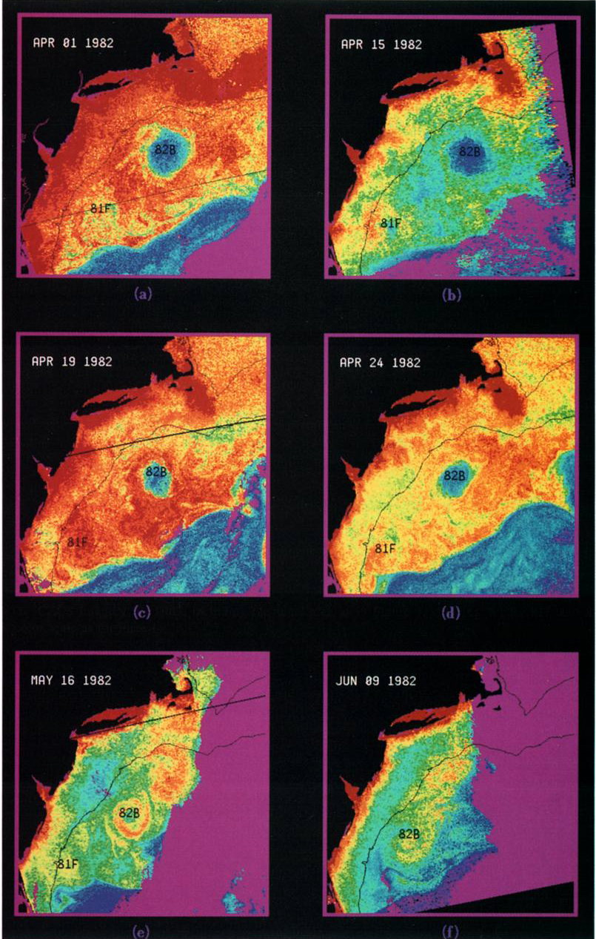
Chlorophyll time-series of WCR82B
April 1
April 15
April 19
April 24
May 16
June 9
Garcia-Moliner and Yoder, 1994
Notes:
Low biomass in otherwise high-chl water in the slope region
Evolution: spring bloom
mid-may transition: Chl increasing
Big surprise: why would relative low in chl biomass transition into relative high?

Slide 27
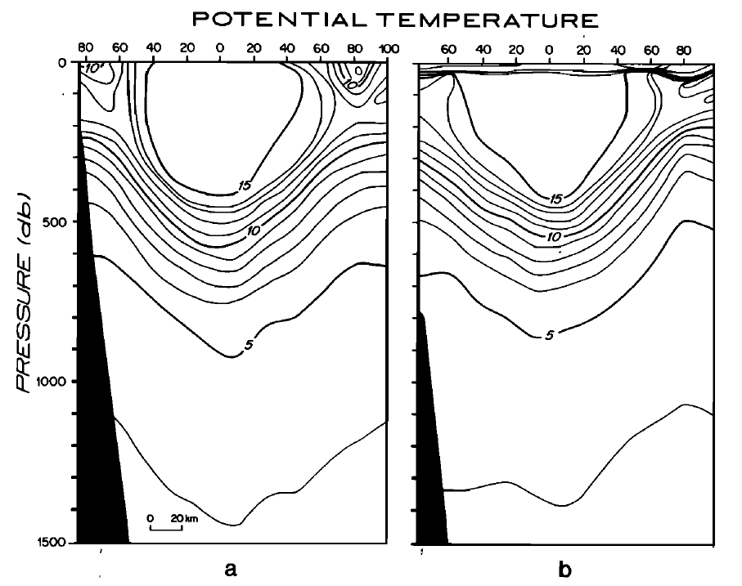
WCR82 Cross Sections
50 m upward displacement of 10°C isotherm in 60 days
April June
Joyce and Kennelly (1985)
Notes:
WCR 82B April and June; Joyce and Kennelly (1985)
Clue is here
Red line: bottom of 10 degree isotherm
Dashed line: 60 days later
1 m / day upwelling
Doesn’t sound like much
Other aspects: stratified surface ocean; deep ML in spring

Slide 28
Frictional decay of a Warm Core Ring
ρ₀
1% I₀
Upwelling
z
Franks et al. (1986)
x
Notes:
Geostrophic balance
What does it do? [steady balance]
Friction, ageostrophic circulation
Nutrient flux
Franks 2D radial model

Slide 29
Lecture stopped here, to be continued

Slide 30
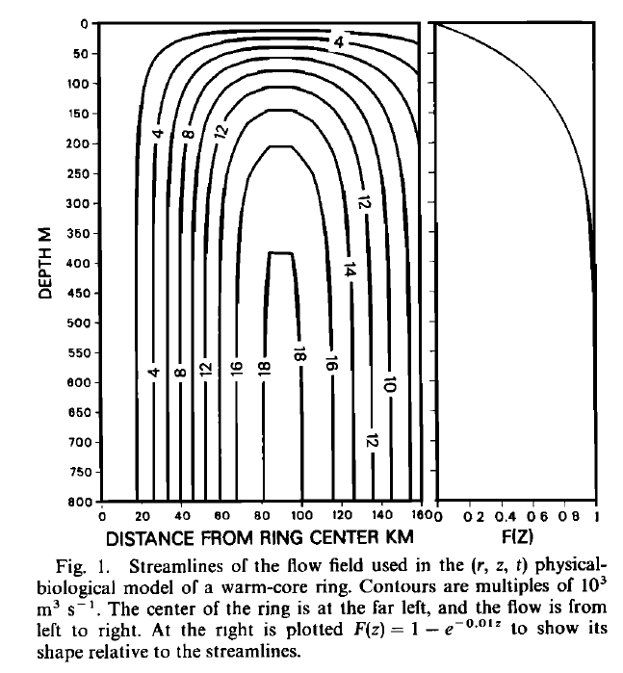

Simulating WCR frictional spindown: ageostrophic secondary circulation
Radial Streamfunction ψ F(z)
Franks et al.(1986)
Notes:
Ageostrophic secondary circulation
1 m/day up in the middle
down at the periphery
Geostrophic swirl velocity – 1 m/s [not depicted here]
Vertical structure function
zero at the surface [rigid lid approximation]
increases with depth into the main thermocline
Simplified schematic does not include downwelling at the edge– all the flow was assumed to leave out the sides above rho0

Slide 31
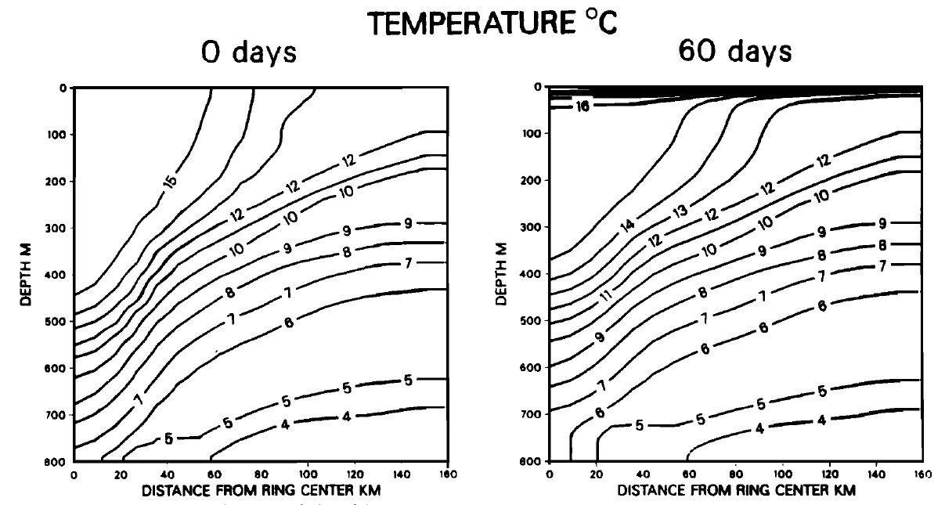
Results of the physical simulation
Notes:
Ics: fit to obs, deeper MLD inside than outside
Heating near surface, upwelling at depth
7 degree isotherm rises from 780 to 700
15 rises from 440 to 370

Slide 32
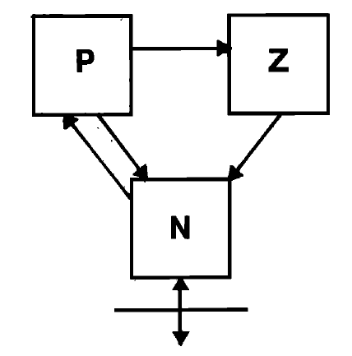


Notes:
Term-by-term analysis; closed system, +/- terms, relate to arrows
Michaelis-Menten nutrient uptake
Phytoplankton mortality
Ivlev grazing formulation; no limitation on total grazing
lambda – Ivlev constant
acclimation to food concentrations
Gamma – slopping feeding
g – zooplankton mortality
Upwelling, nutrient supply; Note Ks

Slide 33

Simulated nutrient concentration
Notes:
Initial condition based on obs: lower inside than out near surface
Cf. Ks value
nutrient replete, i.e. light limited
Formation of the nutricline; nutrient limited above
Evidence of upwelling at eddy center
gradient tighter in the core of the eddy
broader at the periphery

Slide 34

Simulated phytoplankton concentration
Notes:
Uniform IC
Turnover time is fast, ICs are quickly forgotten.
Phytoplankton bloomed everywhere; eddy center higher 3.25 vs. 2.6 (25% increase)

Slide 35
Why is the eddy-induced upwelling almost invisible in the nutrient field?
Radial Streamfunction Nutrients Phytoplankton
Notes:
P accumulation confined to area of maximum upwelling within 30km of eddy center
Difference in the nutrient field barely detectable
Capacity for uptake by phytoplankton far surpasses the rate of physical supply
Good thing ocean color sensors see 1-2 optical depths, otherwise this would not be visible from space. Cf SST sensors.

Slide 36

Sensitivity to the prescribed upwelling velocity
Notes:
No upwelling – no enhancement
Higher the upwelling, bigger the peak in P.
Augmented upwelling sharpens the phytocline [and nutricline] but enhancement never makes it all the way to the surface.
As soon as the nutrients hit the light, phytoplankton will bloom and fully utilize all of the upwelled nutrient.
Satellite detection – 1-2 optical depths, can’t see the DCM if it is too deep.

Slide 37

Comparing with observations: simulated chlorophyll concentration
Phytoplankton nitrogen
Notes:
Conversion to chlorophyll necessary for comparison with observations. Simple bio-optical model of Falkowski and Wirick (1981).
Outside the ring: uniform phytoplankton biomass in the upper 30m, yet chl increases: photoadaptation.
Inside the ring: augmentation of the DCM to about 1.7 ug l/ l (50 % increase)
Notice no surface enhancement– if ocean color satellites were like AVHRR and only saw the surface, the eddy-induced bloom would not be visible. However, it sees the 1st optical depth which is a few tens of meters in the open ocean.

Slide 38

Chlorophyll observations from WCR82B
Smith and Baker (1985)
Yentsch and Phinney (1985)
Notes:
Enhanced DCM present at eddy center, but lots of other structure at the periphery.
Stommel – “our models have a dream-like quality”
1.8 ug Chl per liter contour
1.0
2.5
Periphery in section 3 – over 3

Slide 39
Chlorophyll time-series of WCR82B
April 1
April 15
April 19
April 24
May 16
June 9
Garcia-Moliner and Yoder, 1994
Notes:
Biomass min to max
Far from uniform
Streamer along the periphery, appears to be entrained

