Slide 1
Model evaluation
Notes:
We have been evaluating models all along throughout this course.
Different types of models are evaluated in different ways.
This lecture will survey those aspects, and develop more quantitative means for comparing models with observations, with an eye toward hypothesis testing.

Slide 2
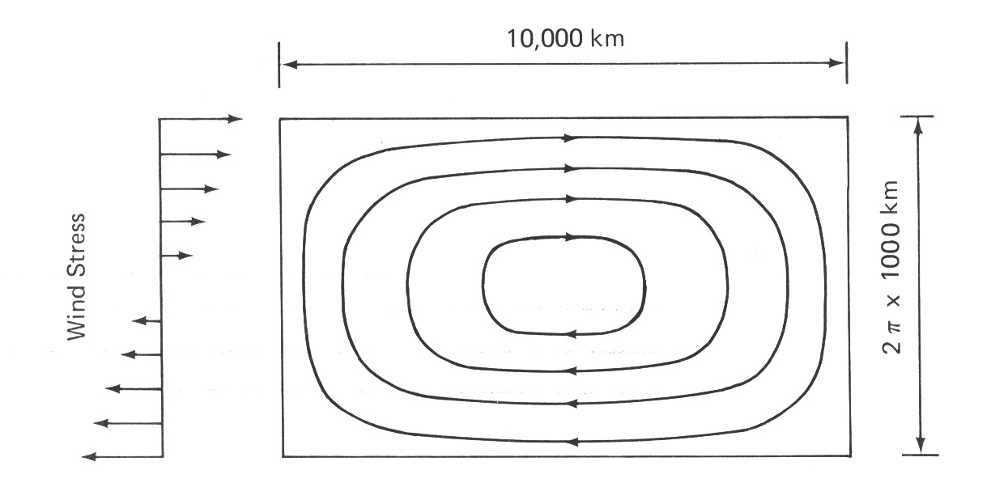
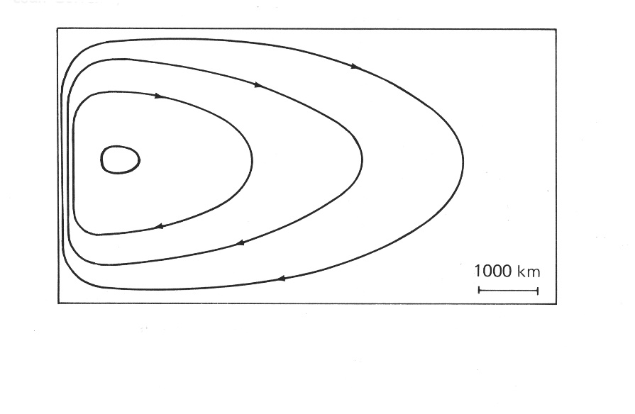
Two models of the Gulf Stream
Stommel, 1948
Notes:
Testing process models.
Rectangular basin forced by a sinusoidal wind stress
Uniform rotation versus meridional variation in the coriolis parameter
One has a Gulf Stream, the other one doesn’t
Model evaluation done by inspection
Test of the hypothesis that beta is a cause of westward intensification

Slide 3
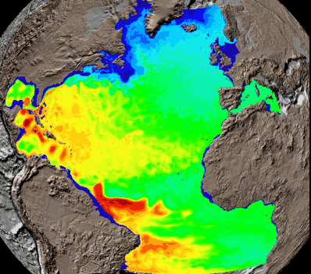
A third model of the Gulf Stream
Temperature
at 100m
Simulation
duration:
1 year
Simulation courtesy of
Mat Maltrud, Los Alamos National Laboratory
Notes:
Simulation models: complex mean state, temporal variations.
Criteria
Separation from the coast
EKE
Eddy demographics # of WCRs, CCRs, etc

Slide 4
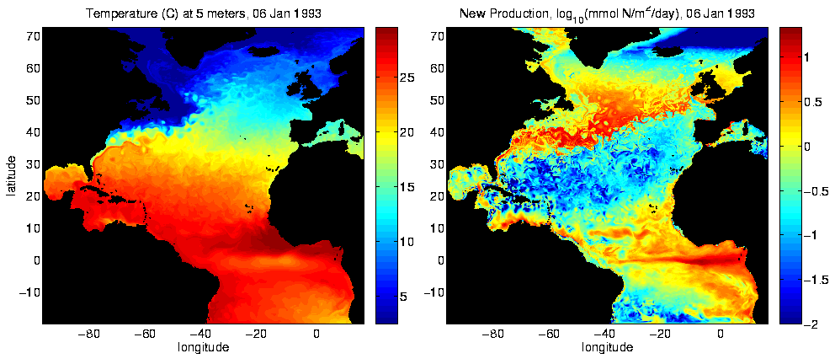
An eddy-resolving model of the North Atlantic
Temperature log (New Production)
Beyond Phenomenological Assessment
Property distributions
Time-dependence
Rates and fluxes
Quantitative Skill Evaluation
Does one model match the data better
than another? At what level of
confidence?
Hypothesis testing

Slide 5
What is Truth?
Truth
ε_{d}
ε_{p}
ε_{m}
Prediction
Data
Model
Misfit δ
Truth real but unknowable
Errors unknowable
Prediction a credible blend:
Data + Model
Invokes statistics of ε_{d ,} ε_{m}
Prediction Error: blend of ε_{d ,} ε_{m}
Misfit: δ = ε_{d} - ε_{m}
Skill:
Misfits
Small, Noisy
Deduced Inputs
Plausible, Smooth
Processes, Features
Realistic
Lynch et al., 2009
Notes:
What is truth?
Both the model and the observations are approximations to the truth
Inescapable that we are pursuing truth that cannot be known with certainty.

Slide 6
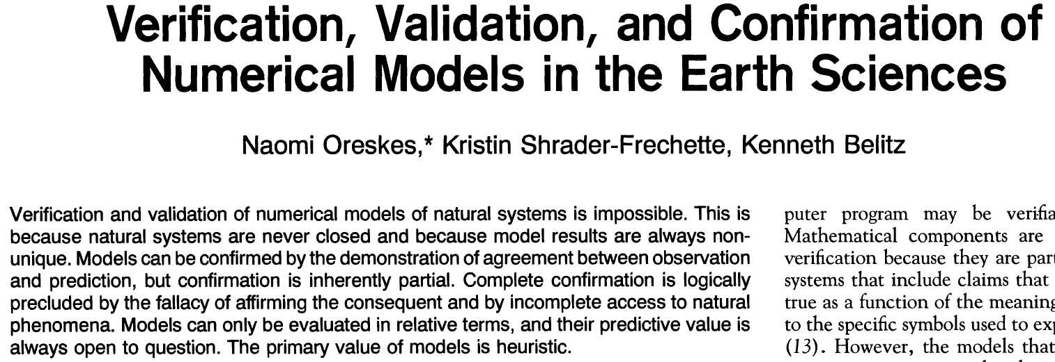
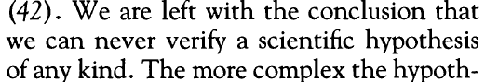
…
Notes:
The final issue of the journal Science?
Affirming the consequent
If P then Q
Q
Therefore P – an incorrect conclusion.
My model predicts A
I observe A
My model is correct
Fallacy of affirming the consequent: my model could have gotten A for the wrong reason.
Important principles contained herein; avoid being paralyzed by this conclusion.

Slide 7
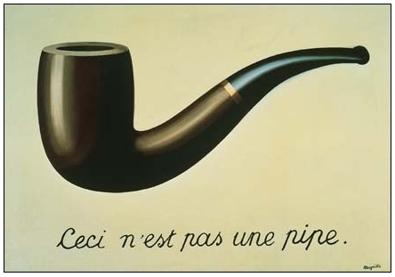
Correctly put by Rene Magritte…
…it’s a question of construction
Slide courtesy of Neil Ganju, USGS

Slide 8
Or even more simply…
Ceci n’est pas l’ocean
Slide courtesy of Neil Ganju, USGS
Notes:
This is not the ocean; the primitive equations are an approximation to the ocean.
We can learn a lot about how the ocean works with this approximation.
Rejoinder to Oreskes: all models are wrong, some models are useful.

Slide 9
What is Truth?
Truth
ε_{d}
ε_{p}
ε_{m}
Prediction
Data
Model
Misfit δ
Truth real but unknowable
Errors unknowable
Prediction a credible blend:
Data + Model
Invokes statistics of ε_{d ,} ε_{m}
Prediction Error: blend of ε_{d ,} ε_{m}
Misfit: δ = ε_{d} - ε_{m}
Skill:
Misfits
Small, Noisy
Deduced Inputs
Plausible, Smooth
Processes, Features
Realistic
Lynch et al., 2009
Notes:
Getting back to the truth triangle…
We have our 2 approximations to the truth, and we can measure the misfit between them.
Can shrink the misfit to zero and still be wrong.
Concept of overfitting

Slide 10
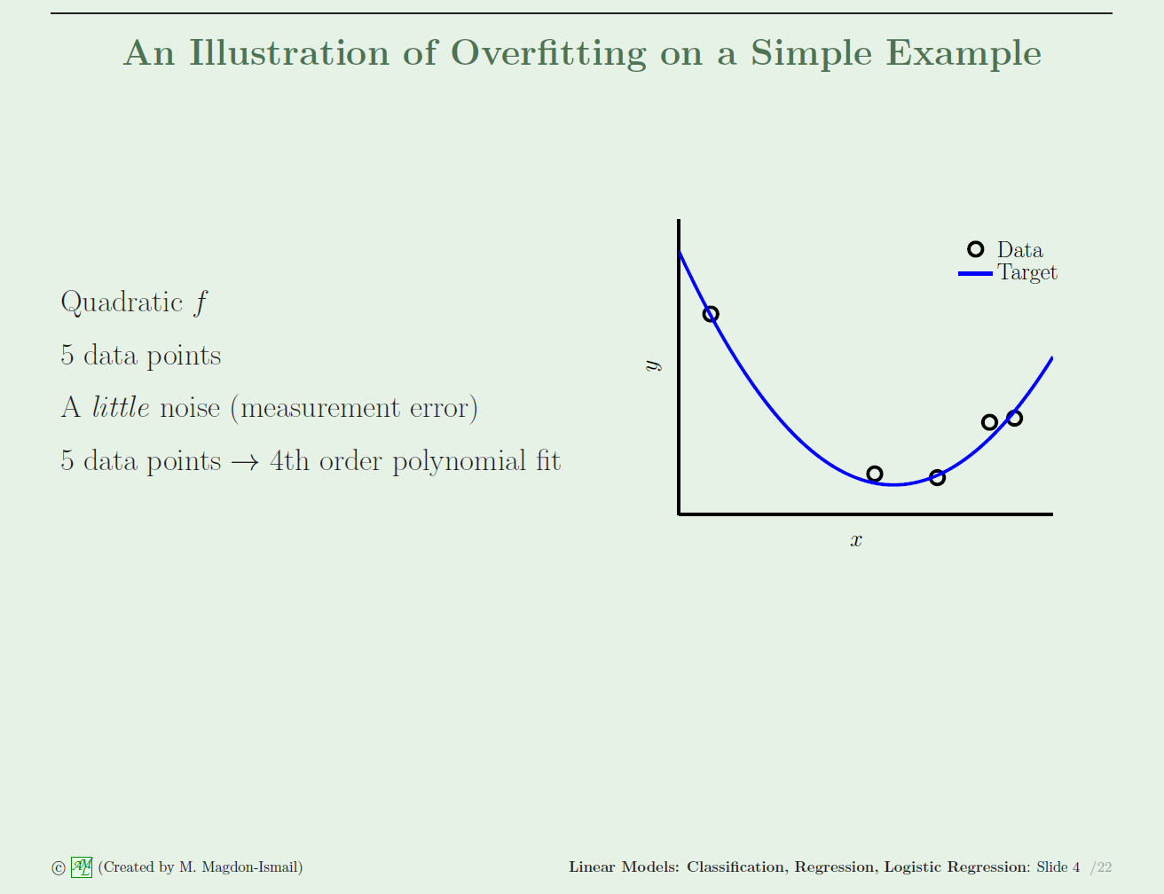
data
truth
“Truth”
d = T + ε_{d}
Notes:
Function y is quadratic in x
Simulated data with measurement error

Slide 11
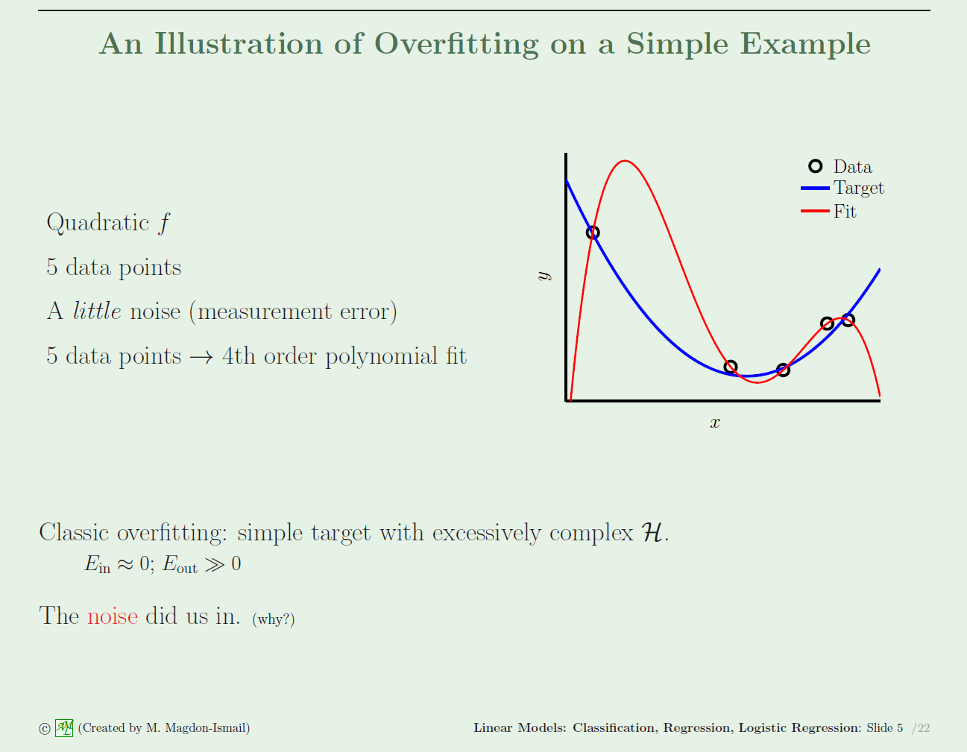
data
Truth
model
“Truth”
d = T + ε_{d}
Model
Misfit = data – model = 0
Errors are large away from the data
Notes:
The model fits the data perfectly but is wildly different than the truth away from the data.
This can be a problem with all aspects of modeling, particularly phys-bio where the data are relatively sparse.
Misfits commonly attributed to not enough dynamics, leading to addition of more complexity; tendency prone to overfitting.
Degrees of freedom: e.g.. Std dev is N-1 because it requires a mean.

Slide 12
What is Truth?
Truth
ε_{d}
ε_{p}
ε_{m}
Prediction
Data
Model
Misfit δ
Truth real but unknowable
Errors unknowable
Prediction a credible blend:
Data + Model
Invokes statistics of ε_{d ,} ε_{m}
Prediction Error: blend of ε_{d ,} ε_{m}
Misfit: δ = ε_{d} - ε_{m}
Skill:
Misfits
Small, Noisy
Deduced Inputs
Plausible, Smooth
Processes, Features
Realistic
Lynch et al., 2009
Notes:
How do we measure the misfit?

Slide 13
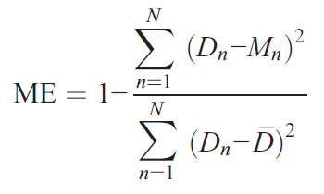
Misfit Metrics
Rationale
Systematic model evaluation requires a
hierarchy of performance metrics.
Definitions
Bias
RMS difference
Centered RMS difference (“pattern similarity”)
Correlation coefficient
Coherence
Model Efficiency
Notes:
Bias – difference in the means.
RMSD – square root of the sum of the squares of differences between predictions and observations.
CRMSD – RMSD that accounts for bias: subtract the means from both observations and model and compute the RMS.
Model efficiency; similar to RMS difference but normalized by the departures of the data from the mean value.
All available in Matlab and other toolboxes

Slide 14
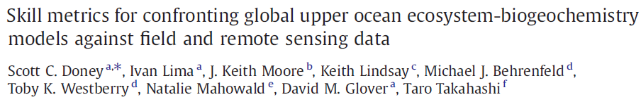
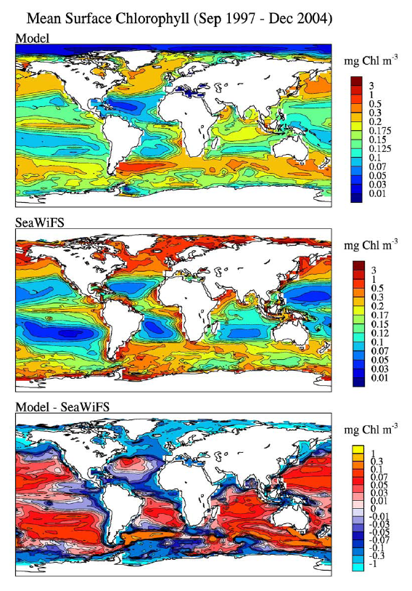
Notes:
Example skill evaluation of a coupled physical-biogeochemical model using satellite CHL.

Slide 15
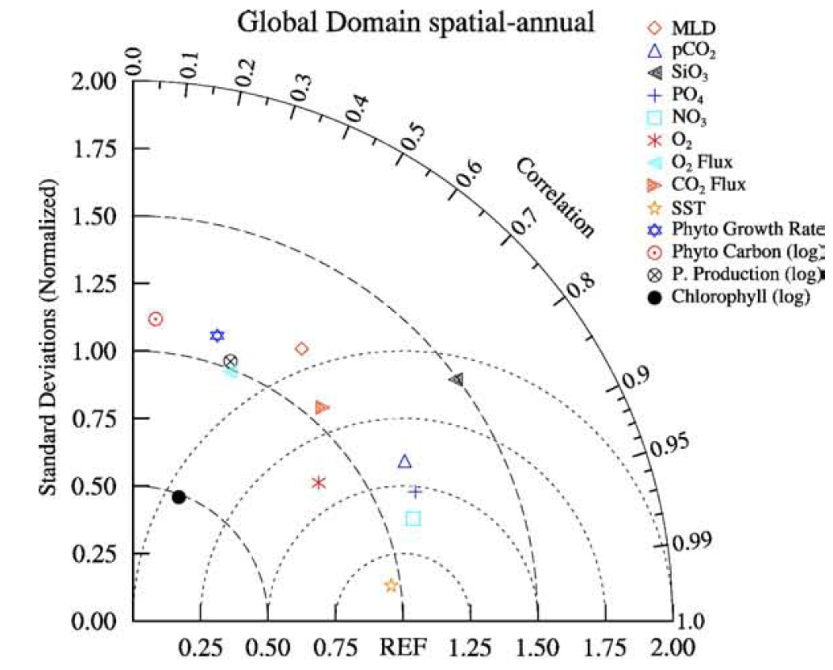
Taylor Diagram
Phyt C
SiO₂
Chl
NO₃
SST
Azimuthal position: correlation
Radial distance: standard deviation, normalized by std dev of data
Perfect fit: (1,0)
Mean model: (0,0)
Centered RMS difference proportional to distance from (1,0)
Doney et al. 2009
Notes:
SST – close to reference point
Nitrate – still very close
Phytoplankton carbon – std is OK but correlation is close to zero
CHL – 0.5x std
SiO2 – 1.5x std
Codes in special issue repository

Slide 16
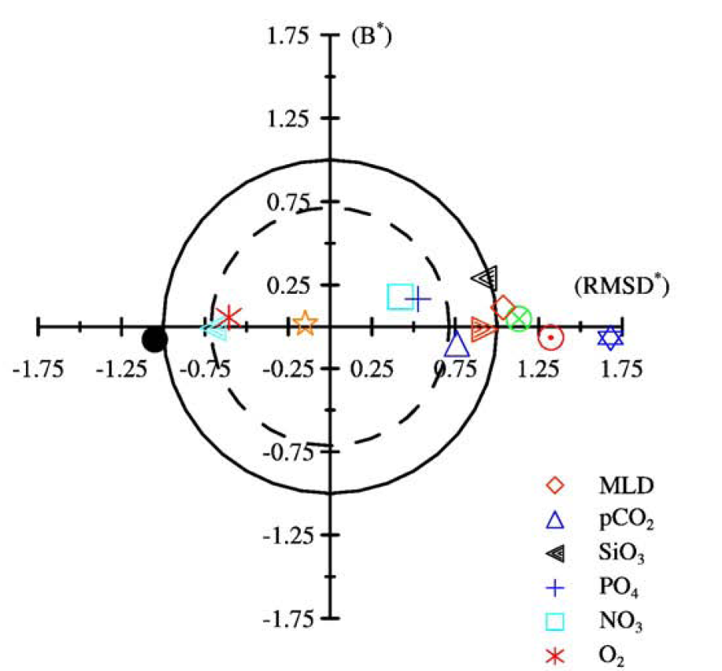
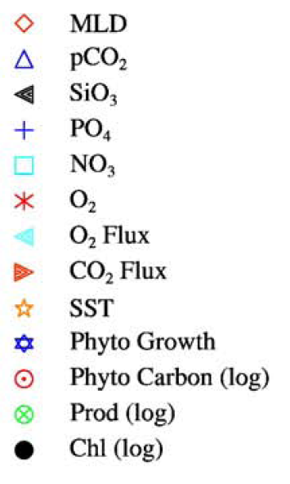


Target Diagram
Normalized bias = $\frac{\overline{m}−\overline{d}}{σ_{d}}$
RMSD = average
of the data
SiO₂
NO₃
Chl
SST
Phyt C
Observational uncertainty
(SST)
Jolliff et al. (2009)
Doney et al. 2009
Notes:
Y-axis: normalized bias
Upper half-plane: mean of the model larger than the mean of the data
Lower half-plane: mean of the model less than the mean of the data
X-axis: centered RMS difference multiplied by the sign of the difference in the standard deviations of the model and observations
left half plane, model variance too low
right half-plane, model variance too high
Center: target – zero bias, variance equal to the data
radial distance – RMS difference; origin is zero misfit, note observational error
position – bias and variance
NRMSD’=1 and the mean model
SST: good; observational uncertainty, overfitting [SST used to infer heat flux]
Nitrate: model biased high, variance too high
Silicate: variance higher than obs (like Taylor diagram); bias: model too high – model no better than the mean of the data
Chl: a little worse than mean model; biased low, variance too low
Phyt C – even worse, not biased but variance too high
Some properties worse than the mean model
Quantitative evaluation of the misfit; comparison of the misfit between variables.

Slide 17
Receiver-Operator Characteristic (ROC)
Quantifies skill as a function of threshold using a binary discriminator
Appealing characteristics for HAB and water quality applications with critical
thresholds such as dissolved oxygen and toxin concentration.
Threshold
Perfect model
Data
False negative
True positive
Threshold
True negative
False positive
Model
Icarus Allen
Notes:
ROC was devised during the Second World War as a means for radar operators to correctly identify hostile or friendly aircraft based on a radar signal, a situation where the incorrect identification of a hostile aircraft could be catastrophic.
Threshold – e.g. 80 micrograms of saxitoxin per 100g of shellfish tissue
Model prediction of the data utilizes the same threshold.
True positives, true negatives.
Two kinds of errors: false negative, false positive
Impact of model errors different in different applications
HABs
False negative – public health threatened
False positive – economic opportunity lost
Radar
False positive – shoot down a friendly aircraft
False negative – enemy gets through

Slide 18
Receiver-Operator Characteristic (ROC)
Temperature Chlorophyll
Sensitivity=fraction of true positives
Specificity=fraction of true negatives
Sweeping threshold through sensitivity vs. specificity space
Above data range (0,0) no TP, all TN
Perfect model (0,1) all TP, TN
Below data range (1,1) all TP, no TN
Random number generator 1:1 line
Icarus Allen
Notes:
Phys-bio model of the North Sea by Icarus Allen
Encourage you to use as many different types of metrics as you can to quantify the relationship between model and observations.

Slide 19
Problem: How does one assess the skill of models in which data have been assimilated?

Slide 20
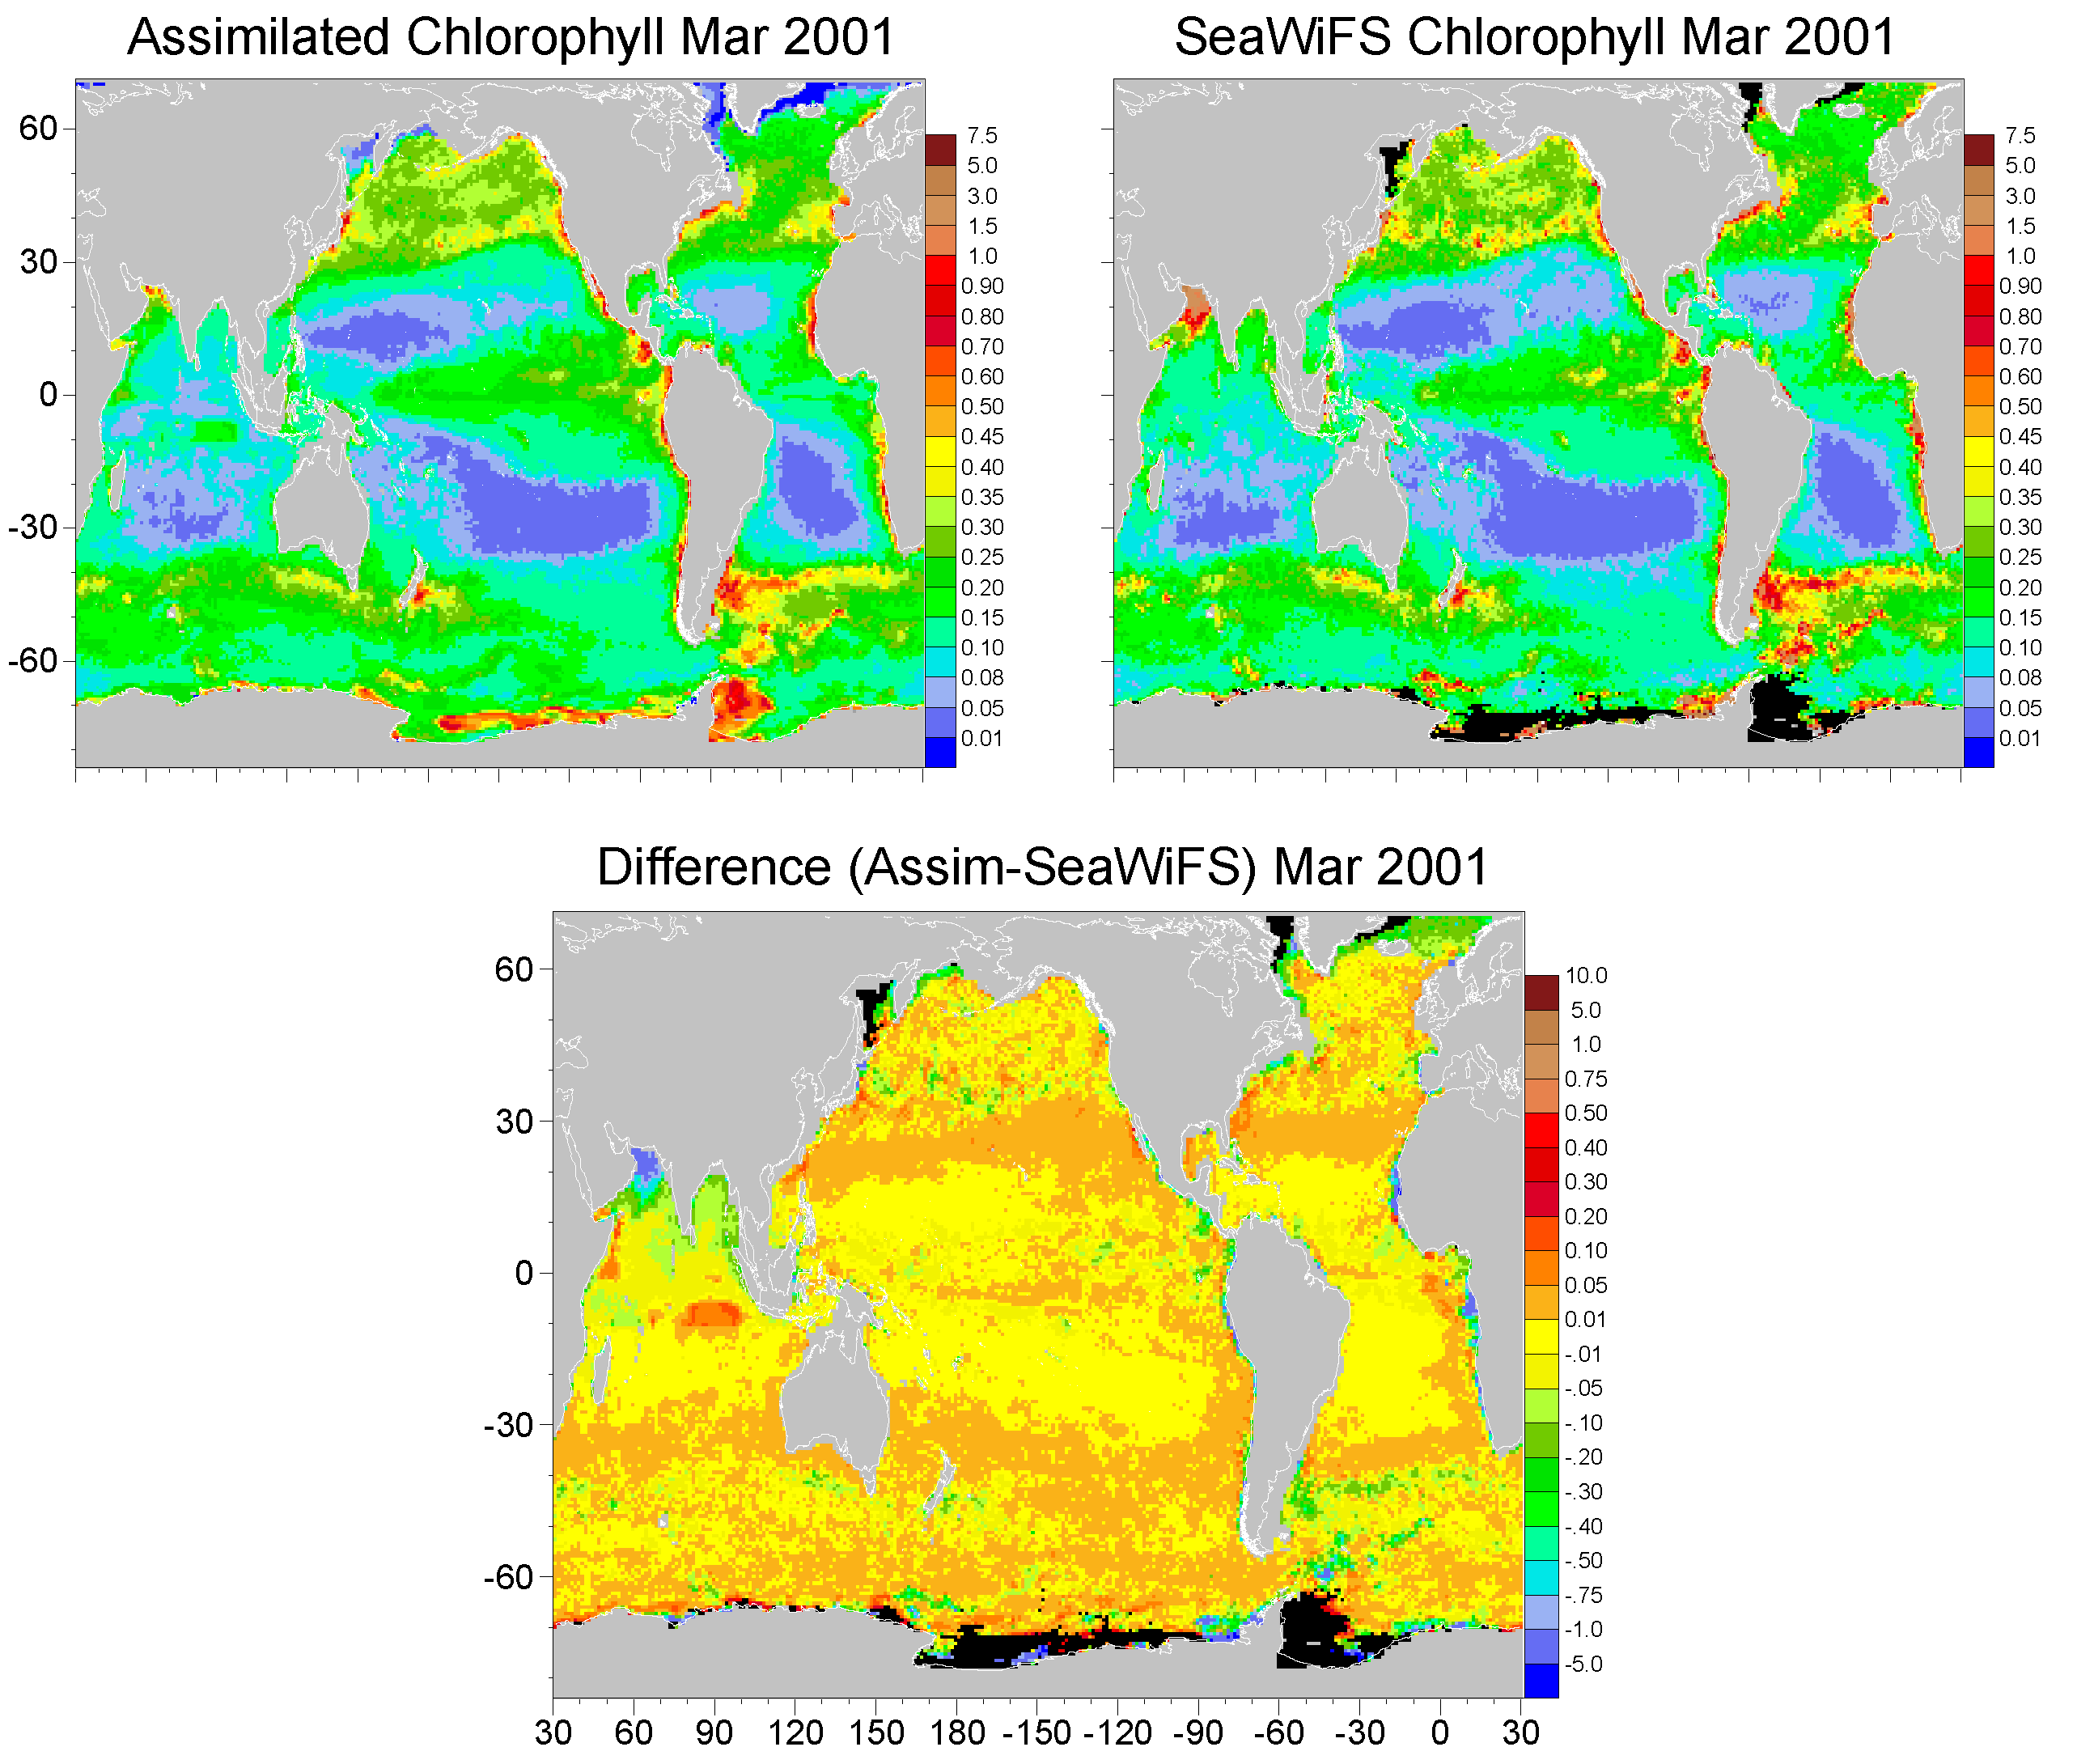
Fig. 4.2. Assimilation model chlorophyll (mg m⁻³), SeaWiFS mean chlorophyll, and the difference (Assimilation-SeaWiFS, in chlorophyll units) for March 2001. From Gregg (2007).
Notes:
NASA Ocean Biogeochemical Model – Watson Gregg
Assimilating ocean color data; comparing model back to the data set being assimilated
Most of the differences are very small, bounded by +/- 0.05
A few trouble spots, e.g. predicted high biomass in Indian Ocean not observed by SeaWiFS

Slide 21
Error
Error
Figure 4.3. Annual bias and uncertainty for assimilation as a function of assimilation frequency (days of assimilation events, i.e., 1 is every day, 2 is every other day, etc.) assimilation is performed). The annual bias and uncertainty for the free-run model is shown. From Gregg (2007)
Notes:
Free run NRMSD = 65%
Bias 21%
Assimilation cycles shorter than 180 days reduce the total error
model could have the right pattern but in the wrong place; assimilation fixes that.
Bias is a stronger constraint: only when the assimilation cycle is shorter than 20 days is the model bias reduced.
Says something about the timescale over which the model mean tends to diverge from the observations.

Slide 22
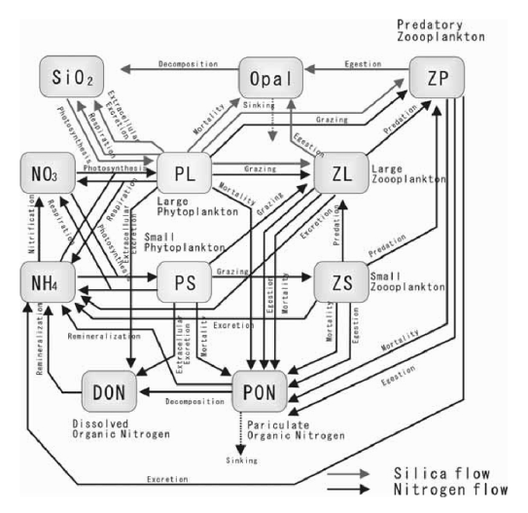
Complexity: advantage or liability?
NEMURO model (Kishi et al., 2004)
P
production
grazing
N
Z
death
remin
death
D
excretion
Goal: To objectively compare the skill of ecosystem models characterized by varying levels of complexity
Friedrichs et al. 2007
Notes:
Regional Testbed project
From Wikipedia: Occam's razor is used as an abductive heuristic in the development of theoretical models rather than as a rigorous arbiter between candidate models.^{[4][5]} In the scientific method, Occam's razor is not considered an irrefutable principle of logic or a scientific result; the preference for simplicity in the scientific method is based on the falsifiability criterion. For each accepted explanation of a phenomenon, there may be an extremely large, perhaps even incomprehensible, number of possible and more complex alternatives. Since failing explanations can always be burdened with ad hoc hypotheses to prevent them from being falsified, simpler theories are preferable to more complex ones because they tend to be more testable

Slide 23
How can we objectively compare model skill?
Developed a framework (regional testbeds) for quantitatively comparing different ecosystem models:
  1-D (vertical) numerical framework
  Physical forcing fields
    from 3-D circulation model or data:
    T, MLD, light, vertical velocity, k_{z}, horiz advection
  Biogeochemical data
  Assimilation/optimization framework
Friedrichs et al. 2007
Notes:
Necessity of implementing various biological models in a common physical framework; bio models can be sensitive to subtle differences in physics.
Parameter optimization framework: testing model skill rather than the degree to which the models have been tuned to the data.

Slide 24
Methods: Ecosystem Model Descriptions
Simplest Models (single P compartments)
Model 1: N, P, Z, D (McCreary)
Model 2: N, P, Z, D, DON (Hood)
Model 3: N, P, Z, D, chl, T (CCCMA/Christian)
Model 4: N, P, Z, D, chl, NH₄ (Anderson/McGillicuddy)
Model 5: N, P, Z, D, chl, NH₄, DOM, T, C (Schartau)
Friedrichs et al. 2007

Slide 25
Methods: Ecosystem Model Descriptions
More Complex Models (multiple P compartments)
Model 6: N, NH₄, Fe, 2P, 2Z, 2D, chl (Christian)
Model 7: N, NH₄, Fe, 2P, 2Z, 2D, chl (Wiggert)
Model 8: N, NH₄, Si, 2P, 2Z, 2D (Chai)
Model 9: N, 2P, 4Z, D, DOM, B (Laws)
Model 10: N, NH₄, Si, 2P, 3Z, 2D, chl, DOM (Fujii)
Model 11: N, PO, NH₄, Si, Fe, 3P, 0Z, D, chl, DOM (Dunne)
Model 12: N, PO, NH₄, Si, Fe, 3P, Z, 2D, chl, DOM (Dusenberry)
Friedrichs et al. 2007

Slide 26
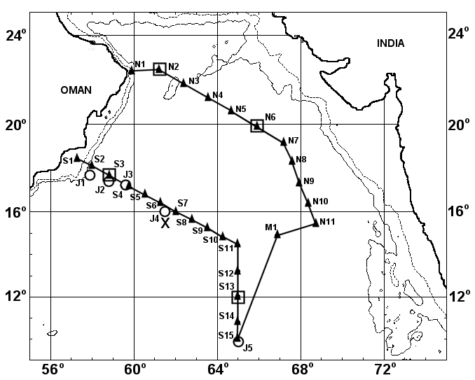
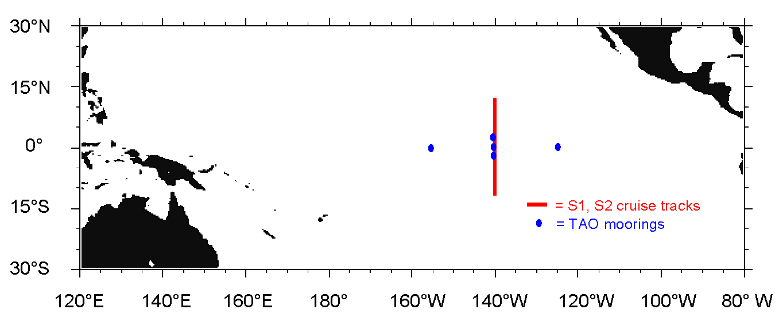
Biogeochemical data
Cruise observations:
nitrate
chlorophyll
primary production
Sediment trap:
1 year time series
Arabian
Sea
Equatorial Pacific
Friedrichs et al. 2007

Slide 27
Model-data comparison
cost function = measure of model-data misfit
# data
# sites types N_{ij}
cost function = Σ Σ Σ W_{ij} (X_{dat}-X_{mod})²
i j n
N = number of observations
W = weight (inversely proportional to square of uncertainty)
X_{dat} = Data (PP, chl, NO₃, or export)
X_{mod} = Model equivalents of the data
Normalize model cost to cost of the mean of the data:
Means (over depth and time) are computed for each type of data
Compute cost assuming X_{mod} equals mean at all times and depths
Friedrichs et al. 2007
Notes:
Weight – put the different data sets on equal footing

Slide 28
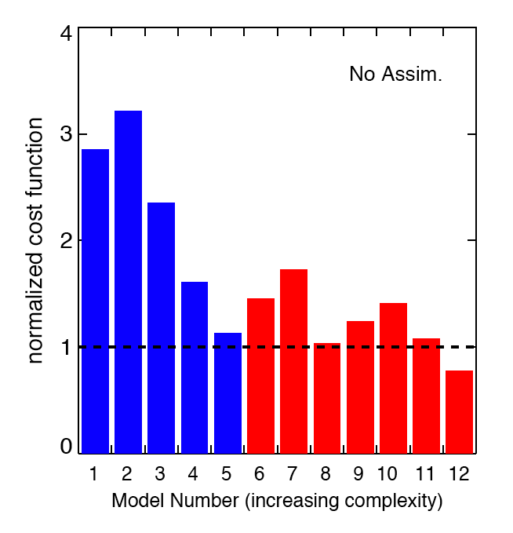
Pre-assimilation skill comparison
Worse
than
mean
Ecosystem
Models
= single P
= multi-P
Better than
mean
Without data assimilation, only one model does better than mean
General improvement with increasing complexity
Are we comparing model structure, or degree of tuning?
Friedrichs et al. 2007

Slide 29
Variational Adjoint Method
Nonlinear weighted least squares parameter
optimization method
Minimize cost function by systematically and iteratively adjusting values of a subset of model parameters
Key: selection of appropriate subset of model parameters
1. sensitivity of cost function
2. parameter correlations
Three to four parameters can be optimized
[P max growth rate, remineralization rate, …]
Friedrichs et al. 2007
Notes:
12 different models, different parameter sets

Slide 30
Experiment 1
Expt. 1 Expt. 2 Expt. 3
AS EP
data data
AS EP
params params
AS EP
output output
AS EP
data data
simultaneous
params
AS EP
output output
AS EP
data data
AS EP
params params
AS EP
output output
Individual cost Simultaneous cost Cross validation cost
Friedrichs et al. 2007

Slide 31
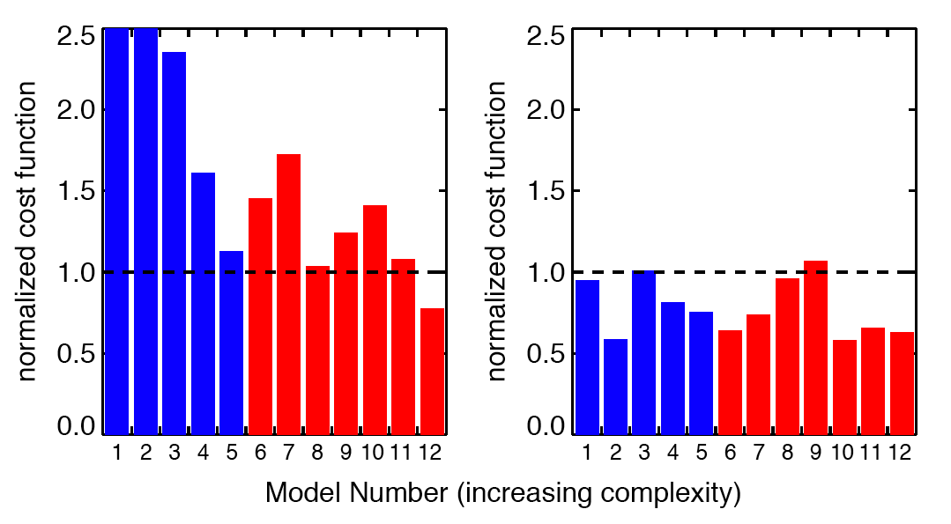
Expt. 1: Individual Assimilation
No Assim
Indiv Assim
= single P
= multi-P
Most models do better than mean of observations
No improvement with additional complexity
Friedrichs et al. 2007
Notes:
Very important lesson about testing models with observations: parameter optimization is an essential aspect.

Slide 32
Experiment 2
Expt. 1 Expt. 2 Expt. 3
AS EP
data data
AS EP
params params
AS EP
output output
AS EP
data data
simultaneous
params
AS EP
output output
AS EP
data data
AS EP
params params
AS EP
output output
Individual cost Simultaneous cost Cross validation cost
Friedrichs et al. 2007

Slide 33
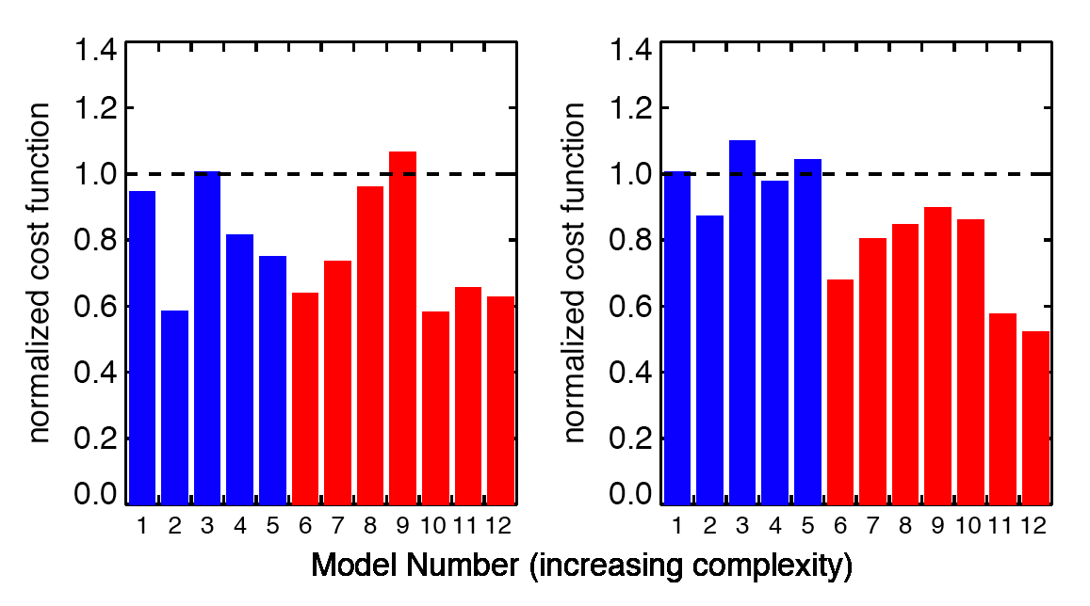
Expt. 2: Simultaneous Assimilation
= single P
= multi-P
Indiv Assim
Simul Assim
More complex (multi-P) models can fit data at both locations
simultaneously better than simpler models
Friedrichs et al. 2007
Notes:
Only 1 simple model beat the mean.
More complex models seem to have greater ability to simulate a wider range of regimes.

Slide 34
Experiment 3
Expt. 1 Expt. 2 Expt. 3
AS EP
data data
AS EP
params params
AS EP
output output
AS EP
data data
simultaneous
params
AS EP
output output
AS EP
data data
AS EP
params params
AS EP
output output
Individual cost Simultaneous cost Cross validation cost
Friedrichs et al. 2007
Notes:
Cross-validation: evaluating the portability of the models.

Slide 35
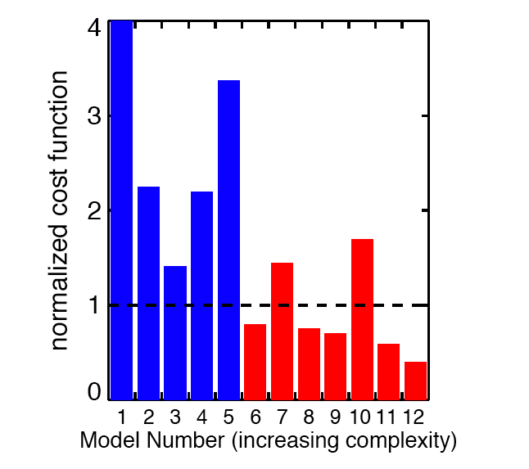
Expt. 3: Cross Validation
Worse
than
mean
Ecosystem
Models
= single P
= multi-P
Better than
mean
Only five models do better than mean
More complex (multi-P) models do better in cross validation, i.e. are more portable
Friedrichs et al. 2007
Notes:
All of the simple models are worse than the mean
Some, but not all, of the complex models do better than the mean.

Slide 36
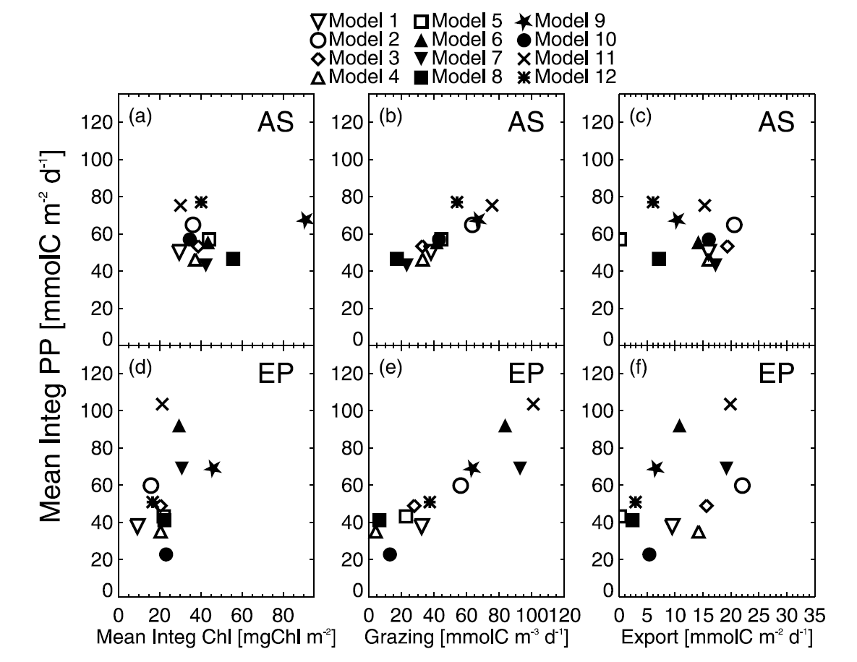
Fitted models have different solutions
2X
5X
Friedrichs et al. 2007
Notes:
The models fit the data in different ways.
Can get the right answer for many different reasons
factor of five variation in EP in Equatorial Pacific
factor of five variation in integrated PP, despite Chl being constrained by a factor of 2
contrast with AS solutions, which are more clustered (except for 1 outlier)
Oreskes paper: models are not unique; can get the right answer for a variety of different reasons.

Slide 37
Problem: More complex models contain more degrees of freedom.
How do we determine whether a more complex model has statistically more significant explanatory power than a simpler one?

Slide 38
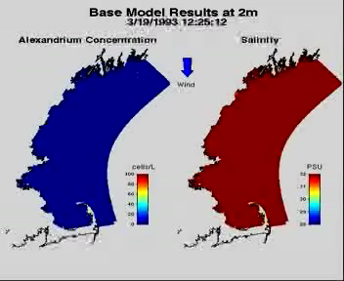
Hindcast Simulations in the Western Gulf of Maine
Stock et al. (2005)
Model: ECOM 3-D
MY 2.5 Closure
Forcing: Wind, Heat Fluxes,
Tides,River discharge

Slide 39
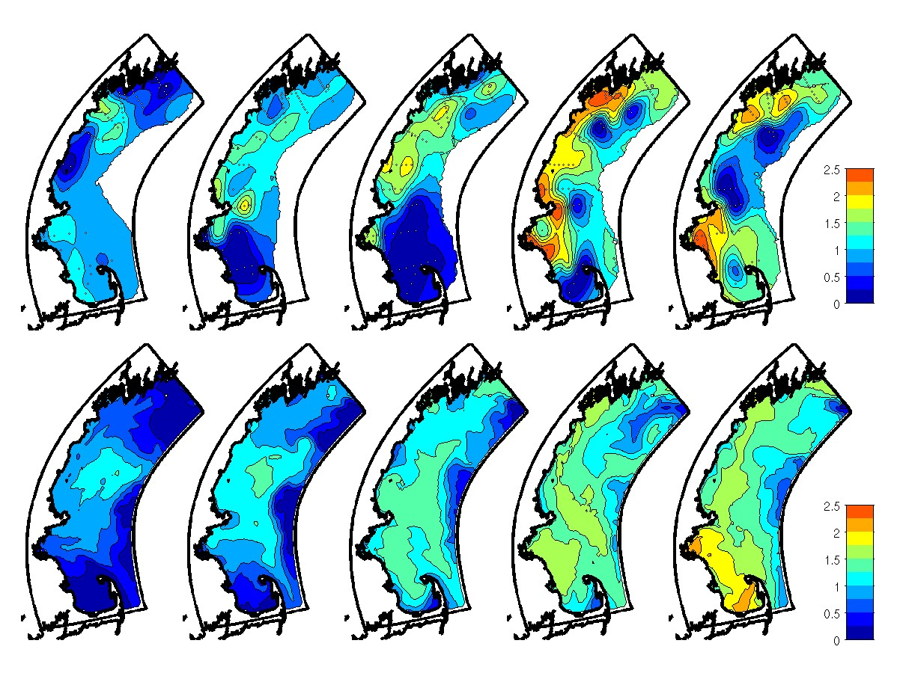
4/13
4/29
5/11
5/25
6/5
1993 Obs
log10(C)
Best Model
log10(C)
Notes:
Note overprediction in CCB 5/11

Slide 40
Maximum Likelihood Methodology
Model-data misfit of concentration (c)
Likelihood function for a model with parameters θ_{n}:
Maximum likelihood ratio test: null hypothesis (L₀ vs. alternative L₁)
Likelihood ratio (l) has chi-square distribution with m-n degrees of freedom
Stock et al., 2005
Notes:
Test hypotheses about bloom dynamics, recognizing model-data discrepancies.
Likelihood function: model-data misfit (essentially epsilon squared) scaled by the covariance of the errors
In this case, error covariance is assumed to be an analytic function with length scales longer in the along-isobath direction than in the cross-isobath direction.
Likelihood ratio of the null model to that of an alternative with more parameters
Alternative model should fit the data better
Likelihood ration has a chi-square distribution with the degrees of freedom equal to the number of additional parameters in the alternative model.
Use this statistic to determine whether L1 fits the data significantly better than L0; or more precisely, the confidence with which one can reject L0 in favor of L1.

Slide 41
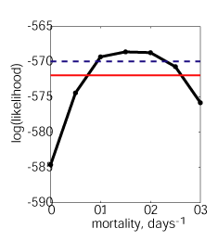
Models with and without mortality
Confidence limits set based on properties of maximum likelihood parameter estimates
90%
99%
Reject null hypothesis: mortality≠0
0.1 0.2 0.3
Mortality, days⁻¹
Notes:
Hypothesis: mortality is important in controlling termination of the bloom.
Null model – mortality = 0
Sweep through zero through 0.3 per day.
Maximum likelihood estimate – mortality = 0.15 per day
90% confident that the mortality is between 0.1 and 0.2 per day

Slide 42
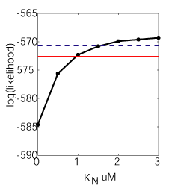
Models with and without nutrient dependence
Reject null hypothesis: K_{N} ≠0
90%
99%
K_{N} = half saturation
constant for nutrient
uptake
Notes:
Maximum likelihood estimate on the end pont Kn=3
Can reject the null model with high level of confidence in both cases: mortality and nutrient limitation

Slide 43
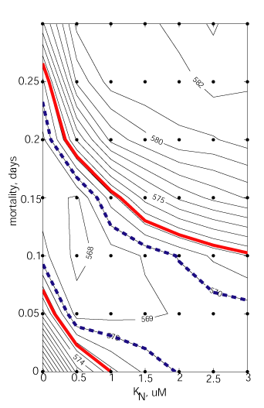
Nutrient Dependence or Mortality?
Reject baseline for mort. + DIN
Cannot determine if loss limitation is best imposed by mean mortality, DIN or some combination.
Avoid erroneous rejection
-1
99%
90%
Notes:
Likelihood surface
Maximum likelihood: mortality = 0.1, Kn= 0.5
Strongly reject the hypothesis that mortality and Kn = 0
Confidence intervals: maximum likelihood estimate not distinguishable from m=0, Ks=3 and m=.1, Ks=0.
Looks like both are important, but the data cannot distinguish between mortality and nutrient limitation in controlling the bloom.
In other words, its time to stop; there are remaining misfits, but additional complexity is not the answer– the data do not support it. Need better process understanding.
MLRT: a powerful tool for hypothesis testing, useful in simple applications like multiple regression all the way to 3D coupled phys-bio models.

Slide 44
12.823 Roadmap
Biology
Complex
Physics
Simple
Complex
Qualitative
Quantitative
Connection to observations
Notes:
This completes our brief survey of how models can be used to investigate physical-biological interactions.
Underlying models have ranged from very simple to complex in both physics and biology
Connection with observations has ranged from qualitative in terms of evaluating process models to more direct via simulation models and data assimilative models.
The entire three-space is valid from a scientific point of view.
The overarching theme is hypothesis testing, and the entirety of this three-space is valuable for that purpose.
Models have matured to the point where they are a third element of the scientific method, on equal footing with theory and observation. Simulation is a particularly effective tool for physical-biological interactions, where the processes are highly nonlinear and observations are sparse– in a way, models constitute a vehicle to get the most from data.

