Slide 1
1. Evolution part 2
2. Model evaluation
Project presentations – 15 min, 5 min Q&A
Friday May 14
Katy
Evie
Michael
Jane
Monday May 17
Zoe
Kharis
Isabel
Jacob
Reports due May 20

Slide 2
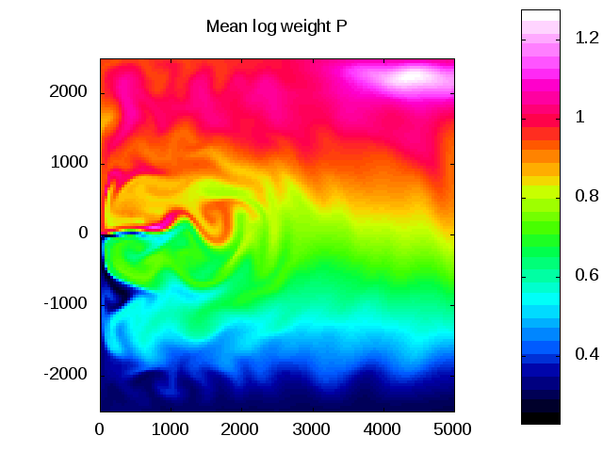
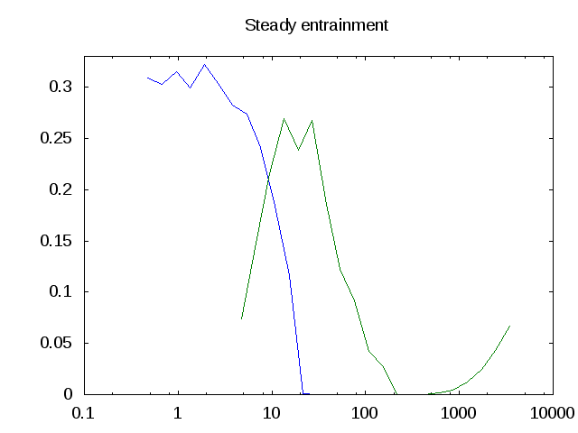
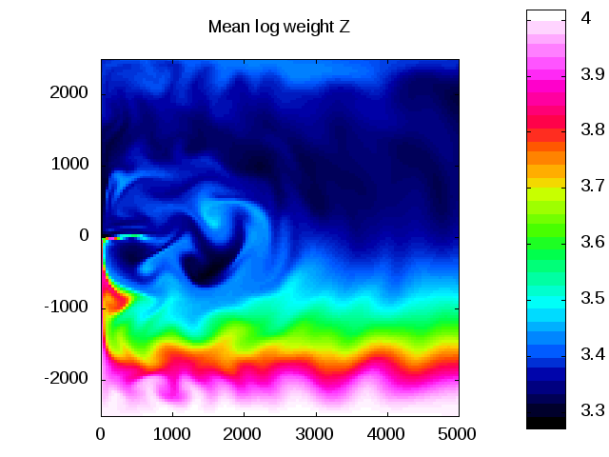
NPZ model with evolving traits
in a double-gyre system
Mean log weight P
P
Z
Biomass
Mean log weight Z
Weight
Notes:
Glenn’s last example of evolution – NPZ model with traits formulated as continuous variables allowed to evolve over time.

Slide 3
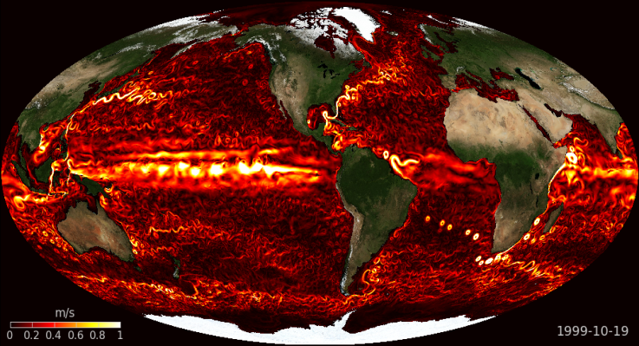
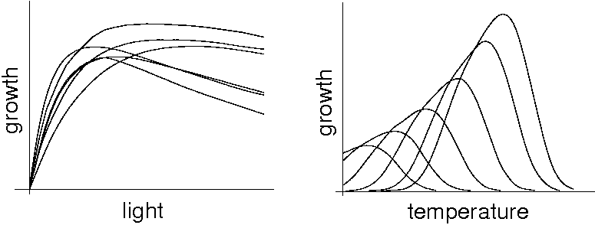
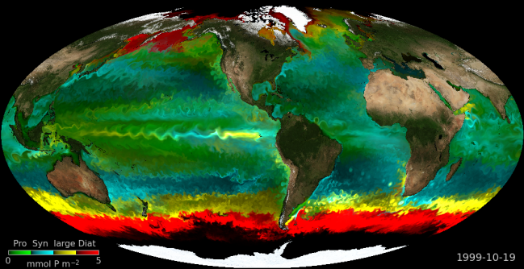
Follows et al. “Darwin” model
An alternative to specifying functional types: the “Darwin” model
physiology
environment
Fitness &
selection
Many 10s of initialized
phytoplankton types.
Stochastically assigned
physiological characteristics
2 grazers
Global 3d ocean circulation model
N, P, Fe, Si cycles
ecosystem structure
and function
Follows et al. (2007)
c.f. Pimm and Lawton (1979)
Bruggeman & Kooijman (2007)
Notes:
3
3
3
Stepping back from the continuously evolving case
This example: not modeling evolution but selection.
Stochastic assignment of traits assigned in the beginning assuming specific functional forms and allometric relationships.

Slide 4
Notes:
Syn and Pro – prokaryotes
Pro – NH4 and NO2 nutrition
Syn, picoeuks: nitrate

Slide 5
Small
Small
Large
Large
Small
Large
Notes:
Q: which ecotype is represented here? [Prochlorococcus]
What would a diatom look like? [large, high light, silica, NO3, NO2, NH4]
Nutrient uptake: small cells have a higher affinity for nutrients (sfc to volume)
Light absorption: growth increases with light, then decreases (photoinhibition). Large cells require higher light to achieve their maximal photosynthetic rate (sfc to volume; package effect)
Optimal temperature ranges: large cells have the capacity to grow more quickly than small, but there is overlap
Random assignment of the various characteristics, followed by random assignment of specific parameters.
Overall: small cells outcompete large cells in low light, low nutrient conditions
large cells outcompete small cells in high light, high nutrient conditions.

Slide 6
Notes:
Phytoplankton:
Each of the 78 species has a unique and stochastically assigned maximal growth rate, nutrient uptake kinetics, temperature, and light parameters.
Nutrient limitation: Gammas and Ks describe nutrient preferences [e.g. Ks lower for NH4 than NO3]
Nutrient equation:
R describes the nutrient ratios [e.g. NO3:NH4=0 for Prochlorococcus]
S is remineralization
Phytoplankton equation:
Sinking is size-dependent; larger cells sink more quickly than smaller cells.
There is linear mortality of P and grazing by 2 size classes of Z using the Monod formulation.
Linear mortality in P,Z feed into DOM and POM, which are then remineralized to N, which is represented by S in the nutrient equation.

Slide 7
Notes:
Physiologically based allometric relationships objectively based but randomly assigned.

Slide 8
Experimental Design: Follows et al. (2007)
ECCO GODAE 1x1 degree global ocean circulation state estimates
Initialized with climatological T, S, PO₄, NO₃, SiO₂
78 Phytoplankton, 2 Zooplankton uniform and low
Darwin model integrated for 10 years to quasi-steady state
Year 10 analyzed
10 different ensemble members
Notes:
10 year quasi-steady state: ecosystem has adjusted to the initial transients; deep sea nutrients still evolving.

Slide 9
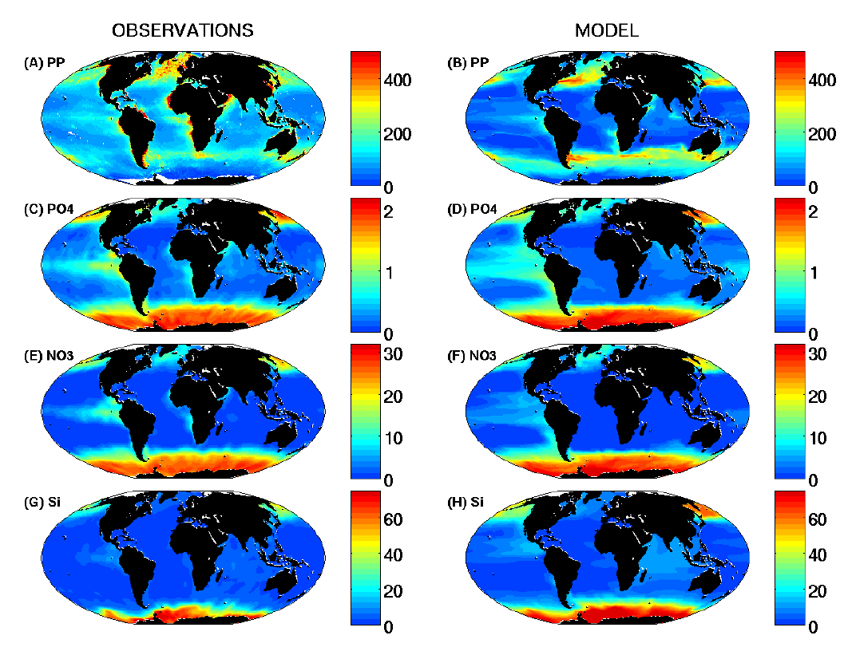
Results: 0-50m fields
g C m⁻² yr⁻¹
µM PO₄
µM NO₃
µM Si
Notes:
Satellite-based estimate of PP
High in N Atl
Less in N Pac
Low in subtropics
model overshooting in Southern Ocean
large-scale patterns are similar
PO4, NO3, Si distributions do not drift too far from ICs
HNLC in Eq Pac not as HN, but feature is there
Resolution not sufficient for upwelling regions, e.g. west Africa

Slide 10
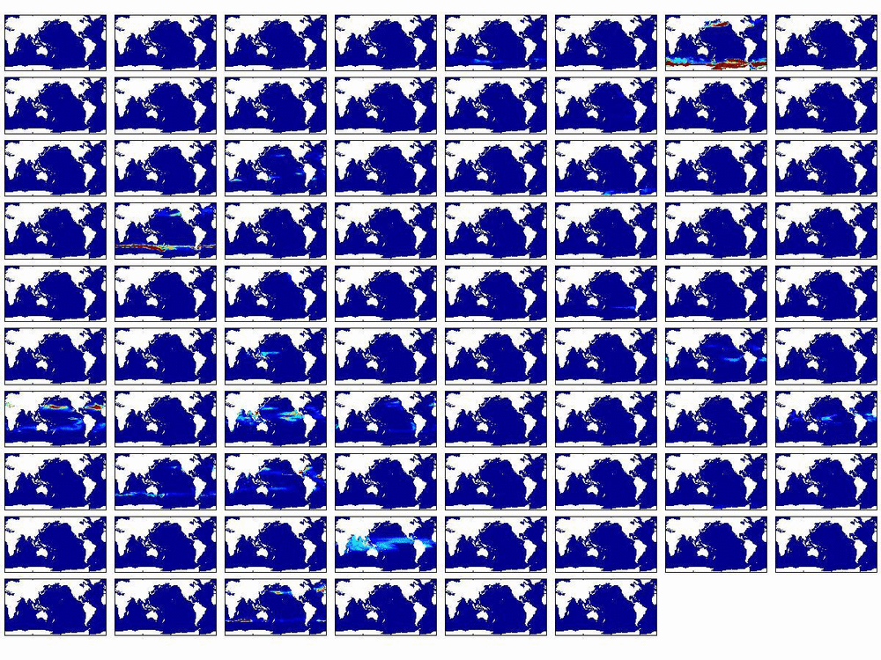
Single ensemble member, all 78 functional types, 0-50m
Notes:
10
78 different ecotypes, all but 20 go extinct
Cf. previous diagram: occupied space is smaller than the energetically feasible space.

Slide 11
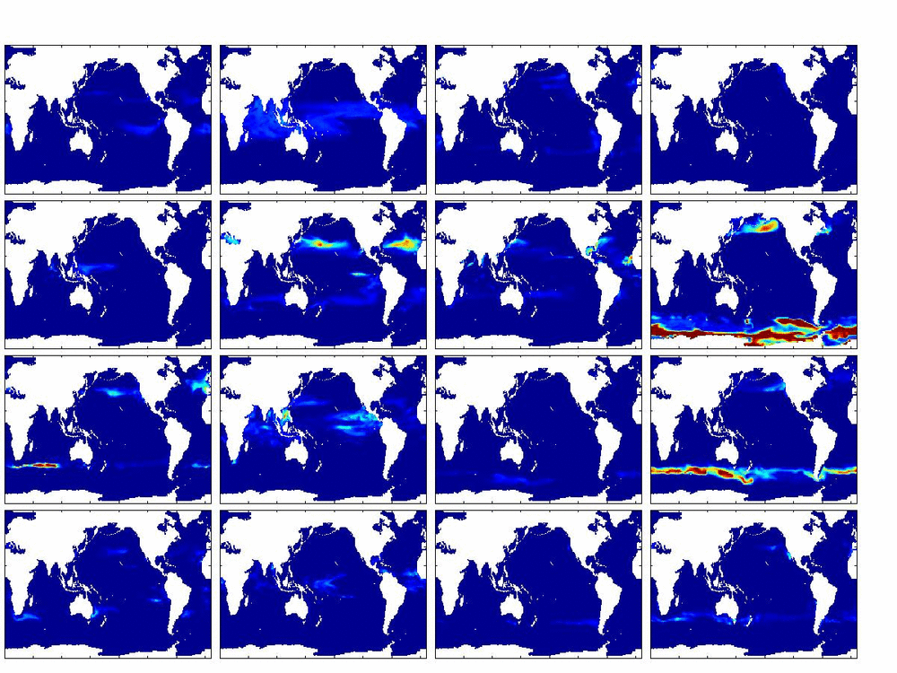
Emergent biogeography – 16 most abundant phytoplankton types
Prochlorococcus analogs
Synechococcus & small eukaryotes
.
Diatoms
Other large eukaryotes
Notes:
In these runs 15 – 20 “phytoplankton functional types” are “fit” i.e. maintain a population above some threshold value
KEY:
1 – 4, top row: The four most abundant Prochlorococcus analogues (small phyto, cannot assimilate NO3)
5 – 9, second row + 1: Small phyto, can consume NO3 (Synchococcus and small eukaryote analogues)
10 – 12, rest of third row: Diatom analogues (large phyto, need Si)
13 – 16, bottom row: Other large phyto

Slide 12
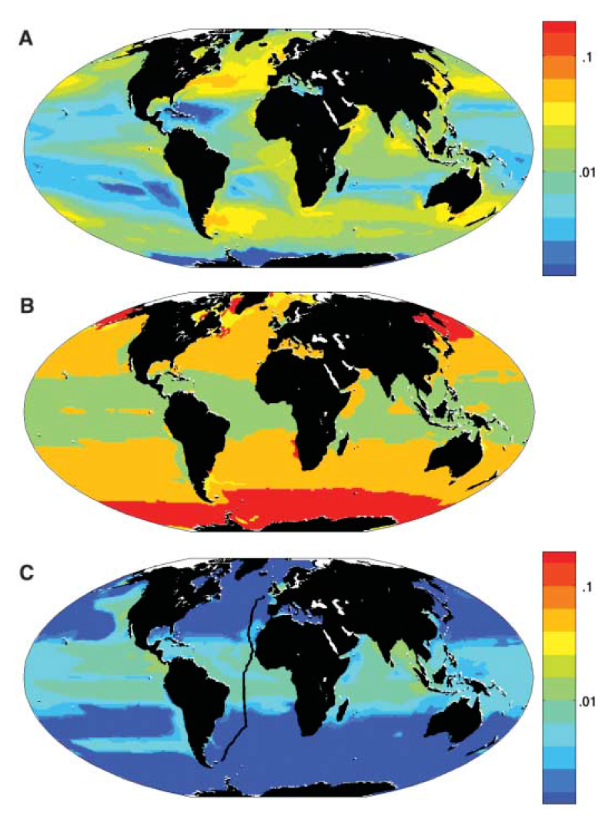
Darwin Model Results
0-50m Total P
µM
Phytoplankton
Biogeography
Pro-like
Other small
Diatoms
Other Large
0-50m Pro-like
µM
AMT transect
Notes:
Synthesis of the predicted biogeography
Diatoms: Southern ocean and subpolar upwelling regions
Small: subtropics
Pro: tropics and southern subtropics
Fig. 1. Annual mean biomass and biogeography from single integration. (A) Total phytoplankton biomass (uM P, 0 to 50 m average). (B) Emergent biogeography: Modeled photo-autotrophs were categorized into four functional groups; color coding is according to group locally dominating annual mean biomass. Green, analogs of Prochlorococcus; orange, other small photo-autotrophs; red, diatoms; and yellow, other large phytoplankton. (C) Total biomass of Prochlorococcus analogs (mM P, 0 to 50 m average). Black line indicates the track of AMT13.

Slide 13
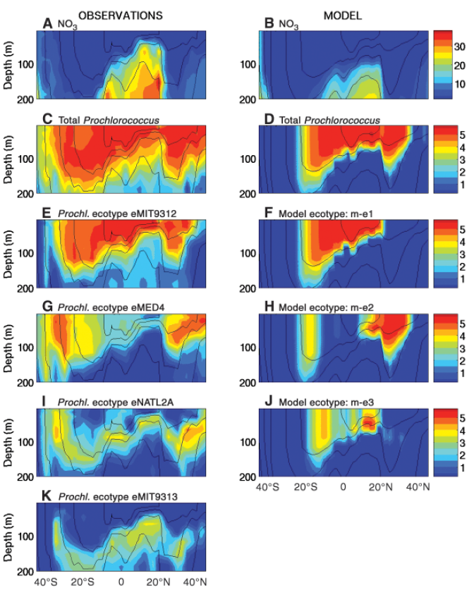
Comparison with observations from AMT13
Notes:
Nitrate: equatorial upwelling evident; simulated concentrations are lower than observed.
Pro present where nitrate is not
QPCR methods of assessing abundance for each ecotype
Ecotypes
M-E1 – most abundant at the equator, not as broadly distributed as obs [tropical origin]
M-E2 – most abundant N of 20N and S of 20S
M-E3: subsurface maximum; low-light adapted
K: no analog for this deep-dwelling clade; is this a clade that can use nitrate in the real world? Did this clade die out in the model? Are there sensitivities to the Ics? Perhaps re-seed after initial adjustment?
Prochlorococcus distribution is a mosaic of these different ecotypes.
Cf. NPZ. Genus Pro is one component of the total P which we lump into Chl in NPZ models; genetic data like these are revealing structure in the populations that is not visible if all P are lumped together. These kind of data provide an entirely new window into physical-biological interactions.
Fig. 2. Observed and modeled properties along the AMT13 cruise track. Left column shows observations (17), right column shows results from a single model integration. (A and B) Nitrate (mmol kg−1); (C and D) total Prochlorococcus abundance [log (cells ml−1)]. (E, G, I, and K) Distributions of the four most abundant Prochlorococcus ecotypes [log (cells ml−1)] ranked vertically. (F, H, and J) The three emergent model ecotypes ranked vertically by abundance. Model Prochlorococcus biomass was converted to cell density assuming a quota of 1 fg P cell−1 (27). Black lines indicate isotherms.

Slide 14
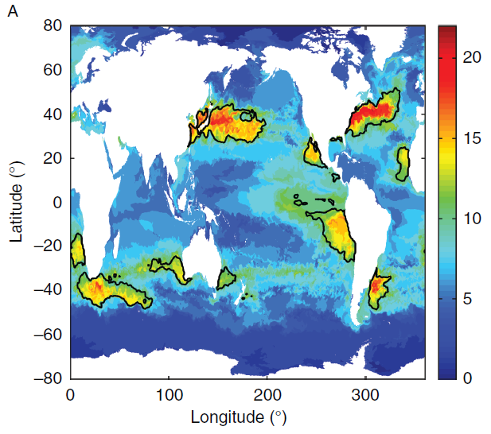
An eddy-permitting run of the Darwin model: assessing phytoplankton diversity
α-diversity: # >0.001% biomass
Clayton et al. 2013
Notes:
¼ degree resolution model: eddy permitting
Alpha-diversity excludes the rarest species.
Clayton: diversity increases in high EKE due to (1) confluence in WBCs, (2) local stimulation due to eddy-driven upwelling, and (3) high environmental variability due to the eddies.

Slide 15
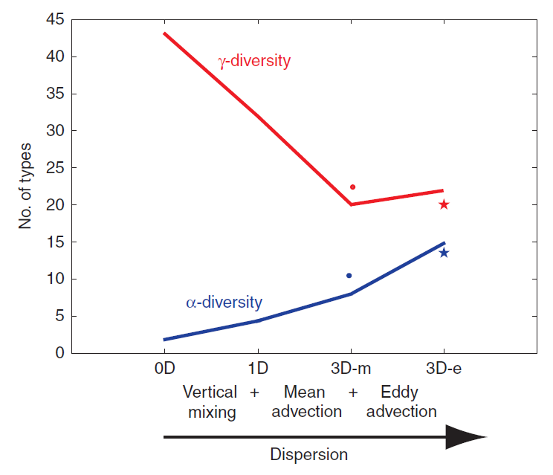
Physical forcing and phytoplankton diversity
Levy et al. 2014
α-diversity: # >0.001% biomass
γ-diversity: α expressed at regional scales
Notes:
0D – 1D – 3D mean – 3D eddy
Clayton 3D eddy makes sense: high diversity in high EKE
Levy: Their counterintuitive results (Figure 15b) suggest that increasing dispersion leads to increasing local diversity (order 10-100 km scales) and decreasing regional diversity (order 1000 km scales). In other words, hydrodynamic transport leads to the dominance of fewer species overall, but those fewer species occur over larger ranges with a higher degree of coexistence.
The decrease in g-diversity with dispersal in our simulations was not anticipated, but we found that the decrease was due to the strong reduction in the number of rare types. In the absence of dispersion, these rare types are characterized by very small home range areas where they are best adapted and outcompete other types. In presence of dispersion, emerging types have larger home ranges or “realized niches” (Fig. 6), although in all experiments the “fundamental niches” (defined by Hutchinson 1957 as the niche an organism would fill in the absence of any competition) are identical. This highlights that types must be adapted to a wider range of environmental conditions to survive and that the quality of competition is very different depending on the amount of dispersal.
(a) Annual average diversity in the surface layer of the high-resolution (HR) configuration described in Clayton et al. (2013). Diversity (α) is defined as the total number of phytoplankton types with biomass greater than 0.001% of the total phytoplankton biomass. Black contour lines indicate phytoplankton diversity hotspots (α > 10.2). (b) Trends in local diversity (α; 10-100 km scales) and regional diversity (γ; 1000 km scales) as a function of dispersion from the simulations described in Lévy et al. (2014). Experiments 0D, 1D, 3D-m, and 3D-e are ranked along the x-axis by increasing level of dispersion in the flow field. In the case with no dispersion (0D) each grid cell in the horizontal and vertical dimensions is treated independently. Vertical mixing is added in the 1D case, and advection by the mean velocity is added in the 3D-m case. The full eddy-resolving flow is accounted for in 3D-e. Results from the latter two experiments are marked with dots and stars, respectively.

Slide 16
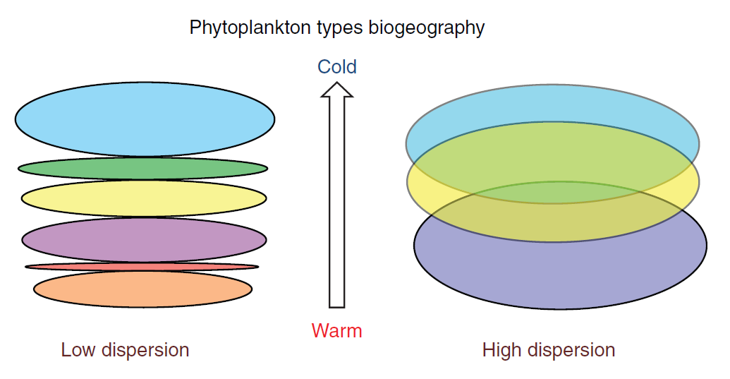
Levy et al. 2014
Notes:
Schematic representation of the changes in community structure and biogeography at high and low levels of dispersion. At low dispersion, there are a large number of types, over small home range areas that are not overlapping: there is no coexistence. The different habitats are organized along the temperature gradient. At high dispersion, the number of types decreases, but the size of the home ranges increases and they intersect: different types coexist. Note that the types are not all the same between the high-dispersion and low-dispersion cases. The different colors illustrate the change in community structure.
Narrow niches persist, specialists win out
Vs
Dispersion increases competition, exchange between niches.

Slide 17
Summary and context
NPZ models – bulk chlorophyll as a proxy for phytoplankton biomass
Phytoplankton functional type models – in situ pigment analysis and satellite-based reflectance spectra allow for separation of different functional groups
Darwin model – suite of emergent ecotypes can be directly compared with genetically distinct populations in the environment and laboratory culture
Genetics based models – ecotypes emerge over evolutionary time scales through explicit simulation of gene flow.

Slide 18
END

