Slide 1
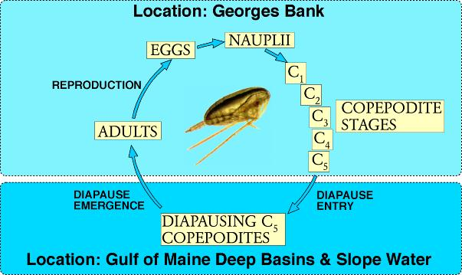
Life cycle of Calanus finmarchicus
Figure Source: Mark Benfield
Notes:
Copepods the most abundant metazooan in the ocean, perhaps on earth; key role in ocean ecosystem dynamics. Grazing on P, uZ, other Z; keystone species in food chains throughout the world
Population dynamics of copepods as an example of more complex biological models described in last lecture.
Size-based
Stage-based
Age-within stage
Size-within stage
Life cycle
Diapause – resting state, deep water, low temp, lower metabolism
Three linkages between physics and biology:
-geographic variations in environmental parameters that mediate biological and chemical rates
-advection
-organism behavior / life history: vertical swimming, diapause, ontogenetic migration
Examples from regional to basin-scale studies of copepod demography.

Slide 2
Copepod population dynamics: from regional to basin scales
I. Climatological distributions of Pseudocalanus spp. based
on MARMAP data from 1977-1987
II. Contrasting life history strategies of Pseudocalanus spp. and Centropages typicus
III. Physical and biological controls of Calanus finmarchicus
populations on Georges Bank
IV. Basin scale population dynamics of C. finmarchicus
Notes:
Population dynamics of copepods as an example of more complex biological models described in last lecture.
Three linkages between physics and biology:
-geographic variations in environmental parameters that mediate biological and chemical rates
-advection
-organism behavior / life history: vertical swimming, diapause, ontogenetic migration
Examples from regional to basin-scale studies of copepod demography.

Slide 3
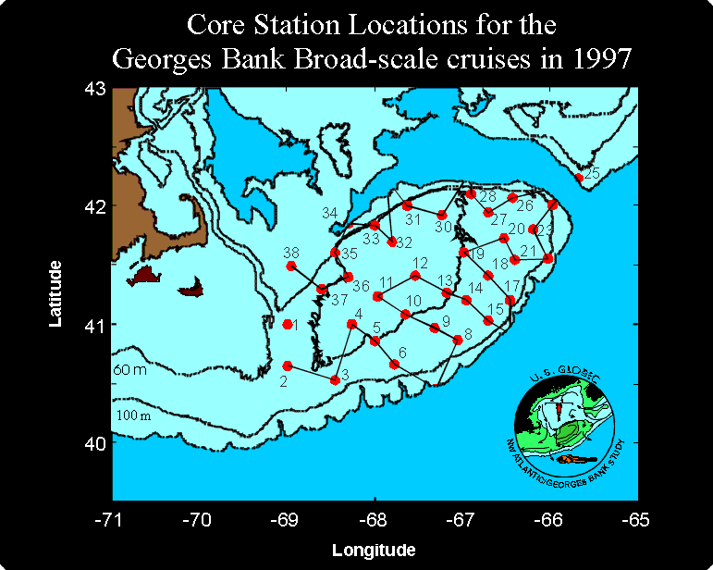
Notes:
US Globec NW Atlantic program 1995-1999; focuses on GB, once of the richest fishing grounds on earth. Overfishing, environmental fluctuations.

Slide 4
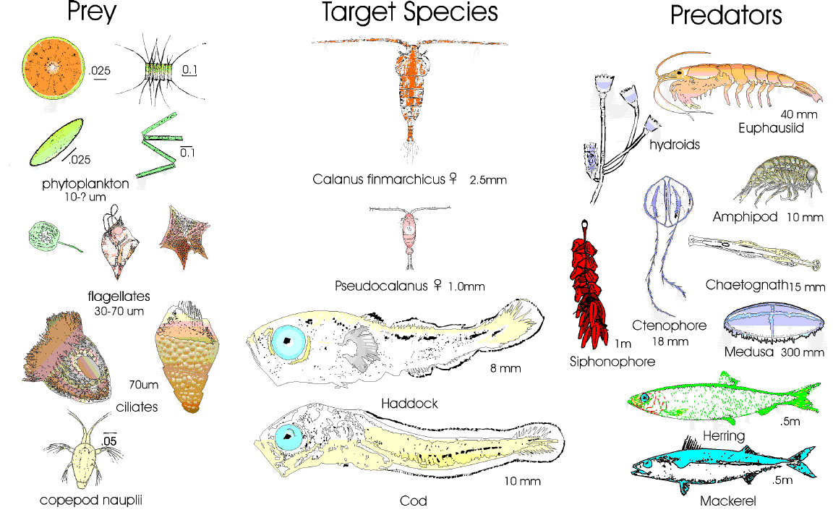
Notes:
Target species, sandwiched in between their predators and prey
Interconnections are many
Not going to attempt to model the whole ecosystem
Population dynamics of keystone species
Cf. Alex model from Monday; End-to-end models

Slide 5
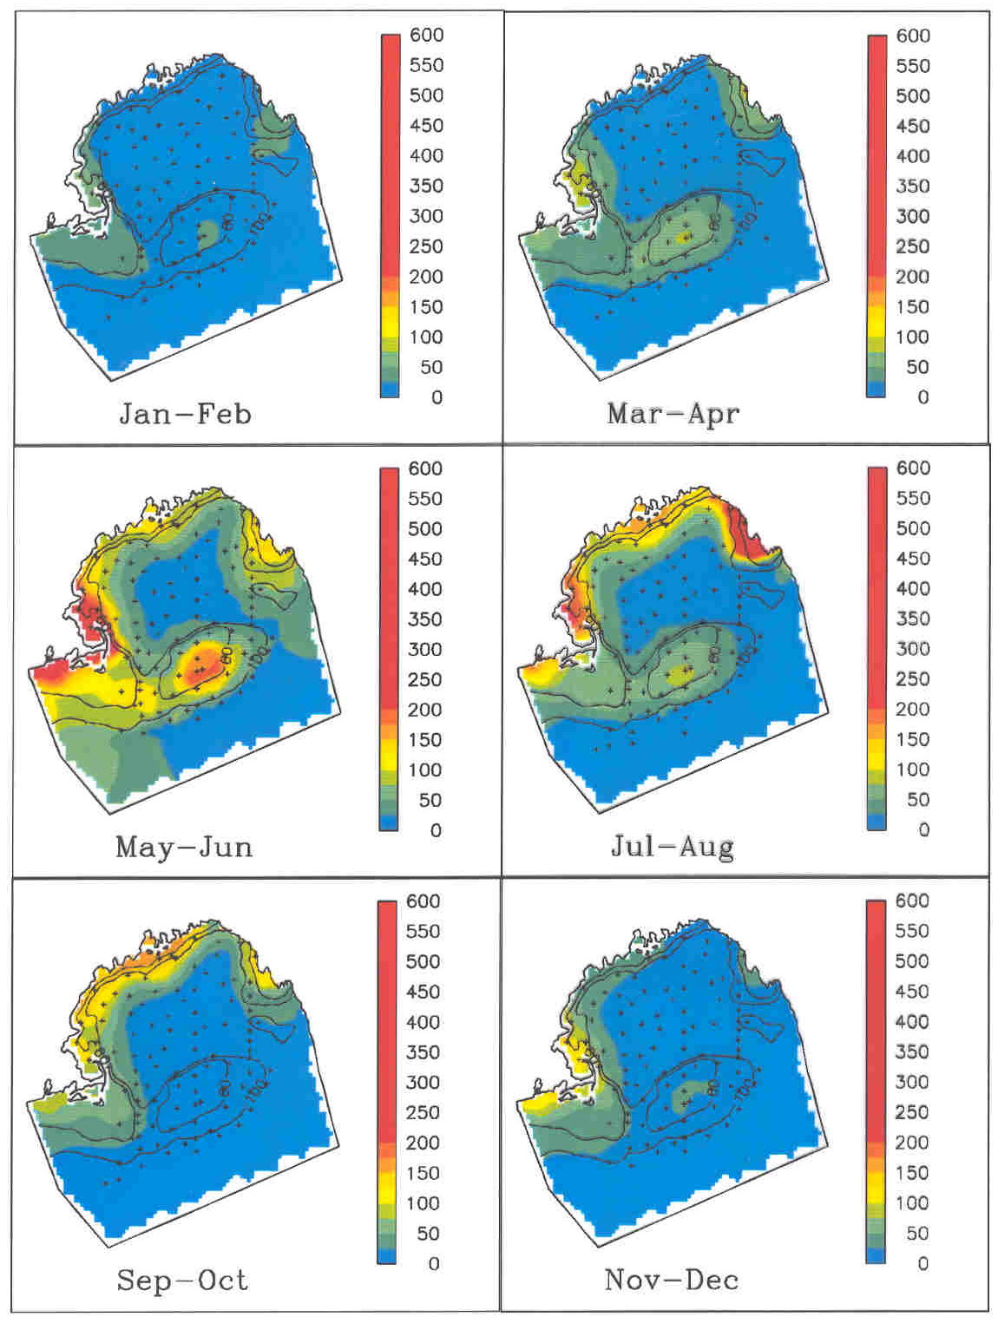
Pseudocalanus spp.
MARMAP 1977-1987
Two population centers:
Western Gulf of Maine
Georges Bank
Davis (1984) hypothesis:
Western Gulf of Maine is
a source region for the
Georges Bank population
Concentration (# m⁻³)
Notes:
Pcal spp. - at least 2 species involved, will discuss species-specific models later.
First set the context with a study of the aggregate population dynamics
MARMAP: monthly to quarterly surveys of plankton
Bi-monthly climatology of average conditions
2 population centers, seasonal variation; coastal population more persistent in the fall and winter months.
Davis 1984 hypothesis

Slide 6
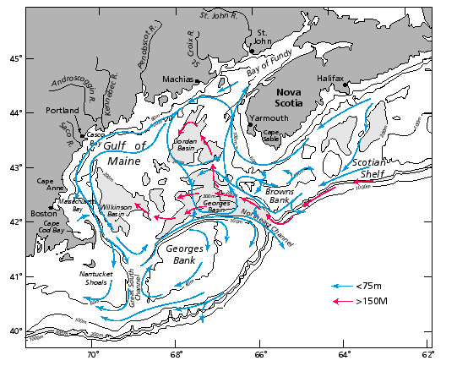
General circulation during the stratified season
Beardsley et al. (1997)
Notes:
Hypothesis stems from connectivity of the coastal GOM with GB

Slide 7
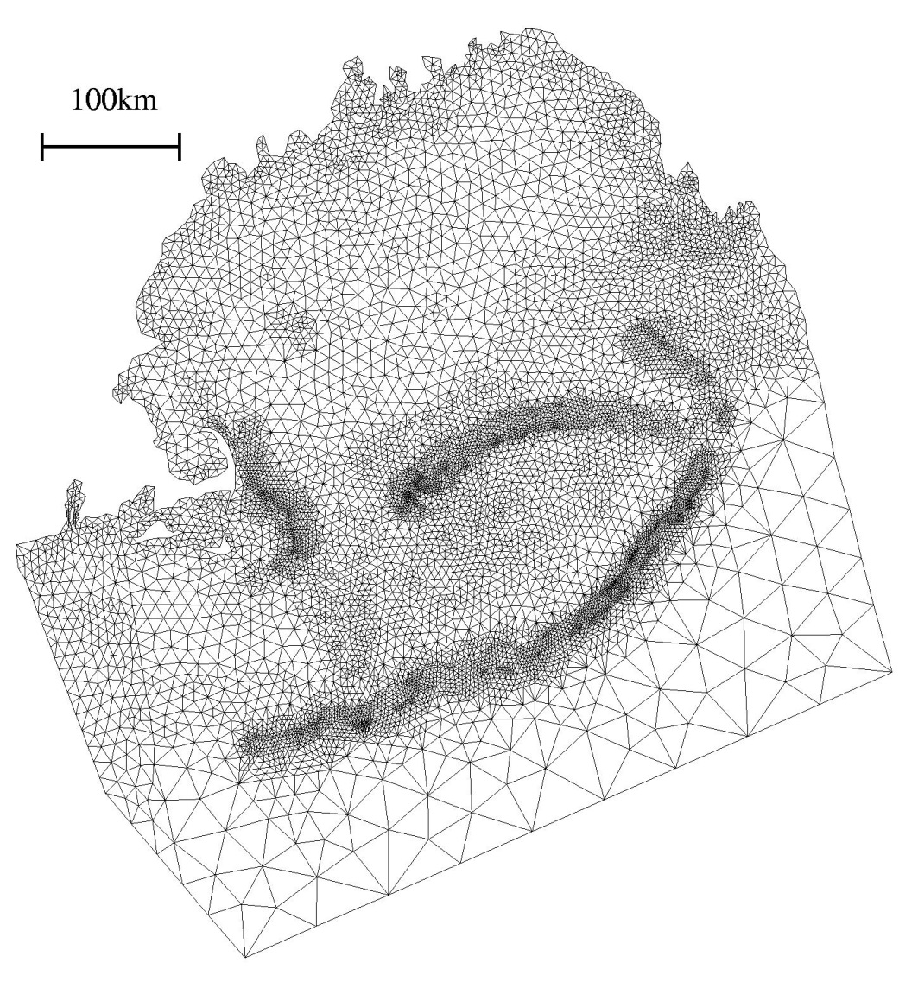
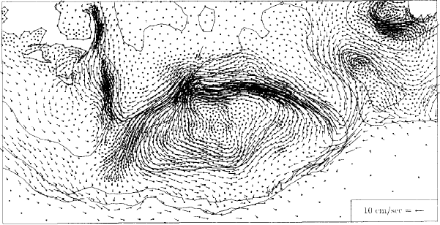
A finite-element model of the Gulf of Maine / Georges Bank region (Lynch et al., 1996)
Notes:
Unstructured mesh: node/element resolution adjustable depending on geometry, bathymetry.
½ km near steep topography
1 km near coast
10km offshore
Cf. structured meshes, i.e. squares, rectangles, orthogonal curvilinear.
Detailed depiction of circulation; strong jet on N flank, clockwise circulation.

Slide 8
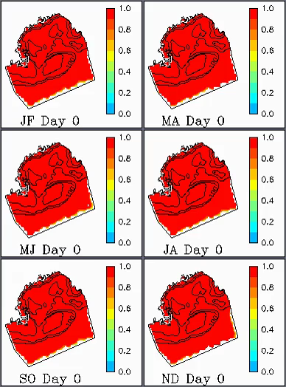
Gulf-wide control volume simulations quantify the impact of boundary conditions on two-month time scales
Notes:
Challenges of regional models: boundary conditions.
Assess impact of BCs on the interior over the 2-month time scales of the simulations run for Pcal
Inflow from Scotian Shelf; diffusion from southern boundary.
Interior relatively untouched by BCs on this time scale.
Strategy: make boundaries far enough away that they don’t affect the solution on the time scales of interest.

Slide 9
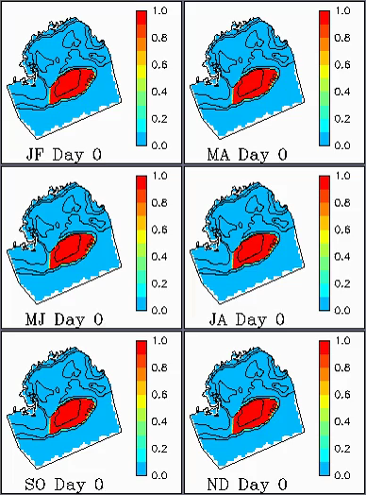
Georges Bank control volume simulations illustrate seasonal variations in residence time
Notes:
GB population of most interest - quantify interconnection with surrounding waters on 2 month time scales
Winter: dilution via flow across N flank
Outflow through GSC
2 month time scales characteristic of the generation time of the organism: significant fraction of water on GB replaced.
Residence time varies seasonally: Jan-Feb leaky; summer less so, circulation more retentive. Stratified period has geostrophic flow that reinforces the around-bank flow, making it more retentive.
Advective challenges for persistence.

Slide 10
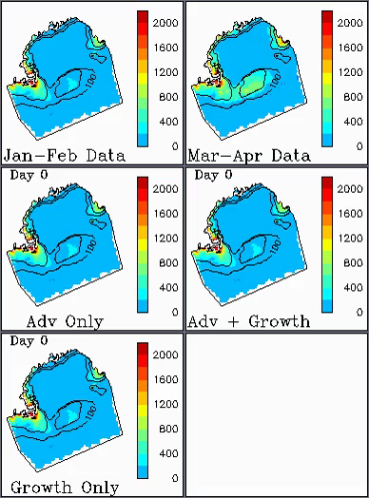
A first attempt to simulate the observed Pseudocalanus spp. distributions…
Notes:
Density-dependent growth dC/dt=mu C, mu gives 30d generation time
Question: adv only; adv + growth
Growth-only model works well for GB, not so well in coastal ocean where population grows too large.
Organisms must be doing sometime to counterbalance the tendency for the ocean to sweep them away.
Forward model fails… try inverse approach: given the observed changes in abundance and circulation in the intervening period, what are the implied biological sources and sinks?

Slide 11
The forward model: an advection-diffusion-reaction equation
Tendency
Diffusion
Reaction
(biological sources
and sinks)
Advection
C concentration
v velocity
K diffusivity
C_{obs}(t₀) C_{obs}(t₁)
time
The forward problem
Notes:
ADR; vertically averaged v and K specified from climatological hydrodynamic simulations.
Inverse problem: what must R be in order to match the observations at t1?
Simplest form of R=R(x,y)

Slide 12
Derivation of the adjoint model (1)
Define a cost function J:
Problem: Given observations C₀(t₀) and C₁(t₁),
find R(x,y) that minimizes J
L
Where λ=λ(x,y,t) are Lagrange multipliers
Notes:
Cost function integrated in space and time throughout the domain. Delat_m is a measurement functional, equal to 1 where there is a measurement, zero elsewhere.
Lagrange function: sum of the cost function and a set of lagrange multipliers times the model equation.

Slide 13

Derivation of the adjoint model (2)
We require R at the minimum of (and therefore J) where
$$\frac{∂L}{∂C}=\frac{∂L}{∂R}=\frac{∂L}{∂λ}=0$$
Adjoint model:
It can be shown that:
Notes:
Differentiate the lagrange function with respect to C, R, and lambda; derive the adjoint model
ADR for lambda, forced by the difference between the predicted and observed concentrations.
Adjoint model provides an ADR for the spread of information backward in time about the model-data misfits (note negative signs).
RHS forcing term whose magnitude is the difference between model and obs.
[Skipping a lot of steps] It can be shown that the gradient of cost function with respect to the unknown control variable R is given by integration of the adjoint model backward in time.

Slide 14
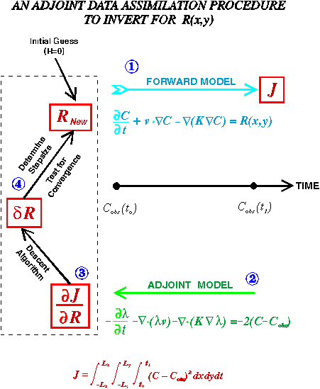
Notes:
Nearly linear model; nonlinearity in positive definiteness

Slide 15
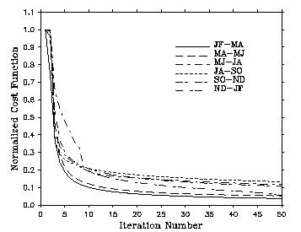
Convergence of the iterative procedure

Slide 16
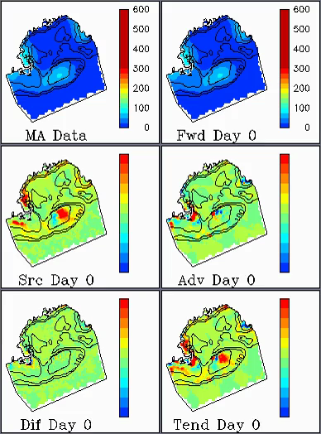
Example results: Mar-Apr to May-Jun
Red: source
Blue: sink
Notes:
Example when population on GB is increasing
Src term fixed in time, other terms vary in time
GB: advective dilution / source dipole counterbalanced by source term
Coastal population: source slightly upstream of center of increasing population; dipole of advection
Three-way tug-of-war between the source term, advection, and tendency; diffusion plays a relatively minor role (similar magnitude but smaller scales; smooths out the solution).
Recall initial hypothesis: coastal population a source for GB. Inverse model treats them as separate, with spatially distinct sources and sinks.

Slide 17
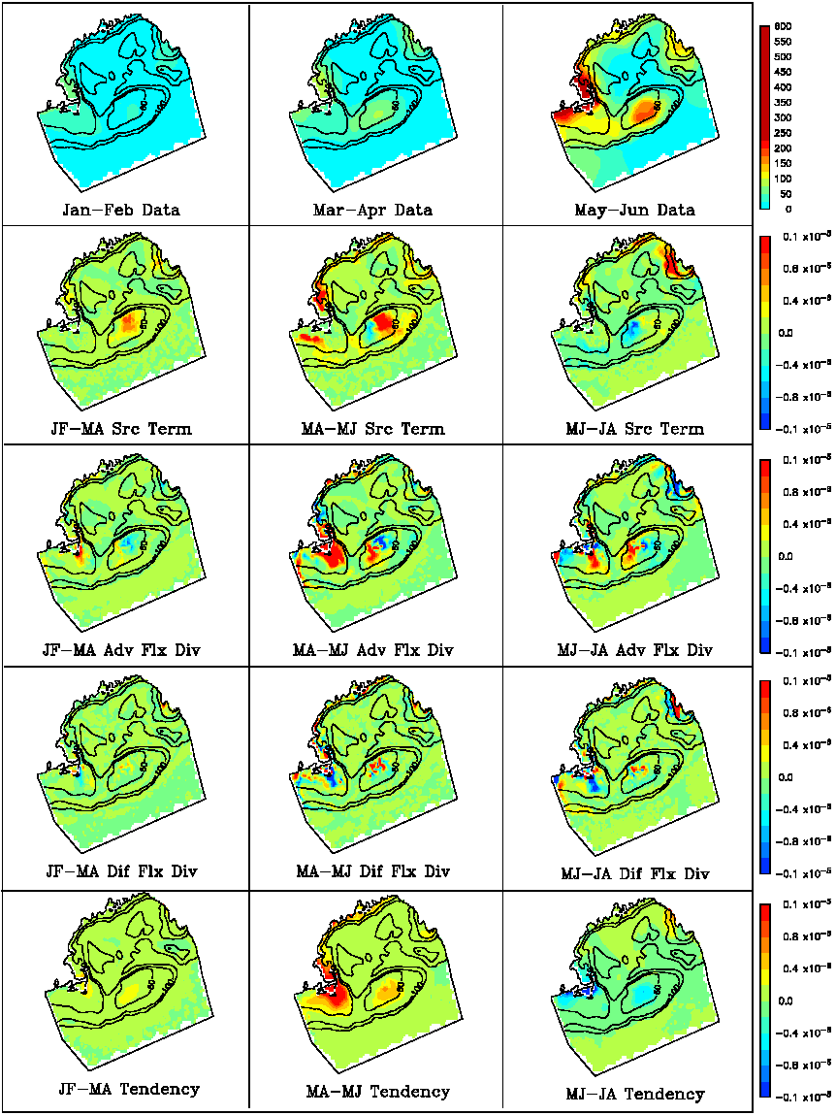
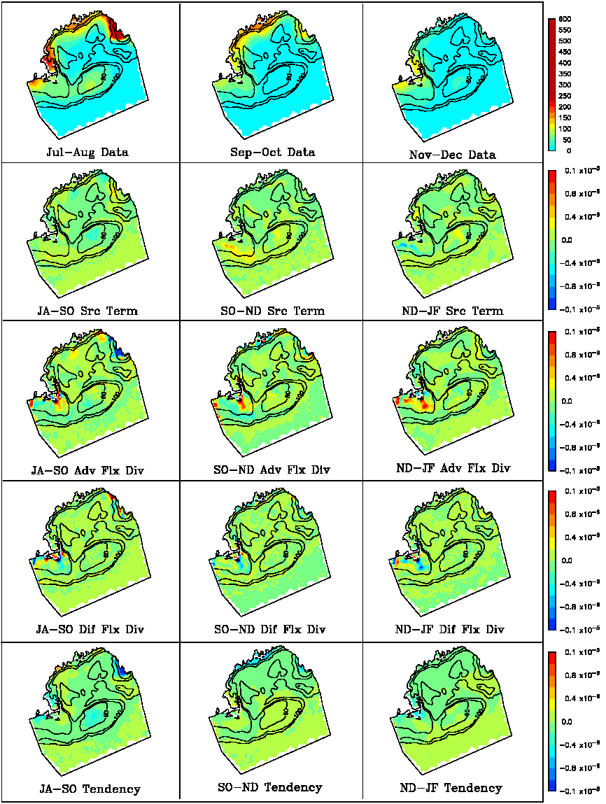
Term-by-Term Diagnosis
Observations
Biological
Source/Sink
Advection
Diffusion
Tendency
JF-MA MA-MJ MJ-JA
Notes:
Geographically specific regions of growth/mortality
These vary seasonally according to animal abundance
patterns, the circulation, and their orientation
Two main balances:
Tendency / source (weak currents or aligned gradients)
Tendency / source / advection
JF-MA: GB source positive, few organisms being advected off the bank, so no SF mortality needed.
Coastal population growing in place, albeit slowly
MJ-JA: population decline; circulation more retentive, advective dilution across the NF not evident. High mortality on SW crest counterbalances advective flux; weak source NW partially offsets around-bank advective dilution, but the net result is population decline (tendency negative everywhere on the crest).
Coastal population stable.

Slide 18
Term-by-Term Diagnosis Continued…
Observations
Biological
Source/Sink
Advection
Diffusion
Tendency
JA-SO SO-ND ND-JF
Notes:
The rest of the year is fairly quiet; continued decline of both coastal and GB populations to Sept-Oct, modest population increases begin Nov-Dec
Population in decline – transport terms play less of a role, more local balance between tendency and source term.

Slide 19
Are the inverse solutions ecologically realistic?
Net population growth
Are food concentrations sufficient?
Net mortality
Is the distribution of predators consistent?

Slide 20
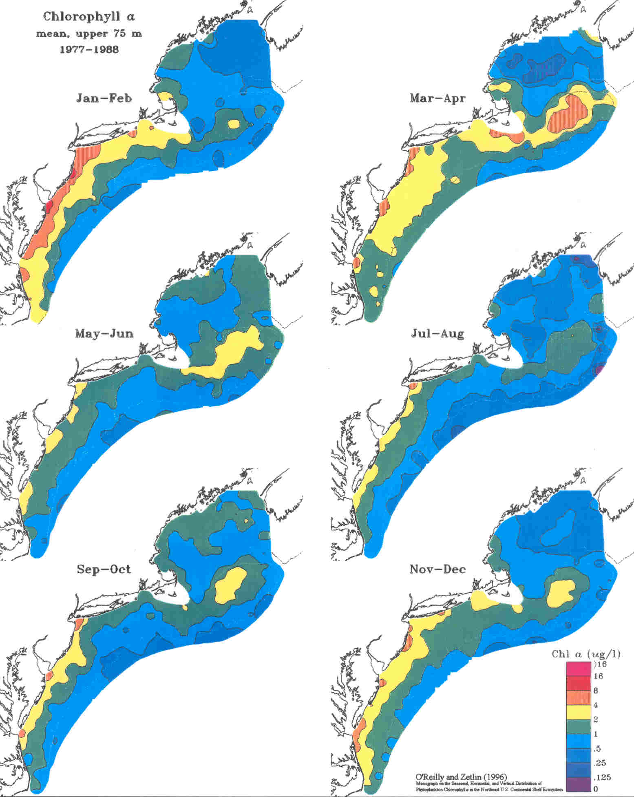
Chlorophyll-a
MARMAP 1977-1987
O’Reilly and Zetlin
(1996)
Jan-Feb
Mar-Apr
May-Jun
Jul-Aug
Davis (1984)
Cutoff for food limitation
0.6 – 1.2 μg Chl l⁻¹
Sep-Oct
Nov-Dec
Cutoff
range
Notes:
Food concentration is
always limiting in the interior of the Gulf of Maine
never limiting on Georges Bank
sometimes limiting in the coastal waters of the western Gulf of Maine (only during the late summer).
The numerical solutions presented here are thus consistent in that growth in never predicted in situations where
food concentrations are limiting. However, it is important to point out that in food-saturated conditions,
(1) net growth does not always occur, and (2) net mortality is often present.

Slide 21
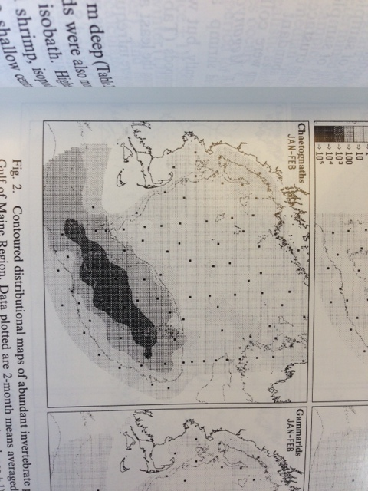
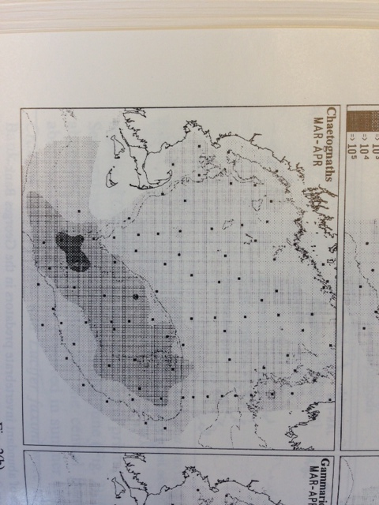
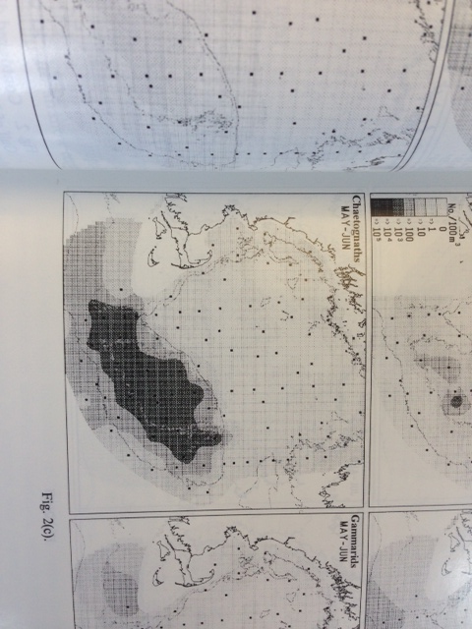
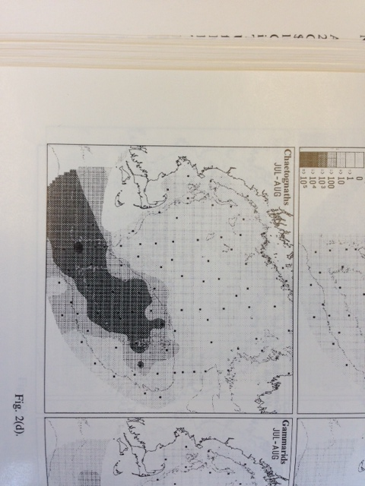
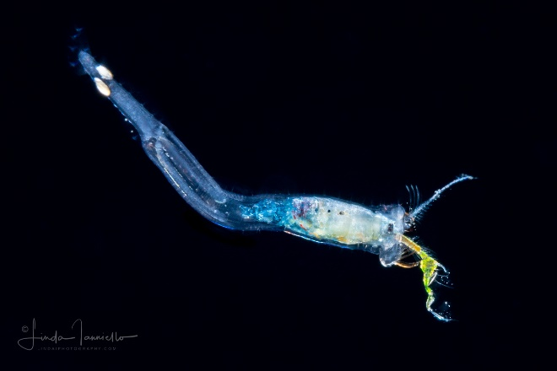
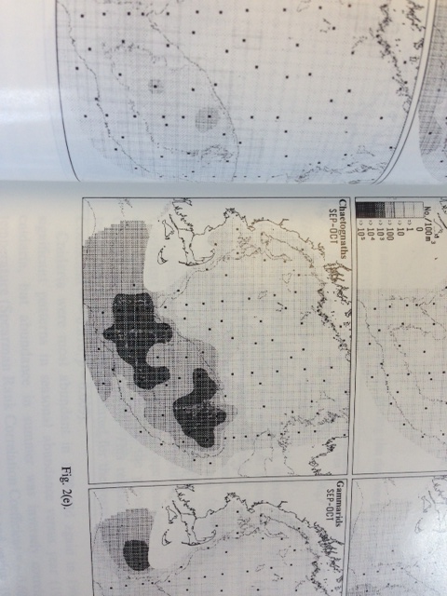
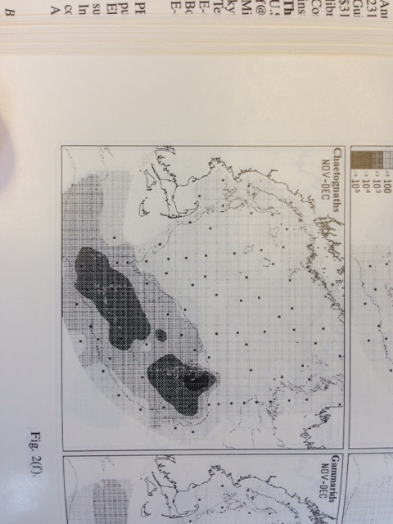
Chaetognaths
MARMAP 1977-1987
Sullivan and Meise (1996)
Jan-Feb
Mar-Apr
May-Jun
Jul-Aug
Sep-Oct
Nov-Dec
Notes:
Their analysis shows that the most numerically abundant potential consumers of Pseudocalanus spp. Are chaetognaths in the case of Georges Bank and euphausiids in the coastal waters of the western Gulf of Maine. It is interesting to note that the period of decline of Pseudocalanus spp. on Georges Bank (May-June to September-October) overlaps the time during which chaetognath abundance is at its maximum. However, there is little evidence in the chaetognath distributions themselves which would suggest higher predation on the south-western quadrant of the crest, which is a persistent feature of the solutions during the period of decline. The relationship between euphausiid abundance and trends in Pseudocalanus spp. in the western Gulf of Maine is even less clear. The highest concentration of euphausiids in this area actually occurs during the middle of the Pseudocalanus spp. growing season. However, the lack of rate information coincident with the distributional data makes inference of grazing pressure based on predator abundance patterns difficult.

Slide 22
Summary of findings: climatological cycles of
Pseudocalanus spp.
Inverse method results in convergent solutions
Resulting biological sources and sinks ecologically
consistent (mostly)
-- food limitation
-- predation
Emerging conceptual model: self sustaining populations in
the WGOM and Georges Bank
Notes:
Connectivity between WGOM and GB populations relatively minimal on the 2-month time scales considered here.

Slide 23
Caveats
Physics
-- errors in the circulation
-- vertical shear
Biology
-- density dependence vs. “geographic” formulation
-- multistage models, behavior, etc.
Observational limitations
-- only adults
-- upper 40m
Notes:
Assumption of perfect physics – deficiencies in circulation will be made up for by the source term.

Slide 24
Some thoughts on model testing and improvement
Forward models
Inverse approaches
http://science.whoi.edu/users/mcgillic/software/scotia_1.0/
Notes:
Forward model failed
Inverse approaches provide info on what is missing
Feeds back into improvement of the forward models.

Slide 25
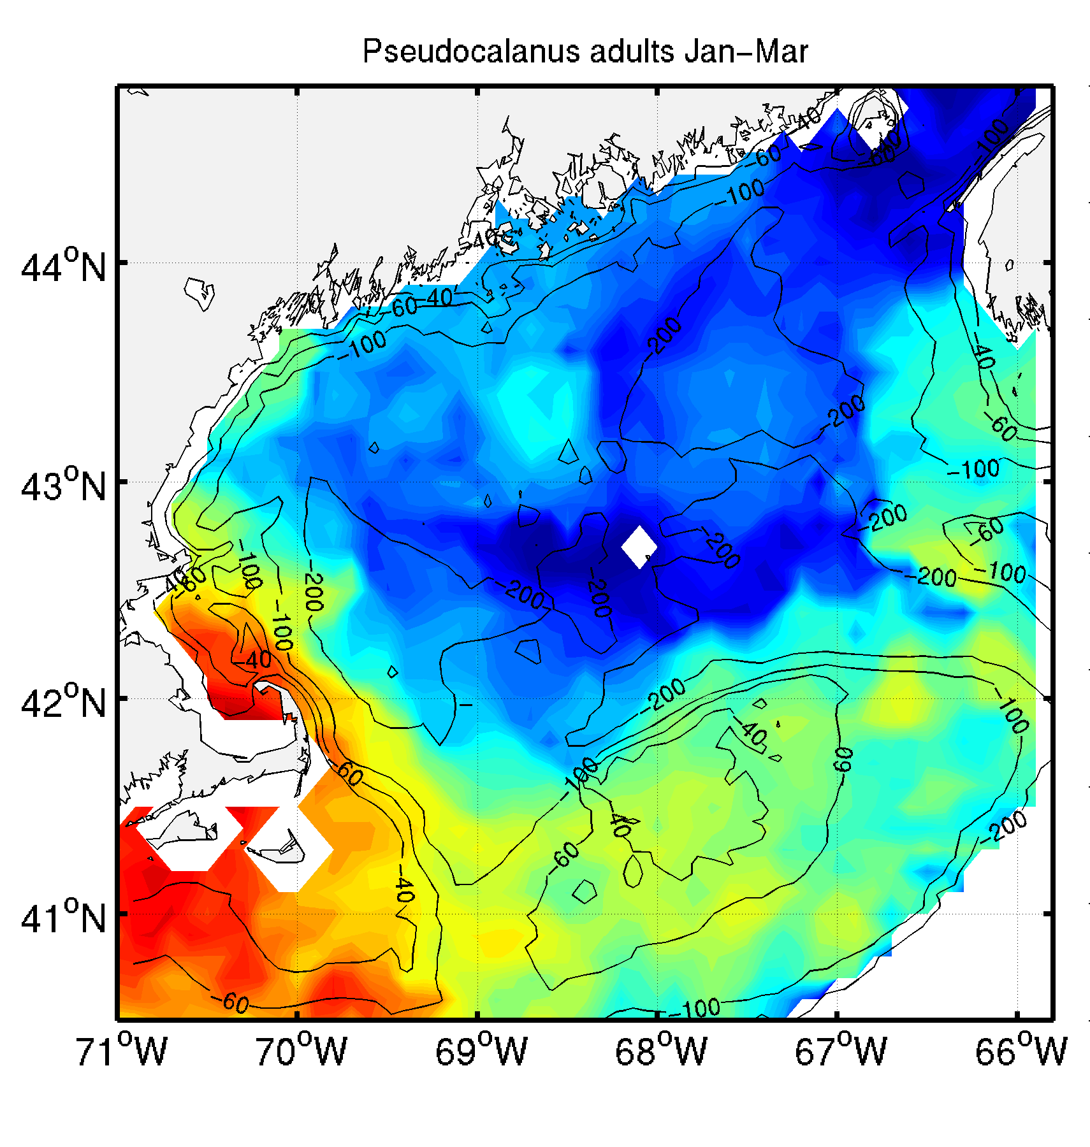
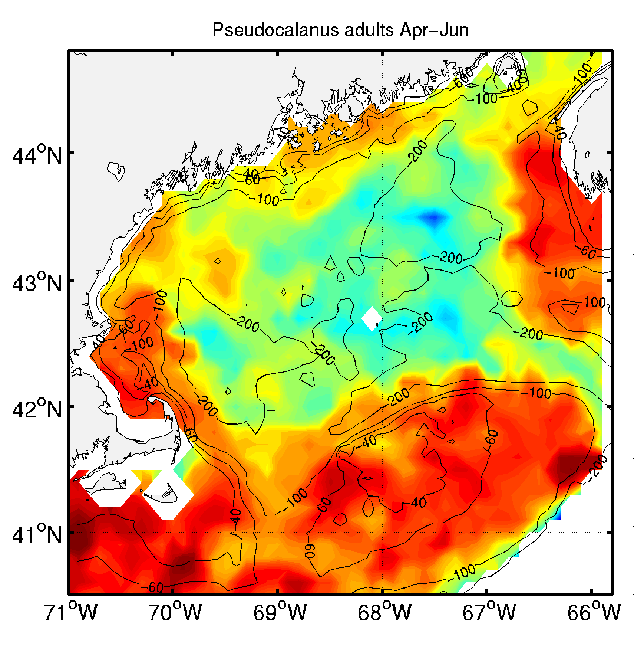
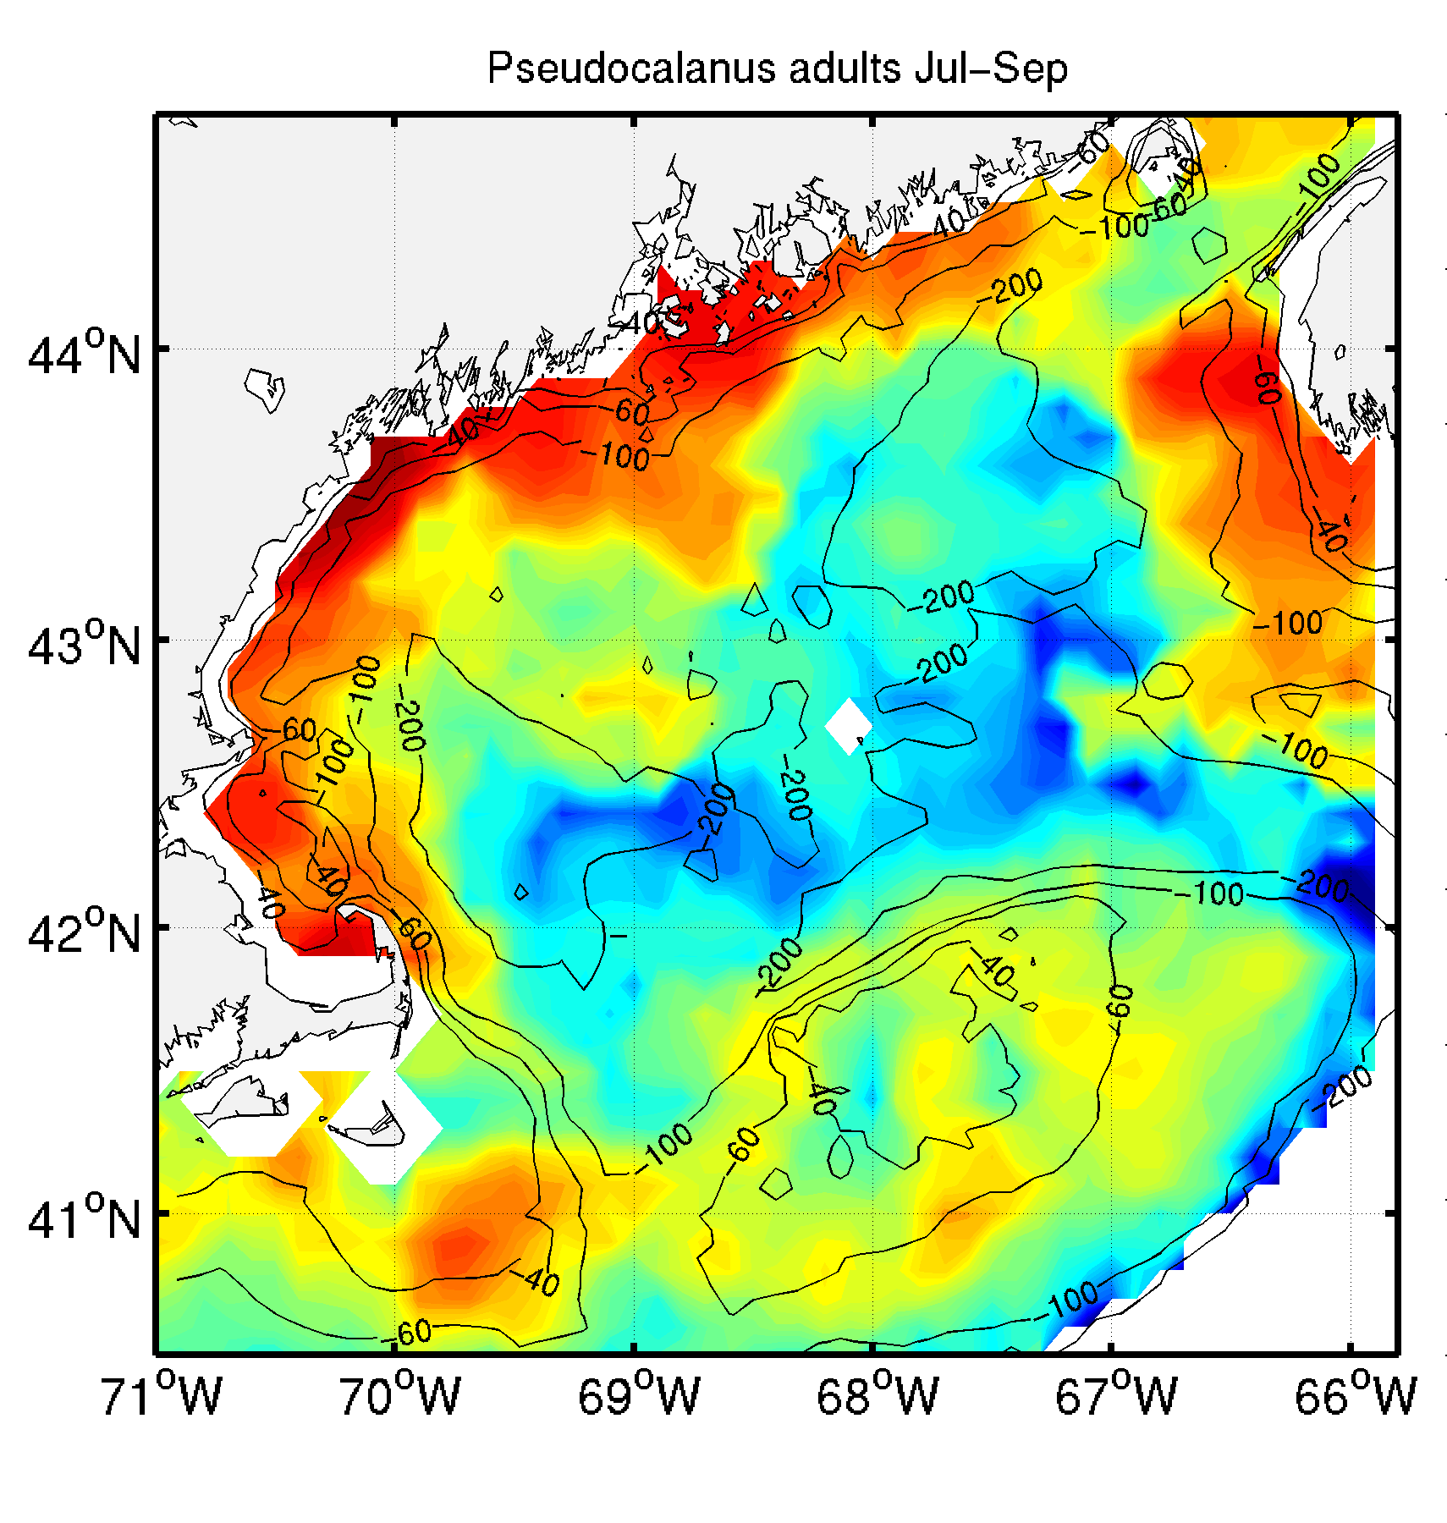
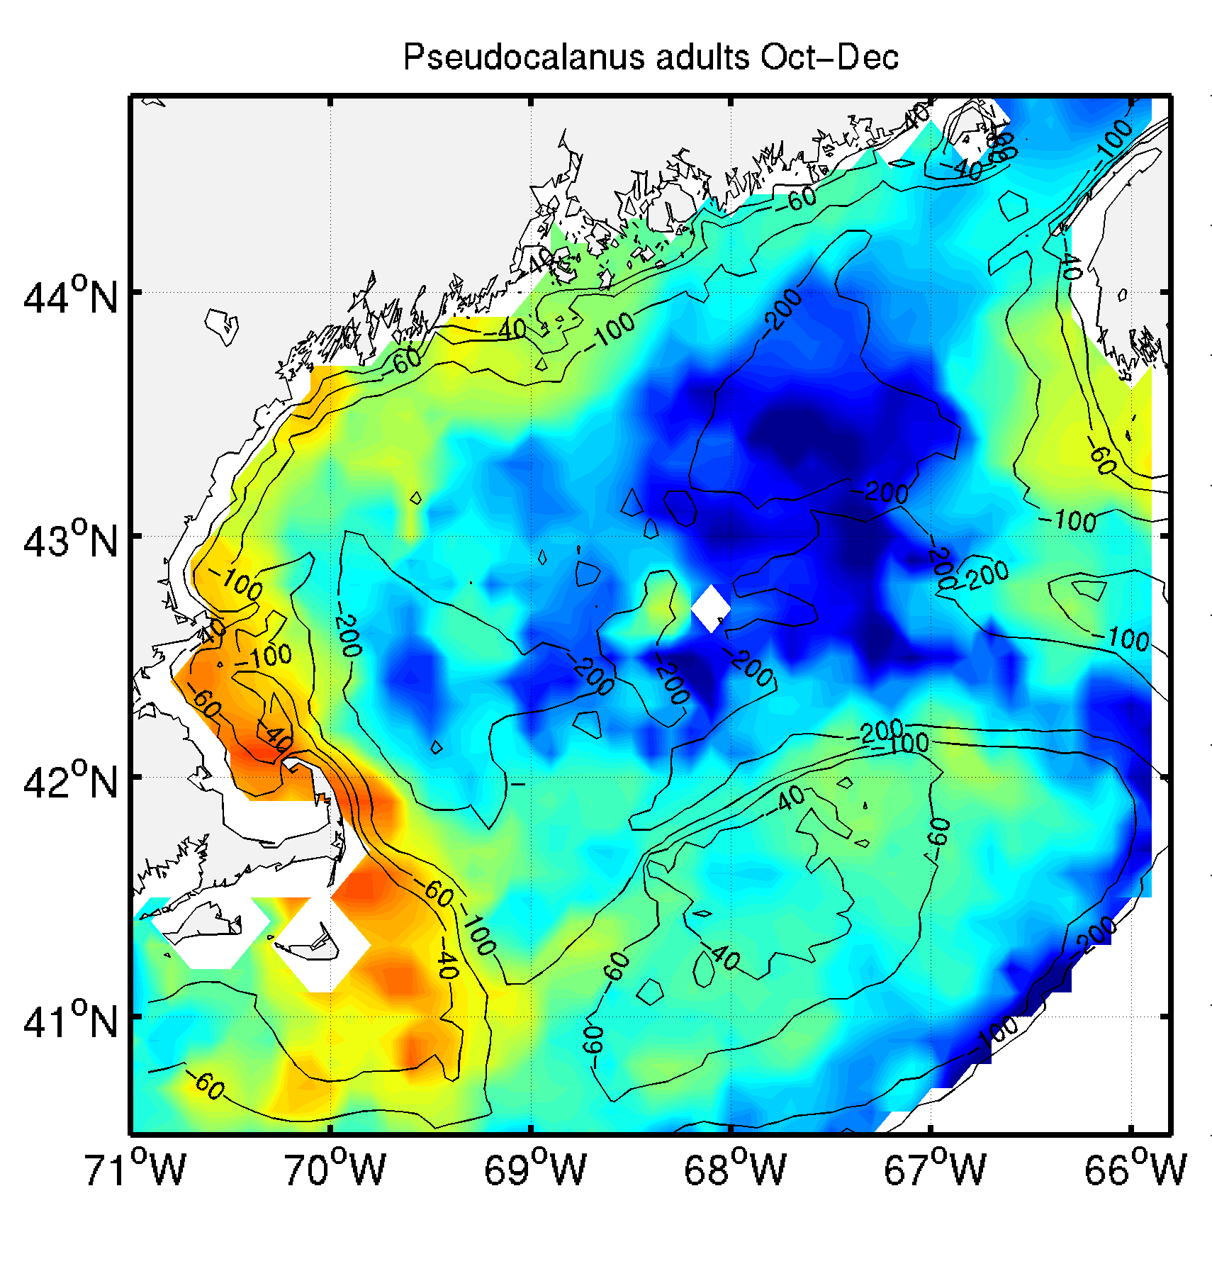
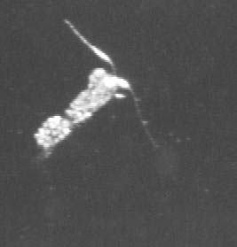
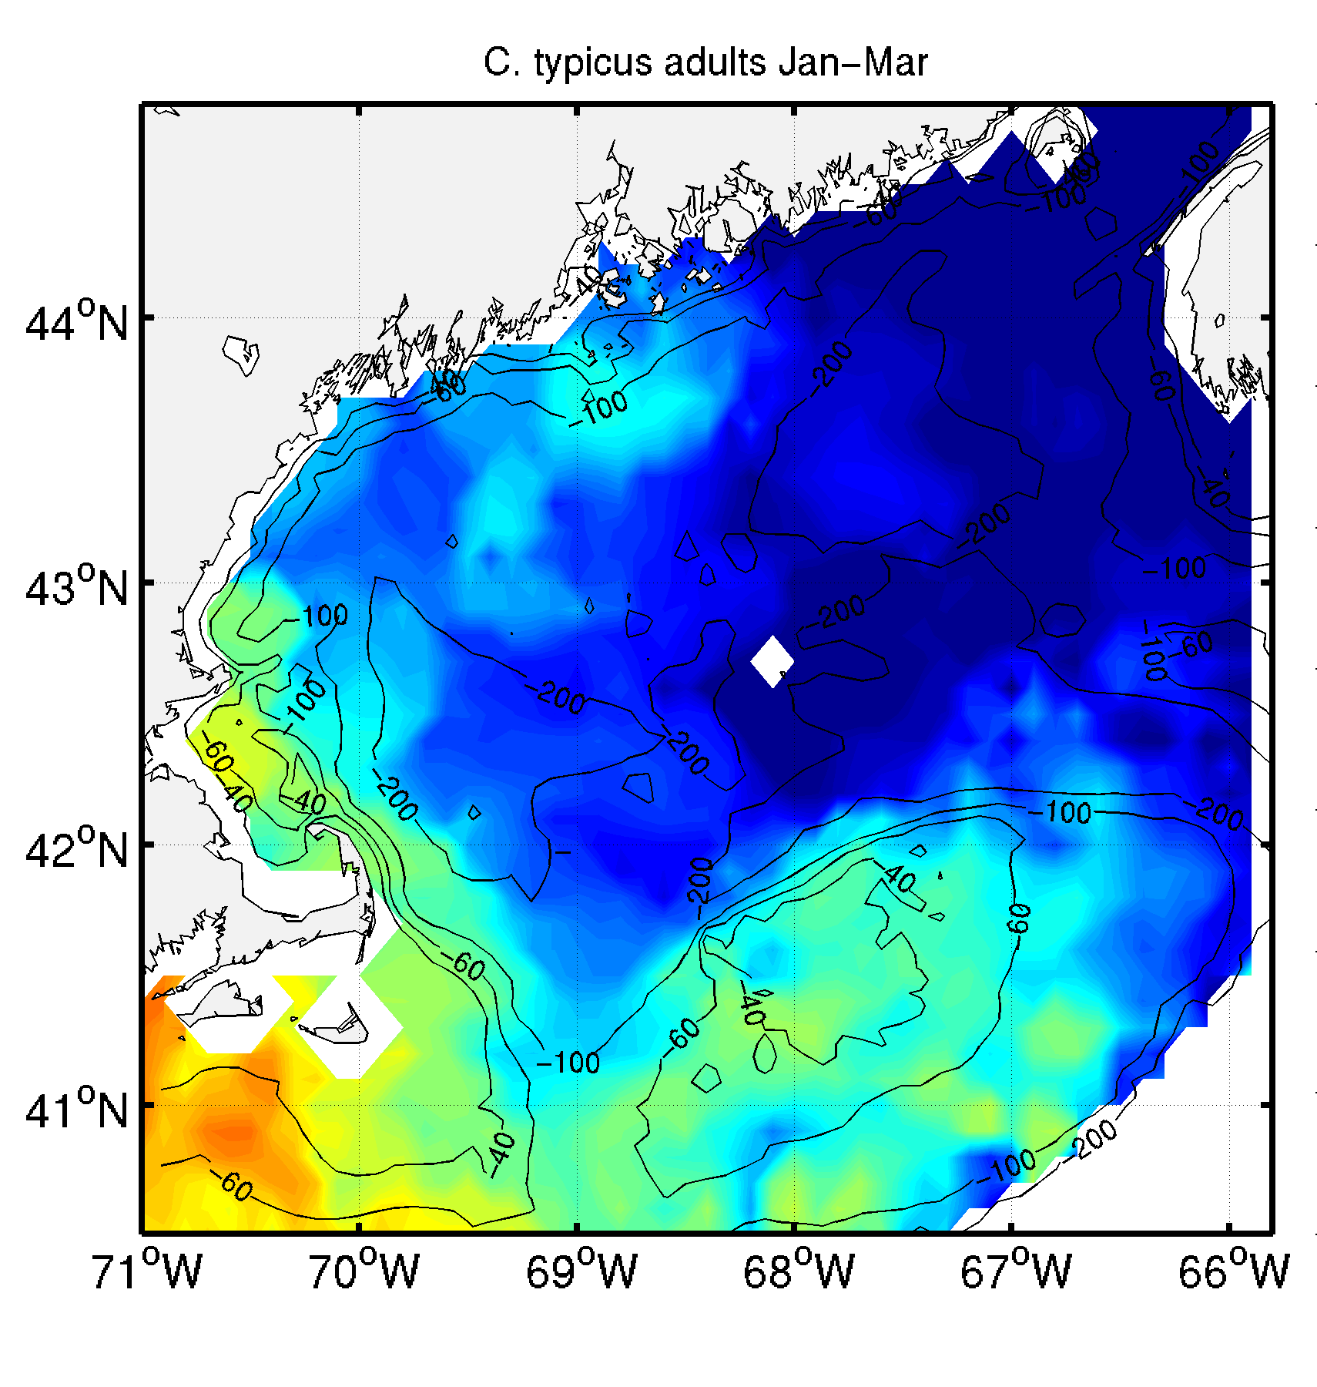
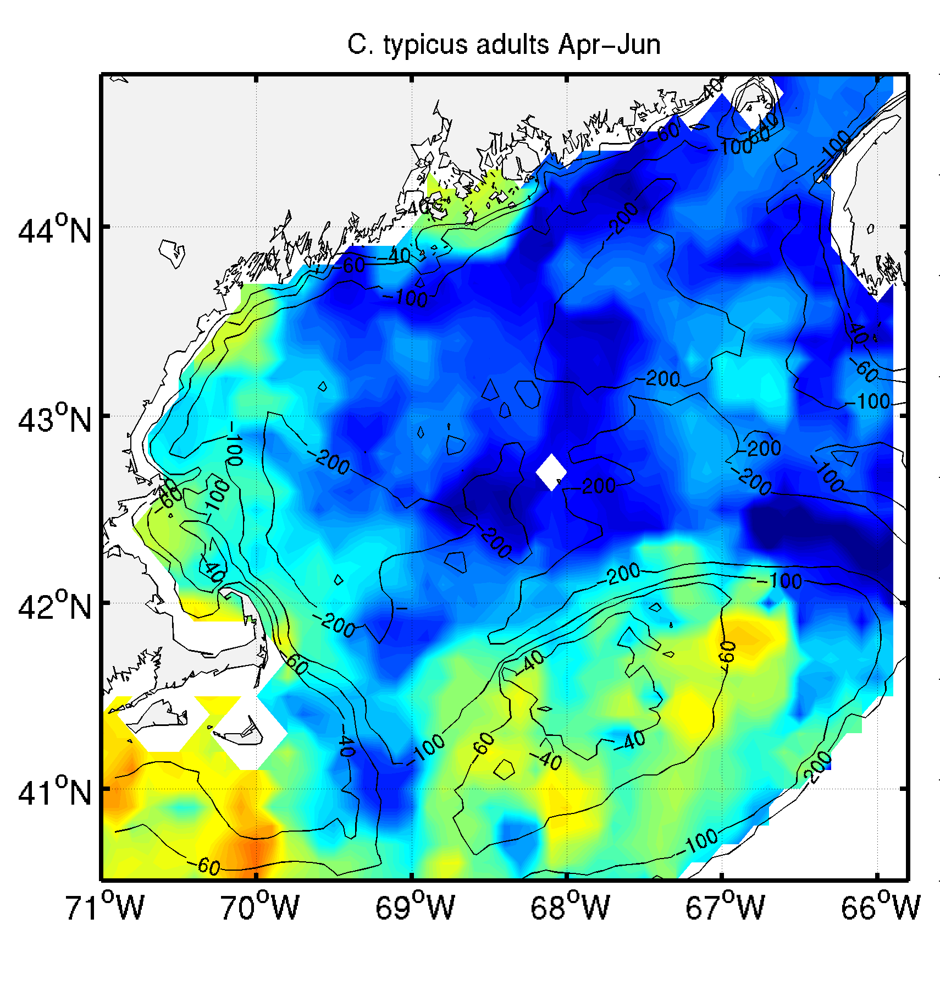
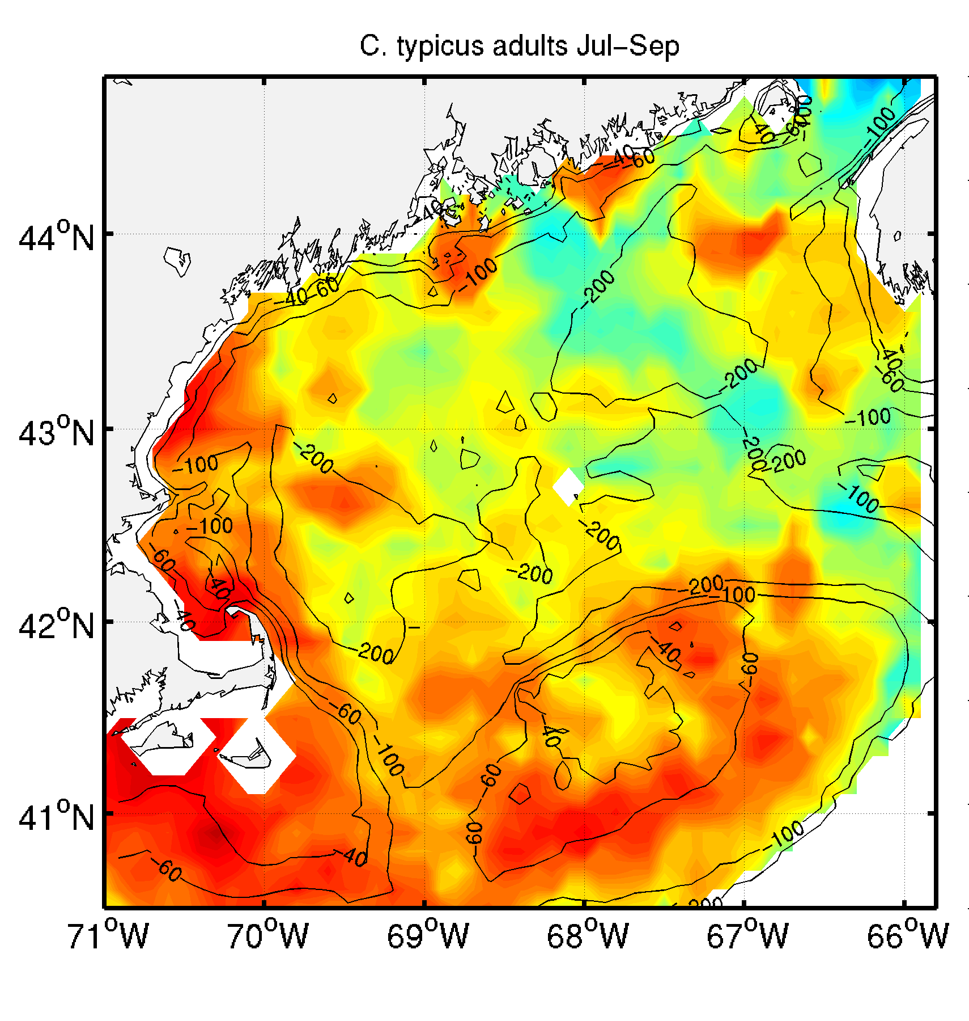
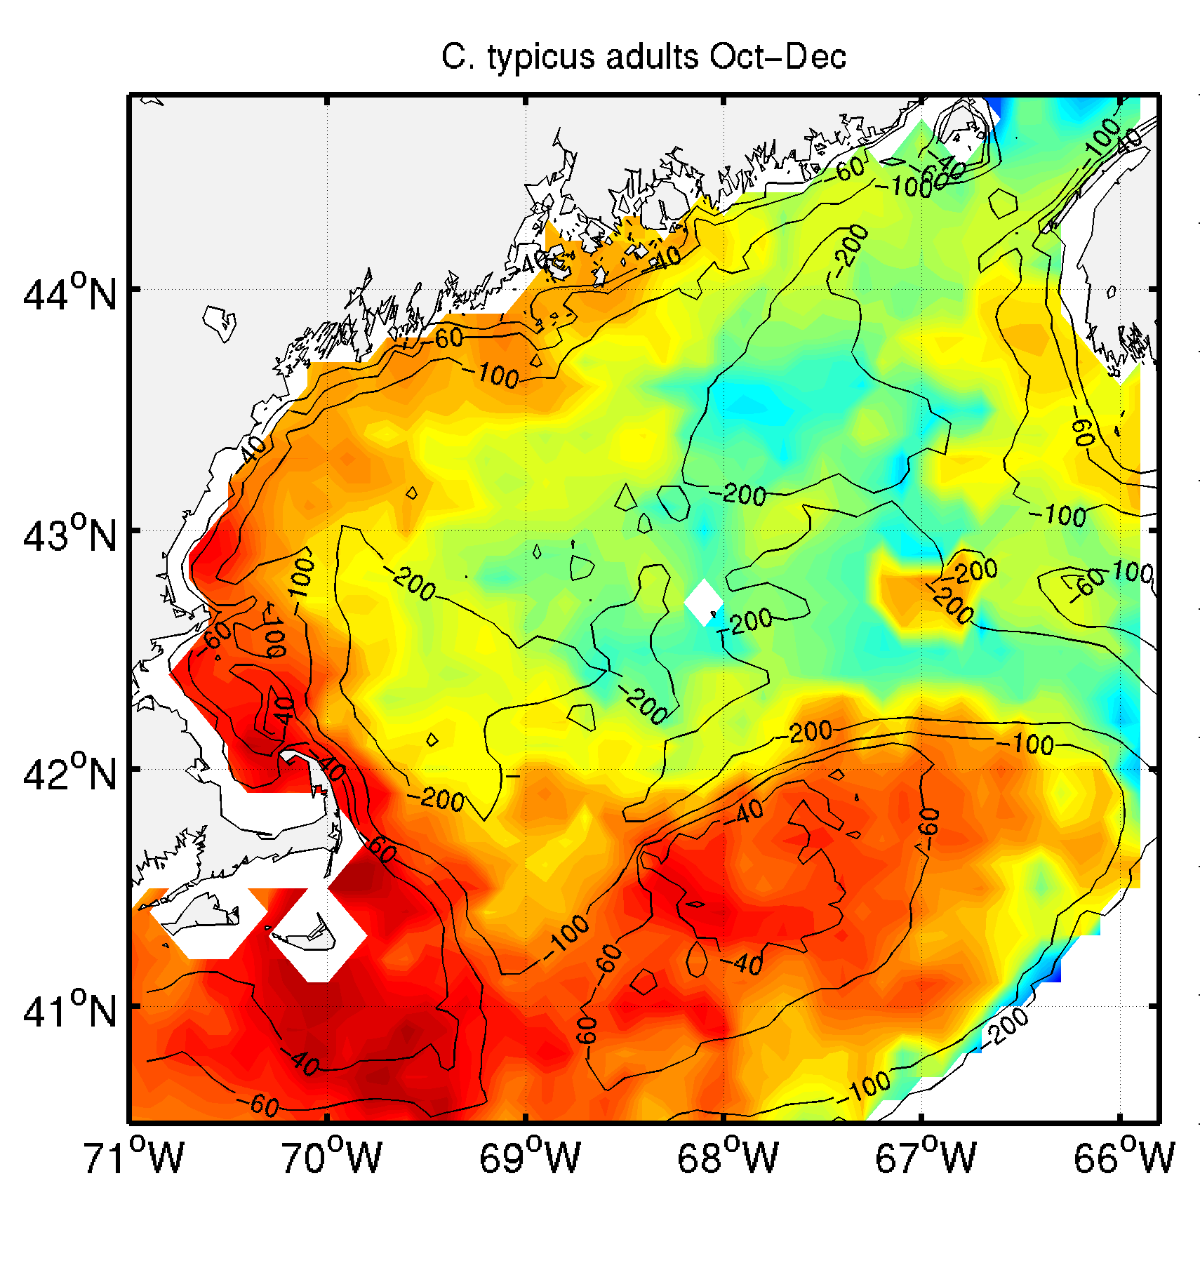
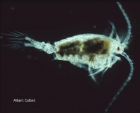
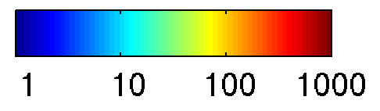
Seasonal variations of adult Pseudocalanus spp. and Centropages typicus
MARMAP/ECOMON climatology 1977-2006
Pseudocalanus spp.
Centropages typicus
Winter
Spring
Summer
Autumn
Ji et al. (2009)
(# m⁻³)
Notes:
Ji: much more sophisticated representations of the population dynamics
VPR images; Pcal broods its eggs, Ct a broadcast spawner – r versus K selection
Different temperature preferences
MARMAP data:
Pcal: coastal and GB populations peak in spring / summer; coastal peaks later
Ctyp: warm water species, peaks in late summer, coastal population extends farther into the GOM than Pcal

Slide 26
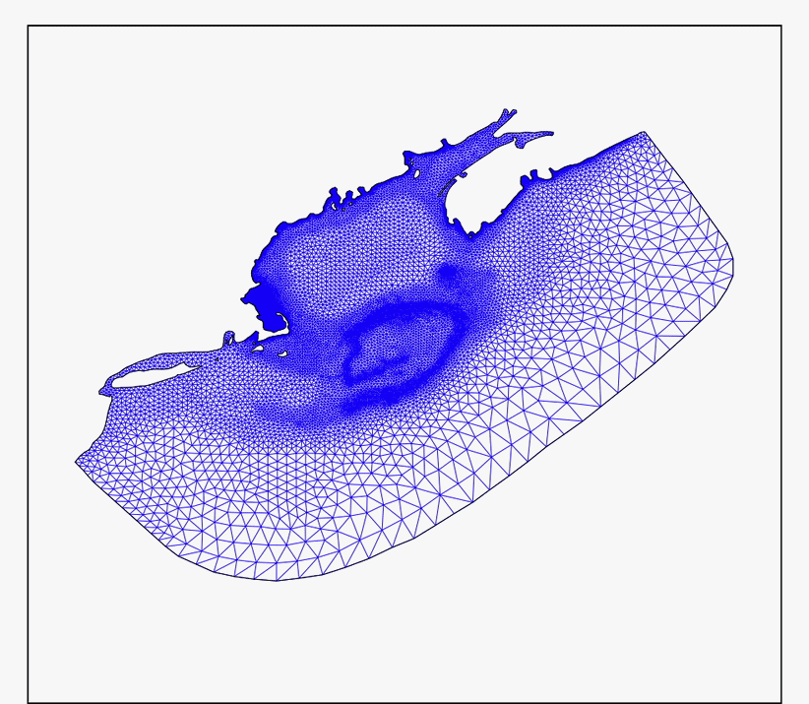
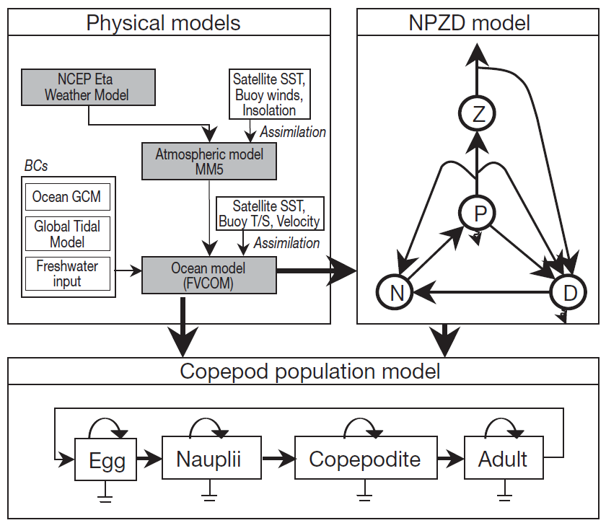
FVCOM modeling framework
Chen et al. (2006) JGR 112, C03018.
Ji et al. (2009)
Notes:
NB. NPZD model used to simulate prey, C.f. prior models where Chl was used as a diagnostic.
4 developmental stages explicitly represented; C&A feed on P simulated by the model; N do not feed

Slide 27
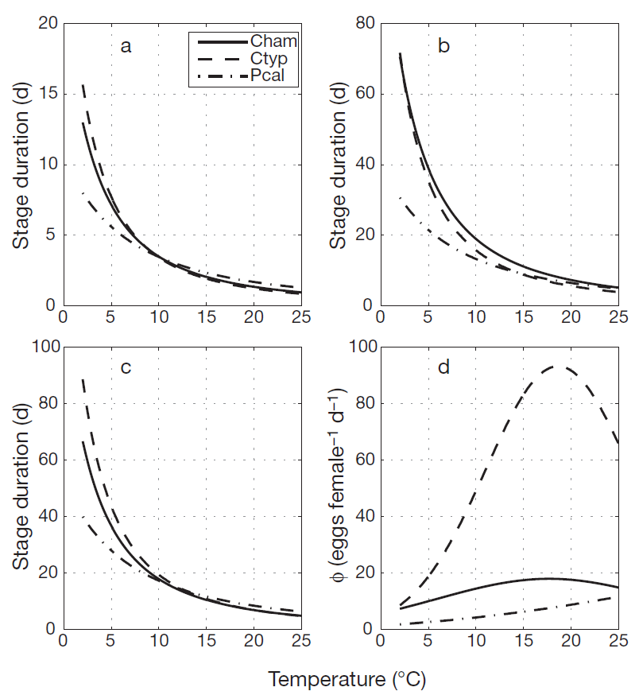

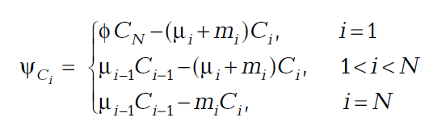



Population dynamics model
Eggs Nauplii
Copepodites
Egg
prod.
T_{b}=5°C
Pseudocalanus spp. (egg sac)
$m_{i}^{b}$= (0.03,0.045,0.02,0.03)
Centropages typicus (broadcast spawner)
$m_{1}^{b}$ = 0.15
Ji et al. (2009)
Notes:
4 ADRs, one for each developmental stage
Egg production proportional to # of adults; loss due to hatching and mortality
Naupliar and copepodite stages: moulting fluxes, mortality
Adults: moulting copepodites, mortality
Temperature dependence of stage duration: Belheradek function – MSD = mean stage duration
Stage duration lower for Pcal at lower temps; i.e. eggs hatch faster; crossover at higher temps; very slight advantage for Ct at high temps
Egg production – Ct broadcast spawner produces many more eggs, especially at higher temps
Mortality – q10 formulation. Baseline temp optimal 5C. Stage based mortality the same for all stages except eggs, reflecting difference in spawning strategy (Ct eggs more susceptible to predation than Pcal, which are protected by the adult).

Slide 28
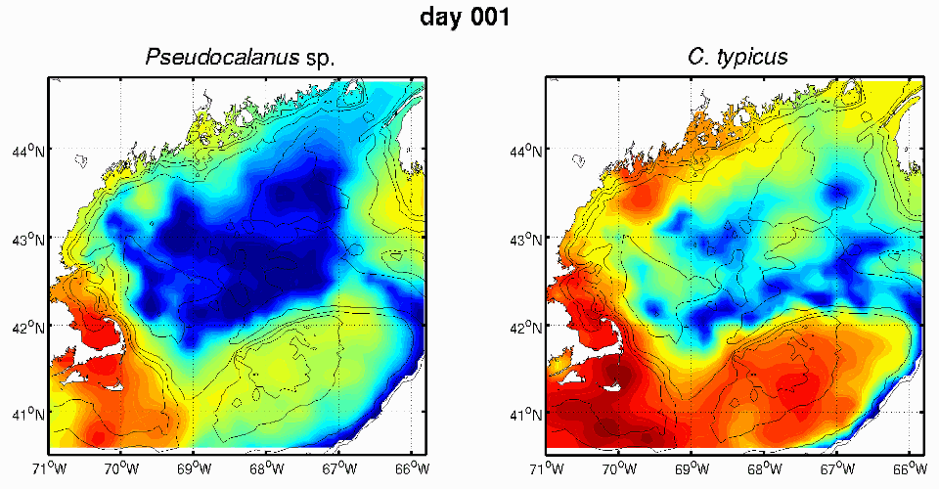
Coupled FVCOM-population model results
Pseudocalanus spp.
Centropages typicus
(# m⁻³)
Notes:
Pcal – GB and coastal blooms; 2nd generation GB followed by coastal population
Ct. blooms after Pcal, in the summertime.

Slide 29
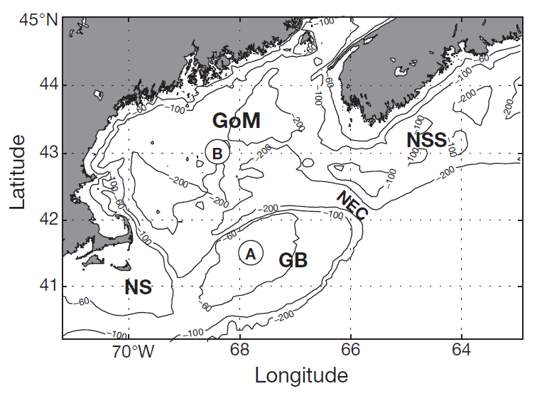
Sensitivity experiments
How important is the temperature dependence of development?
Experiment: Simulate Pseudocalanus spp. with Belehradek parameters from C. typicus.
Ji et al. (2009)
Notes:
Time-series points on GB and GOM

Slide 30
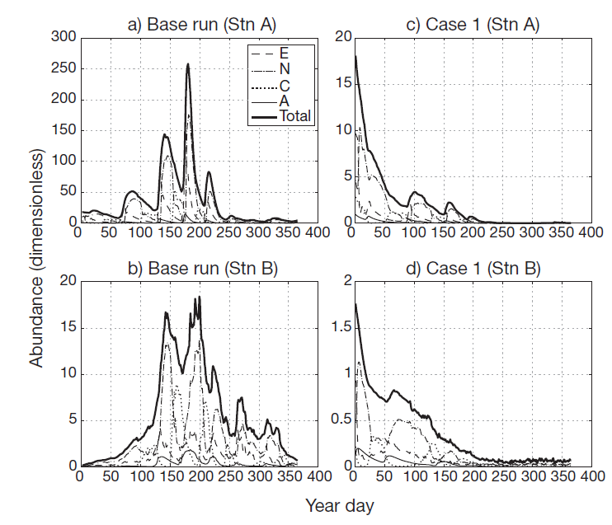
Pseudocalanus spp. sensitivity experiment
Pseudocalanus with
C. typicus Belehradek
Baseline run
Georges Bank
Gulf of Maine
Ji et al. (2009)
Notes:
Base run:
4-5 generations on GB; peak in late spring / early summer
abundance much lower in the GOM (note change in vertical scales)
Temperature dependence of development crucial to Pcal population dynamics in the region

Slide 31

C. typicus sensitivity experiment: is the higher egg mortality essential to the fit?
C. typicus
C. hamatus
Pcal
Pseudocalanus spp. (egg sac)
$m_{i}^{b}$= (0.03,0.045,0.02,0.03)
Centropages typicus (broadcast spawner)
$m_{1}^{b}$ = 0.15
Ji et al. (2009)
Notes:
Contrast broadcast spawner vs brooder;r vs k strategies in ecology

Slide 32
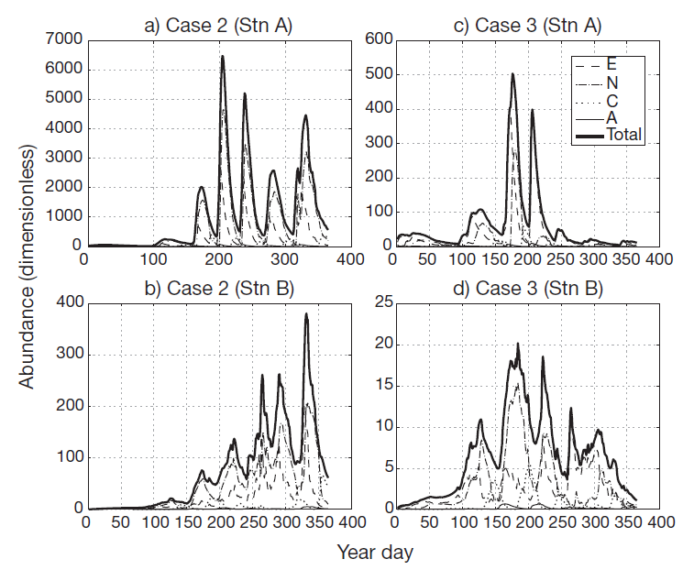
C. typicus with
Pseudocalanus spp. C. typicus
egg mortality Baseline run
Georges Bank
Gulf of Maine
Ji et al. (2009)
Notes:
Base run:
4-5 generations on GB; peak in summer
abundance much lower in the GOM
Lower egg mortality of Pcal (egg sac): population grows to unrealistically high levels. Higher egg mortality needed to match the observations.

Slide 33
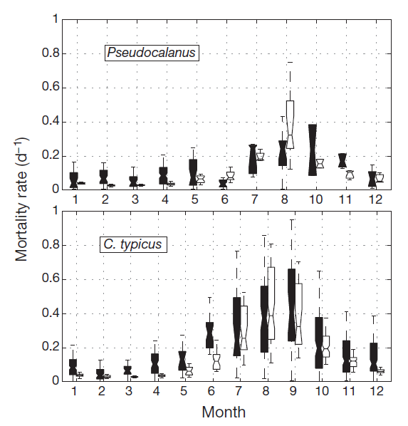
Simulated and observed C5-adult mortality
Sensitivity
to N & C m_{i}:
0.045 0.02
0.05 0.03
Q₁₀=6
Max m:
0.27 0.12
0.30 0.18
Result:
Pcal crashes
Black: VLT
White: model
Median
25/75 %iles
1.5 IQR
Ji et al. (2009)
Notes:
Black: observations
White: model
Simulate Pcal with higher ms, population crashes.
Precision of measurements not sufficient to resolve such small differences in mortality.
Q: why are these models so sensitive to grazing?
Linear formulation; Cf NPZ and Steele and Henderson Z^2 term
Cf. Li et al. (same problem with linear model) and Speirs et al. repeating annual cycle

Slide 34
Life cycle of Calanus finmarchicus
Figure Source: Mark Benfield
Notes:
Diapause – resting state, deep water, low temp, lower metabolism

Slide 35
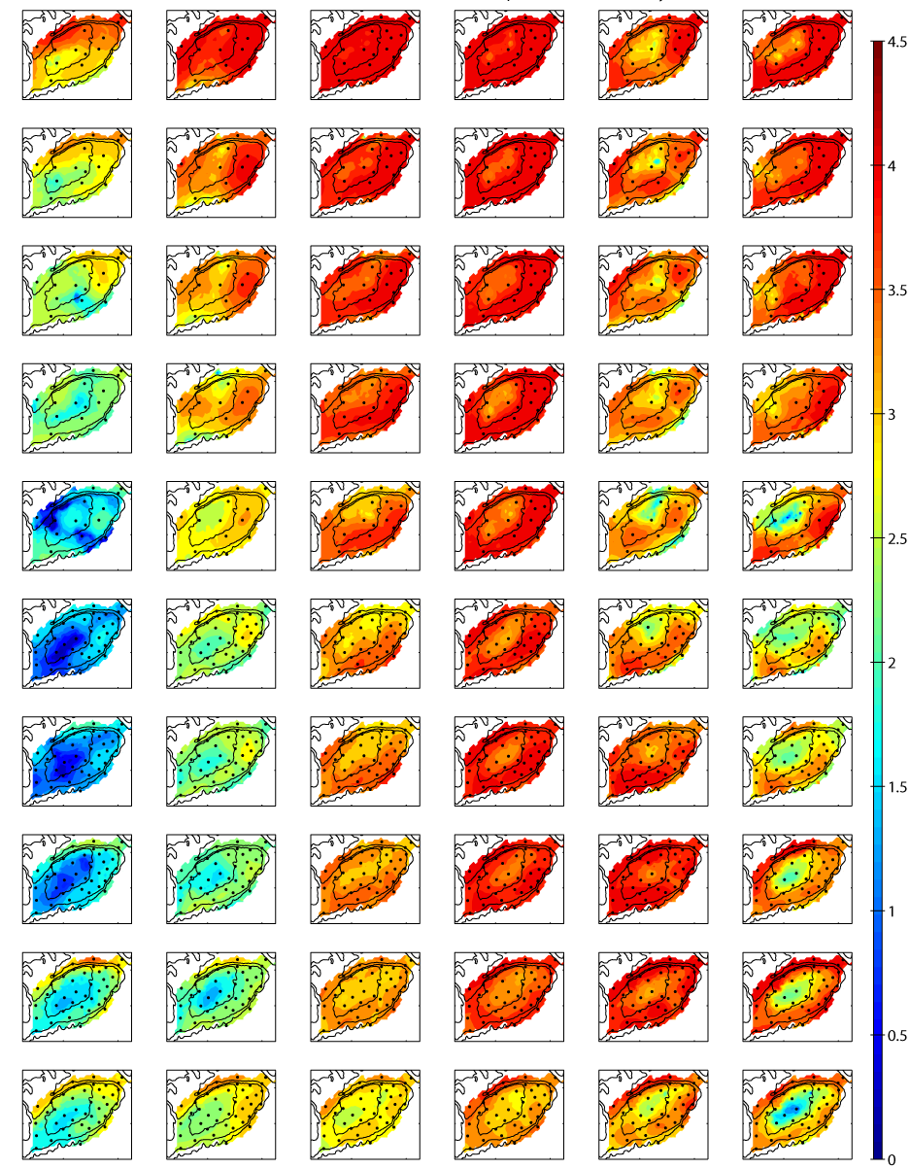
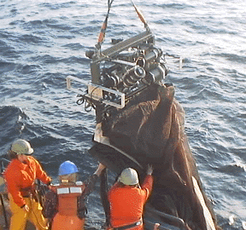
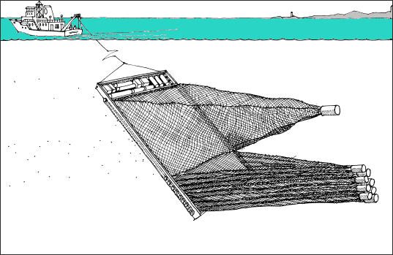
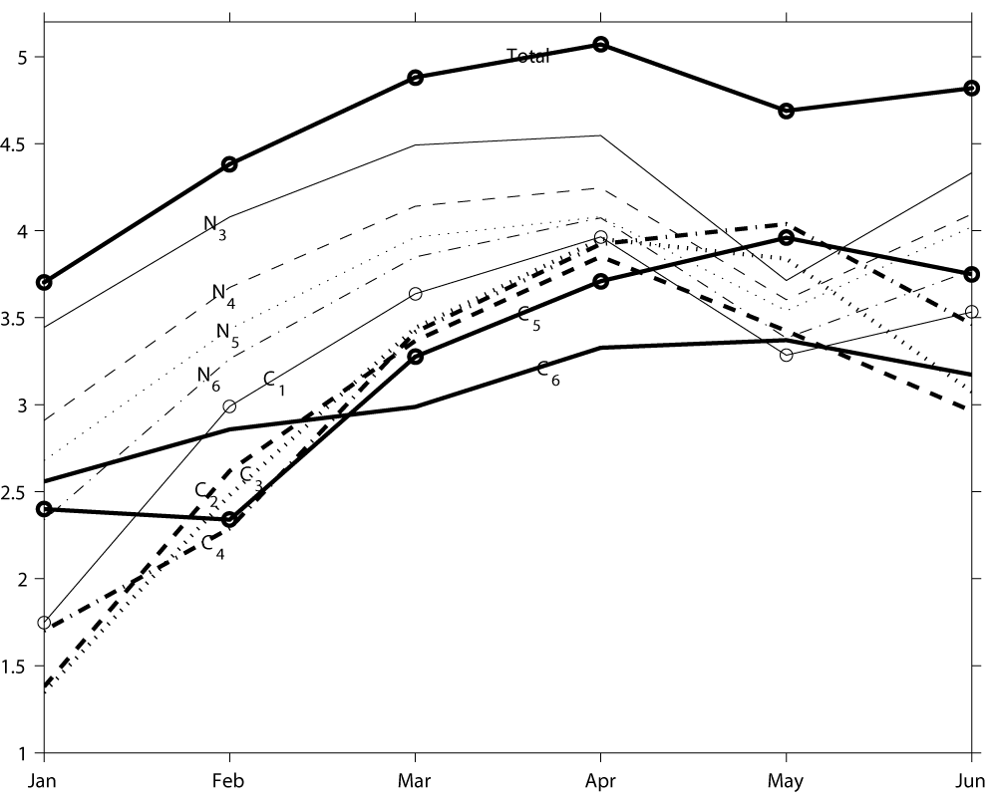
C. finmarchicus climatology:
Globec Broadscale surveys 1995-1999
Jan Feb Mar Apr May Jun
N₃
N₄
N₅
Durbin et al.
http://globec.gso.uri.edu/
N₆
C₁
C₂
C₃
Log(abundance)
C₄
C₅
C₆
Time
Notes:
Synthesis of Cf
MOCNESS
sampling
enumeration
many person years effort
Winter – some adults, few copepodites, more nauplii
Spring – reproduction; cohort propagation through life stages
Apr/May accumulation of C4 and C5 on GB
June – second generation; Calanus hole on crest, present only on bank periphery

Slide 36
An inverse model for C. finmarchicus
F_{i}: molting flux F_{i}(T,Chl) computed (Campbell et al. 2001)
R: sources of N₃ Inferred (monthly)
μ_{i}: mortality Inferred (monthly)
C_{i} off-bank Inferred (initial conditions)
N₃ N₄ N₅ N₆ C₁ C₂ C₃ C₄ C₅ C₆
R
μ_{N4}
μ_{N5}
μ_{N6}
μ_{C1}
μ_{C2}
μ_{C3}
μ_{C4}
μ_{C5}
μ_{C6}
Notes:
Concentration-based approach
Know the abundances
Can predict the molting fluxes
Infer morality; also need sources of N3 and off-bank ICs

Slide 37
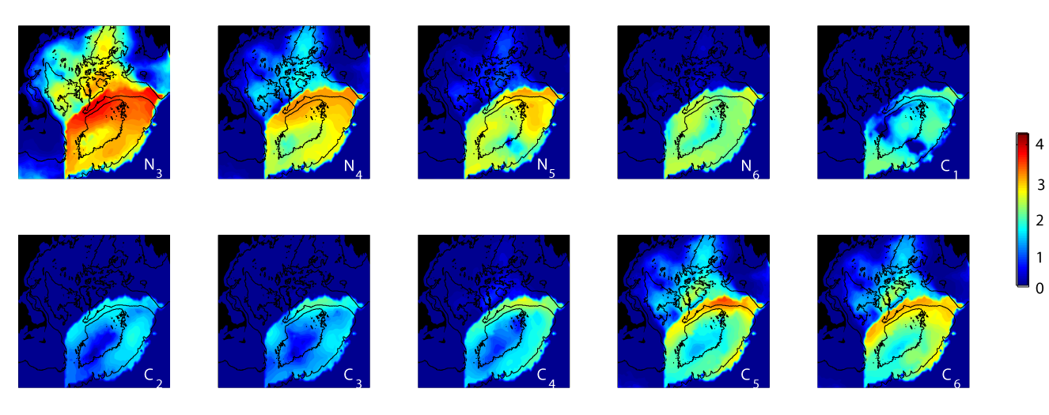
Inferred off-bank initial conditions
N₃ N₄ N₅ N₆ C₁
C₂ C₃ C₄ C₅ C₆
Notes:
Inverse model looks upstream an infers the presence of N3s in the deep basins

Slide 38
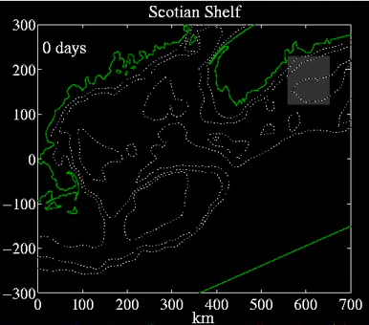
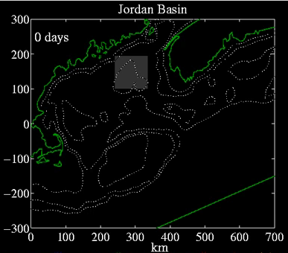


Individual-based models of C. finmarchicus: effects of different source populations
Mark Benfield
Eggs/Nauplii
Copepodite 1-3
Copepodite 4-5
Adult Female
Miller et al. (1998) Fisheries Oceanography 7(3-4) 219-234. U.S. GLOBEC Contribution #101
Notes:
Life history of C.f.; moulting fluxes specified as a function of temperature and food availability
Simulation of 2 generations from key source areas
Western gyres seed the crest; Georges Basin and Scotian shelf seed NE peak
Advection is a key aspect of the oceanographic ecology of the organism

Slide 39

C. finmarchicus solution: January- June
Notes:
Inverse model infers upstream sources of N3
Mortality can fit the obs

Slide 40

Inferred
Mortality
Jan-Feb Feb-Mar Mar-Apr Apr-May May-Jun
N₃
N₄
N₅
N₆
C₁
C₂
C₃
C₄
C₅
C₆
Notes:
Blue is a net sink – mortality negative which is a sanity check
Rates bracketed by observations
Mortality measurements scarce
collect animals
enumerate predators, prey
incubate
enumerate again
Not nearly enough measurements to specify a spatially variable mortality field
We can invert for one, and it is bounded by mortality measurements

Slide 41

Biological control of the vernal population increase of C. finmarchicus on Georges Bank
×
Advective
delivery
Advective
delivery
Georges Bank
Georges Bank
Advective
loss
Advective
loss
only slightly smaller than
N₄ N₅ N₆ C₁ C₂ C₃ C₄ C₅ C₆
Notes:
Turn off advective delivery, solve for new mortality mu hat
Lack of advective source can be compensated by a slightly lower mortality; imperceptible from an observational point of view.
Spring increase in C.f. under biological control; tremendous reproductive capacity, on-bank population in Jan enough to seed it.
Why are these models so sensitive to the mortality?
Linear loss in Z – exponentially increasing or decaying – remember Riley model (can choose a specific value for periodic solution; a small bit of noise caused big departures)
Density dependence – quadratic mortality a la Steele and Henderson more stable

Slide 42


CPR data density
Bin size:
0.25º lat
0.5º lon
Notes:
Basin scale perspective
Time-series observations: GOM, LS, OWS I and M, Oil platform in N Sea (Murchison)
CPR data; yellow-red 100 observations per bin

Slide 43


Continuous Plankton Recorder (CPR)
http://www.sahfos.ac.uk/
Sir Alister Hardy
1925-1927 Prototype deployed on R/V Discovery
1930s Modified design deployed in the North Sea
1946 Routine deployment initiated
Notes:
Very robust; Gauze replaced by silk in later days
Plankton trapped in gauze; rolled into a sandwich that is preserved
Gauze pad sectioned out into 10 nm sections
Calanus: catches C5 and C6

Slide 44

Climatological
C. finmarchicus distributions
Feb
Mar
Apr
May
Jun
Jul
Aug
Sep
Data from the Continuous Plankton Recorder
Planque et al. (1997)
C₅ and C₆
Notes:
Three population centers: NW Atl, Central Atlantic S of Greenland and Iceland, Norwegian Sea
Puts regional scale studies on GB in context– at the extreme of the range of the organism [although the abundances are as high as anywhere else].

Slide 45

The three-gyre hypothesis
Bucklin et al., 2000; Wiebe, 2001
Notes:
Thee independent but interconnected populations.
Null hypothesis: each is self-sustaining.

Slide 46

Physical driver - OCCAM
OCCAM provides:
Transport fields
Temperature fields
Calanus movement occurs between model cells at fixed time intervals and is calculated offline in advance
Ocean Circulation and Climate Advanced Modelling project NOC, Southampton

Slide 47

Biological model
Uniform ‘physiological age’ for each group of stages
Development rate a function of temp. and food (SeaWiFS)
Diapause entry during C5 stage
Speirs et al. (2005) Fish. Oceanog. 14, 333-358
Notes:
13 stage model

Slide 48

Simulated and observed C. finmarchicus distribution
(Surface C5 and C6)
CPR data Model output
JF
MA
Key model improvements:
Fixed fraction of each generation
enters diapause
Overwintering individuals enter
diapause at the end of C5
Mortality increases with
temperature
Density-dependent mortality
MJ
JA
SO
ND
Speirs et al. (2006)
Notes:
Arbitrary initial conditions
Model run out over many generations to statistical steady state
Three population centers present in the model (C5 + C6 surface only)
Note density dependent mortality: instead of having growth and mortality balanced on the head of a pin, density dependence facilitates a stable equilibrium

Slide 49

Models with and without transport
Notes:
To first order, the patterns are the same, but there are some differences
Transport extends population
farther south in the central Atlantic
farther into the Barents Sea, Greenland Sea, Lab Sea
into the Gulf of St Lawrence [none without transport]
Three gyre hypothesis: independent self sustaining populations.

Slide 50

Population connectivity
Yr 1
Yr 2
Yr 3
Yr 4
Self-sustaining interconnected populations
Biological production dominates over advective loss on large spatial scales
Yr 5
Yr 6
Notes:
Labrador Sea population; expands in LS and IS, then in year 3 gets entrained into N Atl drift, throughout by year 6
Norwegian Sea gyre: entrainment into the Greenland coastal current by year 3, swept around to LS and entrained into N Atl drift in yr 4. Yr 6, nearly identical to population initiated by LS.
ICs forgotten by year 6
Biological production dominates over advective loss on large spatial scales.
Impacts – gene flow

Slide 51
END

