Slide 1
Did the widespread acceptance of Sverdrup's ideas lead to 50 years of slow progress toward understanding of bloom dynamics?

Slide 2
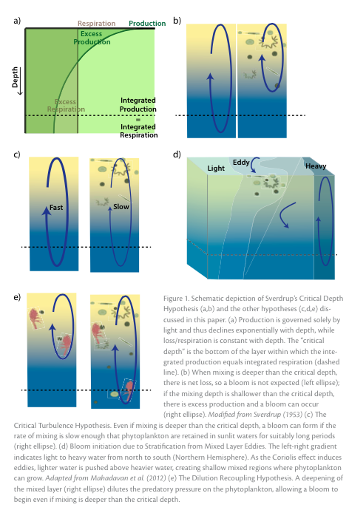
Many possible methods of bloom formation

Slide 3
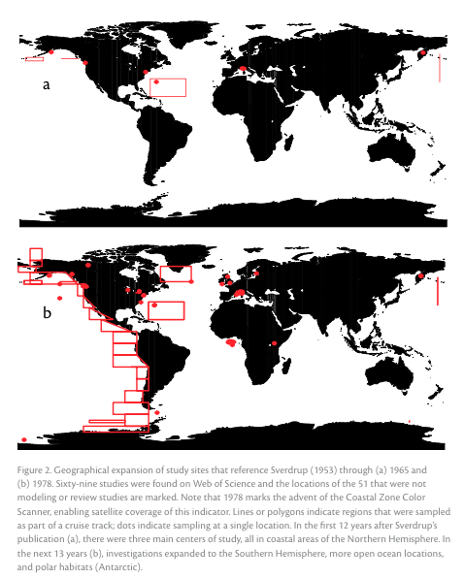
Geographical expansion of study sites that reference Sverdrup (1953)
1953-1965
1966-1978

Slide 4
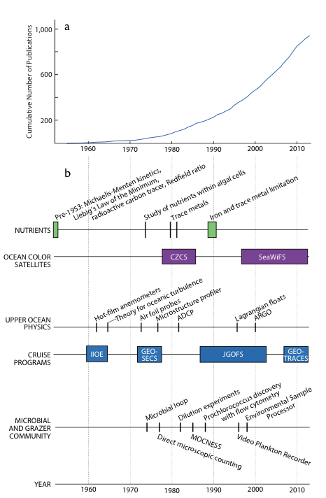
Sverdrup (1953) citations vs. time
Notes:
Graph of Sverdrup (1953) citations over time.
Timeline of seminal achievements pertinent to the case studies highlighted in this paper and based on an extensive litera- ture review. The achievements selected are all burgeoning theories or technologies that spurred research leading to a greater understanding of specific physical, chemical, and biological processes controlling phytoplankton bloom formation. Citations, in chronological order, are (for nutrients) Michaelis and Menten (1913), Redfield (1934), Browne (1942), Droop (1974), Huntsman and Sunda (1980), Fitzwater et al. (1982), and Martin et al. (1990); (for upper ocean physics) Grant et al. (1962), Ozmidov (1965), Nasmyth (1973), Thorpe (1977), and Oakey (1982); and (for microbial and grazer community) Pomeroy (1974), Hobbie (1977), Landry and Hassett (1982) and Fenchel (1982), Chisholm et al.(1988), Davis et al. (1996), and Scholin et al. (1998).

